Slide 1
Better Precepting in Less Time – The Tucanos Method, PIPP and Your Tips Too
Daniel Stulberg, MD
Carlos Cano, MD
University of New Mexico
Dept of Family & Community Medicine
Notes:
STULBERG
Welcome to our presentation

Slide 2
Overview
Precepting in the presence of the patient
Tucano’s style of precepting
Questions
Discussion
Notes:
STULBERG

Slide 3
Disclosures
No conflicts of interest
Notes:
STULBERG

Slide 4
Who teaches who/where?
Students
Residents
Other people
Inpatient
Outpatient
Other locations
Notes:
CANO

Slide 5
What is PIPP?
Presenting In the Presence of the Patient
TIPP Teaching In the Presence of the Patient
Who is doing this?
Notes:
CANO

Slide 6
What’s the data?
4 RCTs, 2 qualitative study
PIPP vs Conference Room Staffing (CRS)
Notes:
CANO

Slide 7
Anderson, Robert et al 2002
University of Colorado
Residents
Ambulatory Internal Medicine clinic
Community based
Medicaid 30-40%
Medicare 30-40%
Notes:
STULBERG
Bit of a new experience for some learners. If faculty not required to see the patient, for example level III or less visits then the resident acts on autopilot and seems to be the Dr. without needing the attending

Slide 8
Anderson
RCT – 2 trials
RCT 1 -CRS VS CRS & attending saw pt
RCT 2 CRS VS PIPP
196 pts
Notes:
STULBERG

Slide 9
Anderson – Patient effects
No difference
Satisfaction with medical care
Overall satisfaction
Listening to my concerns discussed with another doctor made me feel more comfortable
P <0.001
Prefer to listen to my concerns discussed with another doctor in the future
P < 0.001
Notes:
STULBERG
Bit of a new experience for some learners. If faculty not required to see the patient, for example level III or less visits then the resident acts on autopilot and seems to be the Dr. without needing the attending

Slide 10
Anderson – Resident effects
PIPP beneficial 83% SA or A
Residents uncomfortable presenting in room 10%
Diminished autonomy 11% SA or A
Notes:
Bit of a new experience for some learners. If faculty not required to see the patient, for example level III or less visits then the resident acts on autopilot and seems to be the Dr. without needing the attending

Slide 11
Anderson – Faculty effects
No difference
Contributions to teaching
Contributions to diagnosis
No discomfort with discussions in the presence of patient
Notes:
STULBERG

Slide 12
Peterson, Kara et al 2008
University of Iowa
General and Specialty medicine outpatient clinic
Residents
RCT
254 patients
Notes:
CANO

Slide 13
Peterson – Patient effect
Satisfaction unchanged
Better participation in education
P = 0.07
Perception of more time spent with their Dr.
44 min. vs 32 min.
P = 0.04
Notes:
CANO

Slide 14
Peterson – Resident effect
No difference
Autonomy
Supervision
Able to ask questions
Time for teaching
Afraid to perform poorly
I had to edit or choose words carefully P=0.007
Notes:
CANO

Slide 15
Peterson – Faculty assessment
Faculty indicated better scores…
Enhanced patient understanding P<0.001
Enhanced learning understanding P<0.001
Patient involvement in medical decisions P<0.001
Location allowed teaching P<0.001
Notes:
CANO

Slide 16
Peterson - Global
Increased time with patient
No difference total staffing time
Patients, learners, and faculty preferred
Notes:
CANO

Slide 17
Peterson - Global
Increased time with patient
No difference total staffing time
Patients, learners, and faculty preferred
Notes:
CANO

Slide 18
What about Psychiatry patients?
Madson, Linda 2013
University of Iowa
Outpatient psychiatry clinic
Residents
RCT
126 patients
47% decline to participate
4 patients excluded by resident or faculty
Notes:
STULBERG
People often worry about patients with psychiatric issues, due to IRB patients not asked why they declined, some spontaneous answers were time, too upset

Slide 19
Madson – Patient effect
No difference
Confused with medical terms
Embarrassed or uncomfortable
Allowed me to participate in resident education
Time spent with physicians
Time spent with physician adequate P=0.02
Satisfaction with care received P=0.05
Prefer for future visits P=0.003
Notes:
STULBERG
Improved RE time, Satisfaction and preference

Slide 20
Madson –Resident effect
No difference
Autonomy
Adequate supervision
Able to ask faculty questions
Adequate time
Fear of showing lack of knowledge
Had to edit or choose words carefully P<0.0001
Notes:
STULBERG

Slide 21
Madson –Faculty effect
Patients seemed comfortable
Beneficial for patients
Enhanced joint decision-making
Faculty time 6.8 min. vs 13.2 min. P<0.0001
Notes:
STULBERG
I don’t think Psych does not qualify for primary care exception

Slide 22
Power, David et al 2017
University of Minnesota
Medical students! 3rd and 4th yr
Family Medicine clinic
RCT
201 patient encounters
Diverse population
20% with interpreter (other studies English only)
25% employed
33% Medicare
33% Medicaid
Notes:
Stulberg

Slide 23
Power – Patient effect
No difference
Satisfaction with visit
Adequate time with my Dr.
Involvement in the student’s education
Preference for future visit
Confused by medical terms used during visit
2.07 vs 1.67 (5 point Likert) P=0.04
Notes:
STULBERG
Five equal most comfort, one equal most uncomfortable

Slide 24
Power – Student effect
No difference
Autonomy
Adequate supervision
Adequate time for learning
Decreased ability to ask questions
4.34 vs 4.65 (5 point Likert) P=0.002
Afraid of performing poorly or lack of knowledge
1.60 vs 1.34 (5 point Likert) P=0.003
Had to choose words carefully
1.76 vs 1.30 (5 point Likert) P<0.001
Notes:
STULBERG

Slide 25
Power –Faculty effect
Strong preference for PIPP
Learners understanding enhanced P<0.001
Allowed me to teach what I wanted to P<0.005
Assisted in the conduct of the visit P<0.001
Notes:
STULBERG

Slide 26
How much time does this take?
Wrong question!
How much time does this save?
Notes:
STULBERG
How many people are feeling stressed by time requirements/demands?

Slide 27
Show me the minutes…
Actual total faculty time 17.4 min. vs 19.7
Faculty time with patient 17.4 vs 14.1 P=0.01
Patient perception of time 37.6 min. vs 31.5 P=0.21
2.3 min. less faculty time per encounter P=0.09
3.3 min. more time with patient P=0.01
6.1 extra minutes of care by Pt estimate P=0.21
Notes:
STULBERG
Cuba Gooding Jr. to Tom Cruise in Jerry Maguire: Show Me The Money!

Slide 28
20 patients per day…
PIPP vs CRS
Save 40 min.
Extra 60 min. in direct contact with patients
Notes:
STULBERG
Given that it is reported that precepting a medical student adds on average 1.23 hours to the workday for a physician, PIPP can significantly reduce the added time burden.13 - Should be smiling

Slide 29
Limitations
Faculty love it
Patients prefer it
Learners initially hesitant
“You have to be a little more thoughtful”
“which can be good, because you’re choosing your words”
Less questions in front of patient
But less pimping
Notes:
STULBERG

Slide 30
Vanderberg, Rachel, et al 2020
Internal Medicine UPMC
35 attendings
150 IM residents
Qualitative follow up interviews and focus groups
OERPs Outpatient Exam Room Presentations
Enhanced pt care quality via confirmation/correction
Increased pt centeredness & transparency
Highlighted resident as PCP
Notes:
CANO
Participants noted that OERPs enhanced patient care by improving quality of care through verification and correction of resident findings, increasing patient-centeredness, increasing the transparency of the precepting process, and highlighting the resident as the primary provider.

Slide 31
Considerations
May not work well with certain patients or concerns
Preceptor not being able to review HM/preventative care
Patient participation leading to unfocused conversation
Potential to not bring up guidelines or new studies that didn’t directly apply to the patient
Needing to do more chart review with attending to make plan
Notes:
CANO

Slide 32
Other benefits
Time based billing
Confirm history easier
Teaching via pt
Teaching via resident
Pts learn how we think
Bedside rounds on Inpatient
Notes:
CANO

Slide 33
Resident clinic teaching
Medicare guidelines
1:4
1:1 50%
Primary care exception
Notes:
CANO

Slide 34
Do all learners have the same needs?
Notes:
CANO

Slide 35
Learner driven resident precepting
R1 through R5+
Residents
Different years of training
Different skill levels
Different needs
Faculty
How much to teach?
Documentation
Notes:
CANO?

Slide 36
Tucanos Brazilian Grill
Notes:
STULBERG

Slide 37
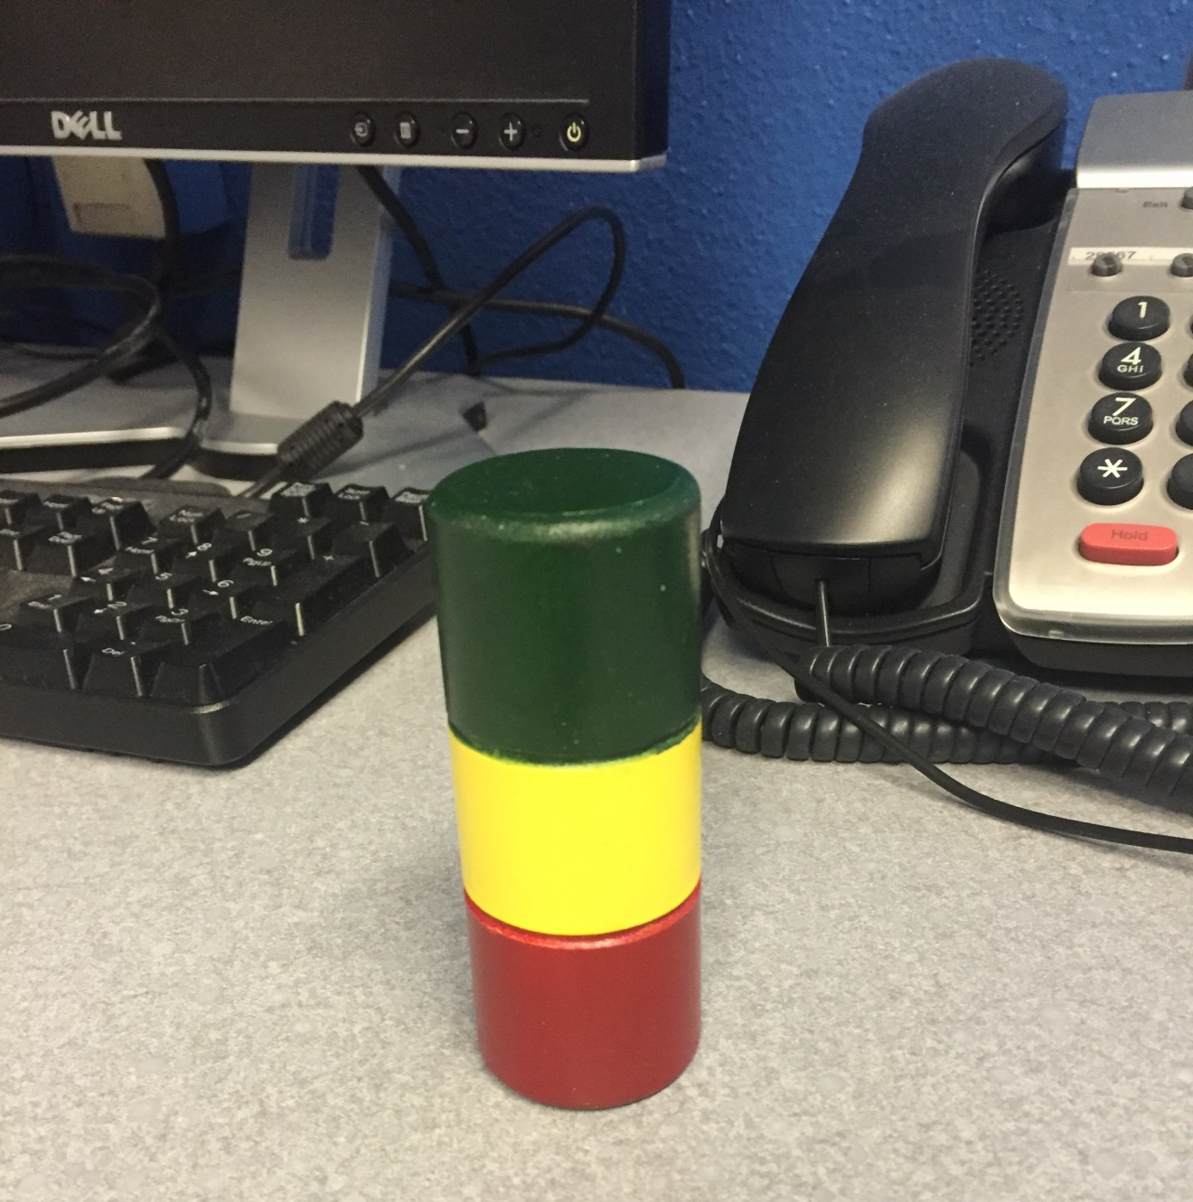
Tucano's style of precepting
Notes:
STULBERG

Slide 38
Tucano's Style of Precepting
Green=Go=I want/need education
Red = Stop = I know what I’m doing, I just need to give you the information for documentation
I’m not sure…
How would you handle this?
I might need help on this one
Notes:
STULBERG

Slide 39
I need a fill up My cup is full
Notes:
STULBERG

Slide 40
Resident response
“I don’t have anyone else here…”
And flipped to green
Notes:
STULBERG

Slide 41
Resident response
I might need help on this one.
Notes:
STULBERG

Slide 42
Choosing a model
1:1 with learner
Medical students
Procedure clinic
Patients not covered under primary care exception
Need to be seen
Multiple residents
Notes:
STULBERG

Slide 43
Discussion
Thoughts?
Preferred methods at your institution?
Experiences?
Are you able to stay with one technique through the day?
Your tips and techniques…
Notes:
CANO

Slide 44
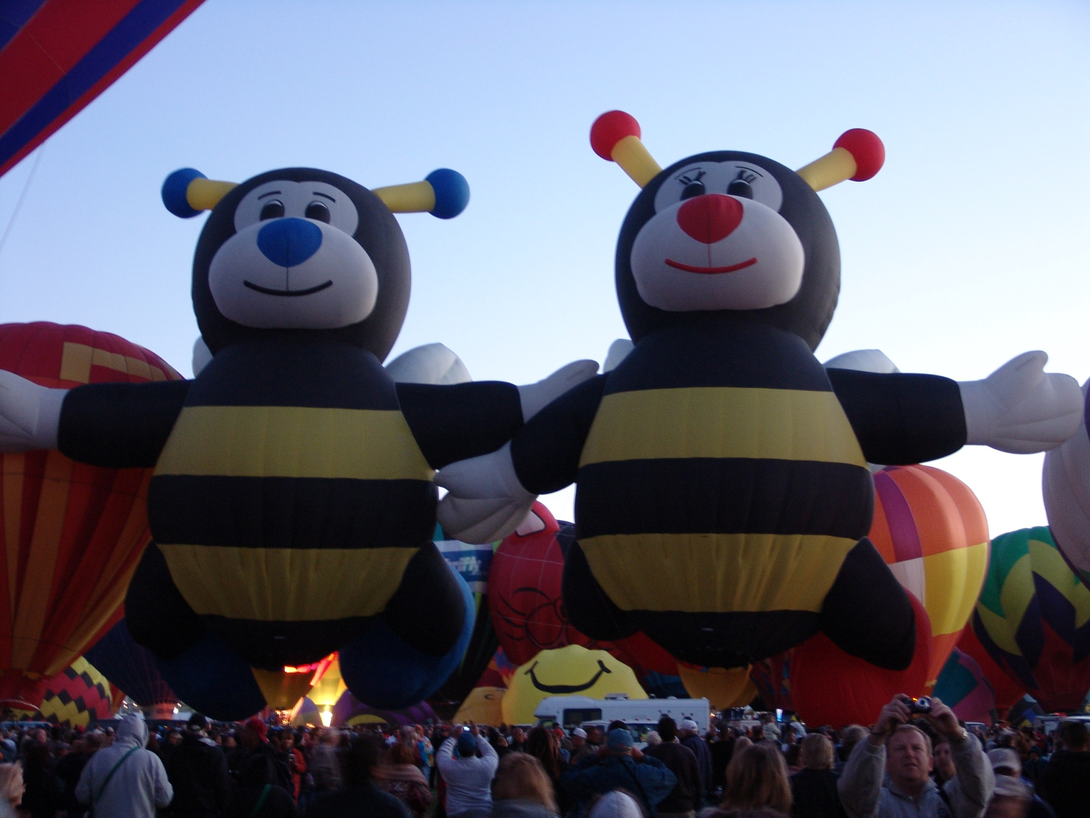
Discussion
COVID
Other Barriers to PIPP and bedside rounds
Notes:
CANO

Slide 45
References
Petersen K, Rosenbaum ME, Kreiter CD, Thomas A, Vogelgesang SA, Lawry GV. A randomized controlled study comparing educational outcomes of examination room versus conference room staffing. Teach Learn Med. 2008 Jul-Sep;20(3):218-24.
Anderson RJ, Cyran E, Schilling L, Lin CT, Albertson G, Ware L, Steiner JF. Outpatient case presentations in the conference room versus examination room: results from two randomized controlled trials. Am J Med. 2002 Dec 1;113(8):657-62.
Madson L, Rosenbaum M, Kreiter C, Lynch A, Witt A. A randomized controlled trial assessing the feasibility of examination room versus conference room teaching in a psychiatric setting. Teach Learn Med. 2014;26(1):40-8.
Power DV, Rosenbaum ME, Hanson L, Reynolds IR, Brink D, Prasad S, Kreiter CD. Precepting Medical Students in the Patient's Presence: An Educational Randomized Trial in Family Medicine Clinic. Fam Med. 2017 Feb;49(2):97-105.
Vanderberg R, Nikiforova T, Hamm M, Spagnoletti C, McNeil M. Outpatient Exam Room Presentations in Resident Continuity Clinics: a Qualitative Report. Med Sci Educ. 2020 Oct 14;30(4):1445-1457.
Notes:
CANO

Slide 46
Daniel Stulberg, MD DStulberg@salud.unm.edu
Carlos Cano, MD CaCano@salud.unm.edu
University of New Mexico
Dept of Family & Community Medicine
Notes:
CANO

