Slide 1
Goals and Agenda

Slide 2
Outline
Key reasons for addressing substance use in primary care
Overview of ‘screening, brief intervention, and referral to treatment (SBIRT)’
Screening workflow
Brief intervention
Epic tools

Slide 3
Substance use and health

Slide 4
Substance use contributes to poor health
Substance use leads to more death and disability than any other preventable condition
Alcohol is the 3rd leading cause of preventable death in the US; drug use is the 10th
Drug overdose is the leading cause of accidental death
>64,000 OD deaths last year
Rising all-cause mortality among middle-age white population attributed to substance use
Robert Wood Johnson Foundation. Substance abuse: The nation’s number one health problem 2001.
Mokdad, A.H., et al., Actual causes of death in the United States, 2000. JAMA, 2004. 291(10): p. 1238-45.
Case, A. and A. Deaton, Rising morbidity and mortality in midlife among white non-Hispanic Americans in the 21st century. Proc Natl Acad Sci U S A, 2015. 112(49): p. 15078-83.
Centers for Disease Control and Prevention, Unintentional poisoning deaths--United States, 1999-2004. MMWR Morb Mortal Wkly Rep, 2007. 56(5): p. 93-6.
Dowell, D.A., Noonan, R.K., Houry, D. Underlying factors in drug overdose deaths. JAMA, 2017. 318(23):2295
Notes:
More OD deaths/year than AIDS-related deaths at height of the epidemic

Slide 5
Substance Use is Under-identified and Under-treated
22 million with substance use disorders
11% receive treatment
Contact with the medical system is routine
But… Most PCPs are unaware of their patients’ substance use (only 24% NYC pts report PCP asked)
D’Amico, Medical Care 2005
Friedmann, Arch Intern Med 2001
Saitz, Am J Drug Alc Abuse 1997
New York City Department of Health Community Health Survey, 2011
National Survey on Drug Use and Health, 2016
Notes:
8% of the US population

Slide 6
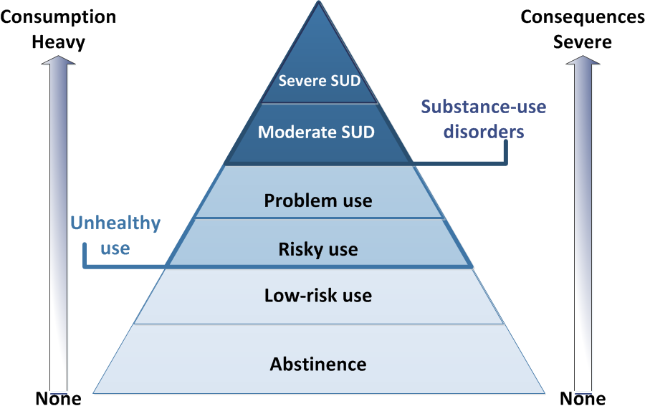
Continuum of Substance Use
~5%
~20%
Saitz, R., Unhealthy Alcohol use. N Engl J Med; 2005:352(6):596
Cherpitel, C.J. and Ye, Y. Drug Alc Dep, 2008;97(3):226
Notes:
Primary care dependence about 5%
Hospital and ED much higher

Slide 7
Definitions of low-risk and unhealthy alcohol use
Low-Risk Alcohol Use | For men aged ≤65 years: No more than 4 drinks on any single day AND No more than 14 drinks per week. For women of any age and men aged >65 years: No more than 3 drinks on any single day AND No more than 7 drinks per week. To stay at low risk, you must keep within both the single-day and weekly limits.
Risky Alcohol Use: Heavy Drinking | Consuming more than the weekly amounts listed above.
Risky Alcohol Use: Binge Drinking | Consuming more than 3 drinks per occasion for women or more than 4 for men.
Alcohol Use Disorder (DSM-5) | Recurrent use despite adverse physical, health, legal, and social consequences.

Slide 8
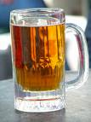
What is a standard drink?
1 standard drink =
One can of ordinary beer (eg, 12 oz. at 5%)
- OR -
A single shot of spirits (eg, whiskey, gin, vodka- 1.5 oz. at 40%)
- OR -
One glass of wine (eg, 5 oz. at 12%)
See “What's a ‘standard’ drink?” http://rethinkingdrinking.niaaa.nih.gov/whatcountsdrink/whatsastandarddrink.asp

Slide 9
And DRUG Use?
No specific quantity limits for drug use
But does occur along a continuum too
Variably impacts persons lives
Non-medical use
Use without a prescription or with a prescription but in a manner other than prescribed

Slide 10
Screening, Brief Intervention, and Referral to Treatment (SBIRT)

Slide 11
What is SBIRT?
Evidence-based approach to addressing unhealthy alcohol/drug use through universal screening
Goal: Identify patients with unhealthy use
SBIRT components
Screening using a validated tool
Brief intervention (if needed)
Referral to treatment (for high risk)

Slide 12
SBIRT Flow Diagram
-
Screening
+
Assessment
Low Risk
Moderate Risk
High Risk (SUD)
Counseling
Monitoring
Brief Intervention
Brief Intervention
+ Treatment
Notes:
Universal screening followed by assessment

Slide 13
SBIRT for alcohol use
Reduces hazardous and harmful alcohol consumption
Decreases health care utilization
Fewer hospitalizations
Lower costs
Ranked as one of the five most effective clinical preventive services
Best Evidence of effectiveness comes from Primary Care

Slide 14
Screening

Slide 15
Screening Workflow [Example]

Slide 16
INSERT TEXT OR PICTURE OF SCREENING TOOLS

Slide 17
INSERT SCREENSHOTS OF HOW SCREENING RESULTS APPEAR IN EHR

Slide 18
Brief Intervention

Slide 19
SBIRT Flow Diagram
-
Screening
+
Assessment
Low Risk
Moderate Risk
High Risk (SUD)
Counseling
Monitoring
Brief Intervention
Brief Intervention
+ Treatment

Slide 20
Brief intervention
Motivational discussions about meaning of screening results with patient
3-5 minutes
Provides feedback
Explores patient’s motivations to change
Grounded in Motivational interviewing
Samet et al, Arch Int Med 1996

Slide 21
Steps of the brief intervention
Steps of the brief intervention
Raise the subject
Provide feedback
Enhance motivation
Negotiate plan
“Can we spend a few minutes talking about your alcohol/drug use?”
“I’m concerned that your use could be putting your health at risk. Your use could affect…”
“On a scale of 1 to 10, how ready are you to make any changes to your use?”
Ask for barriers and motivations
“What are some things you might be able to do now?”
Offer assistance and make follow up plan

Slide 22
“Can we spend a few minutes talking about your alcohol/drug use?”
Raise the
subject
Simple step, but important
Use the screening result as a conversation starter
Ask permission

Slide 23
“I’m concerned that your use could be putting your health at risk.
Your use could affect…”
Provide feedback
Tell patient their level of risk
Connect to their health issues
Express concern
Educate about limits
Use Ask-Tell-Ask

Slide 24
Steps of the brief intervention
“On a scale of 1 to 10, how ready are you to make any changes to your use?” Ask for barriers and motivations
Use the 0 – 10 scale
“Why not a lower number?”
Ask about barriers and facilitators of change:
“What are some things that might be better if you changed your use?”
“What are some things that might make it hard to change your use?”
Enhance motivation

Slide 25
Steps of the brief intervention
“What are some things you might be able to do now?”
Offer assistance and make follow up plan
Negotiate plan
Discuss specific steps that patient will take
Give advice and concerns, but remain supportive
Negotiate a plan and schedule follow-up
Notes:
Key Components
Discuss options and a plan for how to cut back on drinking and/or reduce harm – explore the patients ideas for doing this.
Give clear advice regarding your recommendations
Provide drinking agreement and handout
Objectives
Negotiate goal and build self-efficacy
Assist the client to identify a goal from a variety of options (to include their own ideas)
Avoid being argumentative.
Repeat what client said in Step 3 and say, “What’s the next step?” or “Where do you want to go from here.”
2. Give advice with the client’s permission
Provide options for the client to consider.
Deliver sound advice/education
Provide strategies to help reduce harm.
Options might include: cut back on how often I drink: cut back on how much I drink on days when I do drink; never drink and drive; a trial period of not drinking; stop drinking entirely; get help from someone with my drinking; do nothing.
3. Summarize
Provide a drinking agreement for the client to take home, if they are amenable.
Help client clarify goals to pursue
Provide handout
“this is what I heard you say….. Here is a drinking agreement that can reinforce your new drinking goals. This is really an agreement between you and yourself.”
Suggest follow-up for drinking level/pattern with an appropriate person, and provide any contact information necessary.
Express optimism in his or her intent to change.

Slide 26
INSERT SCREENSHOTS OF ANY CLINICAL DECISION SUPPORT

Slide 27
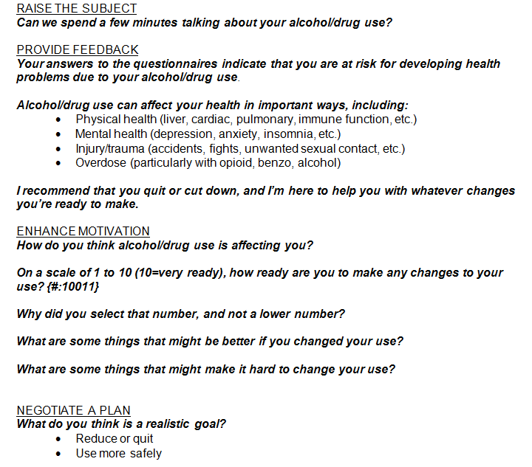
EXAMPLE: Brief Intervention Documentation

Slide 28
EXAMPLE (CONTINUED): Counseling and Plan

Slide 29
Patient education materials example - alcohol
Patient Education: Alcohol
Did you know…?
Alcohol has important effects on your health. Even if you are not a heavy drinker, alcohol can affect your liver, heart, immune system, sleep, mood, sex life, and other aspects of your health.
Any alcohol use during pregnancy can harm the developing fetus
Alcohol interacts with prescribed medications in ways that can be dangerous
Because alcohol affects your thinking, you might put yourself in dangerous situations, leading to accidents, injuries and unsafe sex.
The recommended limits for alcohol use are:
FOR HEALTHY MEN UP TO AGE 65:
No more than 4 drinks in a day AND no more than 14 drinks in a week
FOR HEALTHY WOMEN, AND MEN OVER AGE 65:
No more than 3 drinks in a day AND no more than 7 drinks in a week
DO NOT USE ALCOHOL IF YOU ARE:
taking medications that interact with alcohol
have health condition made worse by drinking
are pregnant or trying to become pregnant
planning to drive or operate machinery
What you can do…
Take action now:
talk with your doctor
set a goal to use less
track how much you are using
ask for support from people around you
If you are having a hard time reducing your alcohol use, talk to your doctor or social worker about getting treatment that can help.
Call 1-888-NYC-WELL for treatment referrals and more information.
We are here to keep you healthy. Let us know how we can help you meet your alcohol use goals.

Slide 30
Patient goal sheet example - alcohol

Slide 31
SBIRT Workflow
-
Screening
+
Assessment
Low Risk
Moderate Risk
High Risk (SUD)
Counseling
Monitoring
Brief Intervention
Brief Intervention
+ Treatment

Slide 32
Referral to Treatment:
About 5% of patients may have high risk alcohol or drug use
These are the patients who benefit from referral and engagement in substance use treatment programs.
Workflow at [your clinic]
Actions taken by PCP
Actions taken by social work/behavioral health/others
Referral process

Slide 33
RESOURCES
NIDAMED: Clinical Resources
https://www.drugabuse.gov/nidamed-medical-health-professionals
Helping Patients Who Drink Too Much – Clinician’s Guide (NIAAA)
https://pubs.niaaa.nih.gov/publications/Practitioner/CliniciansGuide2005/guide.pdf
A Re-think of the way we drink (Mike Evans whiteboard video)
https://www.youtube.com/watch?v=tbKbq2IytC4
SBIRT Oregon website: http://www.sbirtoregon.org/index.php
TAPS Tool (online version): https://www.drugabuse.gov/taps/#/
NYC DOHMH City Health Information: Addressing Alcohol and Drug Use – an Integral Part of Primary Care https://www1.nyc.gov/assets/doh/downloads/pdf/chi/chi-35-3.pdf

Slide 34
QUESTIONS?

Slide 35
Additional material

Slide 36
Brief Intervention: “Steve”
Steps of the brief intervention
http://www.youtube.com/watch?v=b-ilxvHZJDc
Notes:
In case video does not play, visit Youtube video:
http://www.youtube.com/watch?v=b-ilxvHZJDc

