Slide 1
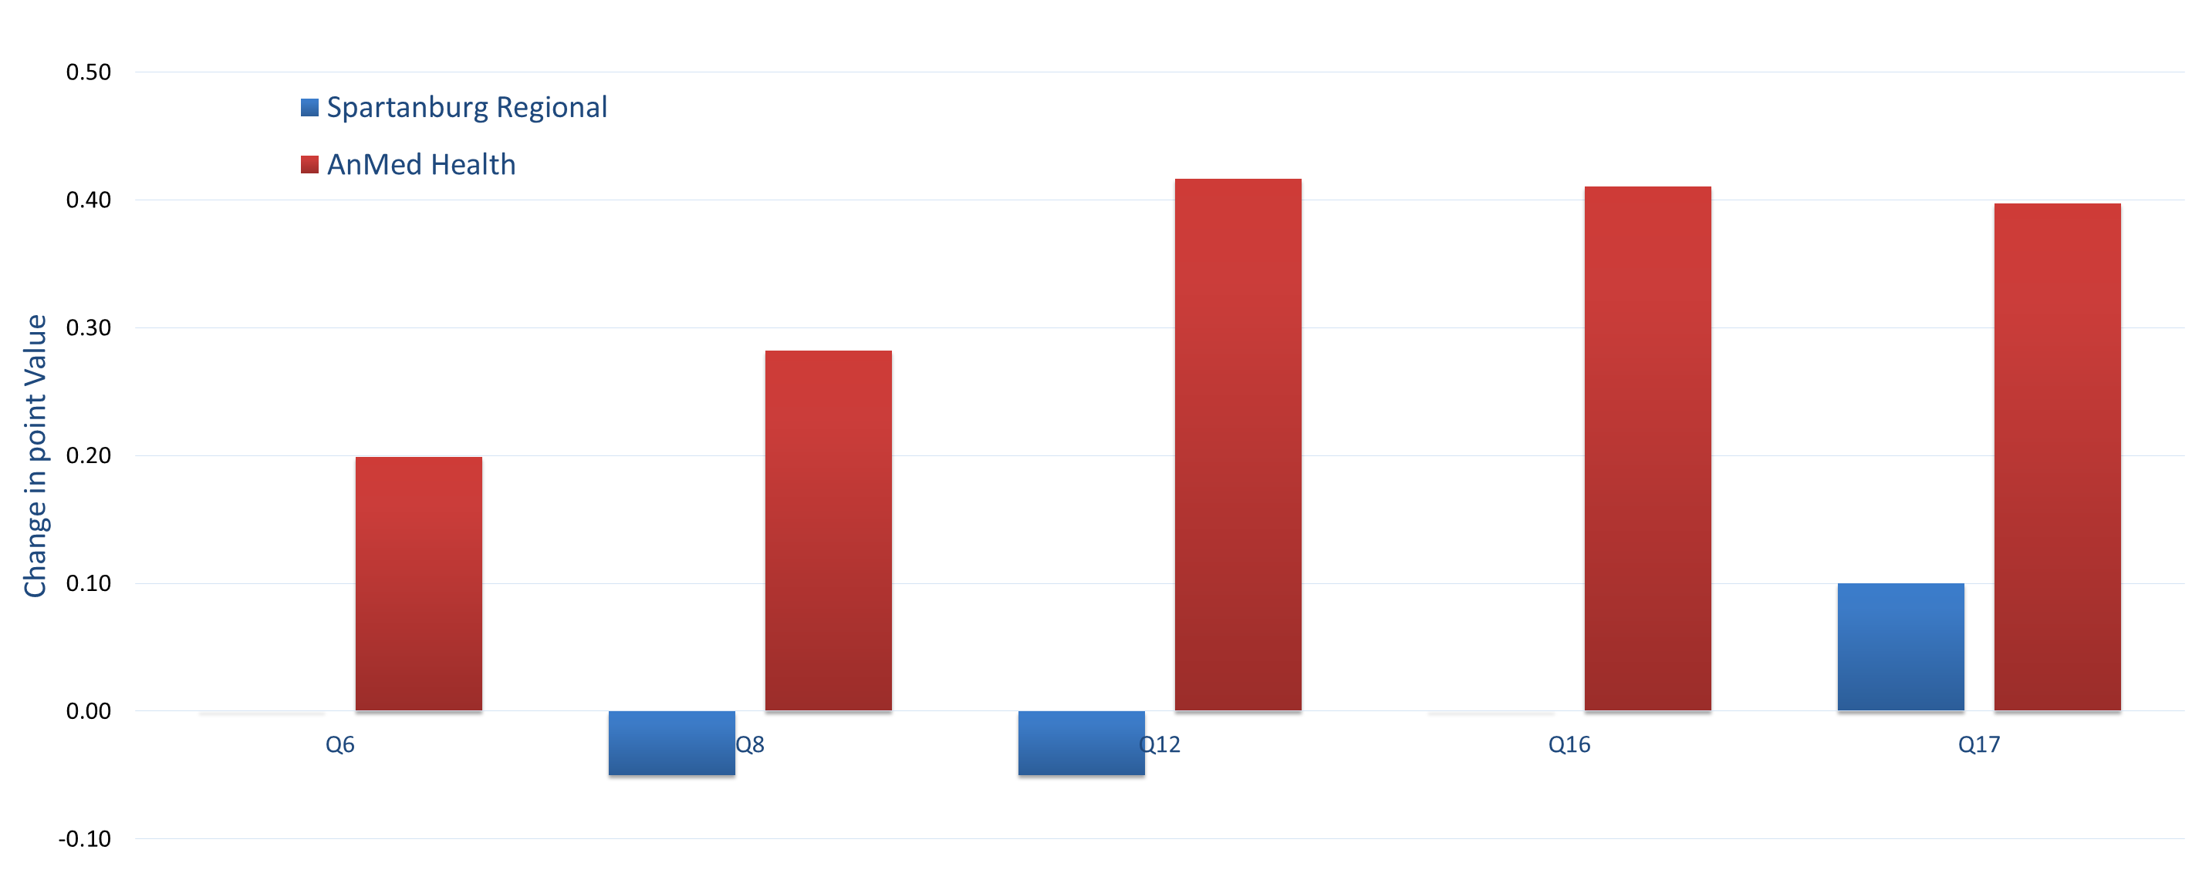
A Simple Disabilities Curriculum
Improves Student Awareness
Medical Student Education
Authors
Nathan Bradford, M.D. FACP; Nathan Gilreath MS2; Melissa Owens, ACUME, AAMC CCA ; Kathy Barrington, MSM
Background
The most difficult piece of this curriculum was the practical exercise in which the student was paired with a patient with a disability. This exercise was difficult for both the student —making contact with the patient, understanding what were the goals and needs, and for the faculty—organizing the visits, explaining the purpose and methods, and reminding the students.
Other more practicable approaches to teach learners about the daily challenges facing persons with disabilities suggested by our own survey and implemented in other institutions include:
Home visits
Small groups of students who interview patients with disabilities
Role plays with students acting the parts of patients with disabilities
Disabilities Curriculum For Medical Students
Physician Education Awareness Project
Medical Care of the Disabled Patient
Transition Project
Medical Student Attitude Survey
“Patient Voices”
video
Future Directions
Learners struggle to communicate and empathize with patients with disabilities, because they:
Lack exposure to persons with disabilities
Lack knowledge about specific disabilities
Lack knowledge about disabilities in general
Often learners and providers believe that disabilities are outside the scope of practice for primary care, making access to health care for persons with disabilities more difficult.
The purpose of this curriculum is to train physicians who appreciate the challenges facing persons with disabilities, particularly as those patients interact with the health care system.
We constructed a disabilities curriculum and embedded it within our third year curriculum so that it complements what the students are learning. There are five pieces of this curriculum spaced out over the year. Those five pieces are illustrated in the graph to the side.
Family Connections, a national disabilities support group, takes physicians to homes of people with disabilities
Video portrays patients with varying disabilities who enact and discuss one of their typical medical encounters
Residency Curriculum Resource (RCR) lecture on disabilities
Medical students partner with adolescents with disabilities to help them transition out of pediatric to adult medical care
Conclusions
Validated instrument that assesses learner comfort with people with disabilities
Methods
A disabilities curriculum is easily implemented within the 3rd year of medical school. It improves learners’ knowledge of disabilities and comfort with patients of varying disabilities, dispelling the notion that disabilities are outside the scope of practice for primary care. As a result, access to healthcare for patients with disabilities is greatly improved and enriched.
There were two 3rd year medical student cohorts: an experimental group at AnMed Health (n=13) with the assigned disabilities curriculum and a control group at Spartanburg Regional in Spartanburg, SC (n=20) without an assigned disabilities curriculum. Both groups were given the attitudes survey at the beginning of the academic year. The AnMed class completed the assigned disabilities curriculum throughout the academic year. At the end of the academic year, both groups repeated the attitudes survey. There are several interesting findings when the answers are compared between the two sites.
Results
AnMed Health showed a larger improvement than Spartanburg Regional on 8 of the 12 questions that were based upon perception of people with disabilities on the Medical Student Attitudes Toward Persons with Disabilities Survey.
AnMed Health exhibited the most noteworthy improvement on questions 6, 8, 12, 16, and 17 when compared to Spartanburg Regional.
References
Graph 1: Improvement of scores at AnMed Health and Spartanburg Regional on the Medical Student Attitudes Toward Persons with Disabilities Survey questions 6, 8, 12, 16, and 17.
Jain, Sweety, “Care of Patients with Disabilities: An Important but Often Ignored Aspect of Family Medicine Teaching”, Fam Med 2006;38(1):13-5.
D’Agata, C et al. “Medical Care for Patients with Disabilities”. AFMRD and STFM Family Medicine Residency Curriculum Resource. 2017.
Veltman A., et al, Perceptions of primary healthcare services among people with physical disabilities - part 1: access issues, Medscape General Medicine. 2001;3(2)Medscape General Medicine, 2001;3(2).
Kripke, Clarissa, Primary Care of Adolescents with Developmental Disabilities, Primary Care: Clinics in Office Practice, 41(3).
Symons, Andrew, et al, A curriculum on care for people with disabilities: Effects on medical student self-reported attitudes and comfort level, Disability and Health Journal (2013).
Questions
Q6: I would be comfortable interacting with a person with an intellectual disability who was in the community on his or her own (i.e., without staff members or caretakers).
Q8: Most people with disabilities resent people without disabilities.
Q12: I would be comfortable working with a person with an intellectual disability who had someone assigned to supervise and train them.
Q16: If I introduced a person with disabilities to my friends, I think they would feel uneasy.
Q17: People with disabilities should be cared for in any primary care office as opposed to a specialty clinic.
no change
no change

