Slide 1
My STFM story
Mentors
Healer’s Art
University of Washington
Harborview
Teaching Health Centers
WWAMI Network
Relationships

Slide 2
Of all the forms of inequality, injustice in health is the most shocking and the most inhuman because it often results in physical death. -Martin Luther King, Jr.

Slide 3
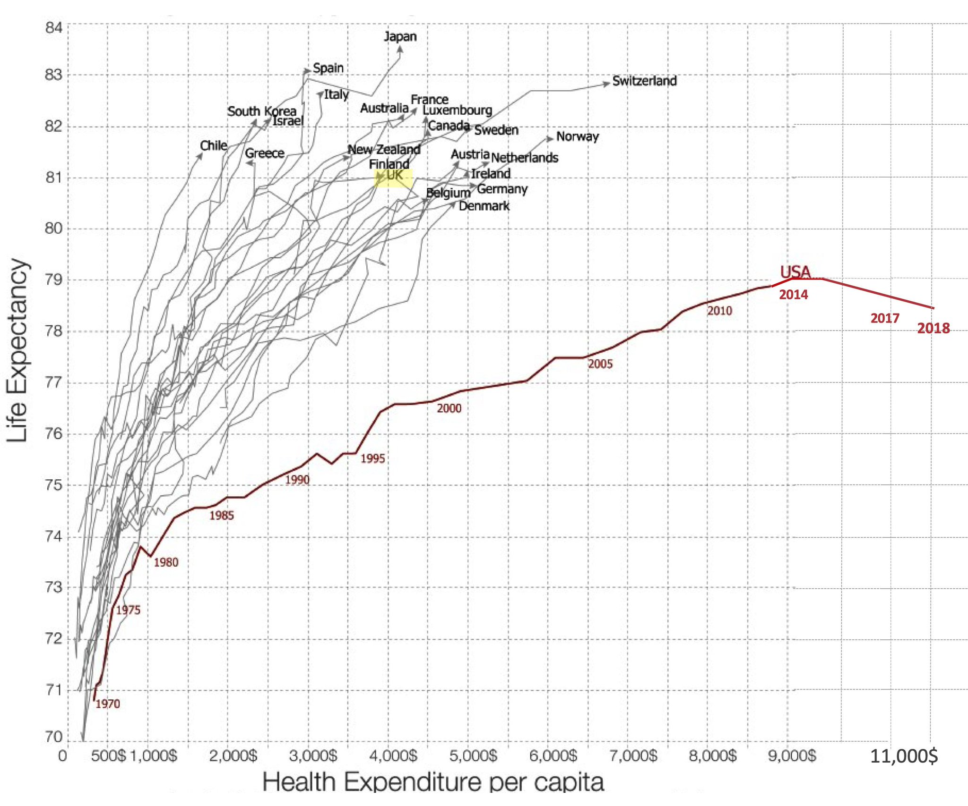
Medicare for All

Slide 4
Era of Incremental change in US health policy

Slide 5
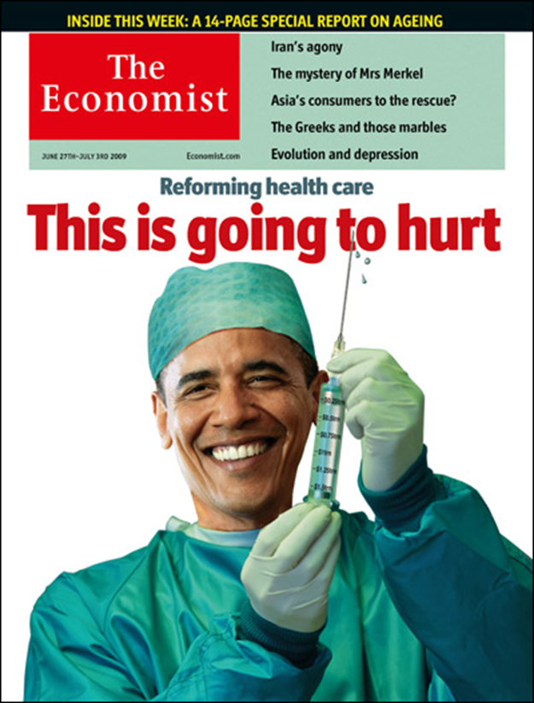

Slide 6
‘PURCHASERS’
Government
Medicare, Medicaid, VA
Employers
Individuals and self-employed
‘PAYERS’
1000 Health insurers, plans
Brokers and intermediaries
Dental, DME, other health costs
Physicians
Hospitals
Administrative costs
Prescription drugs
Care facilities

Slide 7
Single Payer
Government
Physicians, hospitals, prescription drugs, nursing facilities

Slide 8
Single Payer
Government
Physicians, hospitals, prescription drugs, nursing facilities

Slide 9
How about Medicare for All?
1/3 of GoFundMe campaigns are for medical bills
Over 100 House members
5 Presidential candidates
Saves $5 trillion over 10 years

Slide 10
Cataclysmic or catalytic?
Losers
Health insurers
$300b industry
>2.5 million employees
Hospitals
Specialty care
Innovation?

Slide 11
Fundamentally changes market
How do you pay for it?
How do you control costs?
EHRs, accountable care, shared savings, burnout
Doesn’t fix all the problems
Access
Quality

Slide 12
Cataclysmic or catalytic?
Affordable, universal health care
Government sets prices
Primary care based
Goal of better health

Slide 13
You can always count on Americans to do the right thing- after they’ve tried everything else. - Sir Winston Churchill

Slide 14
Clearly we have been on the side of change in American life.
Family medicine has succeeded because we identified with reforms that are more pervasive and powerful than ourselves.
My hope is that we can find leaders who are willing to rethink the priorities of medical education on the basis of medical needs of the public rather than on the basis of preserving the professional self-interest of organized medicine.
We need to perpetuate the reform ethos to expand our numbers, to join with other primary care physicians and specialists in working for a national health program that will give equal access to everybody, regardless of ability to pay.

Slide 15
G. Gayle Stephens, MD Presented before the Society of Teachers of Family Medicine 12th Annual Spring Conference, Denver, Colorado, May 9, 1979

Slide 16
Thank you

