Slide 1
Bipolar Disorder: Managing the Peaks and Valleys
W. Michael Johnson, M.D
Grant Family Medicine Residency; Columbus, OH
Scott A. Fields, Ph.D.
WVU School of Medicine – Charleston;
Dept. of Family Medicine
Ellen Bluett, Ph.D.
Family Medicine Residency of Western Montana; Missoula, MT

Slide 2
Disclosures
The individuals presenting today have no conflicts of interest to disclose

Slide 3
Goals and Objectives
1) Participants will learn how to assess and diagnose bipolar disorder in the clinic setting.
2) Participants will be able to list non-pharmacologic treatment strategies for bipolar disorder (including cognitive behavioral strategies, treatment adherence, and family therapy).
3) Participants will increase their understanding of the latest literature on evidence-based pharmacologic management of bipolar disorder.

Slide 4
Part I. Assessment and Diagnosis

Slide 5
Mood Disorders DSM-5
THIS IS A QUICK REVIEW
Unipolar Depression
Major Depressive Disorder
Persistent Depressive Disorder (Dysthymic Disorder)
Unspecified Depressive Disorder
Bipolar Disorders (Depression +)
Bipolar I Disorder
Bipolar II Disorder
Cyclothymic Disorder
Unspecified Bipolar Disorder

Slide 6
Manic Episode
Distinct period of elevated, expansive, or irritable mood, lasting at least 1 week.
Accompanied by 3 or more* of following:
Inflated self-esteem or grandiosity
Decreased need for sleep (3 hours or less)
More talkative or pressure to talk
Flight of ideas or thoughts racing
Distractibility
Increase in goal-directed activity
Excessive involvement in pleasurable activities that have a high potential for painful consequences
* 4 or more needed if mood is only irritable

Slide 7
Manic Episode
Helpful Mnemonic
DIGFAST
Distractibility
Insomnia
Grandiosity
Flight of Ideas
Activity level
Speech
Thoughtlessness

Slide 8
Bipolar with Psychosis
Severe mania can be accompanied by psychosis:
Hallucinations – hearing or seeing things
Delusions – false fixed beliefs not linked to reason

Slide 9
Hypomanic Episode
Distinct period of elevated, expansive, or irritable mood, lasting at least 4 days.
Unlike manic episode, this episode is not severe enough to cause marked impairment in social or occupational functioning.
Unlike manic episode, there is no potential need for hospitalization.
Unlike manic episode, there are no potential psychotic features.

Slide 10
Major Depressive Episode
Five or more of the following symptoms with either depressed mood and or loss of interest or pleasure for at least a 2 week period.
Depressed mood most of the day
Diminished interest or pleasure
Significant weight gain or weight loss
Insomnia or hypersomnia

Slide 11
Major Depressive Episode
5) Psychomotor agitation or retardation nearly every day.
6) Fatigue or loss of energy
7) Feelings of worthlessness or excessive guilt
8) Diminished ability to think or concentrate
9) Recurrent thoughts of death
The symptoms cause marked impairment
The symptoms are not result of bereavement

Slide 12
Major Depressive Episode
Helpful Mnemonic
SIG E CAPS
Sleep
Interest
Guilt/Worthlessness
Energy
Concentration
Appetite
Psychomotor Activity
Suicidal thoughts or plans

Slide 13
Mixed Episode
Criteria are met both for a manic episode and a major depressive episode.

Slide 14
Bipolar Disorders
Bipolar I – One or more manic or mixed episodes.
Bipolar II – One or more major depressive episodes with at least one hypomanic episode.
Cyclothymic Disorder – At least 2 years of fluctuating hypomanic and depressive symptoms, no more than 2 months w/o symptoms.
Unspecified Bipolar Disorder – Catch all category – includes rapid alterations of symptoms and other situations where criteria are unclear.

Slide 15
Differential Diagnosis
Often mistaken for:
ADHD – Particularly in children – need to discern mood symptoms from “normal” ADHD symptoms
Unipolar depression – Often a patient only comes for treatment when depressed and does not openly disclose manic symptoms. Some theorize that up to 1/3 of “depressed” patients in primary care have Bipolar D/O
Schizophrenia – Particularly if there are delusions or hallucinations during manic state.

Slide 16
Co-morbid Disorders
Substance Abuse – commonly associated with Bipolar Disorder
60% of those diagnosed with Bipolar have substance abuse issues and this includes the majority of youth.
This is the highest rate of any major psychiatric illness.
Likely contributors: early age of diagnosis, self-medication, and mood symptoms brought on by substance abuse.
^{Bowes,} ^{deGruy,} ^{& Hartmann} ^{(2004).}

Slide 17
Prevalence
2.3 million Americans - Bipolar Disorder
1.5% of US population
.7% Bipolar II, .8% Bipolar I
5-10% of primary practice patients will have Bipolar Disorder diagnosis at some time
American Psychiatric Association (2013)

Slide 18
Prevalence
Heritability (% of those having Bipolar diagnosis if family member has it)
Identical twin: 70%
Both parents: 50-75%
Sibling: 15-25%
One parent: 15-30%
^{Lapalme, Hodgins} ^{& LaRoche} ⁽¹⁹⁹⁷⁾

Slide 19
Course
First manifested in late adolescence or early adulthood generally
Some manifested in childhood:
Poor prognosis
More likely to rapid cycle with conduct problems and substance abuse
Treatment important to patient functioning
Suicide – up to 5-10% of those with Bipolar D/O
^{www.nimh.gov}

Slide 20
Suicide Assessment
A thorough assessment of suicidal ideation/plan is warranted:
Patients (or family) need to be asked:
Suicidal thoughts? Specificity of thoughts? Intensity of thoughts? Frequency of thoughts?
History of Attempts?
Current Suicidal Plan? Specificity? Lethality?

Slide 21
A Lack of Evidence
Mitchell (2012) argues that current bipolar disorder rates reflect the practice of medicine but not the science of medicine.
He cautioned about the following:
Adults who suffer extra weight and metabolic syndrome from atypical antipsychotics.
Youth who died on mood related medications.
Diagnostic oversimplification – abandonment of science
^{Mitchell,} ^{CanJPsy,} ^{2012.}

Slide 22
Mood Disorder Questionnaire
Can be used with clinical interview
Brief measure to assess for Bipolar D/O
Takes five minutes to complete
Reasonable sensitivity – identifies about 70% of those with bipolar disorder
Good specificity – Screens out 90% of those who do not have bipolar disorder

Slide 23
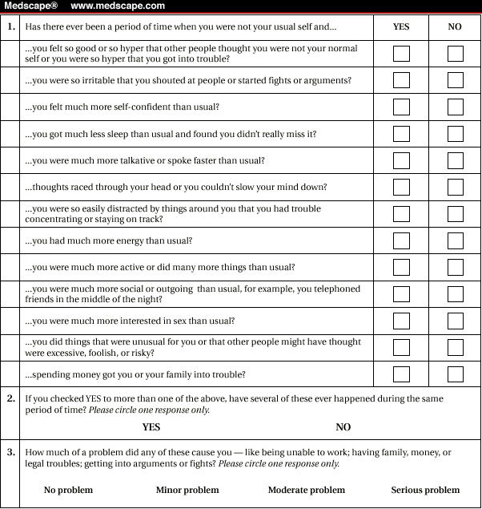
Mood Disorder Questionnaire

Slide 24
MDQ and False Positives
Positive: 7/13; yes; moderate-serious
Zimmerman and associates (Psych Res, 2011) found:
It screened out about 85% of folks who did not have Bipolar Disorder
65 people (15.2%) in the study who did not meet clinical criteria for Bipolar Disorder scored positive for it on MDQ
Those who scored false positive had: PTSD, specific phobia, alcohol / drug issues, eating disorders, impulse control disorders, ADHD

Slide 25
Medical False Positives: Causes of Secondary Mania
Substance Misuse: ETOH, Amphetamines, cocaine, hallucinogens, opiates
Medications: Cardiovascular (captopril); Endocrine (parlodel); Neurological (levodopa); Psychiatric (ritalin; MAOIs)
Diseases: Collagen vascular disease (lupus); Endocrine disease (thyroid); Infectious disease (HIV); Neurological disease (Wilson disease), Vitamin deficiencies (B12, folate, niacin, thiamine)
^{Price} & ^{Marzani-Nissen AFP,} ^{2012.}

Slide 26
Take Home Message
Assessment and Diagnosis of Bipolar Disorder needs to be:
Thorough
Structured
Multi-modal
Revisited throughout treatment

Slide 27
Part II. Non-Pharmacologic Interventions

Slide 28
Non-Pharmacologic Treatment
Evidence-based treatments:
Cognitive Behavioral Therapy
Interpersonal Therapy
Family Therapy

Slide 29
Acute Bipolar Mania
Assess risk of harm
Police, ambulance, inpatient placement
Consultation with psychiatry
Assess sleep deprivation and psychotic symptoms

Slide 30
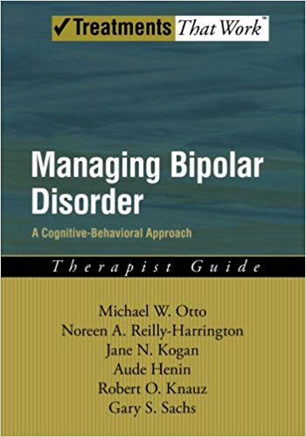
CBT for Bipolar Disorder
4 phases of treatment
Depression-focus phase
Treatment-contract phase
Problem-list phase
Well-being phase

Slide 31
Psychosocial Overview
Supported Therapies: CBT; IPT; Family
Education about bipolar disorder
Mood Charting
Improvement of treatment adherence
Discussing consequences of impulsive behavior
Sleep hygiene
Suicide risk management
Family strain
Notes:
Do you think we should cite some research for CBT, IPT and Family Therapy?

Slide 32
Bipolar Education
Symptoms of Bipolar Disorder, lows and highs
CBT model thoughts, feelings, emotions
Warning signs that mood is shifting:
Depression: No energy, loss of interest, thoughts of death, worthlessness
Mania or hypomania: Talking more, staying up late, feeling like you have special powers
Dealing with triggers (e.g., School or home stress)

Slide 33
Mood Charting
Systematic assessment of daily changes in mood, sleep patterns, medication adherence, and daily stressors.
Quickly recognize problem area for the session.
Notes:
Otto et al., 2009

Slide 34
Treatment Adherence
Adherence challenge: Helping those who usually do not want medicine to understand the importance of medicine.
Bottom line: What was it like without medicine? What were the consequences?
Identifying “social rhythms” – Patterns that keep your body on schedule (e.g., school routine, exercise, sleep).
^{www.mysimplemeasures.com}
Treatment Contract- after initial treatment of manic or depressive episode.
Notes:
Common obstacles with low adherence to medication: side effects, remittance of symptoms that may suggest to the patient a decreased need for medications, and unsupportive social network, conflicts between medication scheduling and personal time demands, and beliefs about being “overdependent” on medications.

Slide 35
Impulsivity
Learning about the link between Bipolar Disorder and impulsive choices:
Drugs, Alcohol, sex, spending money, arguing, fighting, school/work refusal
Practicing slow down techniques (e.g., mindfulness; stop, think, and act).
Working on relaxation and problem solving skills.
Identification of hypomanic thoughts that lead to impulsivity
Avoid financial decisions, drugs and alcohol, relationship decisions, confrontation, and credit card usage.
Rule of “2” – checking with 2 family members/friends before engaging in these activities.

Slide 36
Sleep Hygiene
Work on a regular sleep schedule, even on weekends
Avoid sleep “competition” before bedtime: TV, video games, exercise
Make the bedroom more sleep friendly
Decrease or eliminate stimulants
Avoid sleeping during the day
Keep a journal or worry log
Have a bedtime “wind down” routine
CBT-I is not indicated

Slide 37
Suicide Risk
Points of discussion
Permanence of suicide
Alternative behaviors when struggling
DBT: TIPP skills, Self-soothe, Distraction
How treatment helps keep people from reaching the point of suicidal thoughts
Safety Plan

Slide 38
Family Strain
Bipolar Disorder is typically a family problem
Even if family members do not have Bipolar Disorder, they still must deal with its effects
Patients urged to seek opinions of their loved ones re: behavior and mood
Include family members in treatment contract
Anger management in the family
Problem solving and consequences

Slide 39
Part III. Pharmacotherapy

Slide 40
Acute Bipolar Mania
Severe
Haloperidol 5-10mg IM
Lorazepam 1-2mg IM
Ziprasidone 10-20mg IM
Olanzapine 10mg IM
Aripiprazole 9.75mg IM

Slide 41
Acute Bipolar Mania
Mild to Moderate
Lithium 600-1200mg/day*
Valproate 1200-3000mg/day*
Aripiprazole 15-30mg/day
Quetiapine 400-800mg/day
Risperidone 2-6mg/day
Ziprasidone 80-160mg/day
Haloperidol 5-20mg/day
Lorazepam 10mg/day

Slide 42
Acute Bipolar Mania
Lithium plus atypical antipsychotic
Valproate plus atypical antipsychotic
Atypical antipsychotics: Aripiprazole, Olanzapine, Quetiapine, Risperidone, Ziprasidone, or Haloperidol
Lorazepam
Avoid Lithium in renal disease, mixed state, rapid cycling
Avoid Valproate in liver disease, pregnancy
Ogawa Y. CNS Drugs. 2014; 28(11): 989

Slide 43
Acute Bipolar Depression
Assess for potential self-harm/inpatient
First line:
Quetiapine or Lurasidone
Second line:
Olanzapine plus Fluoxetine
Valproate
Quetiapine or Lurasidone plus Lithium or Valproate
Lithium plus Valproate or Lamotrigine

Slide 44
Acute Bipolar Depression
Third line:
Lithium, Valproate, Carbamazepine
Mood stabilizer plus Fluoxetine or Bupropion
Refractory patients:
Electro-convulsive therapy
Severe suicidal intentions, psychosis, catatonia
Goodwin GM, Psychopharmacol 2016; 30: 495.

Slide 45
Bipolar Disorder- Maintenance
Bipolar Disorder I:
Reduce mania and depressive episodes
Bipolar Disorder II:
Reduce potential for self-harm
Improve social functioning
Angst F. J Affect Disord 2002; 68: 167.

Slide 46
Bipolar Disorder- Maintenance
Continue the therapy for the acute episode
Second Line:
Lithium, Valproate, Lamotrigine, Quetiapine
Third Line:
Aripiprazole, Olanzapine, Risperidone
SSRI’s, TCA
The best therapy is the one the patient will take

Slide 47
Bipolar Disorder- maintenance
Patient concerns: side effects, dependence and costs
Pregnancy:
Assess risks of taper verses continuation of therapy
Avoid Valproate, Carbamazepine, Lithium
Older patients:
Continue the ongoing therapy, closely monitor due to co-morbid conditions
Oostevink F. J Affect Disorder 2009; 116:176.

Slide 48
Pharmacotherapy- Challenges
Bipolar disorder pathophysiology is lacking
Poor understanding of drug actions
Bipolar is episodic, requires long-term studies
Unsure of lasting effects of medications

Slide 49
Long-term Maintenance
Deal with addictions/substance abuse
Deal with anxiety
Deal with relationships

Slide 50
Preventing Relapse
Acknowledge the illness
Know it
Know the effects
Spot a relapse (appoint a spotter)
Emergency plan
Know the triggers
Mend relationships

Slide 51
Questions???

Slide 52
References
American Psychiatric Association (2013). DSM-5. Washington, DC: APA.
Angst, F, Stassen, H, Clayton, P, & Angst J. (2002). Mortality of patients with mood disorders: follow-up over 34-38 years. Journal of Affective Disorders 68(2-3), 167-181.
Bowes, M., deGruy, F. & Hartmann, P. (2004). Diagnosis and management of mood disorders: An American Family Physician Monograph. Leakwood, KS: AFP
Brenner C. & Shyn S. (2014). Diagnosis and management of bipolar disorder in primary care. A DSM-5 update. Medical Clinics of North America 98 :1025-1048.
Goodwin, G., Haddad, P., Ferrier, I, et al. (2016). Evidence-based guidelines for treating bipolar disorder: Revised third edition recommendations from the British Association for Psychopharmacology. Journal of Psychopharmacology, 30 (6), 495-553.
Lapalme, M. Hodgins, S. & LaRoche, C. (1997). Children of parents with bipolar disorder: A meta-analysis.
Miller T. (2016) Bipolar disorder. Primary Care 43(2): 269-84.
Mitchell, P. (2012). Bipolar Disorder: The shift to overdiagnosis. Canadian Journal of Psychiatry, 57, 659-665.
Ogawa, Y, Tajika, A, Takeshima, N, et al. (2014). Mood stabilizers and antipsychotics for acute mania: a systematic review and meta-analysis of combination/augmentation therapy versus monotherapy. CNS Drugs, 28(11), 989-1003.
Oostevink, F, Boomsma, W & Nolen, W. (2009). Bipolar disorder in the elderly; different effects of age and age of onset. Journal of Affective Disorder, 116, 176-183.
Price, A. & Marzani-Nissen, G. (2012). Bipolar Disorders: A review. American Family Physician, 85, 483-493.
Zimmerman, et al. (2011). Psychiatric diagnosis of people who score positive on the mood disorder questionnaire… Psychiatric Review, 185, 444-449.
www.dsm5.org
www.mysimplemeasures.com
www.nimh.gov

