Slide 1
Sociopolitical Rounds: Creating Dialogue for Advocacy in Primary Care
Medical University of South Carolina
Russ S. Blackwelder, MD, Mdiv; Scott Bragg, PharmD; Sean P. Haley, MD, MPH; Thomas Ricks IV, MD; Leah A. Stem, MD, MEd
Notes:
Person 1-Scott

Slide 2
Disclosures
None of the participants have any disclosures to declare
Notes:
Person 1- Scott

Slide 3
Objectives
On Completion of this session the participants should be able to:
Describe an approach to create a safe place for discussing complex public health topics
Identify 5 example questions to spark dialog for healthcare policy reform
Discuss 3 common obstacles encountered with conversations around advocacy
Notes:
Person 1-Scott

Slide 4
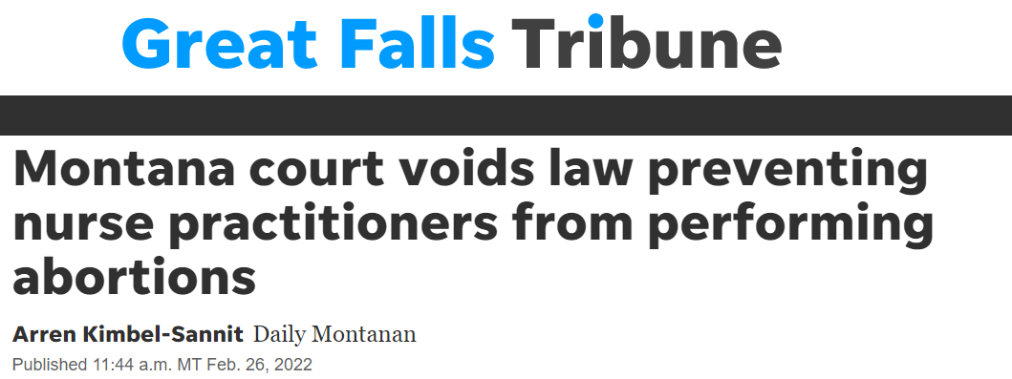
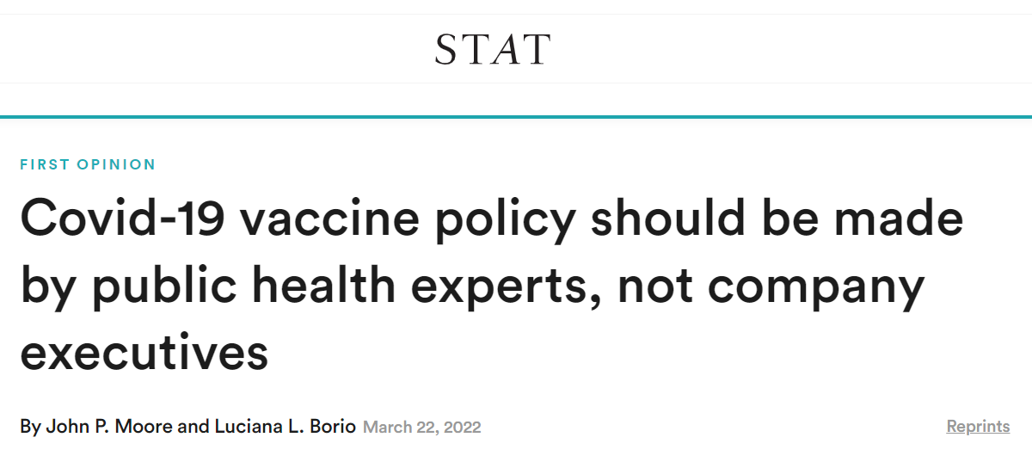
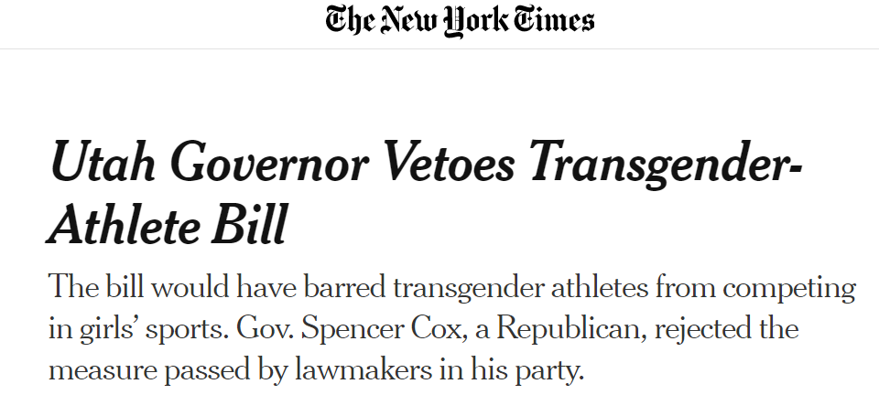
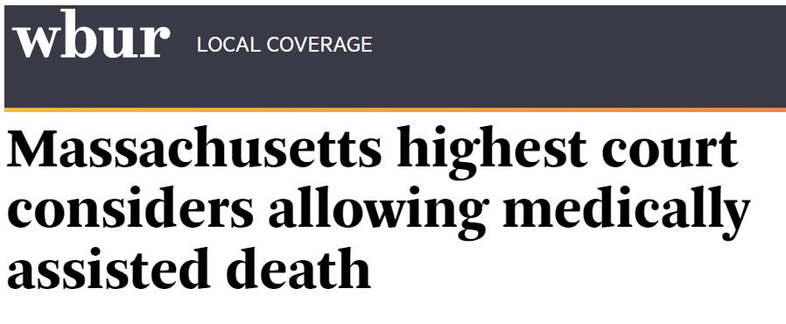
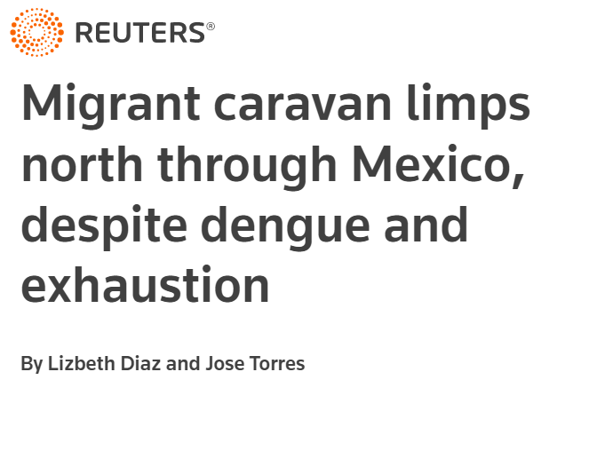
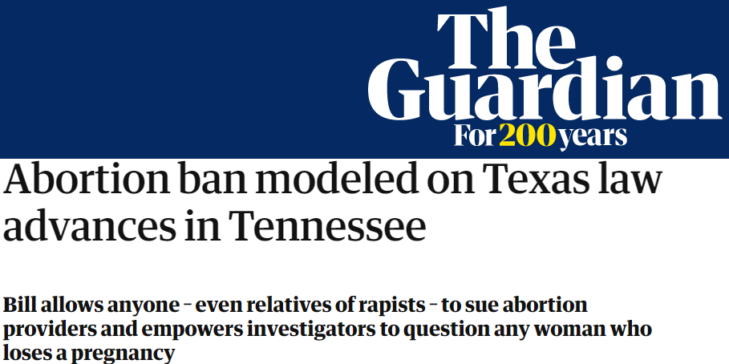
Why Care About Sociopolitical Rounds?
Sociopolitical Rounds matter because healthcare policy matters
Notes:
Person 2 Thomas
Rosser W. (2006). Sustaining the 4 principles of family medicine in Canada. Canadian family physician Medecin de famille canadien, 52(10), 1191–1197.

Slide 5
Sociopolitical rounds spark conversation
Example: Should your state legalize physician assisted suicide?
Moderated discussion around public health, ethics, healthcare policy
Opportunity to:
Learn about relevant issues
Respect divergent viewpoints
Promote interest in healthcare advocacy
Notes:
Person2- Thomas

Slide 6
Sociopolitical rounds are not…
A trial to judge opposing viewpoints
A grandstand to proselytize
A debate club
Notes:
Person 2- Thomas

Slide 7
Health advocacy is vital in medical practice
Healthcare increasingly focuses on social determinants of health
Discussions on healthcare reform identify areas of need and potential advocacy techniques
Notes:
Person 2- Thomas

Slide 8
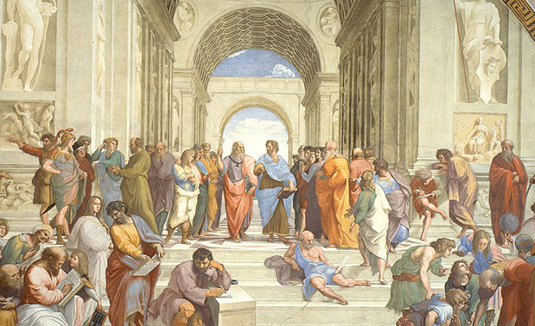
Sociopolitical rounds are a model for civil, informed conversation on diverse issues
Example topics:
Public Policy
COVID-19 Misinformation
Refugee Crisis
Notes:
Person 2-Thomas

Slide 9
27 Participants
How residents form leadership and policy competence
Facilitated discussion after inpatient rounds
Quantitative: Sociopolitical Control Scale responses
Qualitative: Open response on leadership and advocacy
Notes:
Person 3- Leah
Time period: July 1, 2017 – June 30, 2018
1) Residents involved in the sociopolitical discussions will score higher on the sociopolitical
control scale than residents who were not involved in the sociopolitical discussions.
2) Grounded theory method will be used to generate other hypotheses from survey
participant responses. These responses will be coded to highlight themes among
participants to identify how participants view sociopolitical discussions.

Slide 10
Question Prompts
What is the best way to ensure accurate health information is presented in media and how best to combat misinformation?
Which would have the biggest impact on improving population health-universal income, universal housing, or universal health/disability insurance?
Notes:
Person 3-Leah
These are often highly contentious issues that residents, faculty, and students will differ on
Just as rounds can devolve quickly into animosity, so too can they meander for long periods of time. Moderators should be capable of redirecting

Slide 11
Demographics
Year of training (N=54)
PGY1 |  | 25
PGY2 |  | 14
PGY3 |  | 15
Notes:
Person 3-Leah
N=54
TY 7
Fam Med 20

Slide 12
Results
Sociopolitical Control Scale
17-item Likert scale on belief in efficacy in social and political systems
Leadership Competence
Agreement: 46-81%
Neutral: range 17-33%
Disagreement: 2-31%
Policy Competence
Agreement: 26%-74%
Neutral 17-48%
Disagreement: 4-41%
Notes:
Person 3-Leah

Slide 13
Themes
Process of residency forges leaders
Intentional time helps deepen understanding for interacting in leadership and policy
Inspiration to enact change from witnessing inequality and discussing resource utilization
Notes:
Process of Residency develops leadership
Working on interdisciplinary teams

Slide 14
Facilitator Skills are Key
First step: formulate a topic
Maintain a respectful atmosphere for differing views
Play devil’s advocate if discussion favors one side
Goal(s): promote engagement, dialog, and problem solving, not to convince learners of one viewpoint
Notes:
Person 4-Sean
Lessons learned and skills for facilitators
These are often highly contentious issues that residents, faculty, and students will differ on
Just as rounds can devolve quickly into animosity, so too can they meander for long periods of time. Moderators should be capable of redirecting

Slide 15
Small Group Discussion
Discuss this prompt in groups of 6–8:
Is it ethical for physicians to go on strike and are there examples that would lead you to join them?
Prepare a verbal summary of your discussion
Notes:
Person 4-Sean
And now we are going to cut to a sample discussion to give you an idea of what this is actually like

Slide 16
How would you use discussions like these in your program? What questions would you ask?
Notes:
Person 4-Sean

Slide 17
Notes:
Person 4-Sean

Slide 18
Resources
Rosser, W. (2006). Sustaining the 4 principles of family medicine in Canada. Canadian family physician Medecin de famille canadien, 52(10), 1191–1197.
Al-Soleiti, M., Abu Adi, M., Nashwan, A., & Rafla-Yuan, E .(2021). Barriers and opportunities for refugee mental health services: Clinician recommendations from Jordan. Global Mental Health 8, e38, 1–6. https://doi.org/10.1017/gmh.2021.36
Bockting, W., Barucco, R., LeBlanc, A., Singh, A., Mellman, W., Dolezal, C., & Ehrhardt, A. (2020, March). Sociopolitical change and transgender people’s perceptions of vulnerability and resilience. Sex Res Social Policy, 17(1), 162-174. doi: 10:1007/s13178-019-00381-5
Mu, L., Shroff, F., & Dharamsi, S. (2011, April). Inspiring health advocacy in family medicine: A qualitative study. Education for Health, 24(1). http://www.educationforhealth.net
Decat, P., Demirören, M., & De Sutter, A. (2019). Teaching the health advocacy role in family medicine: Trial and error. European Journal of General Practice, 25(4), 177-178. https://doi.org/10.1080/13814788.2019.1674048
Mefford, M., Mittleman, M., Li, B., Qian, L., Reynolds, K., Zhou, H., Harrison, T., Gellar, A., Sidney, S., Sloan, R., Mostofsky, E., & Willams, D. (2020). Sociopolitical stress and acute cardiovascular disease hospitalizations around the 2016 presidential election. PNAS, 117(43). www.pnas.org/cgi/doi/10.1073/pnas.2012096117
Soklaridis, S., Bernard, C., Ferguson, G., Andermann, L., Fefergrad, M., Fung, K., Iglar, K., Johnson, A., Paton, M., & Whitehead, C. (2018). Understanding health advocacy in family medicine and psychiatry curricula and practice: A qualitative study. PLoS One 13(5). https://doi.org/10.1371/journal.prone.0197590
Notes:
Person 4-Sean

Slide 19
Objectives
On Completion of this session the participants should be able to:
Describe an approach to create a safe place for discussing complex public health topics
Identify 5 example questions to spark dialog for healthcare policy reform
Discuss 3 common obstacles encountered with conversations around advocacy
Email: BraggSC@musc.edu
Notes:
Person 4-Sean

