Slide 1
Notes:
Quick POLL SW, LCPC, PsychD, MD/DO

Slide 2
Psychopharmacology in adult unipolar depression
Dominique Fons, MD, University of Illinois COM Peoria
Kim Krohn, MD, U of KS SOM-Wichita/Wesley

Slide 3
We have no financial disclosures.
We are not that ambitious.

Slide 4
Acknowledgements
Scott Metzger, PharmD
Chris Gillette, PharmD

Slide 5
Objectives
Participants will be able to have a better understanding of factors influencing which pharmacotherapy agent to initiate for unipolar depression in adults

Slide 6
Objectives
Participants will be able to learn how to initiate treatment through thorough discussion of pharmaceutical agents for unipolar depression and genetic factors affecting patient response to treatment.

Slide 7
Unipolar Major Depression
Patients who have suffered at least one major depressive episode AND no history of mania
A major depressive episode is a period lasting at least 2 weeks, with five or more of the following symptoms:
Notes:
Persistent sad, anxious, or “empty” mood
Feelings of hopelessness, or pessimism
Irritability
Feelings of guilt, worthlessness, or helplessness
Loss of interest or pleasure in hobbies and activities
Decreased energy or fatigue
Moving or talking more slowly
Feeling restless or having trouble sitting still
Difficulty concentrating, remembering, or making decisions
Difficulty sleeping, early-morning awakening, or oversleeping
Appetite and/or weight changes
Thoughts of death or suicide, or suicide attempts
Aches or pains, headaches, cramps, or digestive problems without a clear physical cause and/or that do not ease even with treatment

Slide 8
Mood Symptoms
Persistent sad, anxious, or “empty” mood
Feelings of hopelessness, or pessimism
Irritability
Feelings of guilt, worthlessness, or helplessness
Thoughts of death or suicide, or suicide attempts

Slide 9
Motor Symptoms
Loss of interest or pleasure in hobbies and activities
Decreased energy or fatigue
Moving or talking more slowly
Feeling restless or having trouble sitting still

Slide 10
Cognitive Symptoms
Difficulty concentrating, remembering, or making decisions

Slide 11
Physical Symptoms
Difficulty sleeping, early-morning awakening, or oversleeping
Appetite and/or weight changes
Aches or pains, headaches, cramps, or digestive problems without a clear physical cause and/or that do not ease even with treatment
Notes:
Put up big paper--ask for categories of anti-depressants and title each sheet with a category. SSRI, SNRI, TCA, MAOI, 2nd GEN’N
Have colorful sticky paper distributed with drug names printed on them--ask participants to place the drugs in the appropriate category.

Slide 12
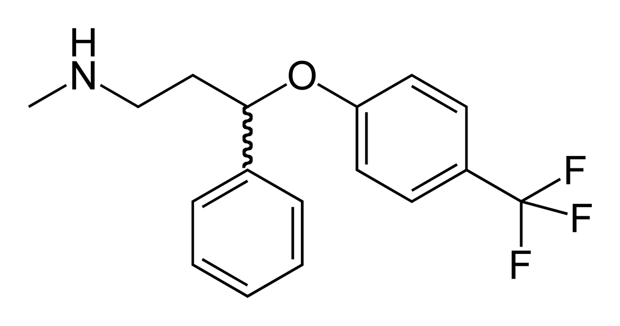
Selective serotonin reuptake inhibitors
SSRIs
Fluoxetine
Sertraline
Paroxetine
Citalopram
Escitalopram
Fluvoxamine
Notes:
Fluoxetine (approved in 1987), sertraline (1991), paroxetine (1993), citalopram (1998) and escitalopram (2002). Fluvoxamine approved for tx of OCD in 1993.
Paroxetine and fluvoxamine are unrelated in chemical structure to other SSRI’s.
Escitalopram and citalopram are stereoisomers of each other, escitalopram more potently inhibits reuptake of serotonin.
Little affinity for other receptors. There are >14 types of pre- and postsynaptic serotonin receptors. These meds decrease action of presynaptic by 60-80%--increases the time that serotonin is available in the synapse, efficacy likely requires downstream effects as well.
Only paroxetine weakly antagonizes the cholinergic receptors.
Fluoxetine is approved for use for dep down to age 8; citalopram to age 12.
About 30% of individuals achieve remission from the first SSRI trial, with average time to remission at 6 weeks in a Natl Inst of Health study
Pseudoresistance is due to inadequate dose or duration.
½ of pts responding by wk 8 had responded by week 2 and eventual response is much lower in those not responding in wk 2.

Slide 13
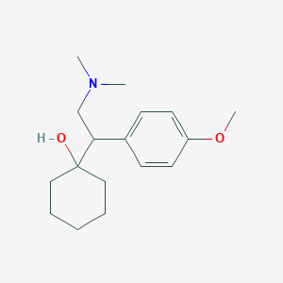
Serotonin norepinephrine reuptake inhibitors
SNRI’s
Venlafaxine
Duloxetine
Desvenlafaxine
Milnacipran
Levomilnacipran
Notes:
Venlafaxine--Effexor
Duloxetine--Cymbalta
Desvenlafaxine--Khedezla, Pristiq
Milnacipran--Savella
Levomilnacipran--Fetzima
Used for chronic pain, body dysmorphic d/o, OCD, PTSD, Menopausal hot flashes, urinary incontinence, and vulvodynia
These work on presynaptic serotonin and norepinephrine transporter proteins--dose and which agent impact which transporters are more potently inhibited. Levomilnacipran preferentially blocks reuptake of norepinephrine at lower doses, and start inhibiting serotonin reuptake at higher doses--the opposite of venlafaxine which is essentially an SSRI at 75mg daily, and more impacting norepi receptor proteins at higher doses.
Can cause pseudoanticholinergic symptoms, because that is what norepinephrine does--constipation, urinary retention, dry mouth.
Duloxetine will not increase blood pressure like the other SNRI’s, but has more capability of interactions with other meds.
HTN risk--should check blood pressure q 1-2 wks for 1st mo, then q 1-2 mos for 6 mos, then q 3-6 mos.

Slide 14
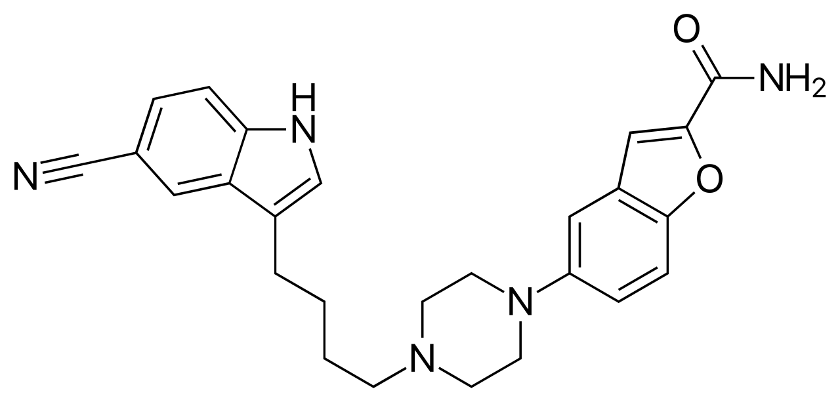
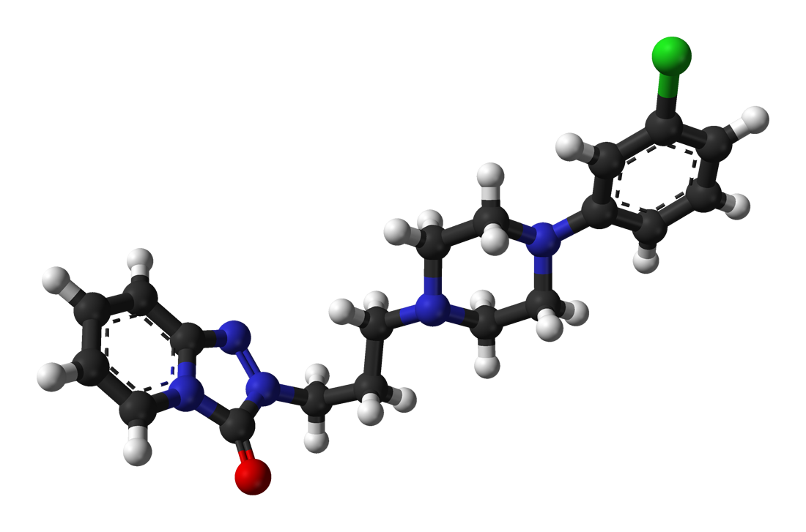
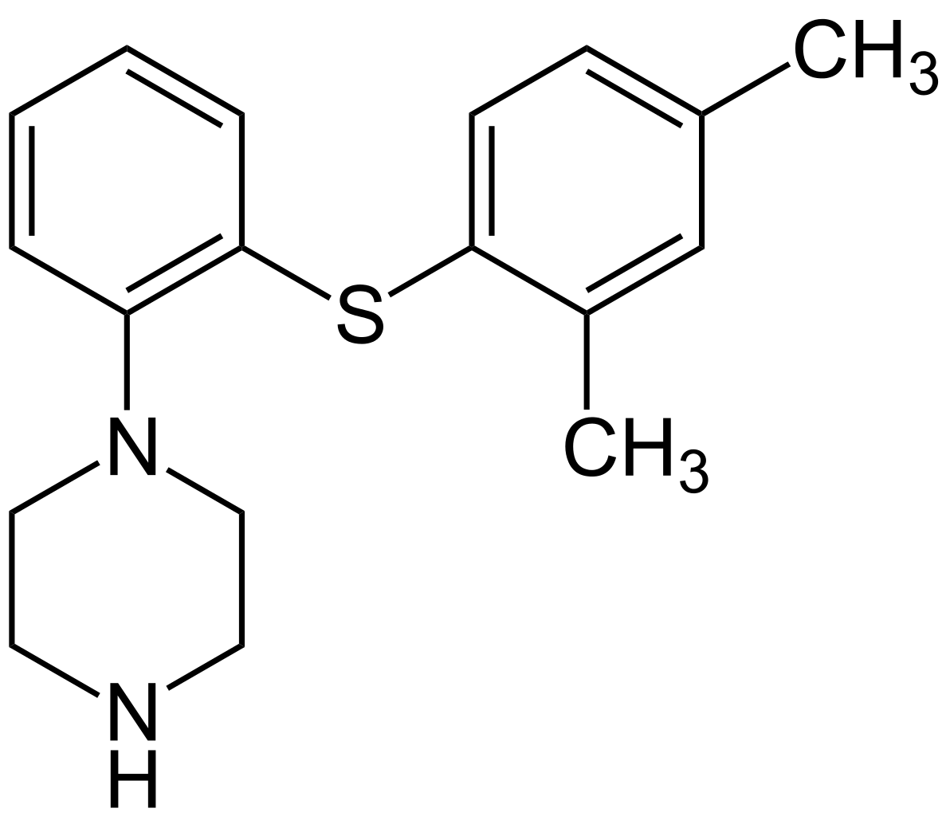
SARIs(serotonin antagonist/reuptake inhibitor)
Vilazodone
vortioxetine
trazodone
Notes:
Not considered first line due to sedatiing effects

Slide 15
Name | Action |  | Cautions | Side effects
Trazodone | 5HT2A receptor inhibitor & RI, Alpha 1 antagonist, anti-histamine |  | Sedating Dry mouth, orthostatic hypotension, caution with Sz Priapism | sedating | Can augment SSRI tolerability of insomnia and agitation
nefazodone | 5HT2A receptor inhibitor & RI, weak Alpha 1 antagonist, weak NE reuptake inhibition, anti-histamine |  | Mildly activating Nausea Sexual dysfunction Caution in Seizures

Slide 16
Name | Action | P450 | Cautions | Side effects
Vilazodone | SSRI + 5HT1A partial agonist | Main: 3A4 Minor: 2D6 2C19 | Do not use with linezolid or IV methylene blue | sedating
Vortioxetine | serotonin RI AND receptor activity modulator(5HT 1D, 5HT 3&7 antagonist, inhibits the 5HT transporter, 5HT1A agonist, 5HT1B partial agonist). | Main: 2D6 Minor 3A ⅘ 2C19 2C9 | Decrease with paired with 2D6 inhibitors like: bupropion, paroxetine, quinidine, fluoxetine Do not use with severe hepatic involvement |  | Impacts: 5HT, NE, DA, ACH, histamine, GABA and glutamate
Notes:
Vortioxetine-2013
Vilazodone-

Slide 17
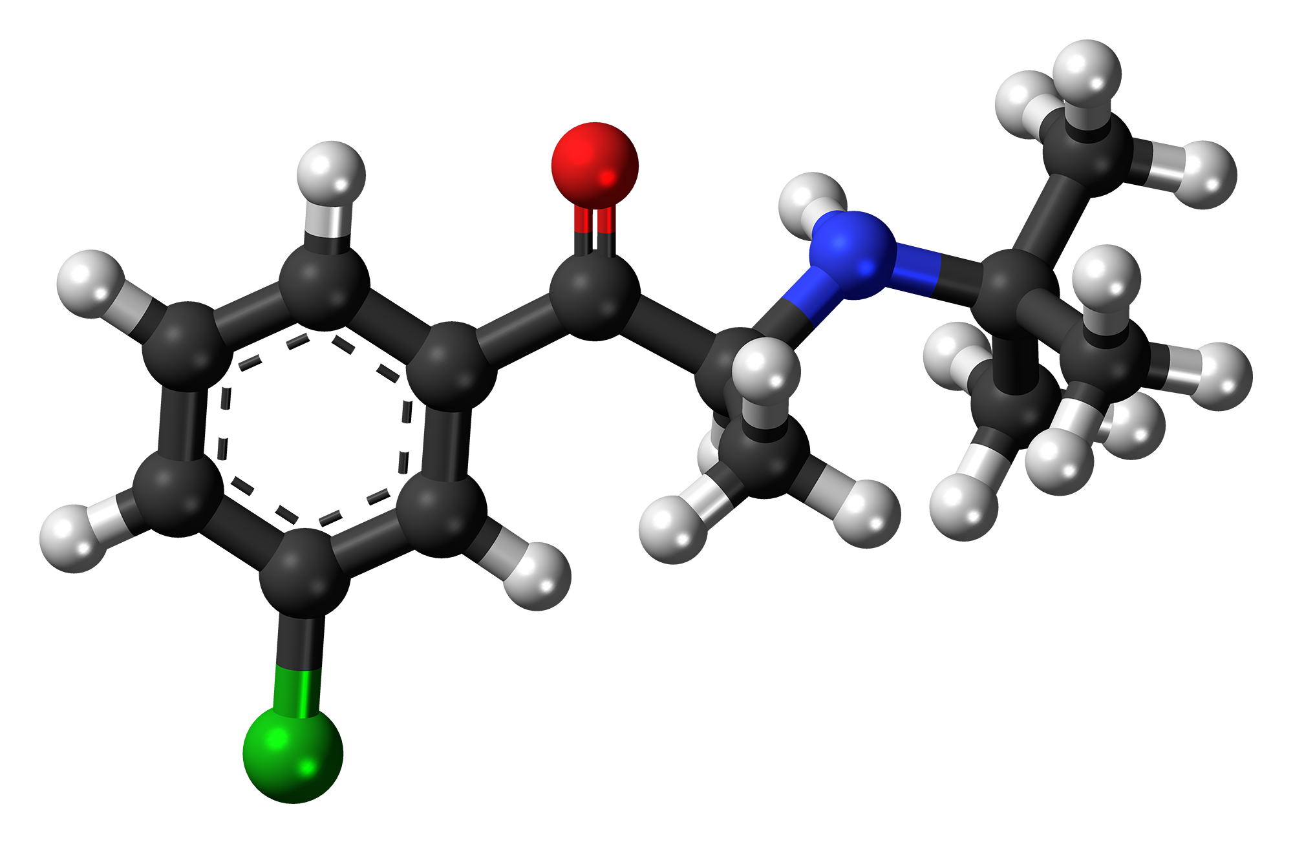
Bupropion
Notes:
IR TID
SR BID
XL daily
DA and NE

Slide 18
Bupropion
NDRI-inhibits NE and DA reuptake
Also works at Beta-1 receptors[Stahl, 200].

Slide 19
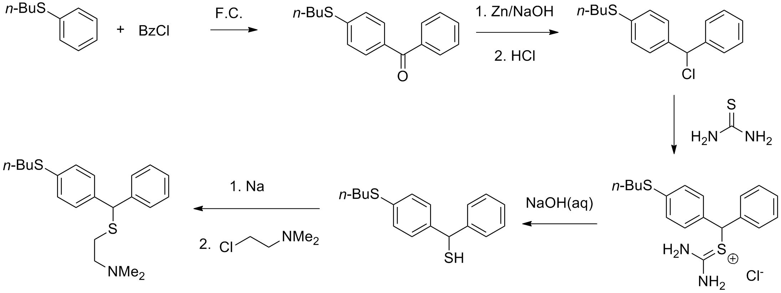
Tricyclic antidepressants
TCA’s
Notes:
3 ringed structure
Originally for anti-psychotics
Discovered for depression in 1950-60’s

Slide 20
TCAs
5 drugs in 1[Stahl]
Block reuptake for serotonin, NE, and minorly DA
All have 4 other actions:
Block mACH receptors
Block histamine H1
Block alpha-1 adrenergic receptors
Block sodium channels in the heart and brain
Notes:
3 ringed structure
Originally for anti-psychotics
Discovered for depression in 1950-60’s

Slide 21
MAOIs-a quick discussion
Phenelzine
Tranylcypromine
Selegiline
Isocarboxazid
Notes:
Discovered by accident when an anti-TB drug helped depression

Slide 22
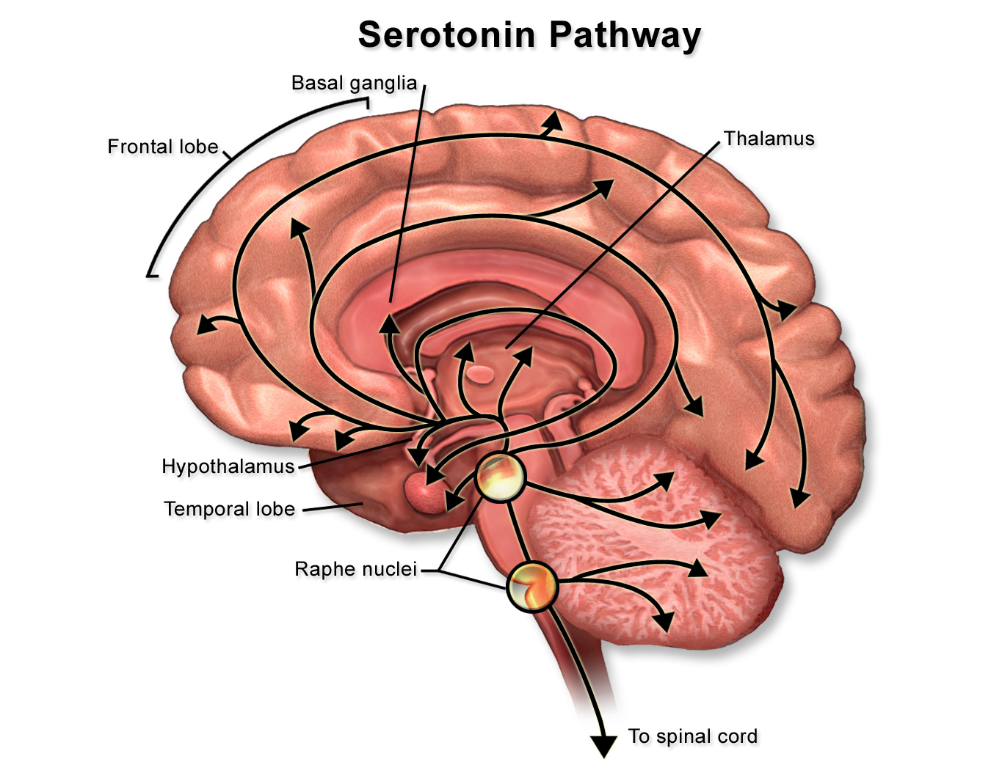
Notes:
Serotonin is synthesized from l-tryptophan, mostly in the brain, and is absorbed from the plasma into platelets and is metabolized to melatonin in the pineal gland! Synthesis is Vitamin B6-, or pyridoxine-dependent. Calcium is also involved.
Central NS: regulates attention, behavior, and thermoregulation
Peripheral: Produced by intestinal enterochromaffin cells, involved in regulating GI motility, vasoconstriction, uterine contraction, and bronchoconstriction, effects platelet aggregation.
SSRI’s are well absorbed in GI tract, reach peak plasma levels w/in 1-8hrs. Bind to proteins, lipophilic, metab via liver.
Fluoxetine has a metabolite that has antidepressent activity--norfluoxetine has half-life of 4-16 days!
Other SSRI’s--about a day
Citalopram and escitalopram are the best choice when drug-drug interactions are of concern, followed by sertraline
Discontinuation syndrome: Dysphoria, dizziness, GI, fatigue, chills, and myalgias
Starting an anti-depressant
Start at fairly low dose, titrate upward, keep maintenance dose at that which was used in obtaining remission; lower doses in elderly and fragile adults (85% of pts achieving remission will have a relapse).
Citalopram is assoc’d with long QT, so use with caution and do ECG before starting.
Fluoxetine and paroxetine should not be used with tamoxifen

Slide 23
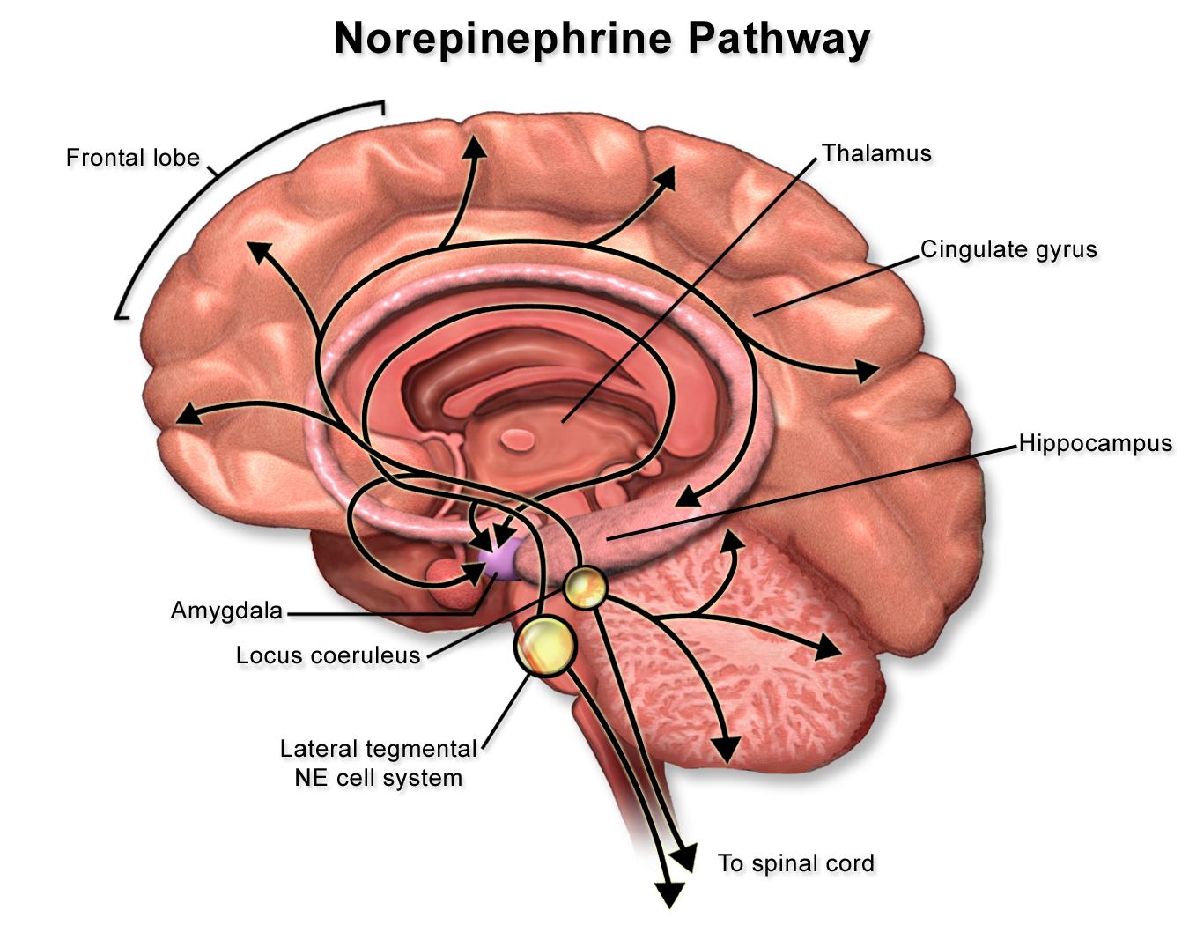
Notes:
NE to frontal cortex for mood, attention, information processing
NE to limbic cortex-> emotions, energy, fatigue and psychomotor slowing/agitation
Beta1 postsynaptic receptors can tranduce the signal for 5HT
NE to cerebellum-> mediate motor movement-> tremor
NE to brainstem-> CV centers-> BP
ME to leaving spinal cord-> Beta1R increase heart rate
alpha1R-> reulate bladder emptying-> urinary retention

Slide 24
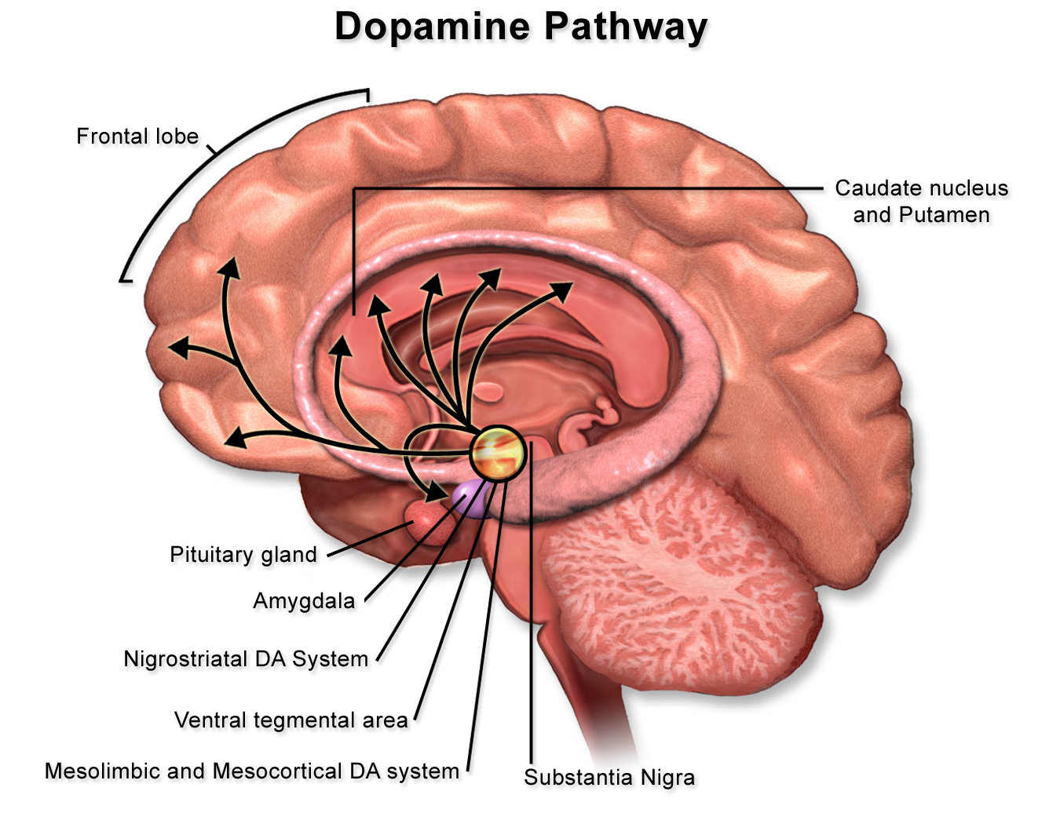
Notes:
DA is a precursor to NE
D2 Receptor stimulated for treatment of schizophrenia and blocked by some neuroleptics and atypical antipsychotics for seizure treatment

Slide 25
“Comparative efficacy and acceptability of 21 antidepressant drugs for the acute treatment of adults with major depressive disorder: a systematic review and network meta-analysis.”
Published in the Lancet 2018
Compared 21 antidepressants
Results:
ALL antidepressants were more effective than placebo
Those with higher response rate AND lower drop-out rate were: escitalopram, mirtazapine, paroxetine, agomelatine, sertraline
Caveats: 73% moderate bias risk, 9% high bias risk
TAKE HOME POINT: few differences between all anti-depressants

Slide 26
Selecting a medication with comorbidities
Yes
Go to symptomatic treatment algorithm
Is the patient healthy without medical conditions?
No
Does the patient have cardiovascular conditions (cardiomyopathy, arrhythmias, previous MIs)?
Yes
SSRIs
No
Is the patient obese?
No
Yes
TCAs
Mirtazapine
(r/o OSA)
SSRI
Bupropion
Trazodone(r/o OSA)
SNRI
SSRI(not paroxetine)
Notes:
*SNRIs still cause sexual dysfunction; just not to the extent of SSRIs
Caveat: liver and kidney disease

Slide 27
Choosing an SSRI
 | Other actions
Fluoxetine | 5HT2C | NE
Sertraline | DA | Sigma actions
Paroxetine | mACH | NE
Fluvoxamine | Sigma actions
Notes:
Sigma actions:

Slide 28
Selecting a medication for depression
Yes
citalopram
escitalopram
Is the patient have a high risk of suicide? Active SI?
No
Does the patient have psychomotor slowing?
Yes
fluoxetine
levomilnacipran
bupropion
No
Pt having trouble sleeping?
No
Yes
trazodone(r/o OSA)
TCAs
mirtazapine
SNRIs
SSRIs
Notes:
*SNRIs still cause sexual dysfunction; just not to the extent of SSRIs
Caveats: active with plan=hospitalization
Caveat for fluoxetine, levo and bupropion

Slide 29
SSRI Side Effects
Frequency | Symptom |  | Frequency | Symptom
17% | Sexual dysfunction Drowsiness |  | 6-7% | Dry mouth, blurred vision, nausea, rash or itching
10-12% | Wt gain, insomnia, anxiety, dizziness, HA |  | 2-5% | Tremor, Stomach upset
Notes:
Asthenia, diaphoresis, diarrhea, hyperprolactinemia, SIADH, movement d/o’s
May have increased risk of suicidality in pts 18-24yrs.
Can prolong QT interval--6ms, dose dependent
Weight gain
Development of diabetes--double risk!
Associated with increased risk of fragility fx--rapidly occurring, decreasing with time

Slide 30
Serotonin Syndrome
Mental status changes
Autonomic hyperactivity
Neuromuscular abnormalities
Hunter criteria
Notes:
Mental status changes: anxiety, agitated delirium, restlessness, and disorientation, easily startled.
Autonomic hyperactivity: Diaphoresis, tachycardia, hyperthermia, htn, vomiting, and diarrhea
Neuromuscular abnormalities: Tremor, muscle rigidity, myoclonus, hyperreflexia, bilat Babinski.
Most occur within 24 hours (us only 6 hrs) of a change in dose

Slide 31
Hunter Criteria
Pt has taken a serotonergic agent and has one:
Spontaneous clonus
Inducible clonus & agitation or diaphoresis
Ocular clonus & agitation or diaphoresis
Tremor and hyperreflexia
Hypertonia
>38* & ocular or inducible clonus
Notes:
Clinical dx, can be fatal
Hyperthermia, agitation, tremor, DTR hyperreflexia, muscle rigidity, dilated pupils, increased bowel sounds, flushed skin
Severe cases may result in complications, such as seizures, rhabdomyolysis, myoglobinuria, metabolic acidosis, renal failure, acute respiratory distress syndrome, respiratory failure, diffuse intravascular clotting, coma, and death
DD: neuroleptic malignant syndrome, anticholinergic toxic, malignant hyperthermia, sympathomimetic toxicity, meningitis or encephalitis
TX: Discontinue serotonergic agents, sedate with benzos, O2, IV fluid, cardiac monitoring, cyproheptadine if necessary, intubation if necessary.
Prognosis: Usually resolves w/in 24 hours

Slide 32
Serotonin Syndrome
Many Drugs associated w/:
Amphetamines Metoclopramide
Carvidopa/levodopa Ondansetron
Tramadol Dextromethorphan
Valproic acid Cyclobenzaprine
St. John’s Wort Triptans
Notes:
Ecstasy

Slide 33
Contraindications to Use of SNRI’s
No duloxetine in individuals w/ narrow angle glaucoma, liver, or kidney disease
Avoid duloxetine in heavy alcohol drinkers
BP can increase w/ venlafaxine and desvenlafaxine
Notes:
Side effects are nausea, dizziness, and diaphoresis--nausea diminishes over time.
Overdoses with venlafaxine may be more lethal than with SSRI’s.
SNRI’s are associated with falls! Falls are now the leading cause of death due to injury for those over 65. Falls account for 40% of all nursing home admissions, and nearly half of seniors do not resume independent living after a fall.

Slide 34
Increased CYP2D6 Metabolism
African American population-5%
Asian-rare
Ethiopian-16-29%
Saudi Arabians-20%
Whites:
Spain-7-10%
Sweden-1-2%
United States-4% --Drozda, 2014
Notes:
Needed to metabolize SSRI, SNRI’s, SARI’s

Slide 35
Cross-tapering
Fast is over 1-2 weeks
Slow is over 3-4 weeks

Slide 36
Take Home Points
When in doubt, start with an SSRI due to safety profile
Choosing a medication and/or psychotherapy depends on[Kovich et al, 2015]:
Medical comorbidities Side effects
Symptoms Cost
Previous response to tx FamHx of tx
Notes:
Caveat: QT prolongation--do EKG before Citalopram, possibly other SSRI’s

Slide 37
Resources
Adams, Miller and Zylstra. “Pharmologic managegent of Adult Depression.” The American Family Physician. March 15, 2008. Vol. 77(6): 785-792.
Arroll et al. “Antidepressants for treatment of depression in primary care: a systematic review and meta-analysis.” Journal of Primary Health Care. 2016; 8(4):325-334.
Cipriani et al. “Comparative efficacy and acceptability of 21 antidepressant drugs for the acute treatment of adults with major depressive disorder: a systematic review and network meta-analysis.”Lancet 2018; 391: 1357–66
Clark, M, Smith, P, Jamieson, B. Antidepressants for the Treatment of Insomnia in Patients with Depression. FPIN's Clinical Inquiries. AAFP 2011, available on line at http://www.aafp.org/afp/fpin.

Slide 38
Resources
Clinical Resource, Choosing and Switching Antidepressants. Pharmacist’s Letter/Prescriber’s Letter. June 2018.
Dhillon, Yang and Curran. “Bupropion: a review of its use in the management of major depressive disorder.” Drugs 2008; 68(5): 653-689.
Drozda, Muller and Bishop. Pharmacogenetics testing for neuropsychiatric drugs: current status of drug labeling guidelines for using genetic information and test options. Pharmacotherapy. 2014; 34:166.
Dupuy, J et al. A Critical Review of Pharmacotherapy for Major Depressive Disorder. Intl J of Neuropsychopharmacology 2011, vol 14 (10): 1417-1431.
Gibb, Andrew and Deeks, Emma. “Vortioxetine: first global approval.” Drugs. 2014; 74: 135-145.
Kovich and Dejong. “Common Questions about the pharmacologic management of depression in Adults. The American Family Physician. July 15, 2015. Vol. 92(2): 94-100.

Slide 39
Resources
Munkholm, K, et al. Considering the Methodological Limitations in the Evidence Base of Antidepressants for Depression: A Reanalysis of a Network Meta-analysis. BMJ Open 2019; 9(6).
PL Detail-Document, SSRIs and SNRIs and Bleeding Risk: Focus on Drug Interactions. Pharmacist’s Letter/Prescriber’s Letter. November 2014.
PL Detail-Document, Treatment of Depression in Pregnancy. Pharmacist’s Letter/Prescriber’s Letter. February 2016.
Professional Resource, Drug-induced Long QT Interval. Pharmacist’s Letter/Prescriber’s Letter. October 2016.

Slide 40
Resources
Sarwar Al. Trazodone and parkinsonism: the link strengthens. Clin Neuropharmacol. 2018 May/Jun;41(3):106-108.
Sobieraj, DM, et al. Adverse Effects of Pharmacologic Treatments of Major Depression in Older Adults. Comparative Effectiveness Review No. 215. (Prepared by the University of Connecticut Evidence-based Practice Center under Contract No. 290-2015-00012-I.) AHRQ Publication No. 19-EHC011-EF. Rockville, MD: Agency for Healthcare Research and Quality; March 2019.

Slide 41
Resources
Substance Abuse and Mental Health Services Administration. The Treatment of Depression in Older Adults: Selecting Evidence-Based Practices for Treatment of Depression in Older Adults. HHS Pub. No. SMA-11-4631, Rockville, MD: Center for Mental Health Services, Substance Abuse and Mental Health Services Administration, US Dept of Health and Human Services, 2011.
Treviño LA¹, Ruble MW¹, Treviño K¹, Weinstein LM¹, Gresky DP¹. Antidepressant Medication Prescribing Practices for Treatment of Major Depressive Disorder. Psychiatr Serv. 2017 Feb 1;68(2):199-202. doi: 10.1176/appi.ps.201600087. Epub 2016 Oct 3.

Slide 42
Resources
Undurraga, J and Baldessarin, R. “Direct comparison of tricyclic and serotonin-reuptake inhibitor antidepressants in randomized head-to-head trials in acute major depression: systematic review and meta-analysis. Journal of Psychopharmacology. 2017; 31(9) 1184-1189.Valerio et al. “A quantitative review on outcome-to-antidepressants in melancholic unipolar depression.” Psychiatry Research. April 2018: 100-110.
Volpi-Abadie, J, et al. Serotonin Syndrome, Ochsner J. 2013 Winter; 13(4): 533-540 Brown, C. Pharmacotherapy of Major Depressive Disorder, US Pharmacist, November 16, 2011
vonWolff et. al. “Selective serotonin reuptake inhibitors and tricyclic antidepressants in the acute treatment of chronic depression and dysthymia: a systematic review and meta-analysis.” Journal of Affective Disorders. 2013; 44: 7-15.

