Slide 1
Sculpting Pain
“An innovative hands on approach to teaching complex pain care”
May 8th, 2018
Ashwini Kamath Mulki, MD & Nicole Defenbaugh, PhD
Notes:
Ashwini

Slide 3
A Complete Health Network
Notes:
All these entities comes together to form a complete and comprehensive health network. It comprises:
8 campuses
Children’s Hospital at Lehigh Valley Hospital. It’s a “hospital within a hospital,” and includes a Children’s ER, NICU, PICU, pediatric unit, 28 pediatric specialties, pediatric surgeons, a child-life program and more
15 ExpressCARE sites located throughout the region. Without an appointment, patients can receive care for common illnesses and minor injuries.
22 Health Centers
Home health, hospice, pharmacy, laboratory and other outpatient services
And doctors and clinical staff working at locations throughout our region.

Slide 4
Preview
Introduction (10min)
Reflective Writing and Modeling Clay Exercise (25min)
Reflect and Pair ‘n Share (10min)
Discussion and Wrap Up (10min)
Notes:
Ashwini

Slide 5
Why This Workshop?
Pain is abstract, personalized and subjective
It is common: symptom, diagnosis by family physicians, socio-economic impact
The different forms and presentations of pain
Teach an empathic response to heighten awareness about one’s own bias
Notes:
Ashwini
Pain can be emotional, physical, social, there are various dimensions to it. Pain being more a subjective symptom, can be ‘seen’ differently by the person experiencing it and the one treating it. Over or under prescribe based on our own experiences or understanding or pain.
An estimated 126 million adults (55.7 percent) reported some type of pain in the 3 months per one survey. It’s common.
As teachers, how do we train our future family physicians to understand better their own perceptions of pain, to empathize and communicate better with their pain patients? This workshop is part of the ‘acute pain’ learning lab we organize for our residents annually, which is co facilitated by our clinical pharmacist and clinical psychologist.

Slide 6
What Is This Workshop?
“A creative activity using kinesthetic,
oral and written techniques to teach learners how to reflect and question perceptions of pain”
Reflecting ~ Sculpting ~ Post Reflection Pair ‘n Share
Notes:
Nicole
Preferred learning styles med students – Aural (45.5%) and physical/kinesthetic (33.1%) (Urval et al, Adv Phys Ed, 2014)
Learning styles across med education level (Samarakoon, Med Ed., 2013)
First years - multimodal (69.9%): auditory-reading (50%), auditory-physical/kinesthetic(31.8%)
Postgraduates – unimodal (52.9%): physical/kinesthetic (33.4%)

Slide 7
Our Residents’ Preferred Styles
PGY3
Solitary (12.83)
Physical (12.00)
Logical (12.00)
PGY2
Physical (12.50)
Visual (12.33)
Social (12.00)
PGY1
Social (16.67)
Physical (13.50)
Aural (13.50)
Notes:
Nicole

Slide 8
Ethics and Safety
There is no right/wrong answer or ‘correct’ way of doing
Be respectful of others’ comments, creations and ideas: ‘be open to what emerges’
Be mindful of your body’s response, recognize, stop and take breaks or change as needed
Write and create as much or as little as you are comfortable
Notes:
Nicole

Slide 9
Reflective Writing (5min)
…think of a time you have experienced pain personally or witnessed your patients with it
“What does pain mean to you?”
Notes:
Nicole
Can be any level of pain, any type of pain, acute or chronic
We not sculpting yet…

Slide 10
Modeling Clay Exercise: Part One (10min)
“ What does pain look like before it is treated?”
“be one with the modeling clay”
Don’t forget to take a picture of what you create!
Notes:
Ashwini
Use as many or few colors on you table only
Not a contest for most creative, enjoy this process, breathe, relax
Nicole and I do not have a conflict of interest and nothing to disclose regarding any modeling clay brand. We do not endorse any particular brand either.

Slide 11
Modeling Clay Exercise: Part Two (5min)
…using only the same material from part one create your response to part two
“ What does pain look like after it is treated?”
Another picture here!
Notes:
Ashwini
No extra material.
Only 5min, not an error,

Slide 12
Reflect and Share Your Thoughts (10min)
Directions: Take 1-2 min to think about the following questions and discuss as a pair:
What is your emotional response to sculpting and reflective writing?
What did you learn about pain?
What would you do the same or differently in treating your patients with pain?
What did you learn about yourself?
Notes:
Ashwini

Slide 13
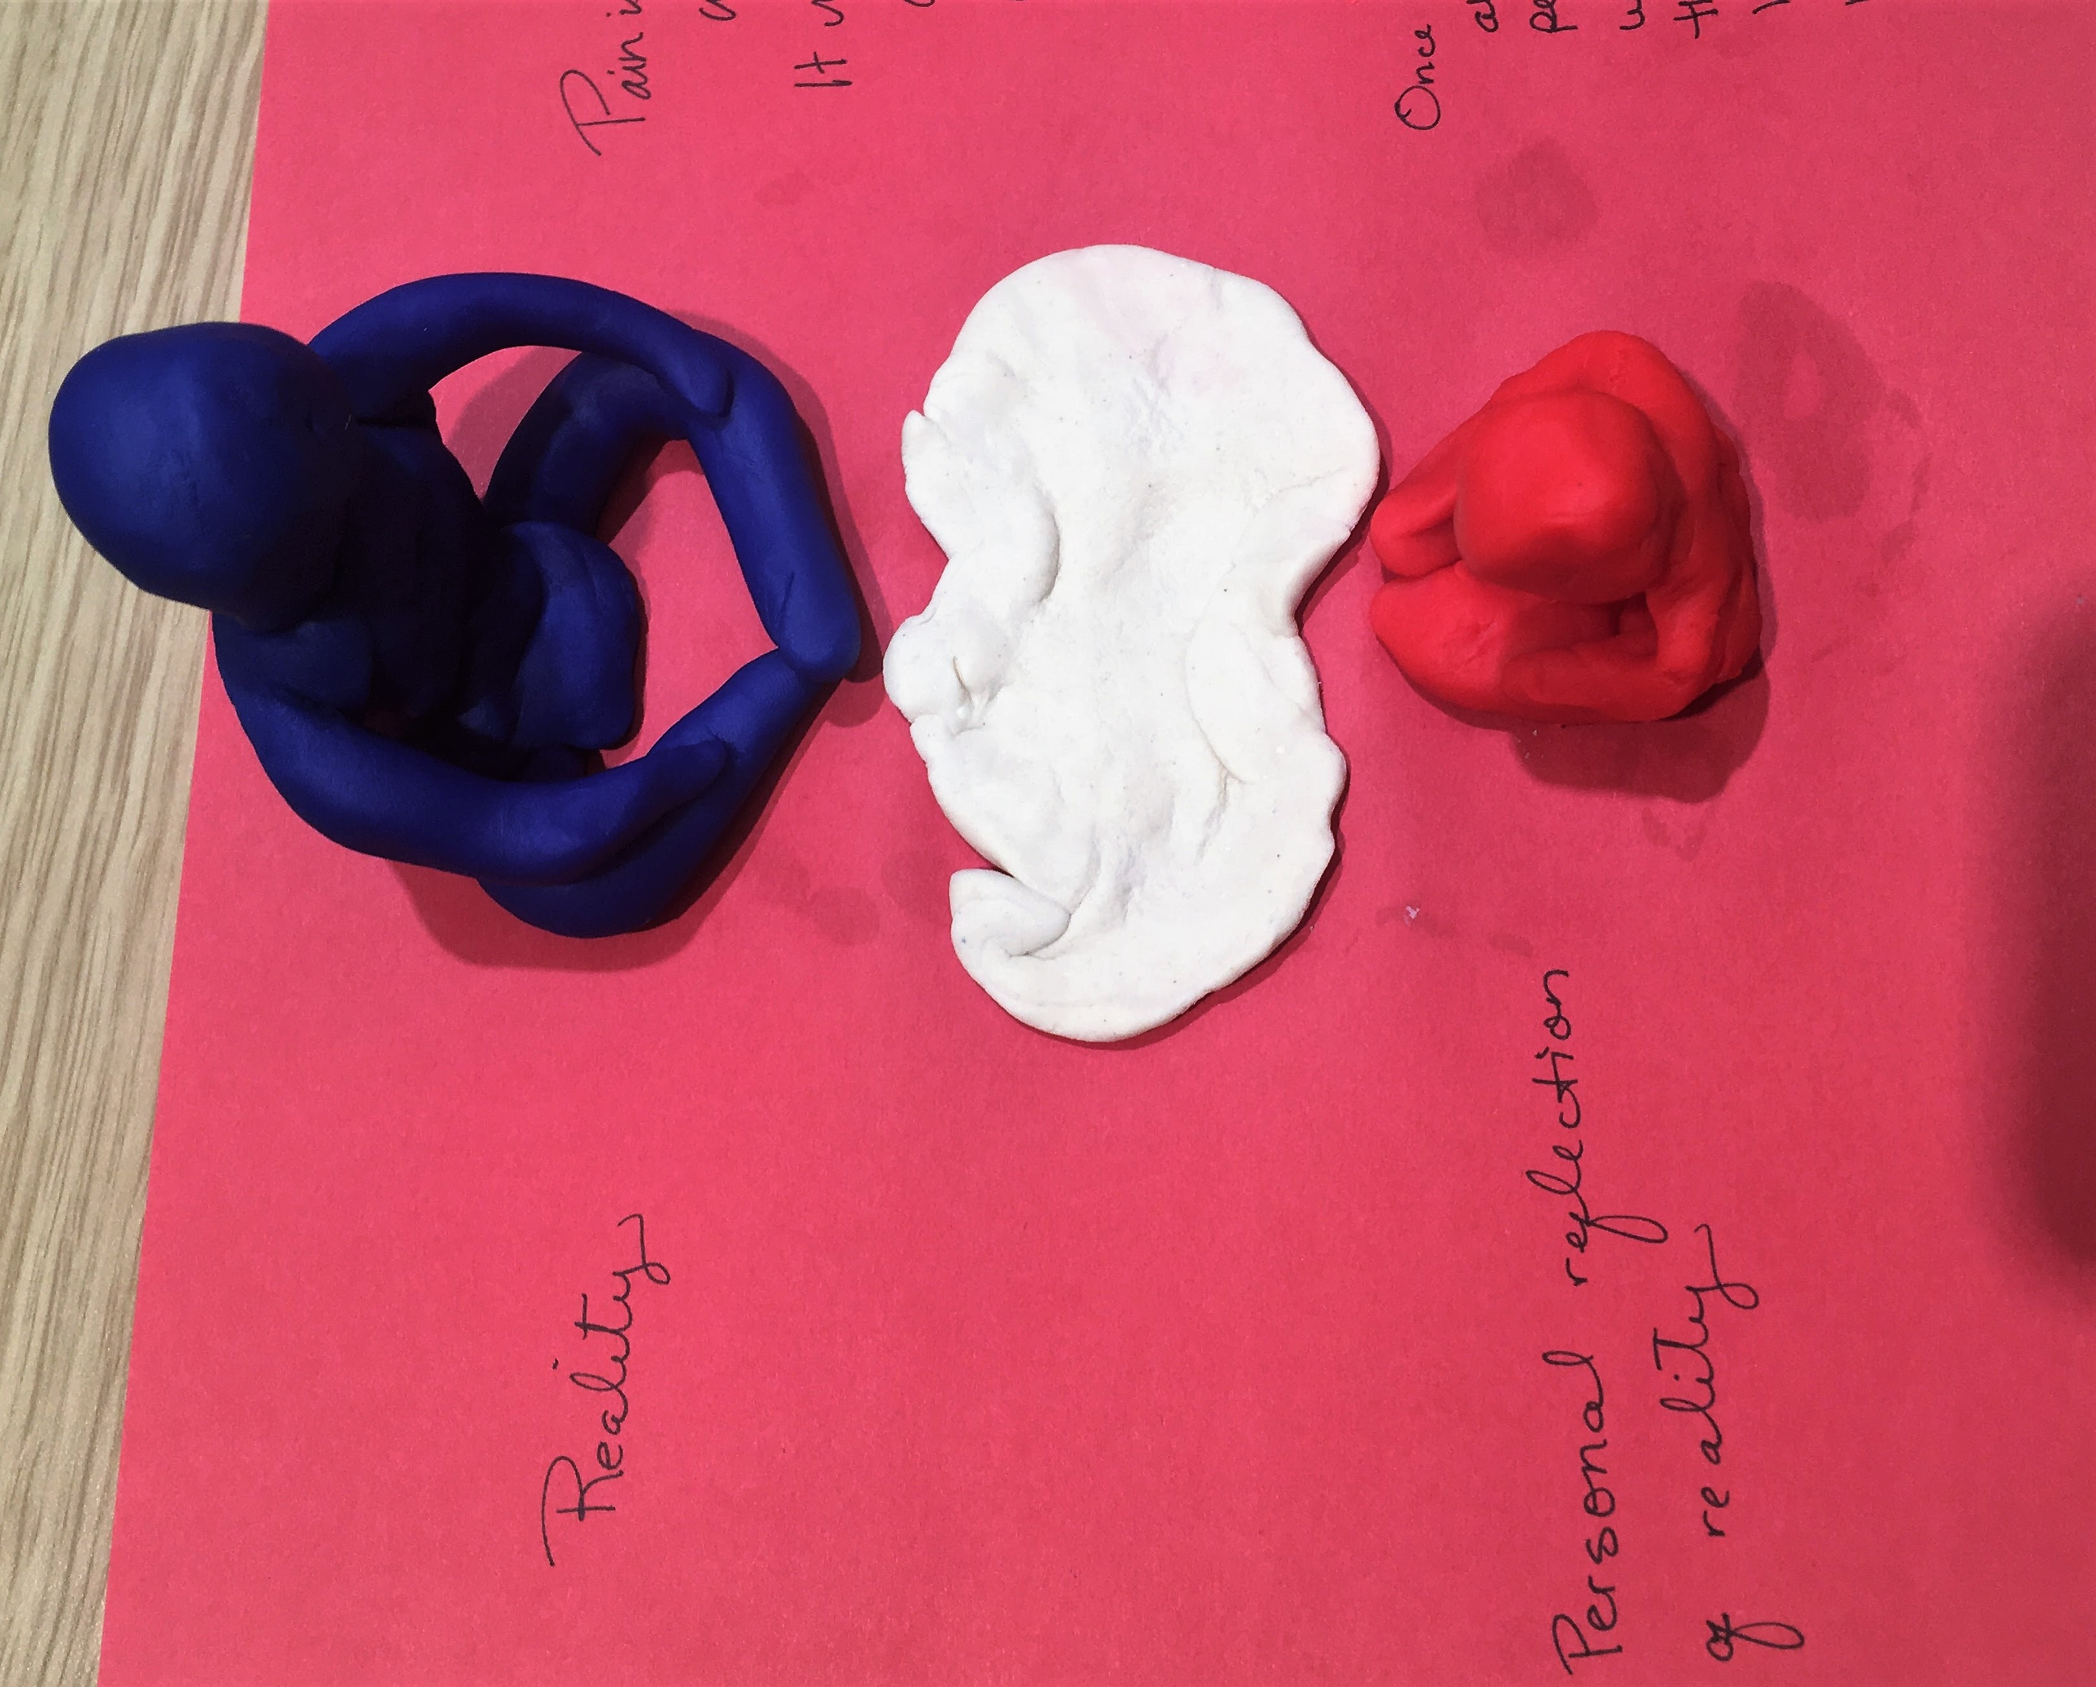
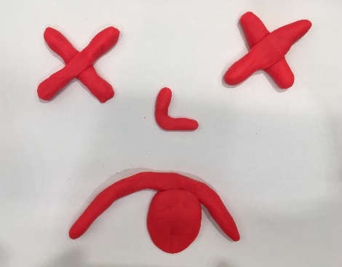
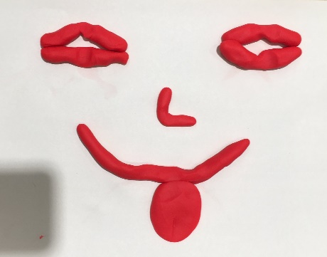
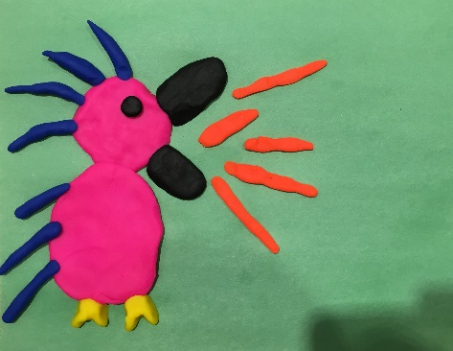
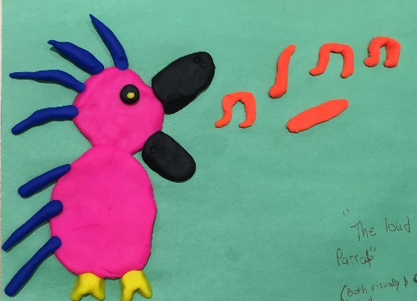
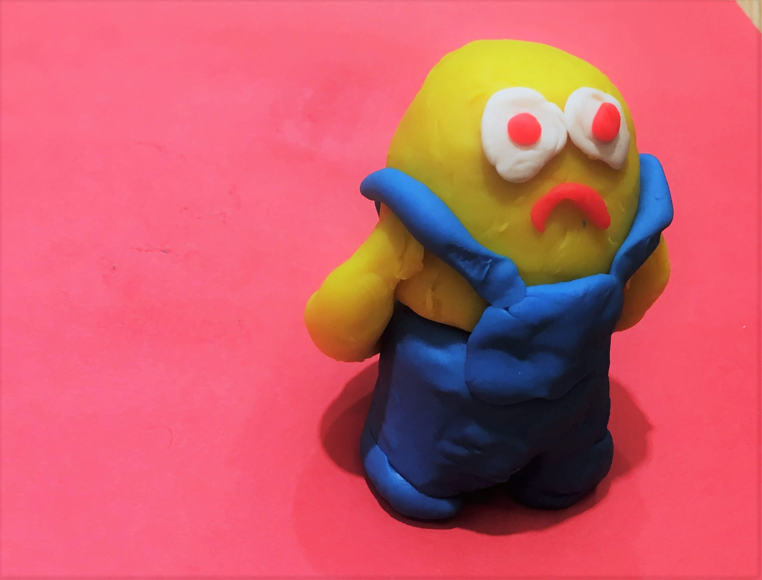
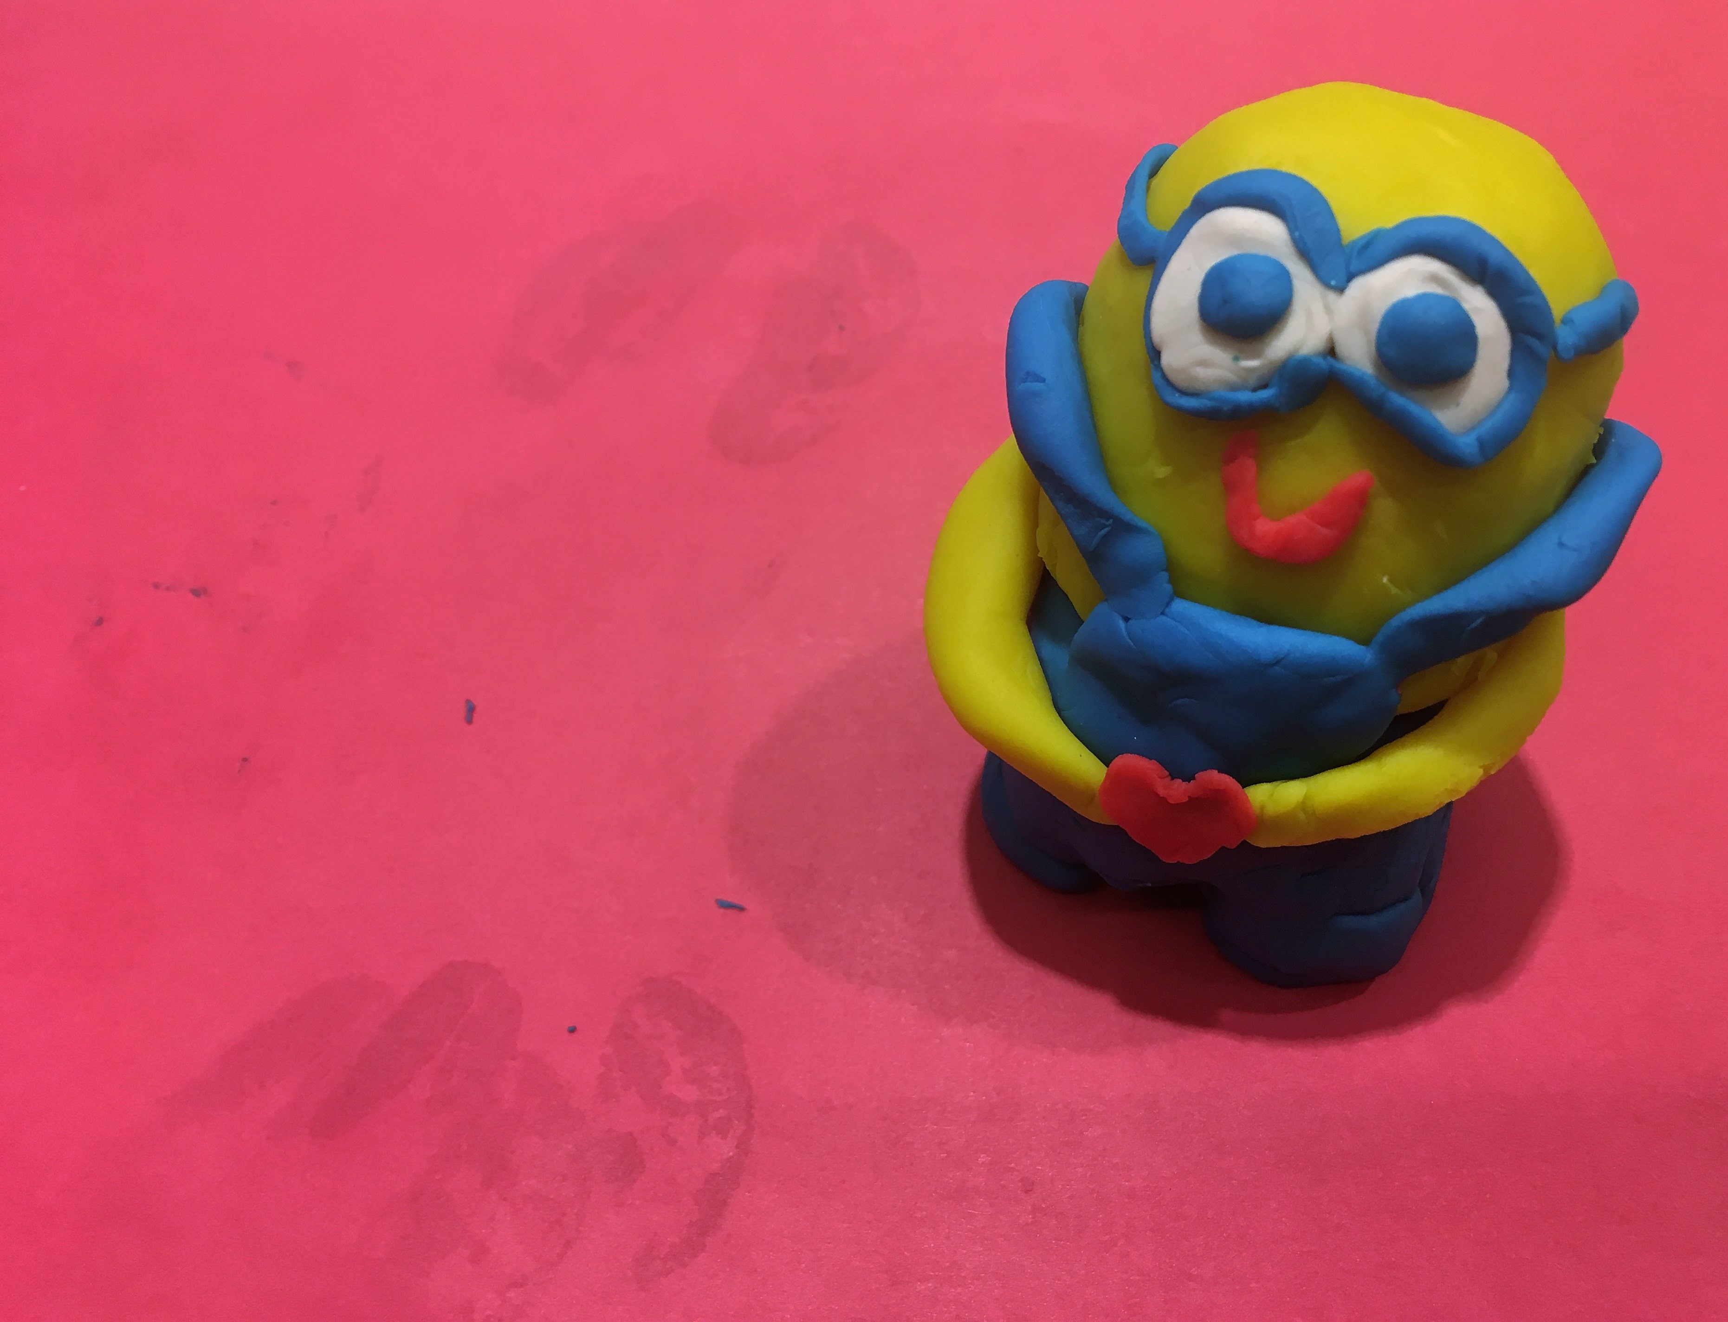
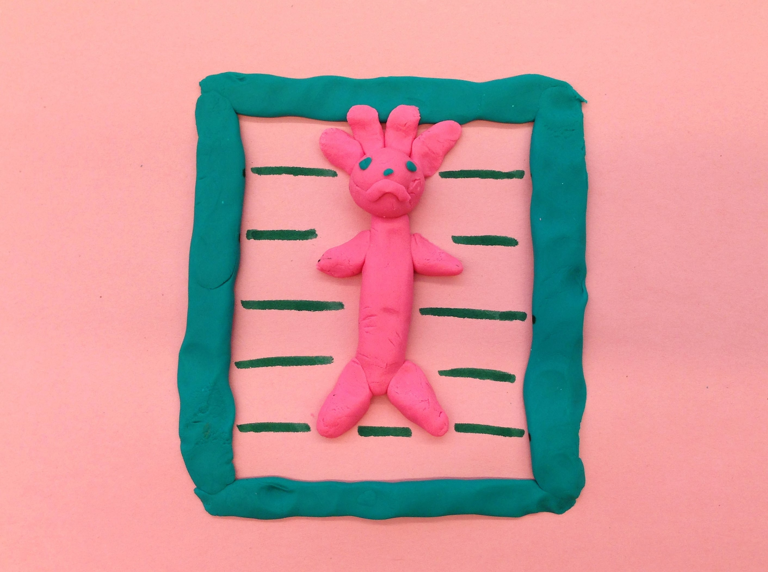
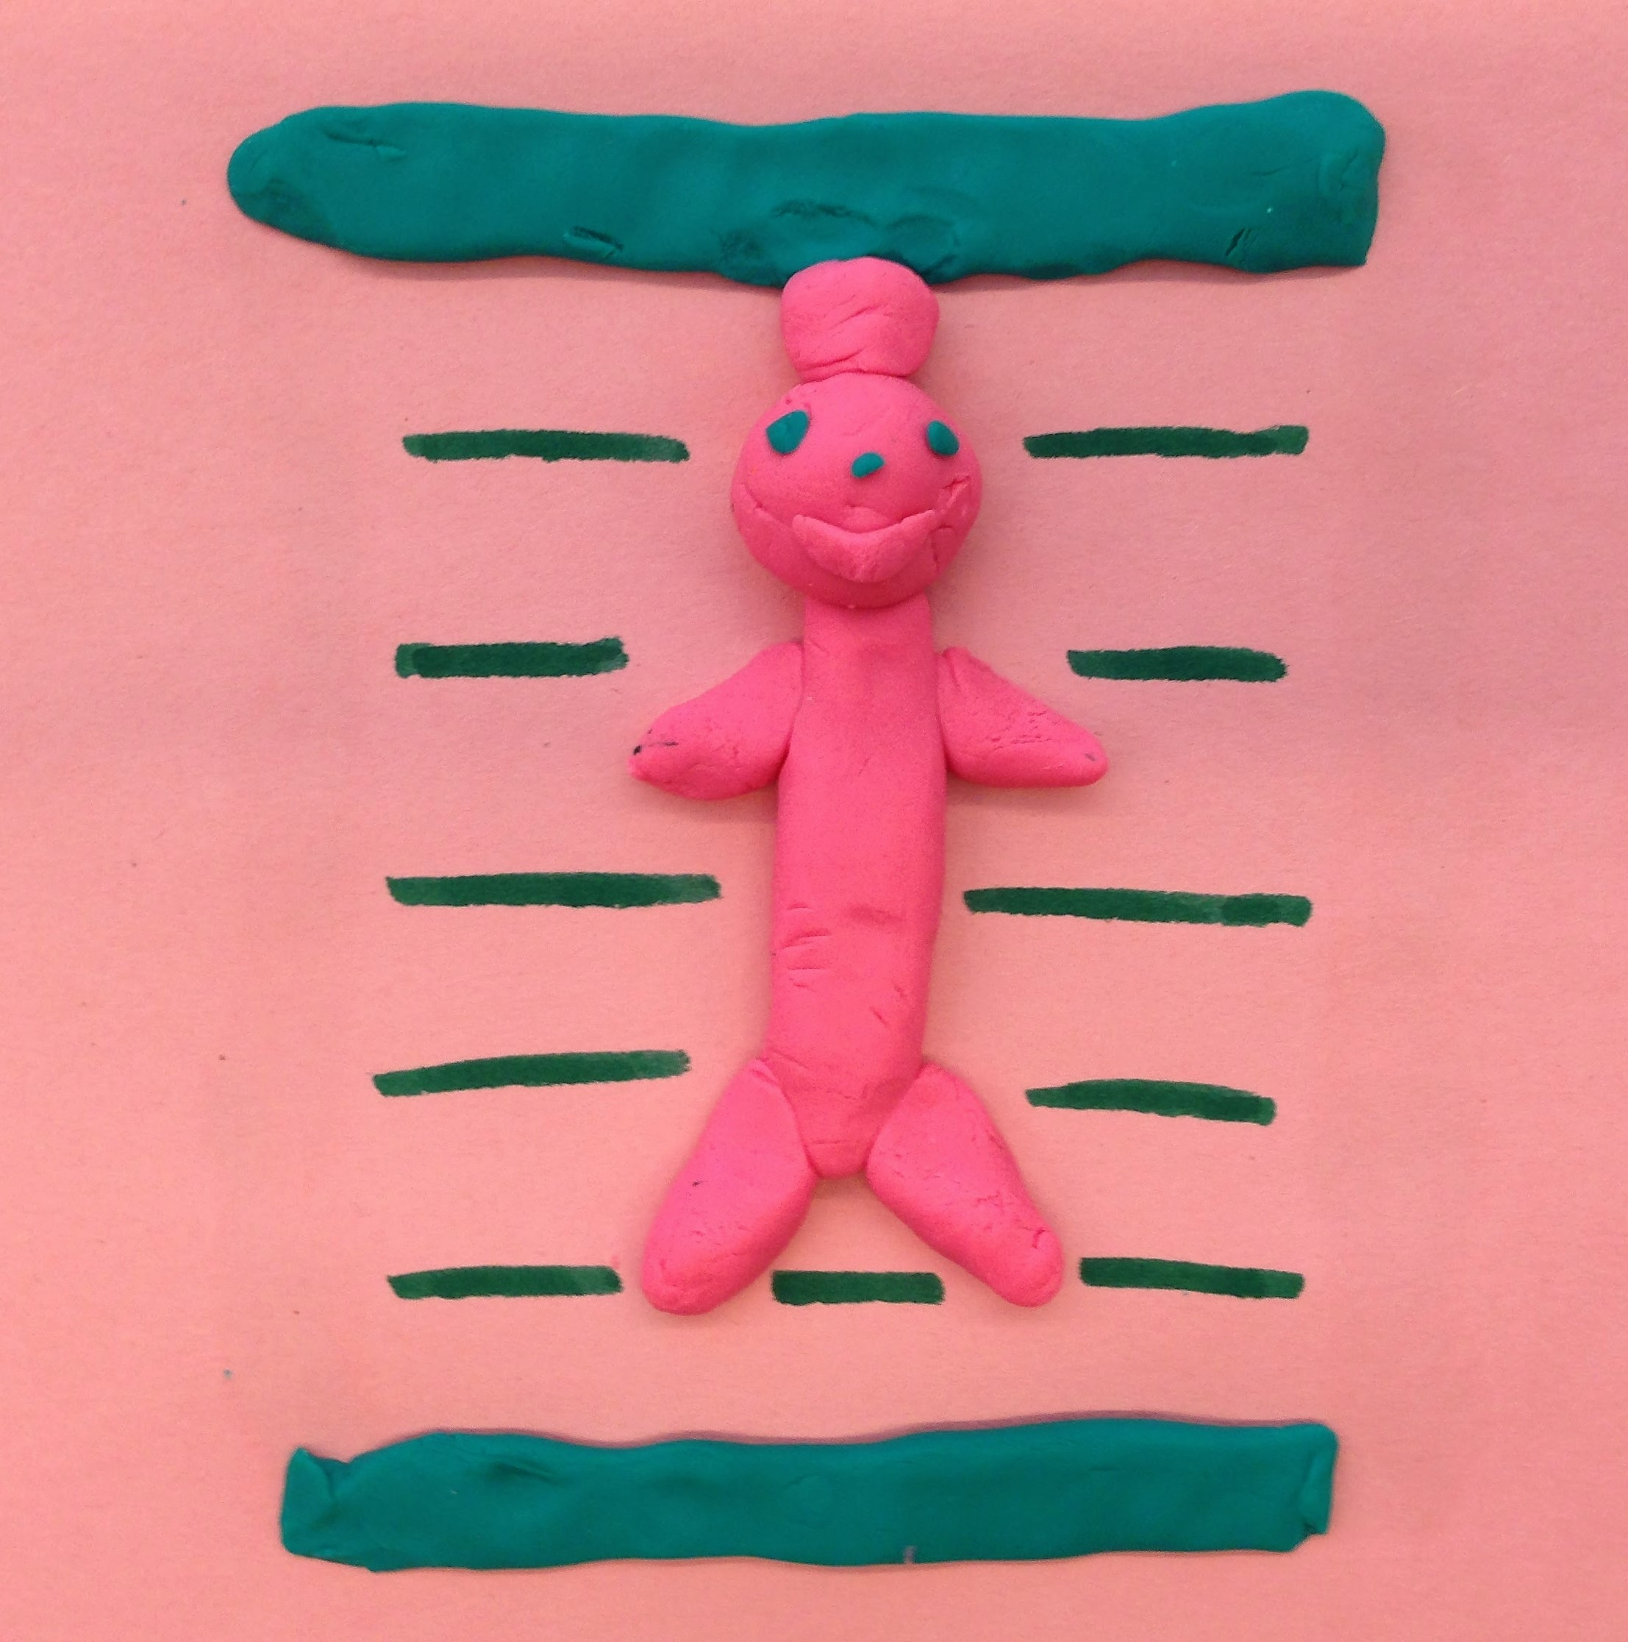
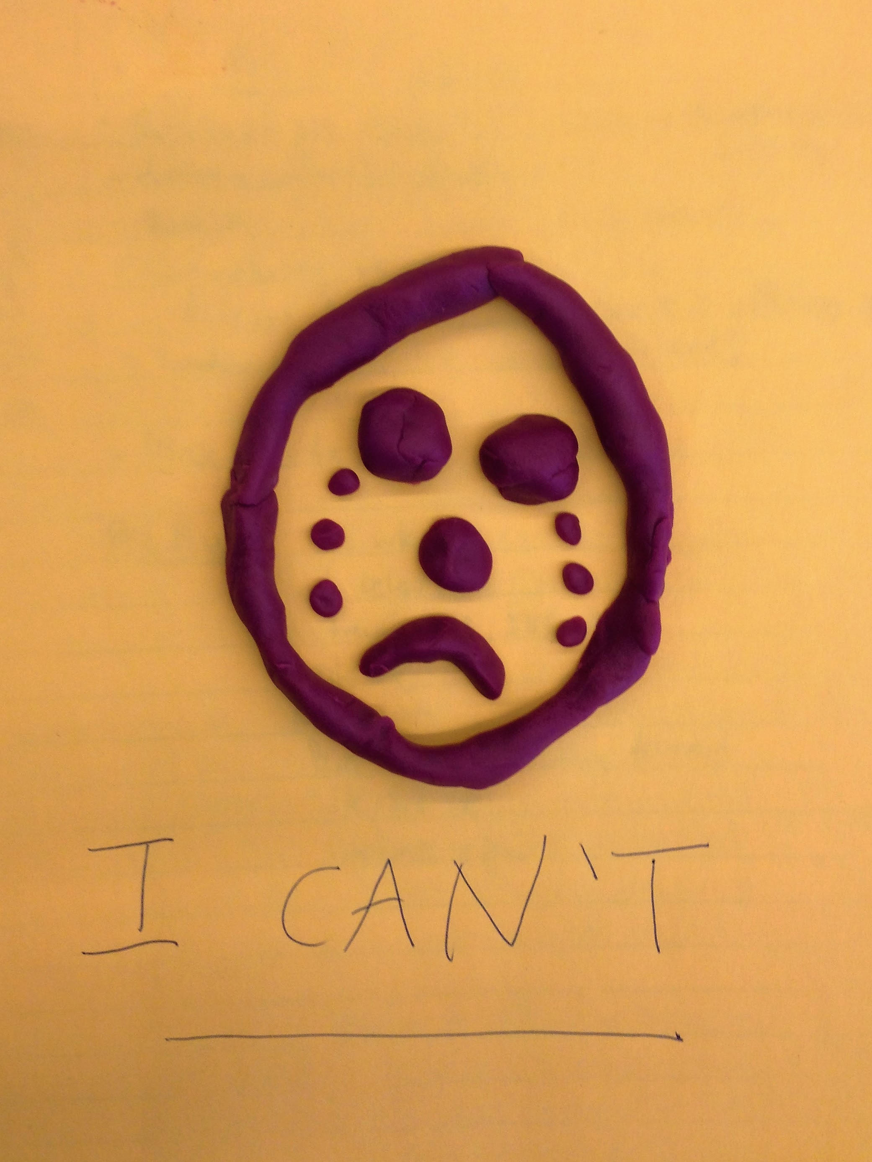
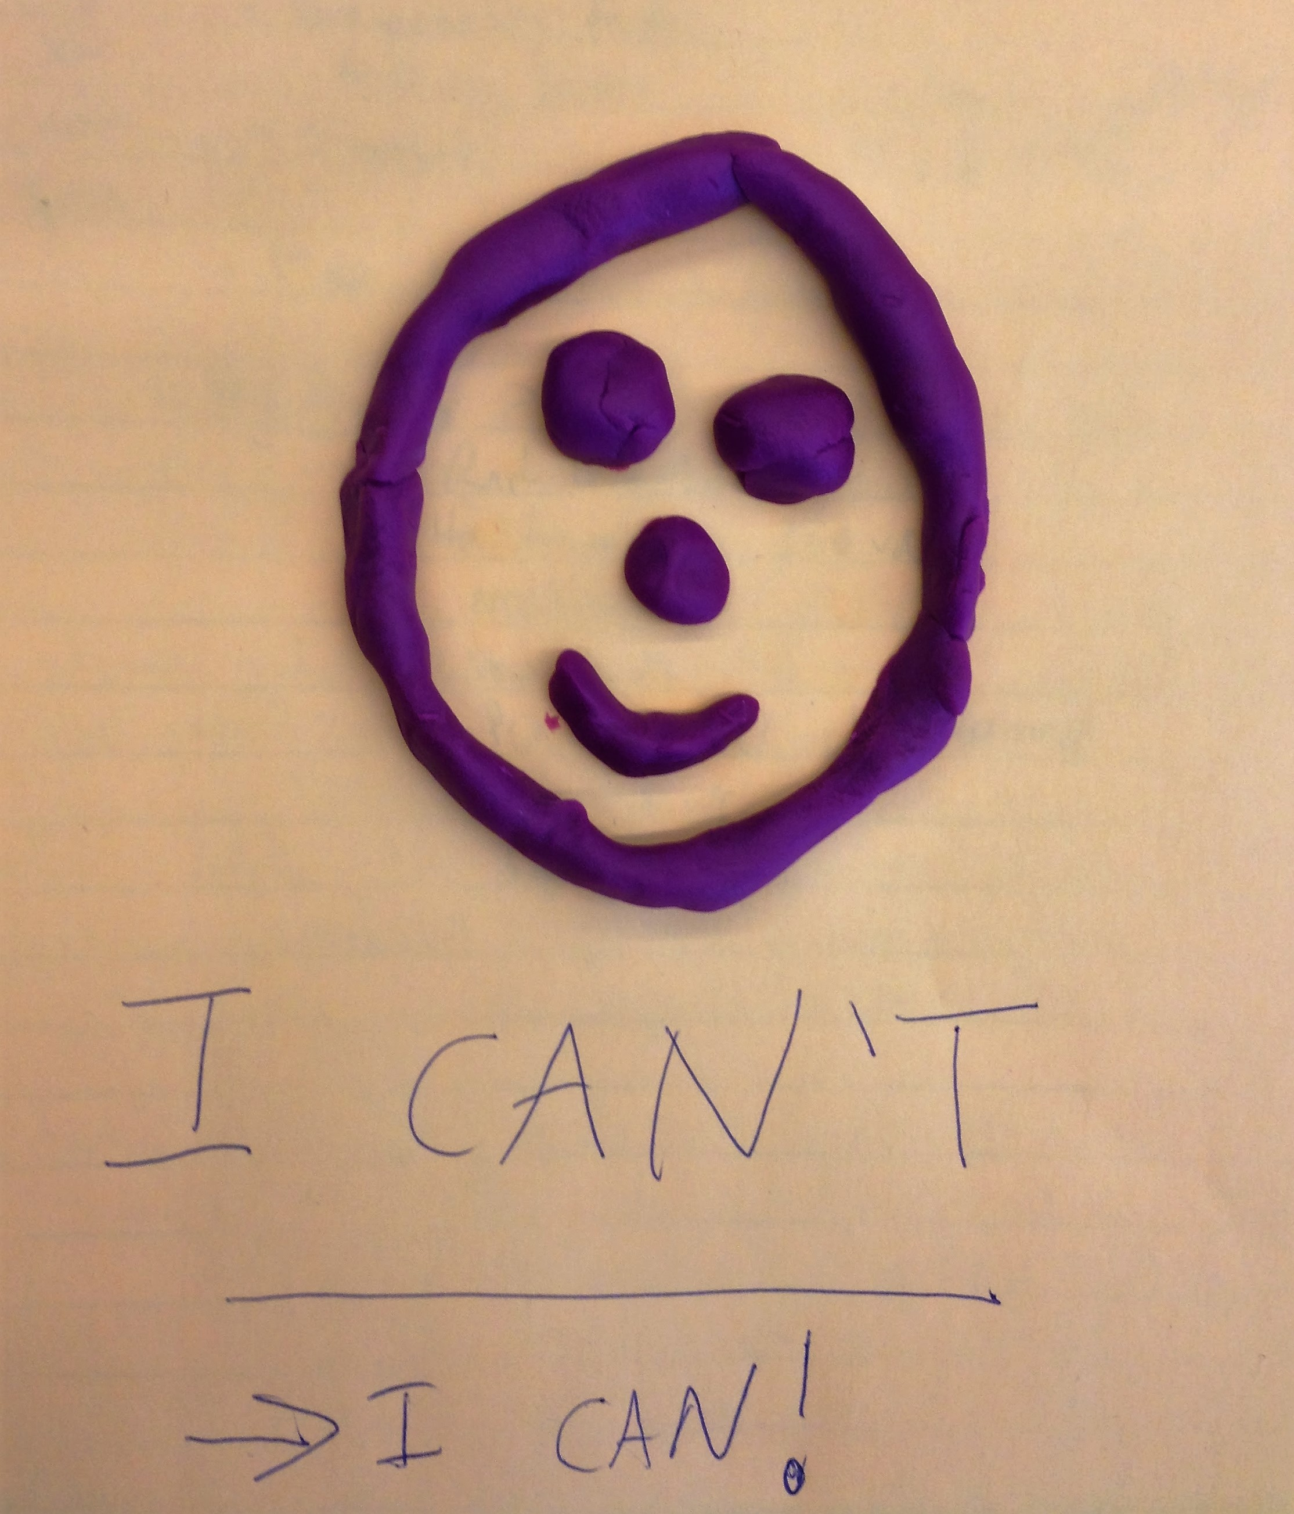
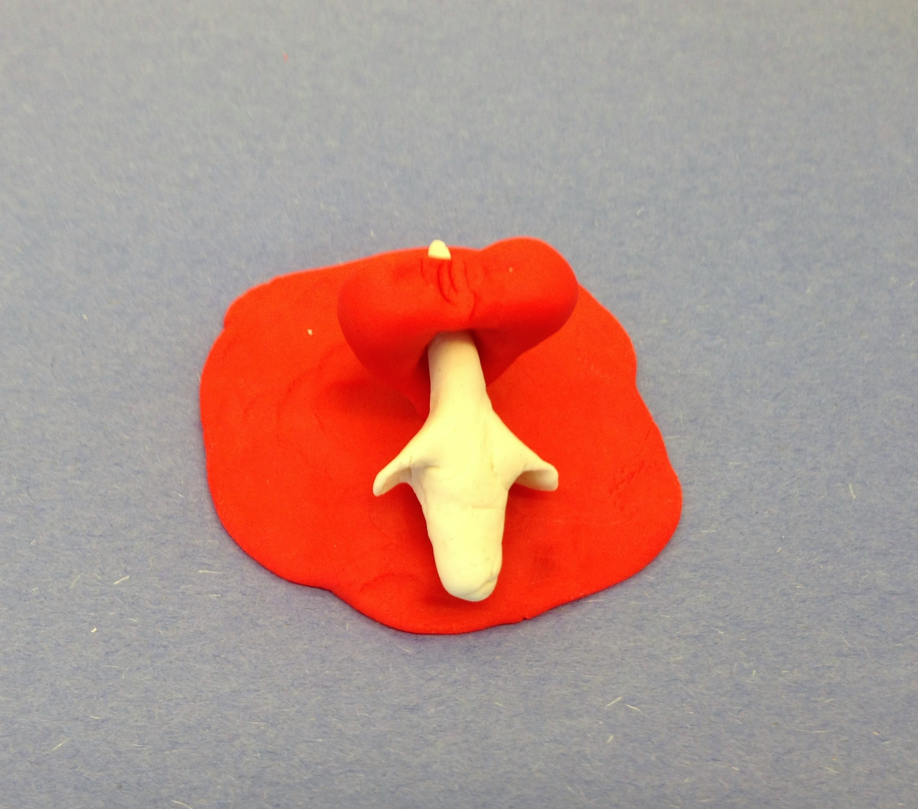
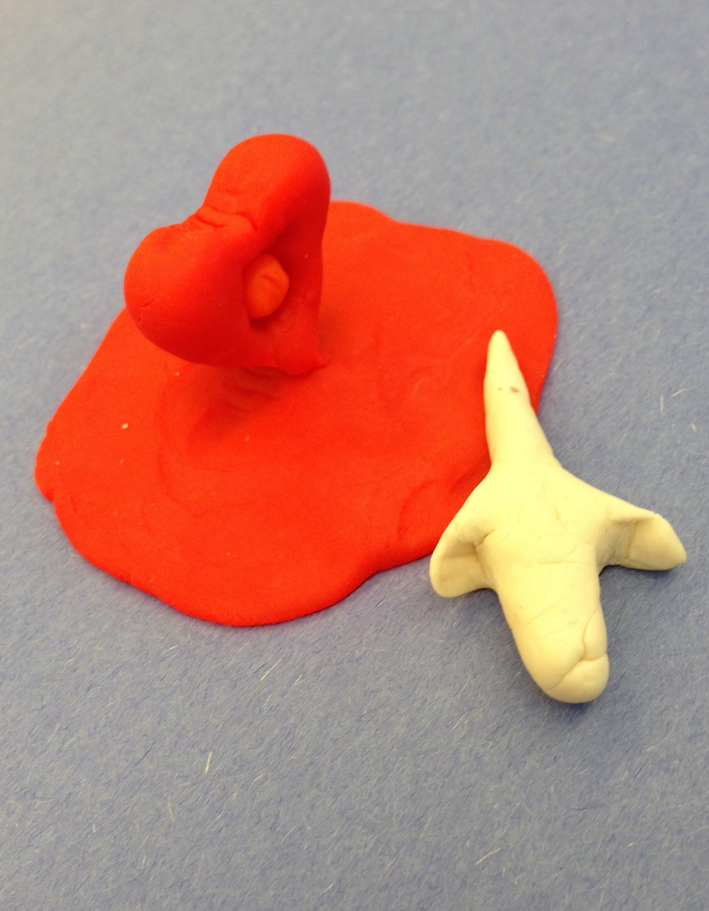
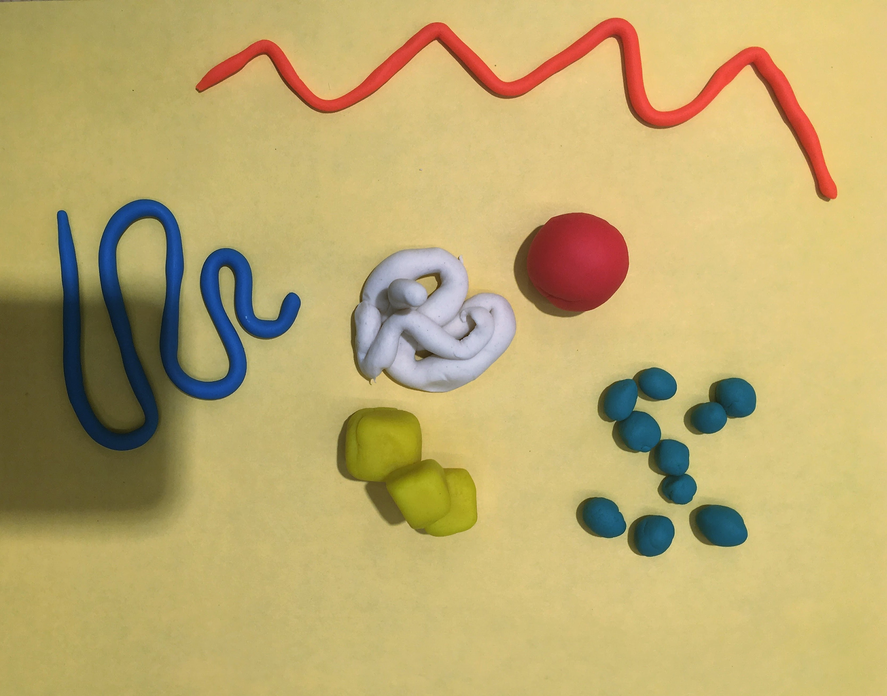
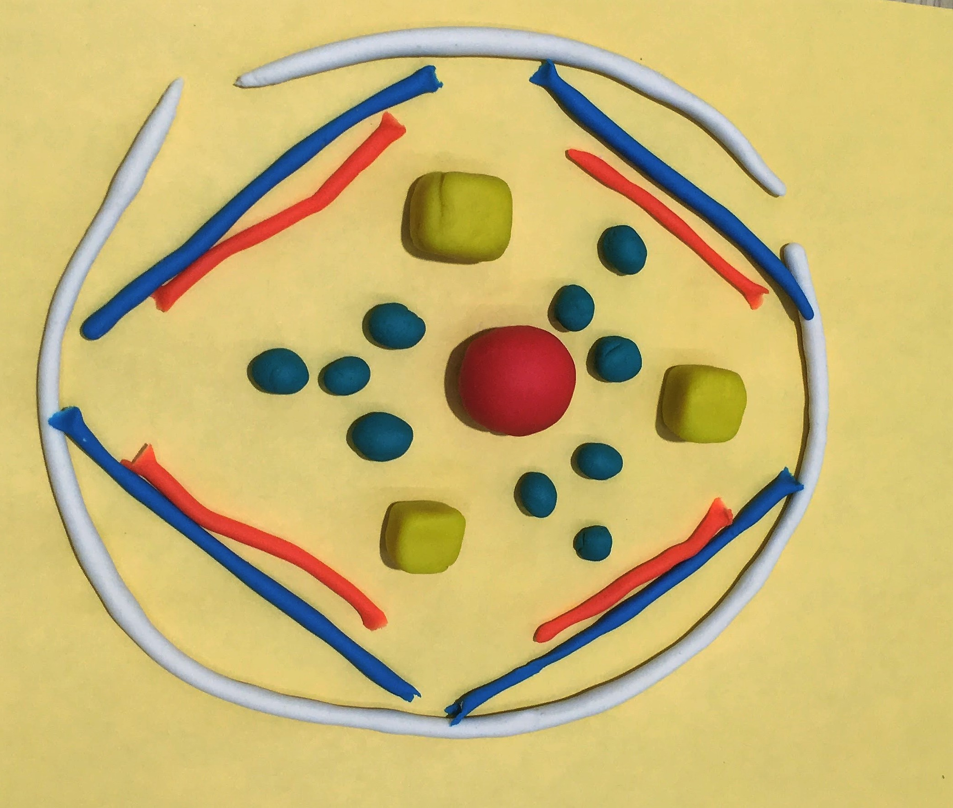
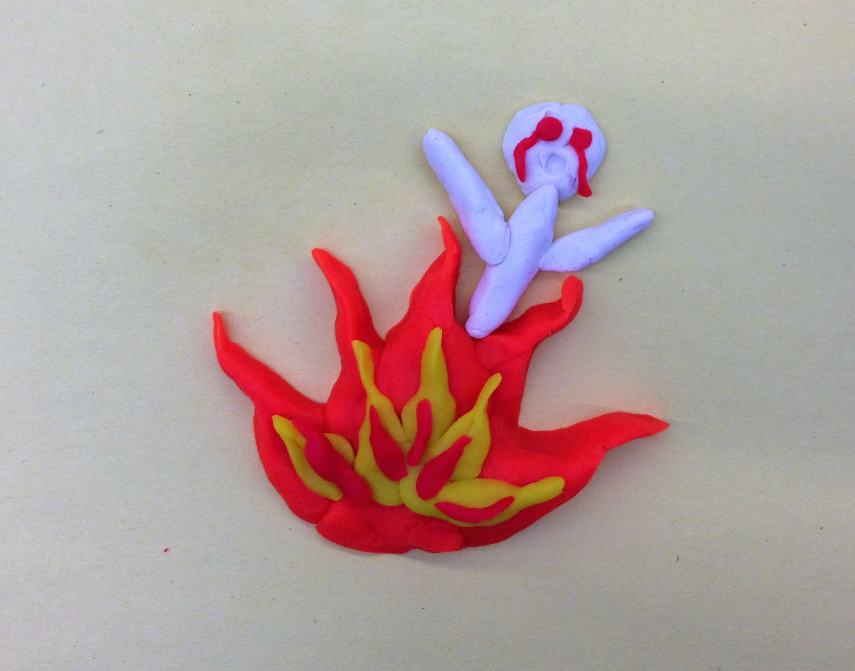
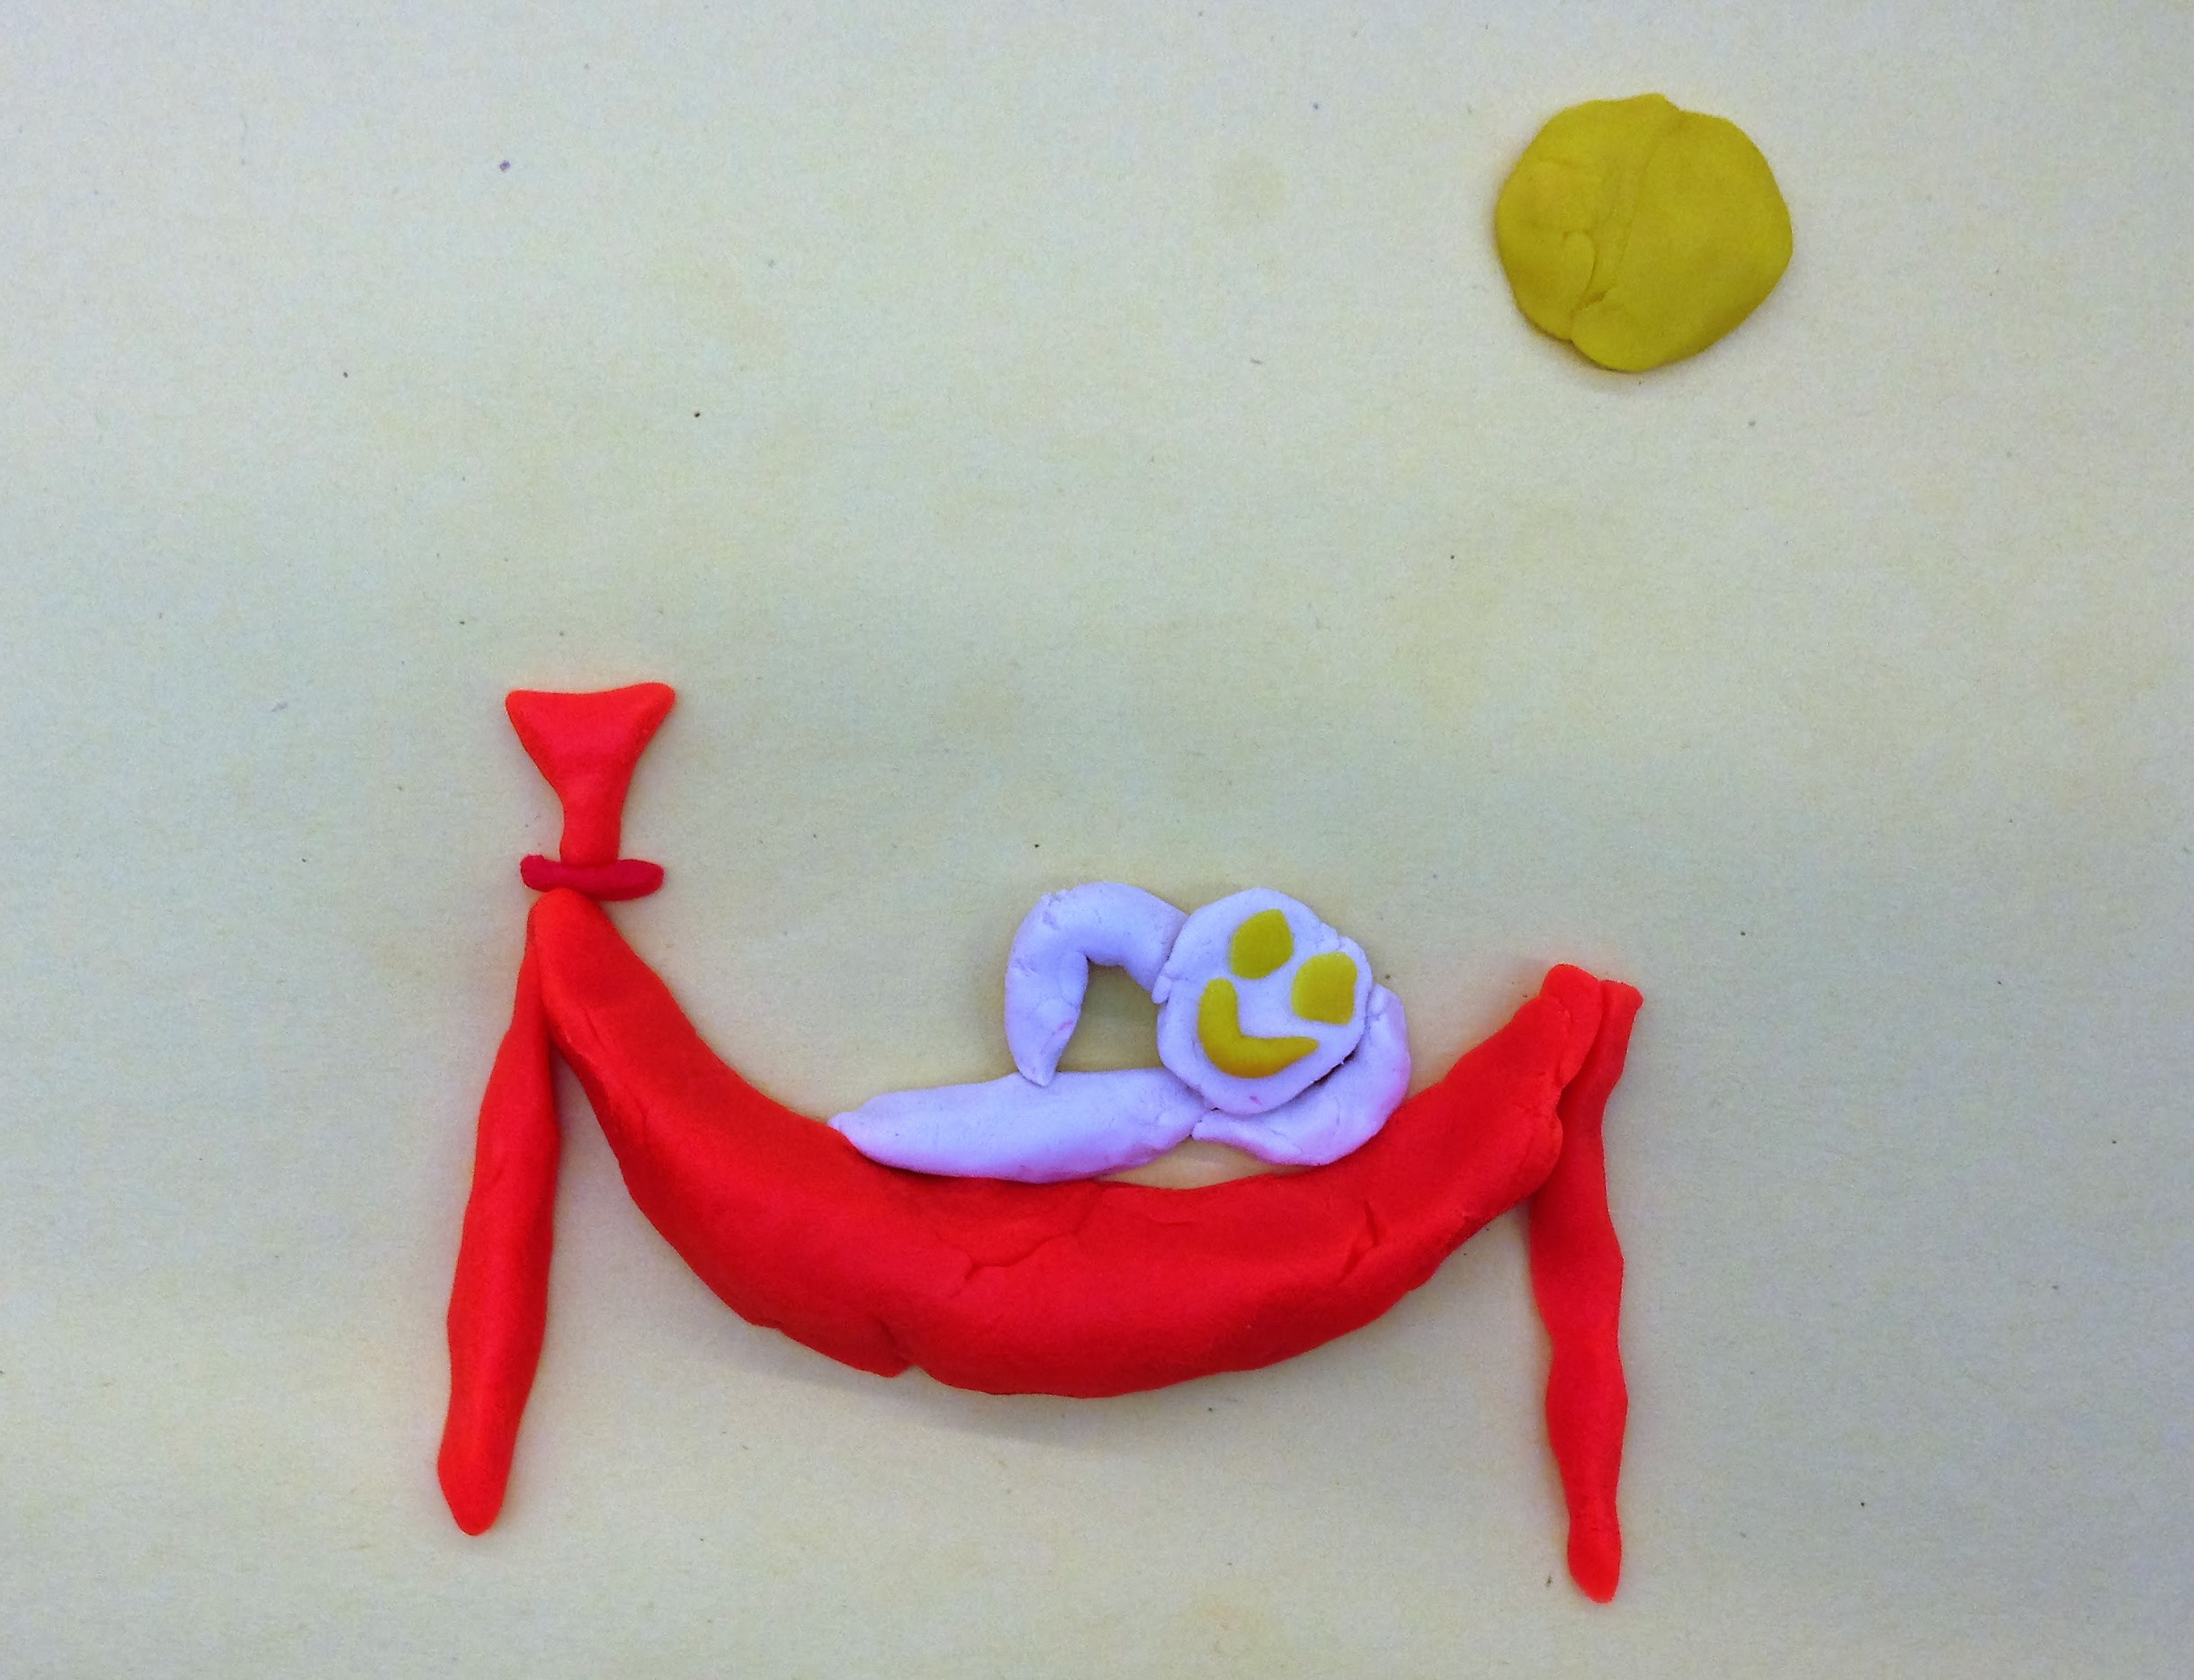
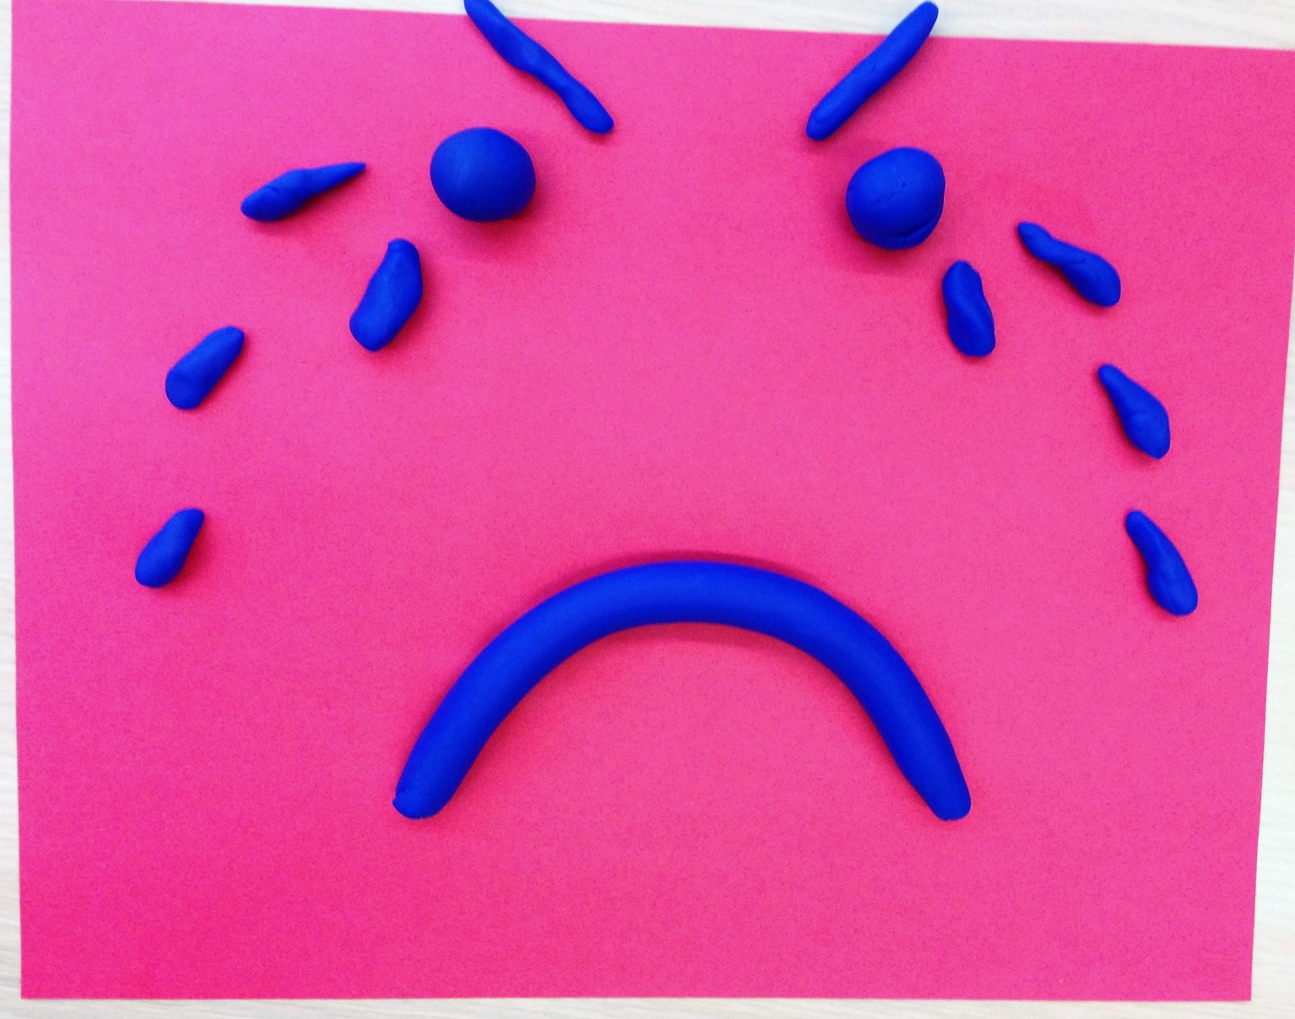
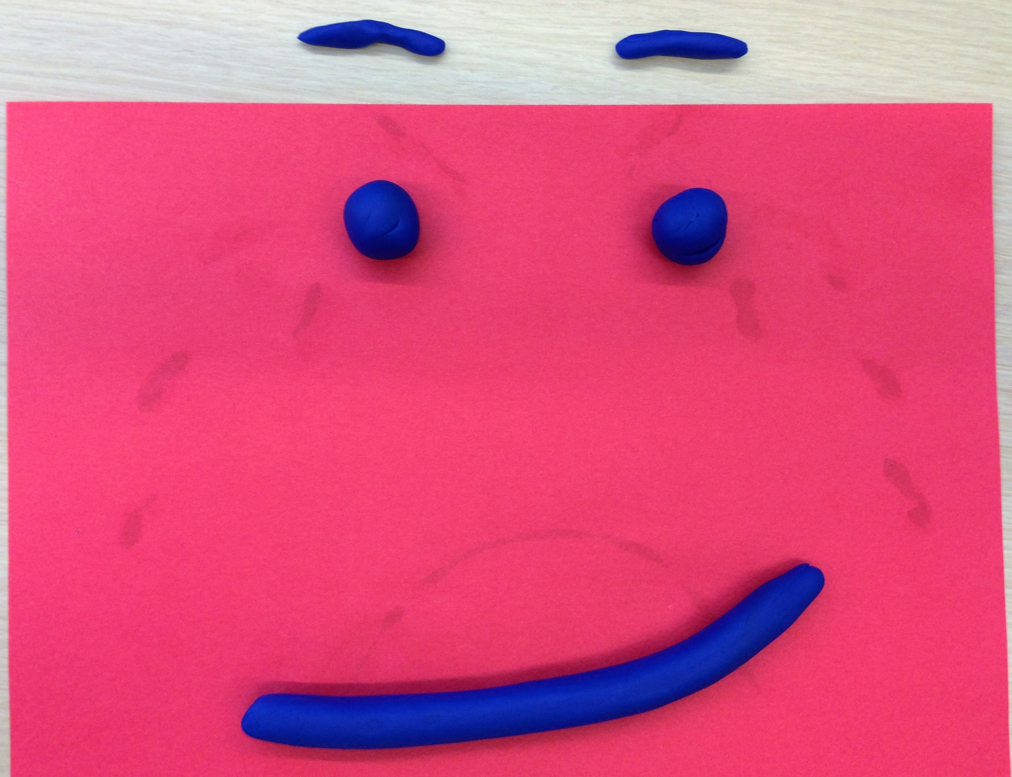
Take aways, thoughts, comments?
Notes:
Nicole

Slide 14
Contact Information:
Ashwini.KamathMulki@lvhn.org
Faculty, Lehigh Valley Family Medicine Residency
Notes:
Ashwini

