Slide 1
Nightmare management: Behavioral interventions for primary care
The 44th Forum for Behavioral Science in Family Medicine
Kathleen A. McNamara, PhD, LCSW
Mark A. Dixon, PhD, LCSW

Slide 2
The 44th Forum for Behavioral Science in Family Medicine
Please check-in to this session
You can use the QR code to the right which should also be available in written form at the entrance to the room.
You can also use this code in your app.
Self Check-In Code: RJE3E

Slide 3
The 44th Forum for Behavioral Science in Family Medicine
Disclosures
There are no financial disclosures related to this presentation.
Information, ideas, and presentation should not be construed to represent the policy or recommendations of the US Government, Department of Defense, or US Air Force

Slide 4
The 44th Forum for Behavioral Science in Family Medicine
Goals and Objectives
Summarize the relationship between sleeping, nightmares, and quality of life
Explain methods of assessing patients for nightmare disorder
Demonstrate understanding of three evidence-based psychotherapeutic approaches to managing nightmare disorder

Slide 5
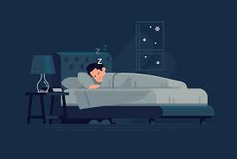
The 44th Forum for Behavioral Science in Family Medicine
Role of Sleep to Your Health (Assefa et al., 2015)
Physical restoration and healing
Boost immune functioning
Increase energy and motivation
Conserve energy
Consolidate memory
Process emotions
Notes:
Express deep desires
Practice confrontation strategies
Facing potential dangers

Slide 6
The 44th Forum for Behavioral Science in Family Medicine
Role of Dreams
We know:
???
We think:
Express deep desires
Practice confrontation strategies
Face potential dangers
Resolve unfinished emotional “business”

Slide 7
The 44th Forum for Behavioral Science in Family Medicine
What is a nightmare?
Extended, extremely dysphoric dream that usually involves efforts to avoid threats to survival, security, or physical integrity (DSM-5)
Prevalent emotion is fear
Usually occur during REM sleep
Post-traumatic nightmares
Idiopathic nightmares
Replicate traumatic event in content and/or emotions
Do not replicate a traumatic event

Slide 8
Nightmare Disorder-DSM 5 criteria
The 44th Forum for Behavioral Science in Family Medicine
Repeated occurrences of extended, extremely dysphoric, and well-remembered dreams that usually involve efforts to avoid threats to survival, security, or physical integrity and that generally occur during the second half of the major sleep episode.
On awakening from the dysphoric dreams, the individual rapidly becomes oriented and alert.
The sleep disturbance causes clinically significant distress or impairment in social, occupational, or other important areas of functioning.
The nightmare symptoms are not attributable to the physiological effects of a substance.
Coexisting mental and medical disorders do not
adequately explain the predominant complaint of
dysphoric dreams.
Acute: ≤ 1 month
Subacute: > 1 month, < 6 months
Persistent: ≥ 6 months
Mild: avg. < 1/week
Moderate: avg. 1-6/week
Severe: avg. 7/week
Notes:
Open up to group: what do you think?

Slide 9
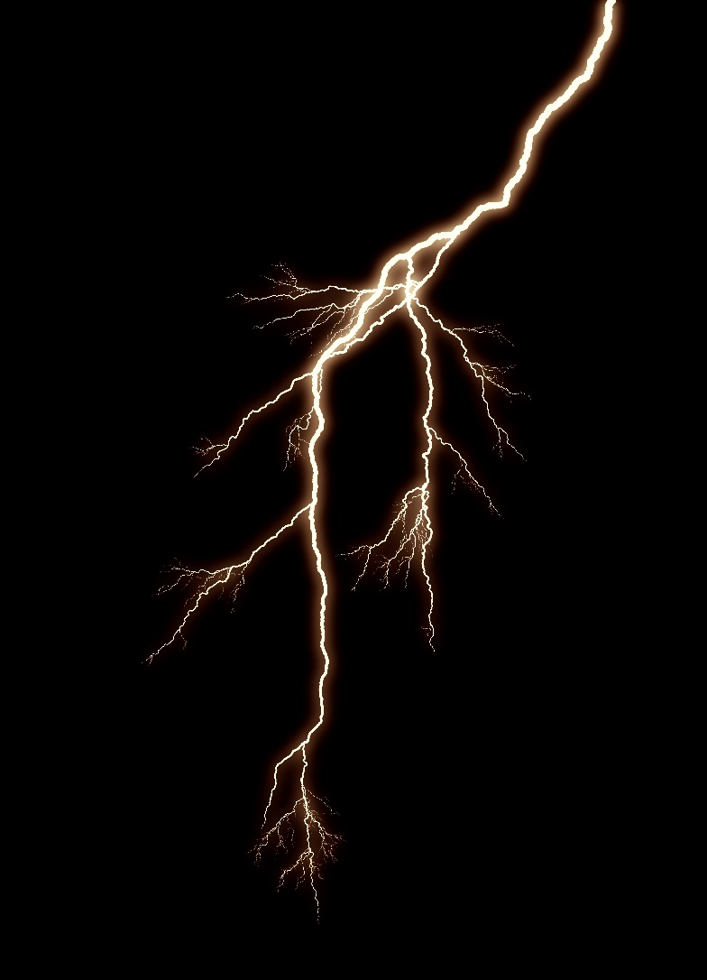
Impact of Nightmares (DSM 5-TR)
The 44th Forum for Behavioral Science in Family Medicine
Nightmare disorder is associated with heightened risk for suicide attempts
Frequent distressing nightmares can result in sleep avoidance, excessive daytime sleepiness, poor concentration, depression, anxiety, irritability
Posttraumatic nightmares lead to more severe arousal, more nocturnal awakenings, stronger aggression and more elevated helplessness than do idiopathic nightmares
Notes:
Open up to group: what do you think are common themes?

Slide 10
Impact, cont. (DSM 5-TR, 2022; Gieselmann et al., 2018)
The 44th Forum for Behavioral Science in Family Medicine
Chronic nightmares frequently constitute an independent mental disorder, sleep disorder, or co‐occurring disorder with another psychiatric condition
Prevalence of Nightmare Disorder:
7%–11% of children
16%–67% of adult psychiatric patients
4%–8% of the general adult population

Slide 11
Common Types of Dreams
The 44th Forum for Behavioral Science in Family Medicine
Notes:
From https://www.verywellmind.com/understanding-your-dreams-2795935

Slide 12
The 44th Forum for Behavioral Science in Family Medicine
Common Nightmare Themes
Women
Men
Children
Sexual harassment
Interpersonal disputes
Loved ones dying/disappearing
Health-related concerns
War/terror
Being chased
Failure or helplessness
Accidents
Being chased by frightening person, animal, or bug
Being eaten
Getting lost
Not being able to move
Aggression
Notes:
Women: underlying fear of personal violation and integrity as well as loss of relational continuity
Men: underlying fear of helplessness and inability to defend themselves or others
Children: underlying fear of helplessness in isolation and loss of self

Slide 13
Nightmare Distress (Schredl et al., 2021)
The 44th Forum for Behavioral Science in Family Medicine
Controlling for nightmare frequency, these factors are associated with nightmare distress:
Neuroticism
Strongest predictor of nightmare distress
Extraversion
Low agreeableness
Female sex
Negative beliefs about nightmares
Low education
Targeting nightmare distress has been found to be more relevant to mental health than targeting nightmare frequency (Gieselmann et al., 2018)
Notes:
Group participation
Neuroticism=emotional instability, increased likelihood to experience negative emotions, depressive mood, and difficulties to deal with everyday stressors)

Slide 14
Nightmare Distress Questionnaire (Belicki, 1992)
The 44th Forum for Behavioral Science in Family Medicine
When you awaken from a nightmare, do you find you keep thinking about it and have difficulty putting it out of your mind?
Do you ever find yourself avoiding or disliking or fearing someone because they were in your nightmare?
Are you ever afraid to fall asleep for fear of having a nightmare?
After you awaken from a nightmare, do you have difficulty falling back asleep?
Do nightmares interfere with the quality of your sleep?
Do you have difficulties coping with nightmares?
Do you feel you have a problem with nightmares?
Do nightmares affect your well-being?
Do you ever have the feeling that something which happened in your nightmare has really occurred?
Do your nightmares foretell the future?
When you have a nightmare, does it ever seem so real that when you awaken you have difficulty convincing yourself it’s “just a dream”?
In the past year, have you considered seeking professional help for your nightmares?
If a treatment were available which might help you control or stop your nightmares, how interested would you be in participating?
Never (0) Sometimes (1) Half of the time (2) Most of the time (3) Always (4)
Notes:
Measures 3 components of distress: 1) general nightmare distress 2) impact on sleep 3) impact on daily reality perception
No cut point or scoring metrics provided; rather, measure progress over time

Slide 15
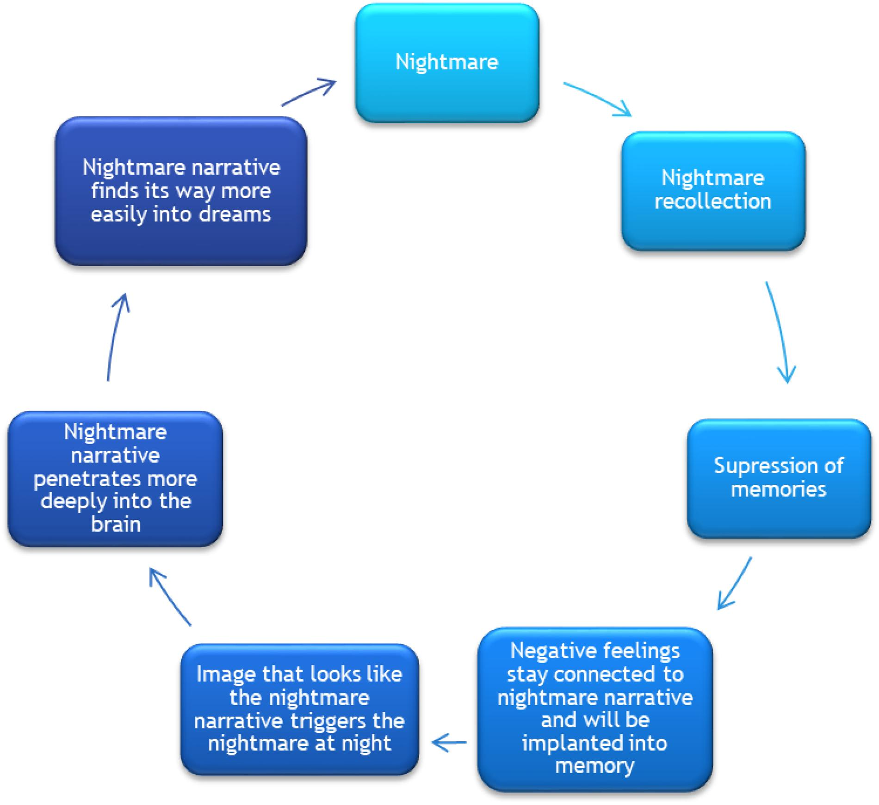
The 44th Forum for Behavioral Science in Family Medicine
Figure: Vicious cycle of nightmares
(Haeyen & Staal, 2021)

Slide 16
Imagery Rehearsal Therapy (aka Nightmare Rescripting)
The 44th Forum for Behavioral Science in Family Medicine
-CBT-inspired intervention; 6+ psychotherapy sessions; can be adapted to primary care
Write down or verbally describe the visceral details of a recurrent, distressing dream
Pay attention to the 5 senses (what you can hear, see, smell, taste, and touch) during the nightmare
Edit details of the dream (5 senses, characters, outcome, etc.), focusing on making the distressing part of the dream into something neutral or positive
Visually rehearse (aka using imagery) rehearse this new script several times throughout the day and right before bed
Write down the rescripted, non-distressing, edited dream. Keep as many elements similar as possible.
1
2
3
4
Notes:
The common treatment rationales of desensitization and exposure therapy are based on the principles of extinction and/or inhibitory learning, by which the symptoms of fear and arousal accompanying the nightmare are overridden by more adaptive behavioural, cognitive and emotional processes.
Nightmare Rescripting handout: https://2039498wfreestuff.s3.amazonaws.com/Nightmare-rescripting.pdf

Slide 17
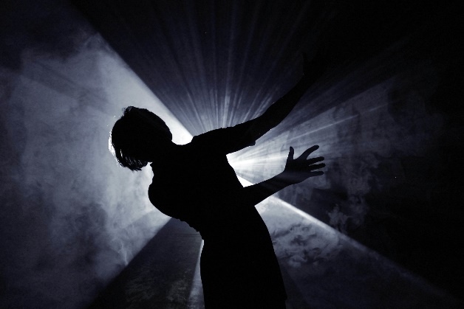
Imagery Rehearsal Therapy Example
The 44th Forum for Behavioral Science in Family Medicine
Nightmare “script”:
I’m alone in a dark room, it feels like a basement, it’s cold. There aren’t any windows. I see a bright light and a shadow, which startle me. I try to run towards some stairs in the distance but my feet are completely stuck to the ground, it’s like my legs become vaporized and I can’t move forward. I feel more and more petrified and then I wake up gasping and exhausted.
New “script”:
I’m alone in a dark room, it feels like a basement, it’s cold. There aren’t any windows. I see a shadow and quickly realize it’s a colony of koalas! They smell like eucalyptus! They’re all wearing glow-in-the-dark necklaces! It lights up the space in these cool colors. Then they start talking to me! They speak English in these cute high-pitched voices and they want to dance with me! We dance together all day!

Slide 18
Imagery Rehearsal Therapy Practice
The 44th Forum for Behavioral Science in Family Medicine
Nightmare “script”: I am in an elevator alone, it’s dark, I can feel that it’s moving but I don’t know if it’s going up or down, suddenly it stops and the doors start to open. I see my assailant there, the same person who attacked me years ago, he’s staring at me, and he starts to walk inside the elevator. I freeze in fear and then wake up gasping for air, feeling cold, sweaty, and my heart is beating out of my chest.
Rescript the above recurring nightmare with your group
Notes:
Hand out handout.

Slide 19
Desensitization and Exposure Therapy (Gieselmann et al., 2018)
The 44th Forum for Behavioral Science in Family Medicine
Teach muscle relaxation
List distressing nightmares from least to most upsetting
Vividly imagine the least distressing nightmare scenario
Use muscle relaxation techniques whenever tension arises
Continue until subjective distress significantly decreased
Continue above process with remaining distressing scenarios
Notes:
“However, one major disadvantage of desensitization and exposure therapies is that the arousal elicited during treatment may cause severe distress in the patient” (Gieselmann et al., 2018)
Can be given as homework to the pt.

Slide 20
Exposure, Relaxation and Rescripting Therapy (ERRT; Aurora et al., 2010)
The 44th Forum for Behavioral Science in Family Medicine
Combines:
Desensitization and Exposure Therapy
Nightmare Rescripting/Imagery Rehearsal Therapy
Approx. 6 psychotherapy sessions, but both elements can be adapted to primary care

Slide 21
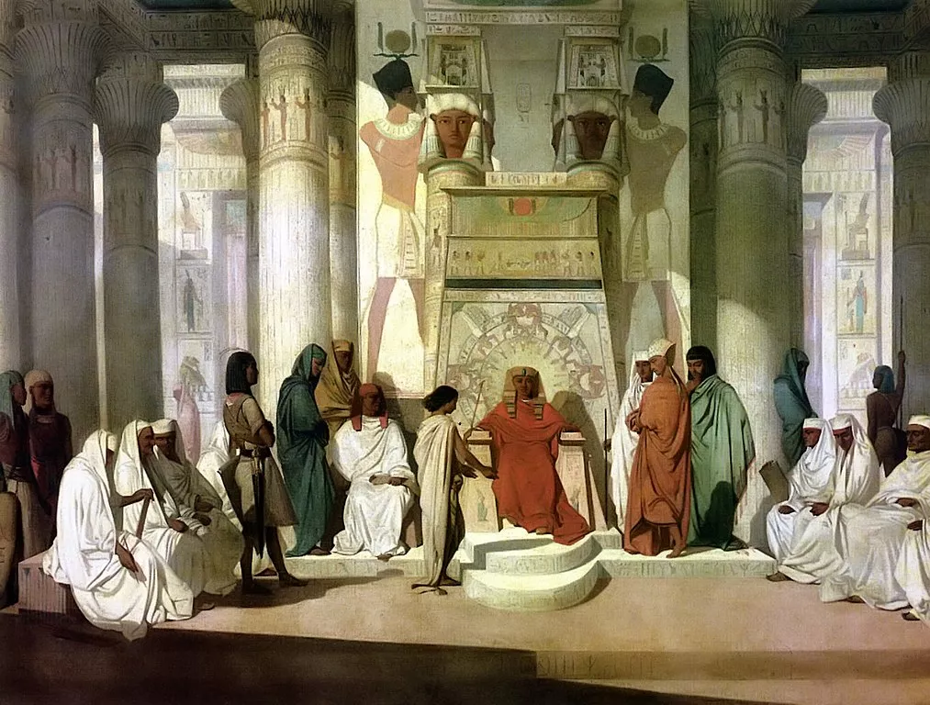
History of Dream Interpretation (Barrett, 2013)
The 44th Forum for Behavioral Science in Family Medicine
Anciently, dreams were often revelatory of future events
Heraclitus (Greek philosopher): dreams are a communication process of the individual which operates during sleep
Notes:
Jung also believed in dreams having a collective aspect in that the archetypes are universal to all people and societies. Thus he would use myths, stories from other cultures to interpret dreams.
Citation:
Barrett, D. (2023). Dream interpretation. In C. A. Kushida (Ed.), Encyclopedia of sleep and circadian rhythms, 2nd Edition (pp.181-184). Academic Press.
https://doi.org/10.1016/B978-0-12-822963-7.00346-7.
(https://www.sciencedirect.com/science/article/pii/B9780128229637003467)
Abstract: Dream interpretation during early psychoanalysis elicited associations from the patient but also involved authoritarian interpretations focused on whatever the analyst believed to be the key human drives—sex, power, transcendence, etc. Modern dream interpretation relies on non-leading questions to lead the dreamer through an associative process to discover their own meaning for the dream. Research finds that patients rate therapy sessions utilizing dreams more highly in terms of session quality, mastery, and insight gained.
Keywords: Archetype; Continuity hypothesis; Dream; Freud; Jung; Interpretation; Psychoanalysis; Psychotherapy; Symbol; Unconscious

Slide 22
History of Dream Interpretation Cont’d (Barrett, 2013)
The 44th Forum for Behavioral Science in Family Medicine
Basic dream analysis schemes stem from three models:
Freud
Thoughts of and meaning of dreams lay outside the conscious mind
Dreams are “wish-fulfillment” to protect sleeper from unsatisfied needs
Jung
Archetypes (mother, hero) based on individual experience
Compensation balances patterns of thinking v. feeling, sensing v. intuition
Adler
Dreams are a problem solving tool to prepare for waking life
“Practice” defenses and plans for future behavior
Notes:
Jung also believed in dreams having a collective aspect in that the archetypes are universal to all people and societies. Thus he would use myths, stories from other cultures to interpret dreams.
Citation:
Barrett, D. (2023). Dream interpretation. In C. A. Kushida (Ed.), Encyclopedia of sleep and circadian rhythms, 2nd Edition (pp.181-184). Academic Press.
https://doi.org/10.1016/B978-0-12-822963-7.00346-7.
(https://www.sciencedirect.com/science/article/pii/B9780128229637003467)
Abstract: Dream interpretation during early psychoanalysis elicited associations from the patient but also involved authoritarian interpretations focused on whatever the analyst believed to be the key human drives—sex, power, transcendence, etc. Modern dream interpretation relies on non-leading questions to lead the dreamer through an associative process to discover their own meaning for the dream. Research finds that patients rate therapy sessions utilizing dreams more highly in terms of session quality, mastery, and insight gained.
Keywords: Archetype; Continuity hypothesis; Dream; Freud; Jung; Interpretation; Psychoanalysis; Psychotherapy; Symbol; Unconscious

Slide 23
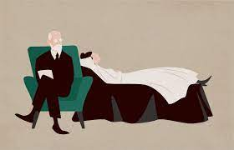
Dream Interpretation Perspectives
The 44th Forum for Behavioral Science in Family Medicine
Historical
Modern
Interpret dreams for the patient
Use of patient centric methods
“
Notes:
Ethics statement found at https://www.asdreams.org/
International Association for the Study of Dream

Slide 24
Dream Interpretation Tool
The 44th Forum for Behavioral Science in Family Medicine
Historical
Modern
Dream analysis and interpretation
Symbolic development using common interpretations
Reliance on the logic or symbolism behind the dream
Free association
Frequent use of open-ended questions
Individual examination of images and associations with events
Seek rich descriptions of what an images means to the person
Dream diaries
Notes:
Ethics statement found at https://www.asdreams.org/
International Association for the Study of Dream
“What do teeth symbolize?” vs “If I didn’t know what teeth were, how would you describe them? What are they for? Has anything happened with teeth recently?”

Slide 25
Hall and Van de Castle Coding System (1962)
The 44th Forum for Behavioral Science in Family Medicine
Physical surroundings: Settings and Objects
Characters: Persons (indiv vs group) and Animals
Social interactions: Aggressive (8), Friendly (7), Sexual (5)
Activities: Communication, Thinking, Physical Activities
Achievement outcomes: Success, Failure
Environmental press: Misfortune, Good Fortune
Emotions: Anger, Apprehension, Happiness, Sadness, Confusion
Descriptive elements: Modifiers (e.g. size, velocity, etc.), Temporal scale
Theoretical scales: Castration Anxiety, Oral Incorporations
(Schredl, 2010)
Notes:
Hall and Van de Castle (1962) found dreams are more often negative than pleasurable and developed a coding system based off Freudian thought. Dreams were interpreted to protect sleep and do not necessarily reveal subconscious parts of our psyche.
Image from https://science.howstuffworks.com/life/inside-the-mind/human-brain/what-does-it-mean-when-dream-about-someone.htm

Slide 26
Structural Dream Analysis (Roesler, 2020)
The 44th Forum for Behavioral Science in Family Medicine
Meaning in not found in symbols and elements
Core to interpretation is the relationship between elements and the course of action taken in the dream (i.e. the structure)
Types of dreams based on structure and ego strength
No dream ego present—observation of a scene
Threat to dream ego—feelings of powerlessness or attempt to escape
Performance requirement—may not have the right tools/skills
Mobility dream—moving towards a destination (specific or unclear)
Social interaction—making contact and communication with people or figures
Support of continuity hypothesis that dreams are an extension of some elements of waking life

Slide 27
Ethics of Dream Interpretation
The 44th Forum for Behavioral Science in Family Medicine
“Ethical dreamwork helps the dreamer work with his/her own dream images, feelings, and associations, and guides the dreamer to more fully experience, appreciate, and understand the dream.”
ASD Ethics Statement

Slide 28
References
The 44th Forum for Behavioral Science in Family Medicine
Assefa, S. Z., Diaz-Abad, M., Wickwire, E. M., & Scharf, S. M. (2015). The Functions of Sleep. AIMS Neuroscience, 2(3), 155-171. https://doi.org/10.3934/Neuroscience.2015.3.155
Aurora, R. N., Zak, R. S., Auerbach, S. H., Casey, K. R., Chowdhuri, S., Karippot, A., Maganti, R. K., Ramar, K., Kristo, D. A., Bista, S. R., Lamm, C. I., Morgenthaler, T. I., & Tracy, S. L. (2010). Best practice guide for the treatment of nightmare disorder in adults. Journal of Clinical Sleep Medicine, 6(4), 389–401. https://doi.org/10.5664/jcsm.27883
Barrett, D. (2023). Dream interpretation. In C. A. Kushida (Ed.), Encyclopedia of sleep and circadian rhythms, 2nd Edition (pp.181-184). Academic Press.
Belicki, K. (1992). Nightmare frequency versus nightmare distress: Relations to psychopathology and cognitive style. Journal of Abnormal Psychology, 101, 592–597. https://doi. org/10.1037/0021-843x.101.3.592
Diagnostic and statistical manual of mental disorders : DSM-5-TR (5th edition, text revision.). (2022). American Psychiatric Association Publishing.
Gieselmann, Ait Aoudia, M., Carr, M., Germain, A., Gorzka, R., Holzinger, B., Kleim, B., Krakow, B., Kunze, A. ., Lancee, J., Nadorff, M. ., Nielsen, T., Riemann, D., Sandahl, H., Schlarb, A., Schmid, C., Schredl, M., Spoormaker, V. ., Steil, R., … Pietrowsky, R. (2019). Aetiology and treatment of nightmare disorder: State of the art and future perspectives. Journal of Sleep Research, 28(4), e12820–n/a. https://doi.org/10.1111/jsr.12820
Haeyen, & Staal, M. (2021). Imagery Rehearsal Based Art Therapy: Treatment of Post-traumatic Nightmares in Art Therapy. Frontiers in Psychology, 11, 628717–628717. https://doi.org/10.3389/fpsyg.2020.628717
Roesler, C. (2020). Jungian theory of dreaming and contemporary dream research–findings from the research project ‘Structural Dream Analysis’. Journal of Analytical Psychology, 65(1), 44-62.
Schredl, M. (2010). Dream content analysis: Basic principles. International Journal of Dream Research, 3(1), 65-73.
Schredl, M., Schramm, F., Valli, K., Mueller, E. M., & Sandman, N. (2021). Nightmare distress questionnaire: Associated factors. Journal of Clinical Sleep Medicine, 17(1), 61–67. https://doi.org/10.5664/JCSM.8824

Slide 29
The 44th Forum for Behavioral Science in Family Medicine
Session Evaluation Link
Session Evaluation Link
Please complete an evaluation of this session. There is a direct link in your conference app. You can also use this QR code.

Slide 30
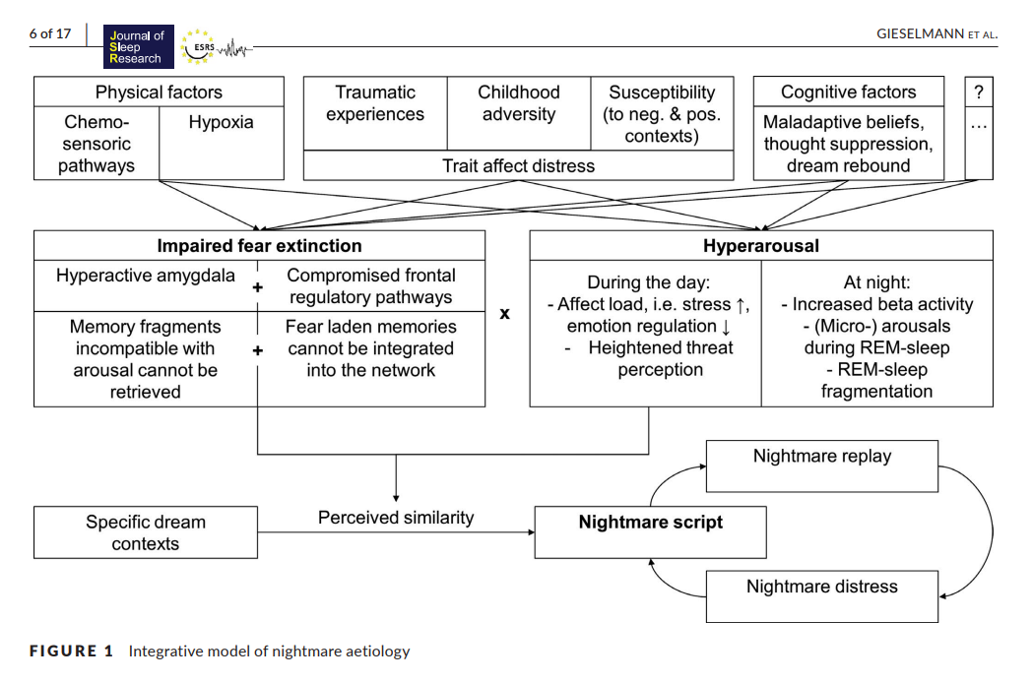
The 44th Forum for Behavioral Science in Family Medicine
Gieselmann et al., 2018
Notes:
Gieselmann et al., 2018

