Slide 1
Easing the Load of Precepting: Efficiently Integrating Students into Ambulatory Training Sites
an Update on Tactic 3 of the Preceptor Expansion Initiative
Vince WinklerPrins, MD, FAAFP
Emily Walters, BA
Notes:
A cross-disciplinary initiative

Slide 2
DISCLOSURES
No disclosures to declare.

Slide 3
Learning Objectives
Following this presentation, participants will be able to:
Use standardized onboarding materials to reduce the administrative burden for preceptors at ambulatory clinical rotation sites
Identify tools to enhance student preparedness for ambulatory clinical rotations
Implement strategies to increase student value to practices at clinical training sites
Notes:
VW

Slide 4
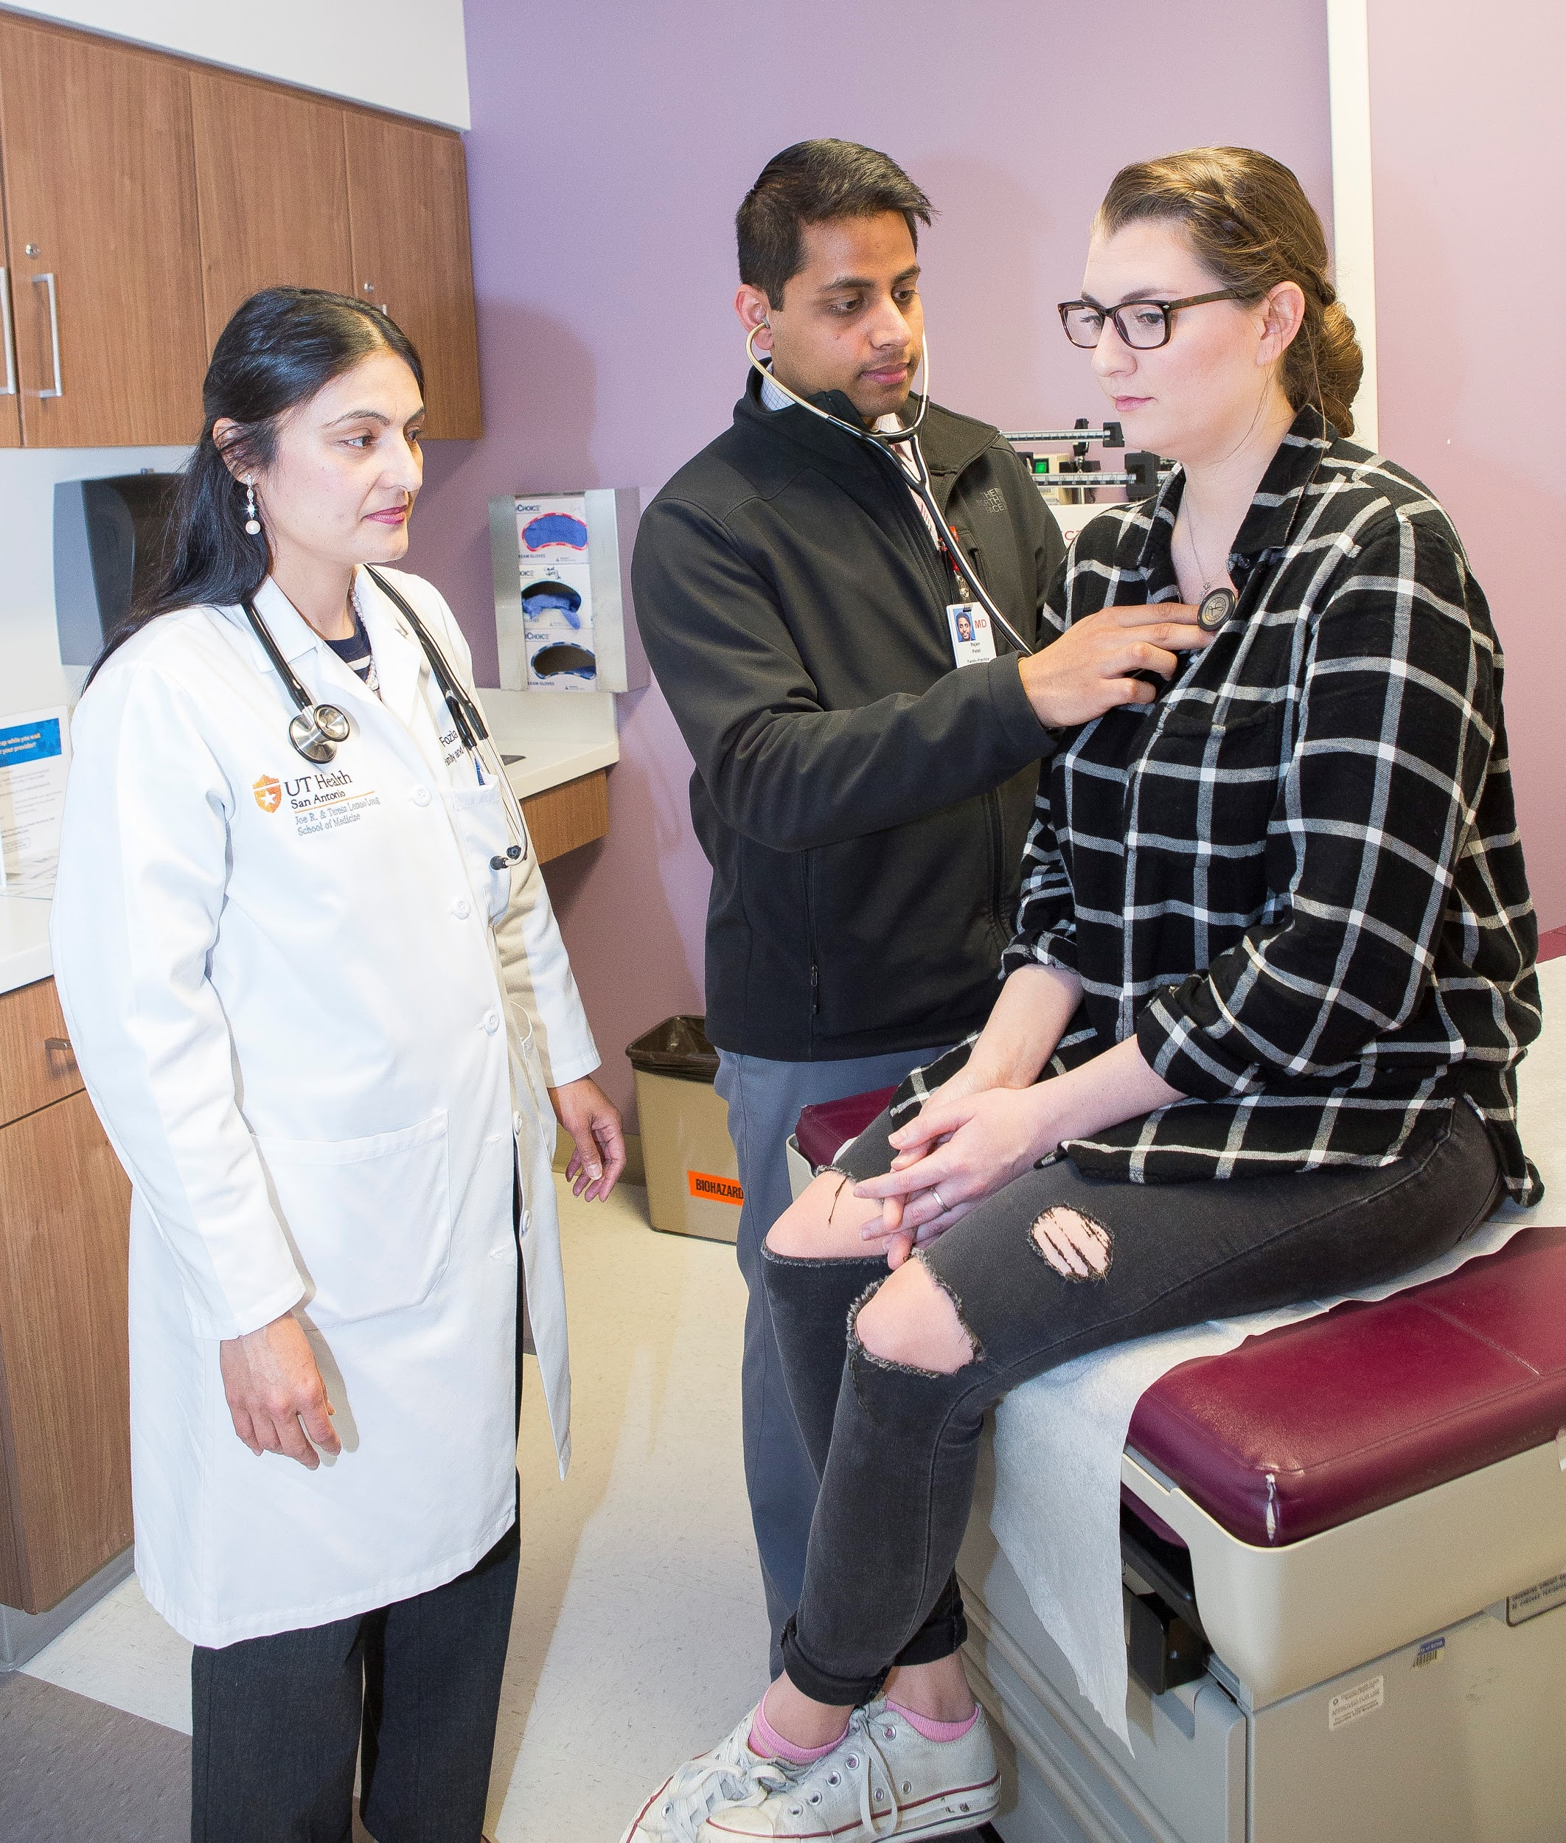
Preceptor Recruitment and Retention Challenges
More demand—MD, DO, NP, PA & pharmacy—new and expanded programs.
Fewer private practice sites + more salaries positions + more group practices=less control—need to get past the practice manager to get in
Intense competition for clinical space and computers—MAs, scribes, other learners.
EHRs, productivity pressures and burnout woes
Notes:
VW
Growth of number of training programs and class sizes
More clinical education of healthcare learners sites with intense competition for space—MAs/scribes/other learners
The work of the programs increasingly concerns recruitment/retention of preceptors.
Many health care training entities have weak systems to provide clinical training and put the onus on students to find training sites

Slide 5
Primary Care Community Preceptor Summit August 2016
Notes:
VW

Slide 6
Preceptor Expansion Initiative Action Plan
Aims:
Decrease % of primary care clerkship directors who report difficulty finding clinical preceptor sites
Increase % of students completing clerkships at high-functioning sites
Oversight Committee
Tactic 1
Tactic 5
Tactic 4
Tactic 2
Tactic 3

Slide 7
Preceptor Expansion Initiative
Tactic 1: Work with CMS to revise student documentation guidelines
Tactic 2: Integrate interprofessional interdisciplinary education into ambulatory primary care settings through integrated clinical clerkships
Tactic 3: Develop standardized onboarding process for students and preceptors. Integrate students into the work of ambulatory primary care settings in useful and authentic ways
Tactic 4: Develop educational collaboratives across departments, specialties, professions, and institutions to improve administrative efficiencies
Tactic 5: Promote productivity incentive plans that include teaching and develop a culture of teaching in clinical settings
https://stfm.org/preceptorexpansion
Notes:
Click and go to website from slide

Slide 8
Tactic 3 Deliverables— Resources for Preceptors and Programs
Promotion of AAMC “Recommendations for Clinical Skills Curricula for Undergraduate Medical Education”
Promotion of “AAMC Uniform Clinical Training Affiliation Agreement”
CV assistance in the faculty appointment process
Online module on Giving Feedback (30-minutes)
Notes:
Click on links in slide
QJ (modules, videos, readings, quizzings) cost associated ($99)-- faculty development (preceptor development)

Slide 9
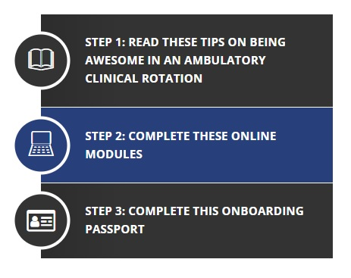
Tactic 3 Deliverables—Resources for Students
Student Passport for Clinical Sites
Learner Resources
"How to Be Awesome in an Ambulatory Clinic Rotation”
Online student training modules
https://www.stfm.org/clerkshiponboarding
Notes:
These will be piloted as part of Tactic 4 (https://stfm.org/about/keyinitiatives/preceptorexpansion/buildingbettercollaborativespilot/)
Click and go to website from slide

Slide 10
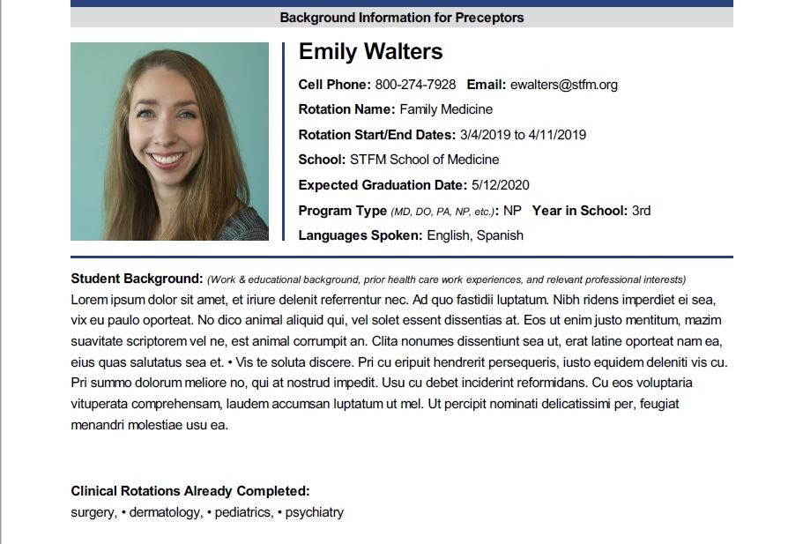
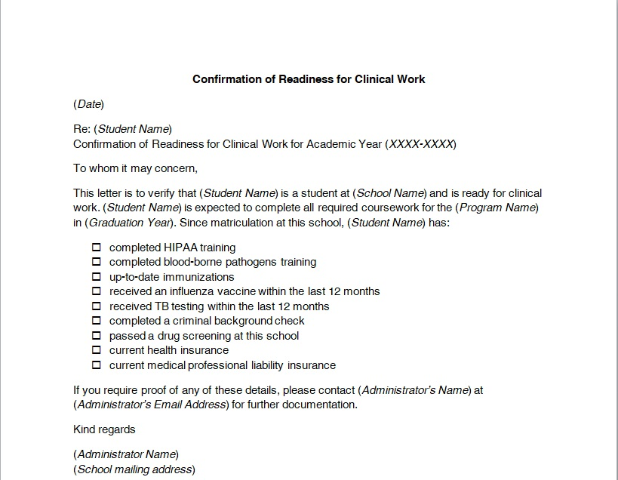
Student Clinical Rotation Passport
Aims to reduce administrative burden on clinical sites
Web-based form to be completed by student
Includes student information
demographics
rotation details
emergency contact info
verification of completion of trainings & other clinical setting requirements
Notes:
QJ: (student access only)
can be downloaded in PDF/word- (passport not editable)--
includes important student information: demographics, previous experiences, procedures the student is comfortable with, rotation details, ensure the student has completed the recommended readings/modules, and includes verification from the educational program that the student has completed appropriate trainings such as: HIPAA, BBP, immunizations, background check, drug screening, etc.
The passport is a document that is useful for both the preceptor and the administrators at the clinical rotation site office. It introduces the student to the preceptor by describing the student's background and clerkship goals, while also serving as a very brief HR onboarding document with details like emergency contact details and evidence that the student is ready for clinical work.

Slide 11
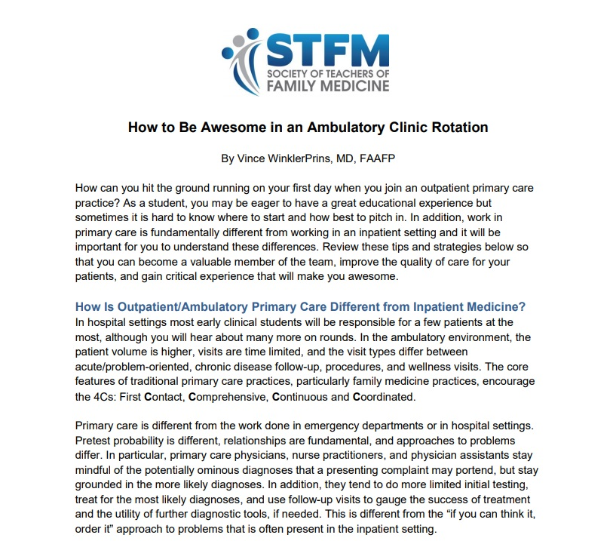
Student Onboarding Resources – Tips for Students
“How to Be Awesome in an Ambulatory Clinic Rotation”—practical outpatient strategies
Presenting patient visits
Chronic disease follow-up
Wellness visits
Focused physicals
Tips for maximizing learning each day
https://www.stfm.org/teachingresources/resourcesfor/students/clinicalrotationtipsforstudents/
Notes:
QJ: How to Be Awesome: written by Vince WinklerPrins
highlights differences between working in inpatient settings and ambulatory care, describes core features of primary care practice, and outlines specific strategies for interacting in the clinical settings (presentations using SNAPPS model, describes wellcare and chronic care, utilizing USPSTF guidelines, and highlights a number of other ways the student can promote their own learning, be helpful to the preceptor, and contribute positively to patient care).

Slide 12
Student Resources - Online Training Modules
Modules to prep for clinical rotations
Writing a High-Quality Note in the Electronic Medical Record
How to Perform Medication Reconciliation
Motivational Interviewing: a Structured Approach to Behavioral Change
https://www.stfm.org/teachingresources/resourcesfor/students/student-onboarding#8537
Notes:
QJ: free on website, faculty can access (for students)
Our tactic team has also developed 3 brief online training modules which are educational for students and also help integrate them in the clinic in a more meaningful. Each module is brief (~15 minutes) and focuses on topics - writing a high-quality billable note, med rec, MI.
goal is to complete all 3 modules prior to starting clinical rotations

Slide 13
Clerkship Onboarding Tools: https://www.stfm.org/clerkshiponboarding

Slide 14
Tactic 4: Develop educational collaboratives across departments, specialties, professions, and institutions to improve administrative efficiencies
A multi-year pilot, funded by the ABFM, called Building Better Clinical Training Experiences: A Learning Collaborative.
Pilot participants chose one of three projects to standardize the onboarding of students and to engage community preceptors.
Will evaluate the onboarding materials developed by the Tactic 3 and Tactic 5 teams.
Notes:
EW:
15 collaboratives, with family medicine departments as their core, were selected for each of the three projects through a competitive application process. Preference was given to departments collaborating with two or more other specialties/departments/professions. From 2019 - 2020, departments and their collaborators will test the materials and processes being developed as part of Tactic 3, as well as recognition and incentive programs being developed as part of Tactic 5. The teams will participate in online and in-person learning communities to share/learn about intervention approaches; conduct standardized pre/post measurement; and disseminate their findings.
Status: Testing of the materials began in May/June 2019. Pilot participants will meet to share and learn from each at the end of October 2019. All projects will wrap up by September 2020.

Slide 15
Building Better Clinical Training Experiences: Pilot Sites
Project 1: Student onboarding
1. Advent Health Medical Group Family Medicine
2. North Carolina Area Health Education Centers
3. University of North Texas Health Science Center
Project 2: Preceptor engagement and onboarding
1. Ohio State University
2. Ohio University Heritage College of Osteopathic Medicine
3. University of Washington School of Medicine
Project 3: Student onboarding and Preceptor engagement and onboarding
1. Hackensack Meridian School of Medicine
2. Keck School of Medicine at USC
3. Louisiana State University- New Orleans
4. Morehouse School of Medicine
5. Rush Medical College
6. Stanford University
7. University of Alabama
8. University of Illinois- Peoria
9. University of Minnesota
Notes:
EW family medicine departments are the core of each pilot educational collaborative, with 1-3 other specialties/departments/professions

Slide 16
Building Better Clinical Training Experiences: Pilot Sites
Project 1: Student onboarding
1. Advent Health Medical Group Family Medicine
2. North Carolina Area Health Education Centers
3. University of North Texas Health Science Center
Project 2: Preceptor engagement and onboarding
1. Ohio State University
2. Ohio University Heritage College of Osteopathic Medicine
3. University of Washington School of Medicine
Project 3: Student onboarding and Preceptor engagement and onboarding
1. Hackensack Meridian School of Medicine
2. Keck School of Medicine at USC
3. Louisiana State University- New Orleans
4. Morehouse School of Medicine
5. Rush Medical College
6. Stanford University
7. University of Alabama
8. University of Illinois- Peoria
9. University of Minnesota
Notes:
EW family medicine departments are the core of each pilot educational collaborative, with 1-3 other specialties/departments/professions

Slide 17
Building Better Clinical Training Experiences: Pilot Timeline
2019
Mid-March: Sites Announced
April 26-May 17: Pre-survey for Clerkship/Rotation Directors and Coordinators
October 24-25: Learning Collaborative meeting in Kansas City
Ongoing 2019-2020: Site visits by evaluation team/tactic team
2020
April-August: Post-survey for clerkship/rotation directors, coordinators and preceptors
September: Pilot projects complete
October: Post measurement data due
Notes:
EW

Slide 18
Building Better Clinical Training Experiences: Pilot Timeline
2019
Mid-March: Sites Announced
April 26-May 17: Pre-survey for Clerkship/Rotation Directors and Coordinators
October 24-25: Learning Collaborative meeting in Kansas City
Ongoing 2019-2020: Site visits by evaluation team/tactic team
2020
April-August: Post-survey for clerkship/rotation directors, coordinators and preceptors
September: Pilot projects complete
October: Post measurement data due
Notes:
EW

Slide 19
Building Better Clinical Training Experiences pilot projects: https://stfm.org/bettertrainingexperiences

Slide 20
Frequently Asked Questions
Is there a way to track whether students have completed the modules?
Students can download a certificate of completion for each module.
Can faculty or preceptors access the student modules?
Yes, anyone can take the modules.
Can a student update their student passport as they continue to gain rotation and procedural experience throughout the year?
Yes, using their online account!
Can a school edit or modify the content of the student passport?
No, the goal is for preceptors to get the same information with every student.
Notes:
EW
Is there a way to track whether students have completed the modules?
After a student has completed the module, he or she can download a certificate of completion for each module.
Can faculty or preceptors access the student modules?
Yes, these modules are freely available to anyone who wants to take them.
Can a student update their student passport as they continue to gain rotation and procedural experience throughout the year?
Yes! The student passport is created online with a unique student account for this reason.
Can a school edit or modify the content of the student passport?
No, the goal is for institutions to use the same standardized passport so that a community preceptor gets the same information with every student.

Slide 21
Initial Student Usage Data (April 2019 – January 2020)
909 students have used the Student Passport
2284 unique page-views for the "How to Be Awesome in an Ambulatory Clinical Rotation" web page
Student Onboarding Module completions
944 of "How to Write a High-Quality Note in the Electronic Medical Record"
915 of "How to Perform Medication Reconciliation"
902 of "Motivational Interviewing: a Structured Approach to Behavioral Change"
Notes:
EW
most of the data is from 3rd year med students
About 5% PA students
3.5% pharmacy students

Slide 22
Initial Student Usage Data (April 2019 – January 2020)
909 students have used the Student Passport
2284 unique page-views for the "How to Be Awesome in an Ambulatory Clinical Rotation" page
Student Onboarding Module completions
944 of "How to Write a High-Quality Note in the Electronic Medical Record"
915 of "How to Perform Medication Reconciliation"
902 of "Motivational Interviewing: a Structured Approach to Behavioral Change"
Notes:
EW
most of the data is from 3rd year med students
About 5% PA students
3.5% pharmacy students

Slide 23
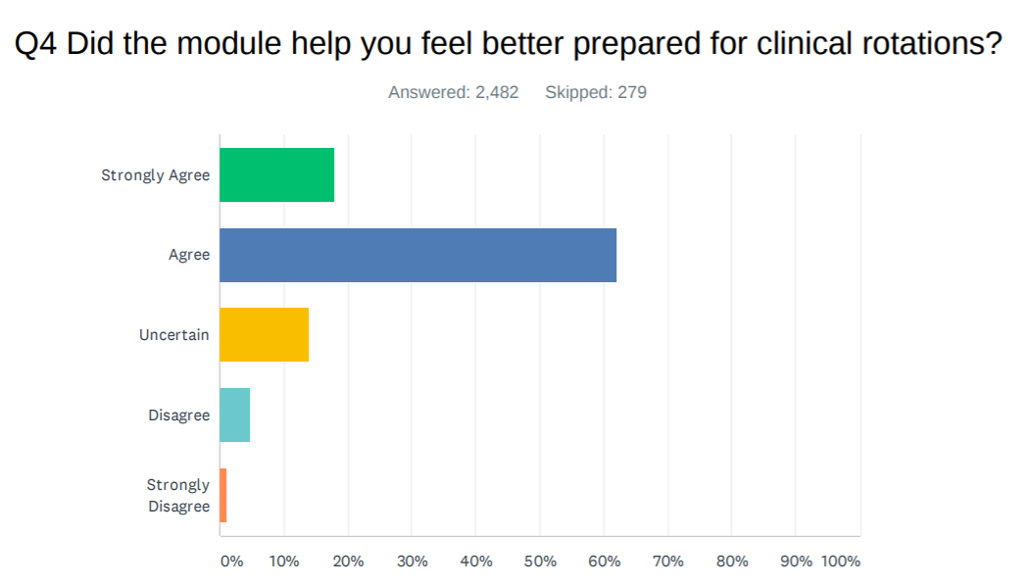
Student Module Survey Data (April 2019 – January 2020)
Notes:
EW
18% Strongly Agree
62% Agree
= 80% agree

Slide 24
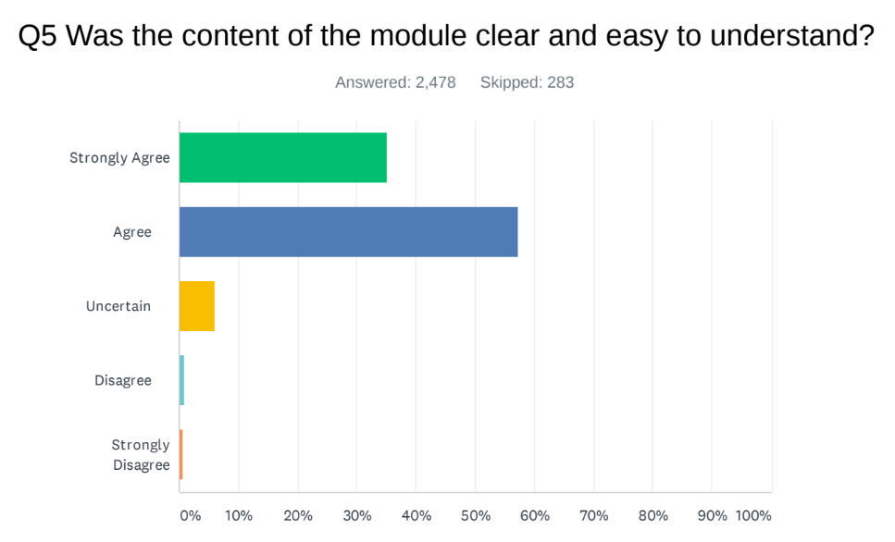
Student Module Survey Data (April 2019 – January 2020)
Notes:
EW
35% strongly agree
57% agree
=92% total agree or strongly agree

Slide 25
Student Comments: “What is one thing you will change or a strategy you will implement as a result of taking this module?”
High Quality Note in the EMR module:
“I will be making my notes more concise. My notes are like paragraphs or essays. This module made me realize how I could be more succinct. I will also be more directed in my questioning with relation to the disease on f/u pts. Rather than asking all ROS”
“Focused history does not necessarily mean shorter, it is just more focused on pertinent information.”
Medication Reconciliation module:
“Summarize the new medication regimen with the patient so they fully understand changes and what they need to do moving forward.”
“I will use the strategy of being exceptionally clear in which medications to START, MODIFY, and STOP when performing medication reconciliation.”
Motivational Interviewing module:
“Be more empathetic about helping patients achieve goals.”
“Think of change as a dynamic process that occurs over several office visits, not just in one sitting.”

Slide 26
Clerkship Onboarding Tools: https://www.stfm.org/clerkshiponboarding

Slide 27
Questions?

Slide 28
Tactic 3 Team Collaborators
Adrian Billings MD, PhD Chief Medical Officer, Presidio County Health Services, Associate Professor, Department of Family and Community Medicine, Texas Tech University Health Sciences Center
Quinnette Jones, MSW, MHS, PA-C Assistant Professor Duke University Physician Assistant Program
Kathy Ellis DNP, RN, ANP-BC, FNP-BC, FAANP Associate Professor of Professional Practice, Division Director, Graduate Nursing, Coordinator, Family Nurse Practitioner Program, Texas Christian University—Harris College of Nursing and Health Sciences
Juleah Williams Membership and Workforce Development Manager, Texas Academy of Family Physicians

Slide 29
Preceptor Expansion Initiative Oversight Committee
Annie Rutter, MD, MS,
Albany Medical College
Oversight Committee Chair
James Ballard, EdD, MS
Executive Director, Indiana AHEC Network;
Indiana University School of Medicine
Adrian Billings, MD, PhD
Presidio County Health Services;
Big Bend Regional Medical Center
Shobhi Chheda, MD, MPH
President, Clerkship Directors in Internal Medicine (CDIM);
University of Wisconsin SOM and Public Health
Dave Keahey, MSPH, PA-C
Physician Assistant Education Association (PAEA)
Joyce Knestrick, PhD, C-FNP, FAANP
President
American Association of Nurse Practitioners (AANP)
Mark Loafman, MD, MPH
Cook County Health and Hospitals System
Diane Padden, PhD, CRNP
American Association of Nurse Practitioners (AANP)
Michael Powe
American Academy of PAs (AAPA)
Scott Shipman, MD, MPH
Association of American Medical Colleges (AAMC)
Beat Steiner, MD, MPH
President, STFM
University of North Carolina School of Medicine
Vince WinklerPrins, MD
Georgetown University, Division of Student Affairs
Hope Wittenberg, MA
Council of Academic Family Medicine (CAFM)
Olivia Ziegler, PA
Physician Assistant Education Association (PAEA)
Mary Theobald
STFM Project Director
Melissa Abuel
STFM
Emily Walters
STFM
Emily Yunker, MPA, PMP
PAEA

Slide 30
References and other sources
Theobald M, Rutter A, Steiner B, Morley CP. Preceptor Expansion Initiative Takes Multitactic Approach to Addressing Shortage of Clinical Training Sites. Fam Med. 2019;51(2):159-165. https://doi.org/10.22454/FamMed.2019.379892.
Latessa Robyn MD; Keen Susan MD; Byerley Julie MD; Foley Kathleen A. PhD; Payne Lauren E.; Conner Kirstie T.; Tarantino Heather MD; Peyser Bruce MD; Steiner Beat D. MD, MPH . The North Carolina Community Preceptor Experience: Third Study of Trends Over Twelve Years. https://journals.lww.com/academicmedicine/Citation/2019/05000/The_North_Carolina_Community_Preceptor_Experience_.44.aspx
Association of American Medical Colleges et al. Recruiting and maintaining U.S. clinical training sites: joint report of the 2013 multi-discipline clerkship/clinical training site survey. https://members.aamc.org/eweb/upload/13-225%20wc%20report%202%20update.pdf.
Committee Tackles Community Preceptor Shortage. Ann Fam Med. September/October 2017 vol. 15no. 5 484-486 doi: 10.1370/afm.2129
Building Better Clinical Training Experiences: A Learning Collaborative. Ann Fam Med. January 2019 http://www.annfammed.org/content/17/1/87.2.full
Power DV, Byerley JS, Steiner B. Policy change from the Centers for Medicare and Medicaid Services provides an opportunity to improve medical student education and recruit community preceptors. Acad Med. 2018;93(10):1448–9. doi: 10.1097/ACM.0000000000002245

Slide 31
Resources
Clerkship Onboarding Resources Toolkit https://www.stfm.org/clerkshiponboarding
Giving Feedback Course https://stfm.org/givingfeedback
Updates about the Preceptor Expansion Initiative: https://stfm.org/preceptorexpansion
“Building Better Clinical Training Experiences” pilot projects: https://stfm.org/bettertrainingexperiences
Recommendations for Clinical Skills Curricula For Undergraduate Medical Education, AAMC 2008. https://store.aamc.org/downloadable/download/sample/sample_id/174/
AAMC Uniform Clinical Training Affiliation Agreement: https://www.aamc.org/professional-development/affinity-groups/gsa/clinical-training-affiliation-agreement

Slide 32
EVALUATE
Please evaluate this presentation using the conference mobile app by scrolling to the bottom of the session description.

Slide 33
THANK YOU

