Slide 1
Working with medical residents that trigger dislike: A professional guide
The 44th Forum for Behavioral Science in Family Medicine
Christopher M Haymaker, PhD
Amber Cadick, PhD

Slide 2
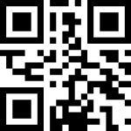
The 44th Forum for Behavioral Science in Family Medicine
Please check-in to this session
You can use the QR code to the right which should also be available in written form at the entrance to the room.
You can also use this code in your app.
Presenters, please insert the QR code picture to the right (in speaker portal – session files).
Also, type here the Self Check-In Code (5-letter-number combination; in speaker portal – session description).
Notes:
801

Slide 3
The 44th Forum for Behavioral Science in Family Medicine
Disclosures
NONE

Slide 4
The 44th Forum for Behavioral Science in Family Medicine
Goals and Objectives
As a result of this session, participants will be able to…
… Identify traits of residents that contribute to our negative reactions
… Utilize reflection to analyze reactions and biases
… Incorporate strategies to mitigate bias into teaching encounters
… Develop a personal process for actively improving relationships and outcomes by borrowing from strategies for handling challenging patients
Notes:
803

Slide 5
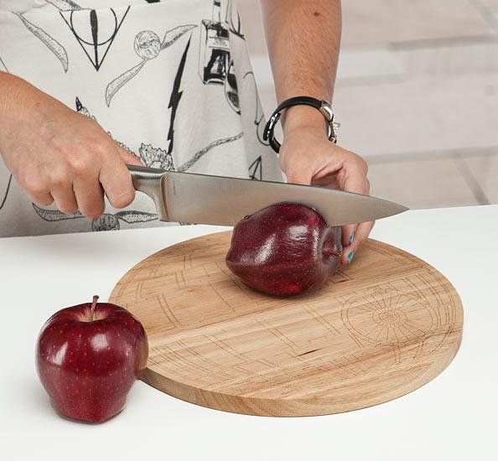
The 44th Forum for Behavioral Science in Family Medicine
Notes:
806: When Amber and I were considering presenting at the Forum this year, I had been doing some reflection on how my personal reactions might influence my teaching. I have an example, and just to be clear, I also have issues. Over the course of the last year, our clinic has undergone some remodeling and at one point faculty and residents were all crammed into the same room for precepting and work and everything. We were pretty much elbow to elbow. It was a little warm because In the winter there's always a battle between folks about whether there should be a space heater. Also, many of us were masked. As I was trying to get a little work done in between direct observations, the resident to my right unmasks and pulls a wooden cutting board out of his backpack. He carefully sets an apple on the cutting board, methodically unstows his pocket knife and cuts the apple into neat chunks. Although I wasn't thinking about it at the time, this resident reminds me powerfully of a colleague from early in graduate school. Both had mustaches, in fact. My early colleague used to pull his chair up behind me as I was trying to write my master's thesis. He would often eat cheese or hot dish and read- almost silently- over my shoulder. While the resident next to me in the precepting room was not reading over my shoulder, I felt this loathing grow in me as he ate his apple, with some relish. So I didn't write much more in the precepting room that day, instead I jammed my headphones on and turned up the volume for whatever clinical encounter there was at the time (and stewed). Later, I sorta wondered how it might affect me if I needed to precept this particular resident, or what would happen if he showed up for a behavioral science rotation. Would this powerful dislike that I had developed affect the way I interacted with him? Am I that shallow? Perhaps....

Slide 6
The 44th Forum for Behavioral Science in Family Medicine
Let's get started with a reflection...
Notes:
812:
[Reminders from the past activity]
Quick think: Think of a learner/resident who you liked or disliked; Consider a significant person, from your past, they remind you of. It can be someone consequential, like a family member, or someone less consequential but memorable. Choose something that you’d be willing to share with someone nearby. 2 minutes
Pair and share: What were the commonalities between the two people? How many connections / reminders were there? 2 minutes
[Group debrief] 2 minutes

Slide 7
What qualities contribute to disliking learners?(Boysen et al, 2023)
The 44th Forum for Behavioral Science in Family Medicine
Disrespect
Academic irresponsibility
Entitlement
Disruptive
Aggressive
Academic dishonesty
Personality traits
Narcissism
Arrogance
Neediness
Prejudicial attitudes
Complaining
Disengaged
Disagreeing with evaluations
Picky about their evaluations
Domineering
Manipulation
Political views
Notes:
815: I think this one might lend itself nicely to a flip chart activity...

Slide 8
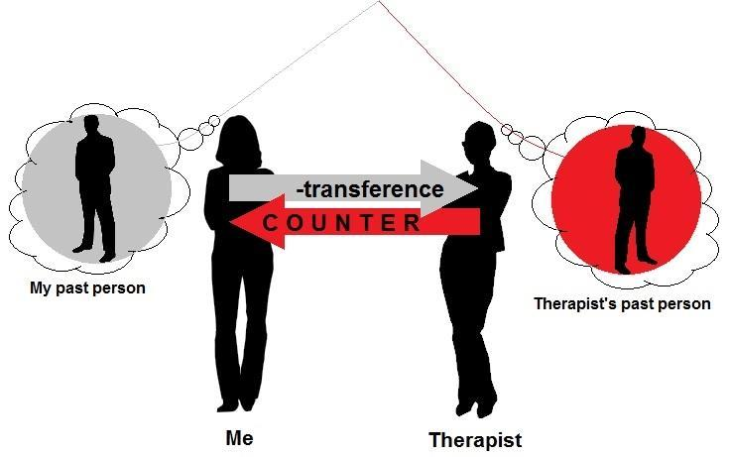
The 44th Forum for Behavioral Science in Family Medicine
Learning from our reactions! Lessons from psychotherapy and counter-transference…(Prasko et al., 2022)
Attending's
Attending
Notes:
8:20

Slide 9
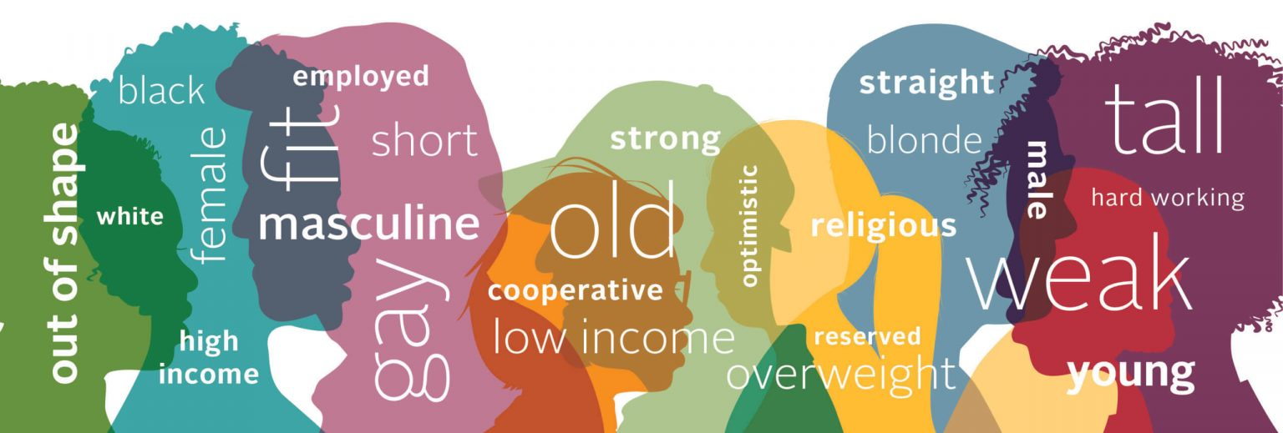
The 44th Forum for Behavioral Science in Family Medicine
Could we talk about bias?
Notes:
7 minutes for next 4 slides: Brief overview of implicit bias here: We all know some things, at this point, about implicit bias. Biases are normal- we all have them. Biases are developed from past experiences, and related to efficiencies that our brains achive through automatic processing. Problems arise when biases are driven by systems of inequity, and result in harmful stereotypes and unjust distribution of resources. We can definitely check our own biases when we're aware of them by utilizing controlled, intentional processing. Alternatively, there are ways to reduce bias when we change processes to reduce the likelihood that bias will affect outcomes.

Slide 10
When learners are disliked, what are the consequences for our learners, our programs and ourselves?
The 44th Forum for Behavioral Science in Family Medicine
Perceptions of teacher support predict connection to the learning environment (Graham et al., 2022)
Notes:
8:23

Slide 11
The 44th Forum for Behavioral Science in Family Medicine
How does this affect the milestones?
Notes:
8:25

Slide 12
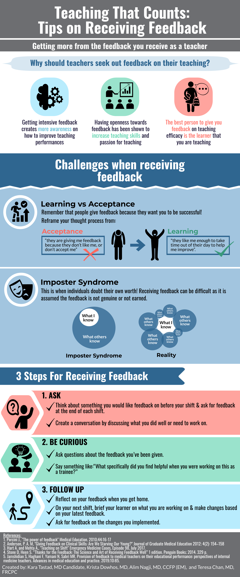
The 44th Forum for Behavioral Science in Family Medicine
How does this affect feedback?
Notes:
8:26

Slide 13
The 44th Forum for Behavioral Science in Family Medicine
Allyship and teaching in the residency curriculum.
(Can we be systematic about challenging bias?)
Formal bias Faculty Dev.
Agentic language and skill based precepting
Faculty development around feedback
Assigning a time to discuss: How could bias be operating here?
Building time to explore resident context (esp. with regard to remediation)
Assigning someone to do bias checks at CCC? (caveats galore)
Notes:
8:33
Not sure which article content, but...
Formal faculty development around bias
Using agentic language versus communal language (skill based versus niceness based)
Faculty development around feedback
Assigning time to discuss: How could bias be operating with this learner?
Explicitly assigning someone to speak up about bias (this could be tricky...)
Building time in the resident assessment process to build relationships and understand context, especially when remediation is being considered

Slide 14
The 44th Forum for Behavioral Science in Family Medicine
Thoughts?
Notes:
836

Slide 15
The 44th Forum for Behavioral Science in Family Medicine
Maybe we could borrow from our strategies for challenging bias in patient care?
Notes:
8:37

Slide 16
The 44th Forum for Behavioral Science in Family Medicine
Resident
Notes:
8:39

Slide 17
The 44th Forum for Behavioral Science in Family Medicine
Resident
Notes:
8:41

Slide 18
The 44th Forum for Behavioral Science in Family Medicine
Resident
Notes:
8:43

Slide 19
Debrief
Notes:
8:47

Slide 20
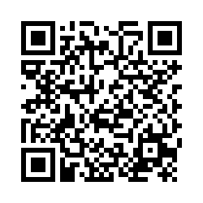
The 44th Forum for Behavioral Science in Family Medicine
Session Evaluation Link
Session Evaluation Link
Please complete an evaluation of this session. There is a direct link in your conference app. You can also use this QR code.
Notes:
8:50

Slide 21
The 44th Forum for Behavioral Science in Family Medicine
References
Blanchard, A. K., Blanchard, J. C., Suah, A., Dade, A., Burnett, A., & McDade, W. (2022). Reflect and Reset: Black Academic Voices Call the Graduate Medical Education Community to Action. Academic Medicine, 97(7), 967. https://doi.org/10.1097/ACM.0000000000004664
Edgoose, J. Y. C., Regner, C. J., & Zakletskaia, L. I. (2015). BREATHE OUT: a randomized controlled trial of a structured intervention to improve clinician satisfaction with “difficult” visits. Journal of the American Board of Family Medicine : JABFM, 28(1), 13–20. https://doi.org/10.3122/JABFM.2015.01.130323
Graham, L. J., Gillett-Swan, J., Killingly, C., & Van Bergen, P. (2022). Does It Matter If Students (Dis)like School? Associations Between School Liking, Teacher and School Connectedness, and Exclusionary Discipline. Frontiers in Psychology, 13. https://doi.org/10.3389/FPSYG.2022.825036
Kalet, A., Chou, C. L., & Ellaway, R. H. (2017). To fail is human: remediating remediation in medical education. Perspectives on Medical Education, 6(6), 418–424. https://doi.org/10.1007/s40037-017-0385-6
Loeppky, C., Babenko, O., & Ross, S. (2017). Examining gender bias in the feedback shared with family medicine residents*. Education for Primary Care, 28(6), 319–324. https://doi.org/10.1080/14739879.2017.1362665
Prasko, J., Ociskova, M., Vanek, J., Burkauskas, J., Slepecky, M., Bite, I., Krone, I., Sollar, T., & Juskiene, A. (2022). Managing Transference and Countertransference in Cognitive Behavioral Supervision: Theoretical Framework and Clinical Application. Psychology Research and Behavior Management, 15, 2129. https://doi.org/10.2147/PRBM.S369294

