Slide 1
Health Behavior Change and Motivational Interviewing Skills: Don’t graduate with out them
Deb Seymour, PsyD
Brandy Deffenbacher, MD

Slide 2
Objectives
Describe approaches to health behavior change
Describe motivational interviewing skills
Practice using health behavior change and motivational interviewing skills in role plays
Prepare to use skills for helping patients change in RCC and AAC clerkship sites

Slide 3
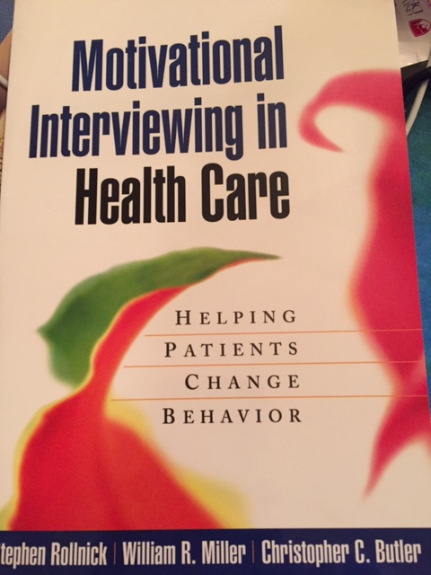

Slide 4
Learning assignments
Read Rollnick (chapters 1-3)
CANVAS -complete 2 health behavior clinical consult forms
Participate in role plays
Discuss challenges and successes in your efforts to engage patients in HBC/MI conversations

Slide 5
WHY PEOPLE DIE McGinnis JM, Foege WH. Actual Causes of Death in the United States. JAMA 1993;270:2207-12. Mokdad AH, Marks JS, Stroup DF, Gerberding JL. Actual Causes of Death in the United States, 2000. JAMA 2004;291:1230-1245.

Slide 6
Transtheoretical model of change DiClemente and Prochaska
Precontemplation
Contemplation
Planning
Action
Maintenance
Relapse

Slide 7
The spirit of motivational interviewing
Honors patient autonomy
Based in empathy
Guiding and exploring vs. directing and instructing
Discussion of ambivalence
Rolling with resistance
Resisting the ‘righting reflex’

Slide 8
Spirit of motivational interviewing
Motivational interviewing
‘Old school’ behavior change
Guides
Explores
Asks
Patient values
Listens
Collaboration
Autonomy
Directs
Instructs
Tells
Provider values
Fixes
Confrontation
Authority

Slide 9
The Five A’s
Ask
Advise
Assess
Assist
Arrange

Slide 10
OARS
O = Open questions
A = Affirmations
R = Reflections
S = Summarizing

Slide 11
Listening for change talk
“I want my partner to be happy and not worry so much.”
“Sometimes I think it would be better if I didn’t use, but I can’t really imagine life without my fix.”
“Smoking pot is part of who I am, everyone in my family smokes, it helps me with my work and is key to my social life, the only thing it isn’t good for is skiing.”
“I would like to go to movies, I guess I will have to invent a smoking friendly theater.”

Slide 12
Evoking change talk
Scaling (importance and confidence)
Discussion of scaling
Reviewing past success
Looking forward and looking back
Verbalizing ambivalence

Slide 13
Scaling Importance and Confidence
On a scale of zero to ten, how important is it for you to ______________?
Where 10 is extremely important and zero is not at all important
2. On a scale if zero to ten, how confident that you can make this change?
Where 10 is extremely confident and zero is not at all confident

Slide 14
Magic number 7
If when scaling importance and confidence a “7” it is a better sign of readiness to move to action and planning.
Ratings below 7 may suggest that more discussion is needed

Slide 15
Follow up questions after scaling
“Why are you not a (lower number than selected)”? –listen for ‘change talk
“Why are you not a (higher number than selected)”? – listen for ambivalence barriers or opportunity for education
What would it take to get you to an 8?

Slide 16
Rolling with resistance
Use empathy
Resist the “righting” reflex
Avoid confrontation
“I understand stopping drinking is not really at all what your goal is.”

Slide 17
Reviewing past success
“You quit using meth while you were pregnant, which is such a strong statement about your parenting and your will power…Tell me what that was like and how you did it?”
“Tell me about what you did during the three years that you were sober?”
“What did you do with the time you would have otherwise spent drinking?”

Slide 18
Looking forward and backward
“Tell me about when you first started using Heroin.”
“What initially drew you toward smoking pot.”
“How do you think things would be for you in 1 year if you stopped smoking tomorrow.”
“What would you do in 2 years if you saved the 5 dollars per day that you spent on cigarettes?”

Slide 19
Verbalizing ambivalence
“So, on the one hand your are really worried about getting COPD because your dad had it and watching him suffer was very hard. On the other hand, you love smoking, it is your only bad habit and you worry that the weight you gain when you quit is even more unhealthy than the smoking itself.”
Capture BOTH sentiments.

Slide 21
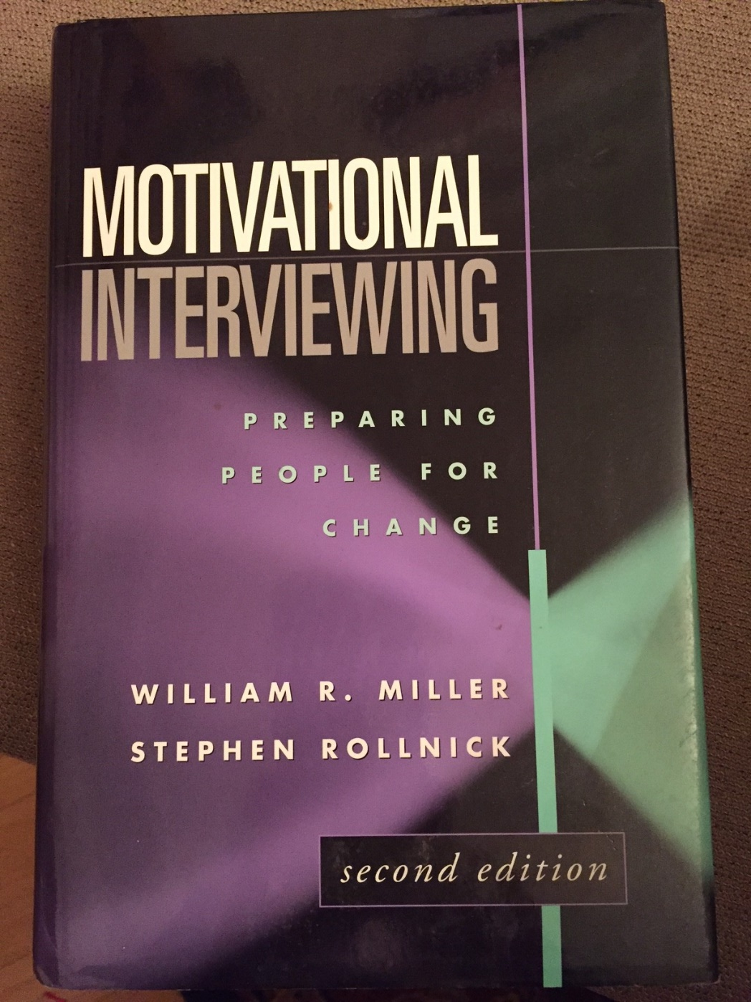

Slide 22
Example: smoking discussion
https://www.youtube.com/watch?v=URiKA7CKtfc

Slide 23
MI in a brief office visit: smoking
https://www.youtube.com/watch?v=URiKA7CKtfc

Slide 24
Scaling-precontemplation 3:45
https://www.youtube.com/watch?v=yNqaUMiU0Dk

