Slide 1
How will residents’ personal values impact their future practice?
Use of values clarification workshops focusing on circumcision and abortion care
Kimberly Collins MD, Valerie Ross MS, Ying Zhang MD/MPH
University of Washington Family Medicine Residency
Notes:
Kim
Overview of Time
Intro - Kim 5 mins
Literature – Valerie 4 min
Survey – Ying 1 min
Our program – Kim 2 min
Exercises – Ying 3 min
Practice Exercise – Valerie 8 min
Discussion – Kim 7 min

Slide 2
Disclosures
The presenters have no relevant conflicts of interest to disclose.
Notes:
Kim

Slide 3
Objectives
Review the definition and relevance of values clarification and conscientious objection in medicine
Understand how we adapted values clarification exercises for abortion to circumcision
Bring a values clarification exercise back to your program
Notes:
Kim
Understand meaning and background of values clarification
Discuss how we adapted values clarification to circumcision
Participate in a values clarification exercise to bring back to your program

Slide 4
What is values clarification?
A technique that helps individuals increase awareness of personal values
Focuses on clinical situations that may involve moral conflict
The goal is not to teach specific values
Helps people think about situations where they may opt for conscientious objection and how they would manage patient care in those situations
Notes:
Kim

Slide 5
Why use values clarification in FM training?
Family Medicine encompasses many controversial medical practices:
neonatal male circumcision
reproductive health
sexual medicine
end-of-life care
transgender medicine
pain medicine
addiction medicine
Trainees are developing their professional identity
Frank, JE. Conscientious Refusal in Family Medicine Training, Fam Med 2011;43(5):330-3.
Notes:
Kim/Story?

Slide 6
Limits of Conscientious Objection
Providers’ personal moral beliefs can conflict with professional and ethical standards and patients’ rights
Conscientious refusals should be limited if they:
constitute an imposition of religious or moral beliefs on patients
negatively affect a patient's health
are based on scientific misinformation
create or reinforce racial or socioeconomic inequality.
“Limits of Conscientious Refusal in Reproductive Medicine.” ACOG Nov 2007, Number 385.
Notes:
Valerie
Referral can be an acknowledgement of thoughtful disagreement among physicians and and the moral sincerity of others with whom one disagrees.

Slide 7
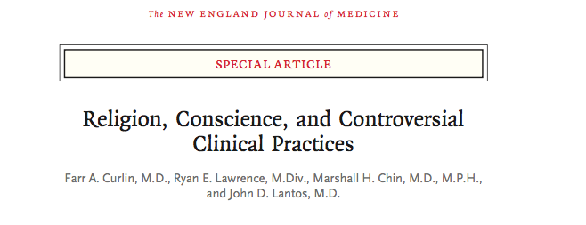
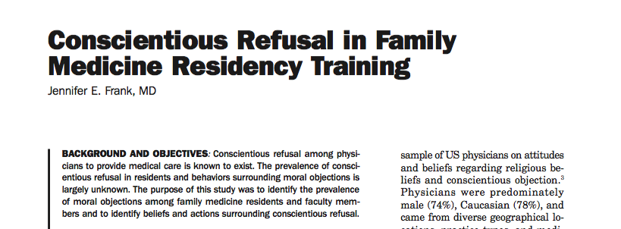
Conscientious Objection: Review of literature
Notes:
Valerie
2007 cross-sectional, random survey of 2000 physicians from all specialties found:
Asked about physicians judgments about their ethical rights and obligations when patients request a legal procedure to which the physician objects for moral or religious reasons.
Many physicians do not consider themselves obligated to disclose information about or refer patients for legal but morally controversial medical procedures. Patients who want information about and access to such procedures may need to in- quire proactively to determine whether their physicians would accommodate such requests.

Slide 8
Conscientious Objection: Review of literature
Conscientious objection exists in family medicine
No universal agreement on how to manage it
Ethical guidelines:
Disclose
Refer
Discuss with colleagues
Allow residents to object
Notes:
Valerie
Literature shows that the norms are not universal.
For providers in underserved areas where referral is not possible, physicians may have to engage in procedures they morally object to.
Emphasizes need to give residents skills to think through moral dilemmas
The culture of conscientious objection in medicine is still being defined.
There are shared beliefs about obligation for disclosure and referral but these are not agreed upon by all
Is it ethically important to model transparency, clarity, and obligation around referral for patients and residents alike?

Slide 9
Audience Poll
Who has participated in a values clarification exercise?
What was the topic of the values clarification exercise:
Notes:
Ying
Abortion
Circumcision
Reproductive health
End-of-life care
Transgender medicine
Other?

Slide 10
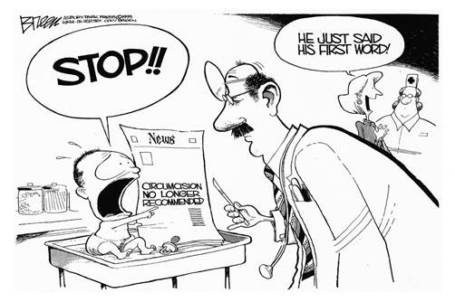
Values Clarification in our program
Opt-out abortion program.
Values clarification has long been a part of our abortion training.
Controversy around circumcision.
Now an opt-out procedure.
We chose to apply values clarification to circumcision.
Notes:
Kim

Slide 11
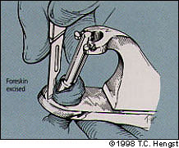
Neonatal Circumcision Controversy
American Association of Pediatrics
Position on Circumcision:
1971: “There are no valid medical indications for circumcision in the neonatal period.”
2012: “the health benefits of newborn male circumcision outweigh the risks, but the benefits are not great enough to recommend universal newborn circumcision.”
Notes:
Kim

Slide 12
Neonatal Circumcision Controversy
AAFP Position on Neonatal Circumcision:
“The decision whether to circumcise a newborn male is affected by parents’ values and beliefs and should be made by parents after a discussion of the benefits and harms. Family physicians should provide this information in an unbiased manner, and the parents’ decision should be respected.”
Notes:
Kim

Slide 13
Neonatal Circumcision Controversy
Three issues:
Health risks vs. benefits
Consent vs. lack of consent
Cultural and religious beliefs
At the extremes:
Belief that circumcision is a cosmetic procedure with risks performed on an unconsenting newborn
Belief that circumcision is a ritual performed for cultural reasons with health benefits
Notes:
Kim

Slide 14
Types of Values Clarification Exercises
Focus on three formats:
Case-based
Narrative
Agree/disagree
Notes:
Ying
Many of the values clarification exercises that have been published in STFM have focused on abortion and we tried to adapt those for circumcision. We wanted to provide a few examples of formats for values clarification exercises for you.

Slide 15
Examples of Values Clarification Exercises
Case-based exercise
For abortion:*
A 24 year-old woman who has been pregnant 3 times and has had 3 abortions comes to you for pregnancy options counseling and desires an abortion
For circumcision:
Parents bring their newborn in for circumcision. During the history you find out that they refused vitamin K because they thought it was unnecessary.
*Steinauer J. How to Facilitate a Caring for Challenging Patients Workshop: Focus on Family Planning. https://www.glowm.com/mis/Facilitator%20Guide-CCPW%20Family%20Planning.doc, accessed on 4/4/2017.
Notes:
Ying

Slide 16
Types of Values Clarification Exercises
Narrative Exercise
General Feelings about Circumcision
Did you grow up with any experiences or values around circumcision that influence your beliefs about the procedure?
What information would you provide the parents of a son who are considering circumcision?
Feelings about the procedure
What factors will determine whether you decide to perform circumcisions in your own practice?
Notes:
Ying

Slide 17
Types of Values Clarification Exercises
Agree/Disagree exercise
Values clarification statements for abortion*:
Every woman has the right to choose to terminate a pregnancy
Parental consent should be required for any teen requesting an abortion
Abortions should be legal only up to 12 weeks of pregnancy.
Values clarification statements for circumcision:
I am in favor of circumcision and will perform them for any patient
Circumcision is a cosmetic procedure with risks performed on an unconsenting newborn
Circumcision is a ritual performed for cultural reasons with health benefits
*Breitbart V, Tanenhaus J. Values Clarification Workshop. http://www.rhedi.org/getting_started/values.php. Accessed 4/4/2017.
Notes:
Ying/Valerie

Slide 18
A Values Clarification Exercise for your program
What procedures/aspects of care present conflict in your program? Have you seen any instances of conscientious objection within your own program?
What topics would be interesting to discuss during a values clarification exercise in your program?
What exercise format might work well at your program?
Agree/Disagree
Narrative
Cases
Another format

Slide 19
Questions

Slide 20
Bibliography
Breitbart V, Tanenhaus J. Values Clarification Workshop. http://www.rhedi.org/getting_started/values.php. Accessed 4/4/2017.
Curlin, FA et.al. Religion, Conscience and Controversial Clinical Practices, NEJM 2007;356:593-600.
Frank, JE. Conscientious Refusal in Family Medicine Training, Fam Med 2011;43(5):330-3
“Limits of Conscientious Refusal in Reproductive Medicine.” ACOG Nov 2007, Number 385.
Steinauer J. How to Facilitate a Caring for Challenging Patients Workshop: Focus on Family Planning. https://www.glowm.com/mis/Facilitator%20Guide-CCPW%20Family%20Planning.doc, accessed on 4/4/2017.

