Slide 1
Management of Sexually Transmitted Infections in Low Resource Settings
Dr. Calvin Wilson
Clinical Professor of Family Medicine
University of Colorado Anschutz School of Medicine

Slide 2
Learning Objectives
By the end of this session, participants should be able to:
Identify the most common STIs present globally
Understand and utilize a modified syndromic approach to the diagnosis and management of common STIs
List the benefits and drawbacks to the syndromic approach to STI management

Slide 3
Principles - STI Diagnosis and Management in Low Resource Settings
STI presentation symptoms and management very similar around the world
Vigilance needed for resistant strains (esp. GC)
Epidemiology will vary by region – esp. syphilis, GC, LGV, chancroid
Accurate diagnosis requires capable laboratory, rapid turnaround of results, and $$$$$$
Not often available in low resource settings
Alternative, population based approach needed that is still sensitive and relatively specific

Slide 4
Syndromic Management of STD
Developed and refined by WHO over past 20 years
Algorithmic approach to the evaluation of specific common symptoms of STIs
Specific antibiotic management dependent on local sensitivities and availability of medications
Found in some initial studies to be very sensitive (>90% in at least 2 studies), but relatively low specificity (25-30%) in some areas (especially vaginal discharge)

Slide 5
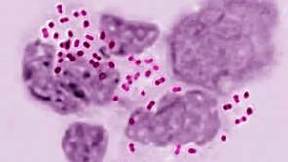
Urethral Discharge - Male

Slide 6
Genital Sore or Ulcer

Slide 7
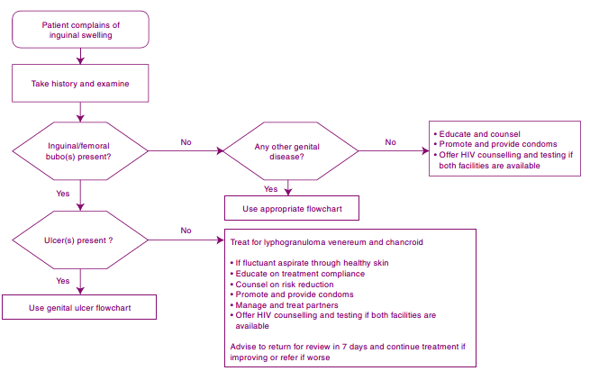
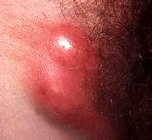
Inguinal Bubo (lump)

Slide 8
Sexually Transmitted Ulcerative Infections
Infection | Characteristics | Treatment | Distribution
Syphilis | Painless, indurated ulceration; often single (Treponema pallidum) | Benzathine Penn 2.4 million U. IM | World-wide
Chancroid | Painful, non-indurated ulceration with associated inguinal adenopathy (Hemophilus ducreyi) | Azithromycin 1 gm PO Ceftriaxone 250 mg IM Erythromycin 500 tid X 7 days | Some areas of Africa and Caribbean
Granuloma Inguinale | Painless, slowly progressive ulcerations without adenopathy (Klebsiella granulomatis) | Azithromycin 1 gm PO per week X 3 weeks Doxycycline 100 mg bid X 3 weeks | Tropical, developing countries
Lymphogranuloma venereum | Tender inguinal or femoral adenopathy, proctocolitis (chlamydia trachomatis) | Doxycycline 100 mg bid X 3 weeks | Americas, Southern Africa, India, SE Asia

Slide 9
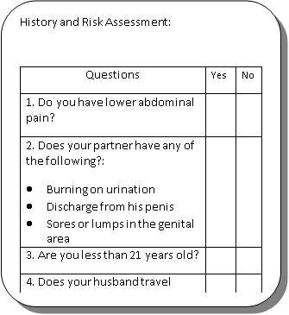
Vaginal Discharge - Female

Slide 10
Lower Abdominal Pain - Female

Slide 11
Advantages to the Syndromic Management of STI
Highly sensitive when used to detect infection among symptomatic patients
Treatment is given at first visit
Avoids expensive laboratory tests
Can be implemented at primary care level because of ease of use
Limits referral to specialist centers
Problem-orientated (based on patient’s symptoms)
High rates of cure, when antibiotics are properly chosen for local resistance patterns
Standardizes diagnosis, treatment, referral, and reporting
Syndromic Management of Sexually Transmitted Infections, CME (South Africa) February 2005 Vol.23 No.2, https://www.ajol.info/index.php/cme/article/view/44035/27549

Slide 12
Disadvantages of the Syndromic Management
Known over-diagnosis and over-treatment with potential for:
increased drug costs
possible side-effects of multiple drugs
alterations in vaginal flora
potential for increased drug resistance
Cannot be used to detect infections among asymptomatic individuals
Presence of vaginal discharge poorly predictive of cervical chlamydial and/or gonococcal infection
Treatment of partners of women with vaginal discharge (many with no STI) may lead to potentially serious social consequences
Not easily accepted by doctors because of perception of inferior quality
Syndromic Management of Sexually Transmitted Infections, CME (South Africa) February 2005 Vol.23 No.2, https://www.ajol.info/index.php/cme/article/view/44035/27549

Slide 13
References
Training modules for the syndromic management of sexually transmitted infections (WHO), 2007 - ISBN 978 92 4 159340 7, http://www.who.int/reproductivehealth/publications/rtis/9789241593407/en/
Syndromic Management of Sexually Transmitted Infections, CME (South Africa) February 2005 Vol.23 No.2, https://www.ajol.info/index.php/cme/article/view/44035/27549
LIU, HONGJIE, JAMISON, DEAN, et al, Is Syndromic Management Better Than the Current Approach for Treatment of STDs in China?: Evaluation of the Cost-Effectiveness of Syndromic Management for Male STD Patients, Sexually Transmitted Diseases: April 2003 - Volume 30 - Issue 4 - pp 327-330, http://www.crd.york.ac.uk/crdweb/ShowRecord.asp?ID=22003000666
Pettifor, A., Walsh, J., Wilkins, V., & Raghunathan, P. (2000). How effective is syndromic management of STDs? A review of current studies, Sexually Transmitted Diseases, 27(7), 371-385, https://utah.pure.elsevier.com/en/publications/how-effective-is-syndromic-management-of-stds-a-review-of-current

