Slide 1
Digital Accessibility: Improving Teaching and Creating an Inclusive Learning Environment
Scott Bragg, PharmD
Lisa Mims, MD, MSCR
Alec DeCastro, MD
MUSC Family Medicine Residency

Slide 2
No Disclosures or Conflicts of Interest

Slide 3
Objectives
Identify 5 methods to increase teaching material digital accessibility
Recall 3 resources for determining document accessibility
Discuss common obstacles encountered by faculty related to digital accessibility

Slide 4
Why Focus on Digital Accessibility?
Many educators unaware of new web accessibility requirements (i.e., WCAG 2.1 criteria under Section 508 of the Rehabilitation Act)
Current learners have different needs
Focus on digital accessibility can improve your teaching

Slide 5
Section 508 of Rehabilitation Act of 1973
All information technology must be accessible to people with disabilities, including employees and the public
The Section 508 Standards were originally published in 2000
Section 508 was refreshed with an update in 2017
Web Content Accessibility Guidelines 2.0: Level A and Level AA
Structured provisions for functionality of information communication technology (ICT)
Addressed access for people with cognitive, language, and learning disabilities

Slide 6
Web Content Accessibility Guidelines (WCAG)
Gives guidelines on making web content more accessible
Web content refers to info in a web page or application, including:
Natural information such as text, images, and sounds
Code or markup that defines structure, presentation, etc.
Three levels of Success Criteria
A*
AA*
AAA
* In accordance to the Section 508 refresh, WCAG 2.0 Level A and AA criteria apply

Slide 7
ADA Lawsuits
Litigation continues to accelerate
Increased 210% in 2017 and 177% in 2018
Expect growth will slow but still robust going forward
Source: ADA Title III
Notes:
Note data on lawsuits for 2019 and 2020 are estimates based on recent trends

Slide 8
Universal Design for Learning
CAST (2018). Universal Design for Learning Guidelines version 2.2. Retrieved from http://udlguidelines.cast.org
Notes:
Accessibility is a key element of developing teaching content that can reach learners of all shapes and sizes

Slide 9
Build it in, Don’t Bolt it on
The goal is not to be perfect by the end.
The goal is to be better today.

Slide 10
Accessibility: Major Areas of Concern
Images
Styles
Organization
Links
Color
Captions

Slide 11
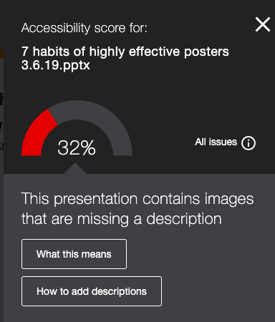
Demo PowerPoint Accessibility Check: Before

Slide 12
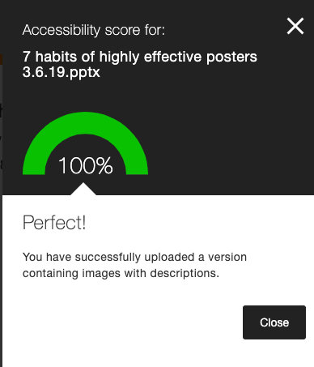
Demo PowerPoint Accessibility Check: After

Slide 13
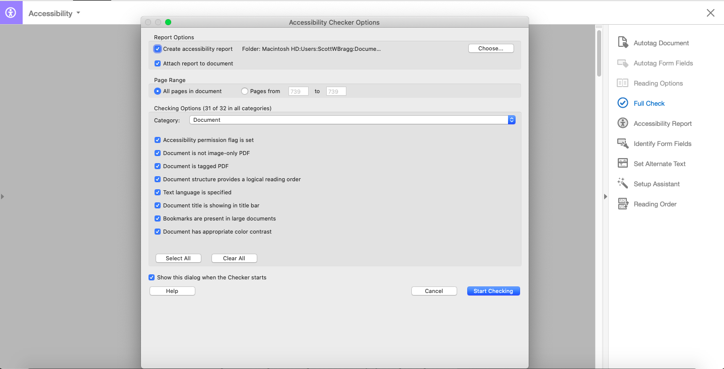
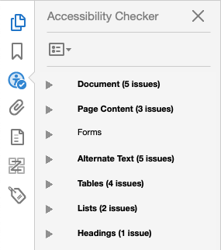
Demo PDF Accessibility Check

Slide 14
Benefits of Highly Accessible Content
Promotes improving your teaching
Complies with federal accessibility law
Helps users with and without disabilities
Creates new opportunities with alternative file formats
Schmutz S, et al. Hum Factors.2017;59(6):956–972.
Photo credit: Realize blog post

Slide 15
Alternative File Formats
Accessible documents converted by LMS to different versions
Helps adapt content to users
Examples: mp3, ePub, BeeLine Reader, HTML

Slide 16
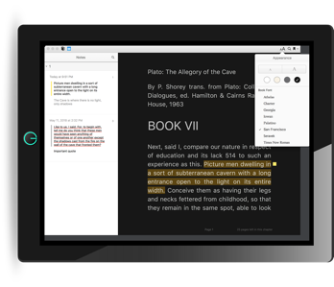
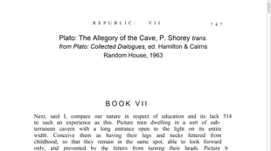
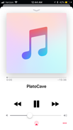
Usability of Content in Digital Age
Skim a Tagged PDF on a desktop for high-level understanding
Annotate and highlight an ePub on a tablet for deep reading
Listen and review an MP3 on your phone for reinforcing understandings
Notes:
In education, students with disabilities have been excluded or included in the classroom
When considering the unique needs of our learners, then we can proactively design for inclusive learning
The road to inclusive learning begins with accessible content

Slide 17
Introducing: Blackboard Ally
Institution
Instructor
Student
Institutional reporting to drive targeted coaching
Data and training to remediate issues
Personalized experience to use content

Slide 18
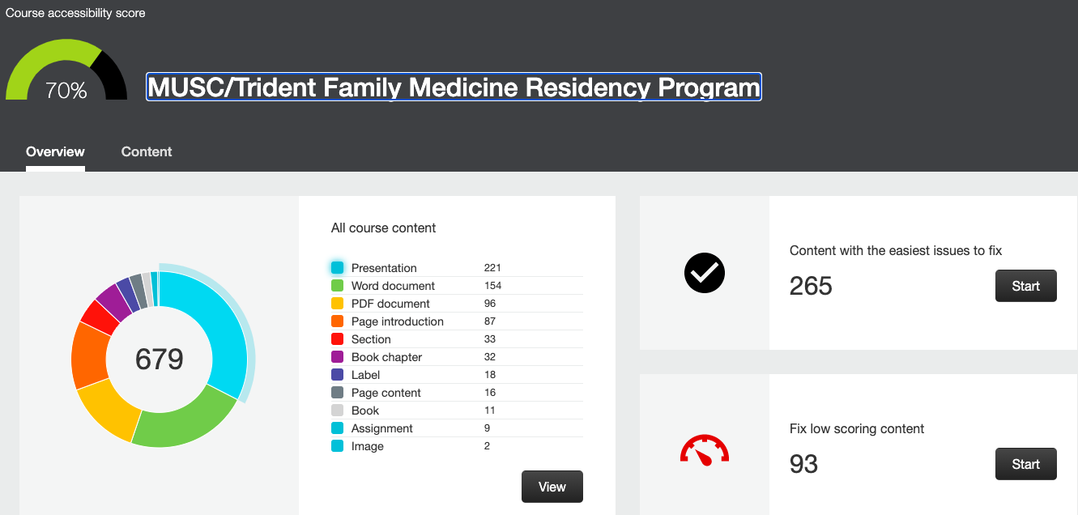
Ally Instructor Reports

Slide 19
Categories of Accessibility Issues

Slide 20
Example Ally Accessibility Presentation Report

Slide 21
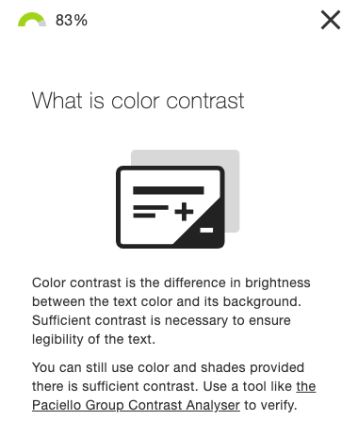
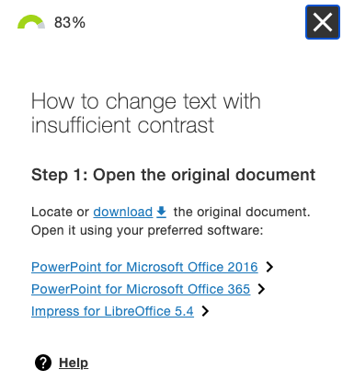
Step-Wise Instructions to Improve Documents

Slide 22
Strategies to Implement at Your Institution
Shift to Universal Design for Learning
Train how and sustain with the “why”
Standing item on agendas
Keep focus on accessibility among faculty
Small chunks for success
Focus on high impact areas for growth
Make it part of the workflow
Flex old content, but make all new content accessible
Acknowledge champions and success
Recognize and praise wins

Slide 23
Please Email us for Questions and Thanks for Watching!
Correspondence:
Scott Bragg, PharmD
braggsc@musc.edu

