Slide 1
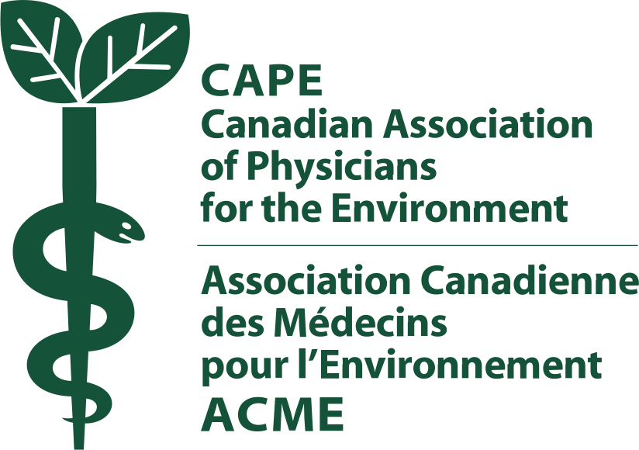
Developing & Implementing Curricula on Climate Change in Family Medicine Training
Ruben Hernandez Mondragon MD
Esther Johnson MD MPH
Clayton Dyck MD CCFP FCFP
Weyinshet Gossa MD MPH
Neil Arya MD CCFP FCFP
Mike Benusic MD MPH CCFP

Slide 2
Disclosures
No financial/commercial conflicts to disclose.
Dr. Gossa: The opinions and assertions expressed herein are those of the author(s) and do not necessarily reflect the official policy or position of the Uniformed Services University, the Department of Defense or the United States government

Slide 3
Objectives
Define the impact of climate change on individual and population health, and identify the role family physicians have in both contexts.
Formulate ideas for possible curricular design that can be implemented in undergraduate and postgraduate medical education to ensure that future family physicians have the appropriate knowledge and skills needed to address climate change.
Identify potential barriers in the implementation of above curricular ideas and promote solutions.

Slide 4
Session Structure
Presentation (Mike): 20-30 minutes
Panel & group discussion (all): 30-40 minutes

Slide 5
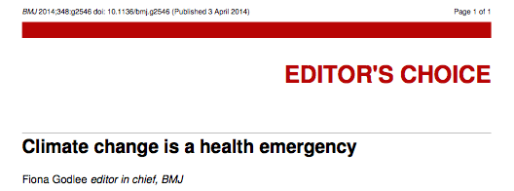

Slide 7
The Vitals
1.5-2°C
350ppm
0.8°C
413ppm
1/3
Notes:
Above pre-industrial levels
1-International target (Kyoto, Copenhagen) for the maximum allowable degree of worldwide warming.
New analyses suggest that even this may be too high, and that we should move to a 1.5 degree Celsius maximum (Paris agreement)
“the impacts associated with 2 deg C have been revised upwards, sufficiently so that 2 deg C now more appropriately represents the threshold between dangerous and extremely dangerous climate change.”
Anderson K and Bows A Beyond ‘dangerous’ climate change: emission scenarios for a new world. Phil. Trans. R. Soc. A (2011) 369, 20-44
--The methane pulse (released by melting permafrost) will bring forward by 15–35 years the average date at which the global mean temperature rise exceeds 2°C above pre-industrial levels — to 2035 for the business-as-usual scenario..”
=extra $60 trillion (net present value) of mean climate-change impacts for the scenario with no mitigation
-Climate science: Vast costs of Arctic change. Gail Whiteman, Chris Hope & Peter Wadhams Nature 499, 401–403 (25 July 2013)
Peters et al. The Challenge to Keep Global Warming Below 2 Deg. Nature Climate Change, 2013
“The latest emission scenarios continue to track the high end of emission scenarios making it even less likely that the world will stay within 2 degrees celcius of warming. A shift to a 2 degree pathway requires immediate significant and sustained global mitigation with a probable reliance on net negative emissions in the long term.”
Max proportion of fossil fuel reservesthat can be burnt by 2050

Slide 8
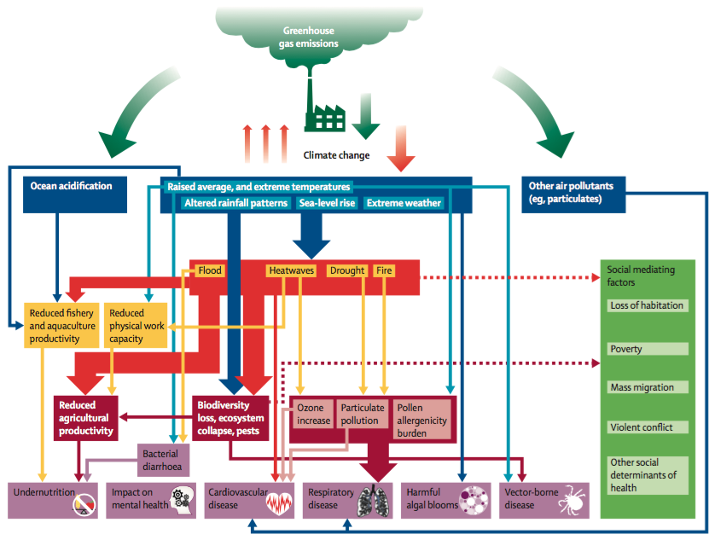

Slide 9
Health Impacts of Climate Change
direct impacts
temperature related
extreme weather events
indirect impacts
air pollution related
vector borne and zoonotic diseases
increased scarcity of food and fresh water
rise in sea level
areas becoming uninhabitable
mass human migration, conflict and violence

Slide 10
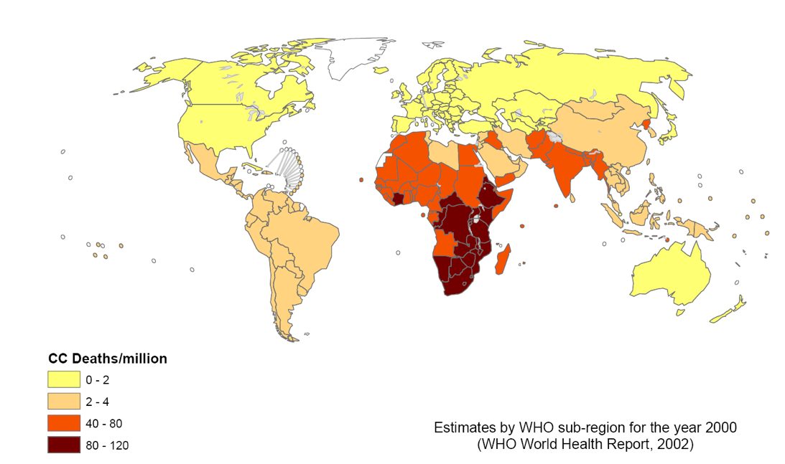
Impacts in Low/Middle-Income Countries
By 2030-2050 projected 250,000 additional deaths per year (WHO, 2014)
malnutrition, gastroenteritis, malaria
Notes:
Between 2030 and 2050, climate change is expected to cause approximately 250 000 additional deaths per year, from malnutrition, malaria, diarrhoea and heat stress.The direct damage costs to health (i.e. excluding costs in health-determining sectors such as agriculture and water and sanitation), is estimated to be between US$ 2-4 billion/year by 2030.Areas with weak health infrastructure – mostly in developing countries – will be the least able to cope without assistance to prepare and respond.
All countries will be affected. The most vulnerable ﾐ the poorest countries and populations ﾐ will suffer earliest and most, even though they have contributed least to the causes of climate change. The costs of extreme weather, including floods, droughts and storms, are already rising, including for rich countries.
Stern: The impacts of climate change are not evenly distributed - the poorest countries and people will suffer earliest and most. And if and when the damages appear it will be too late to reverse the process. Thus we are forced to look a long way ahead. Climate change is a grave threat to the developing world and a major obstacle to continued poverty reduction across its many dimensions. First, developing regions are at a geographic disadvantage: they are already warmer, on average, than developed regions, and they also suffer from high rainfall variability. As a result, further warming will bring poor countries high costs and few benefits. Second, developing countries - in particular the poorest - are heavily dependent on agriculture, the most climate-sensitive of all economic sectors, and suffer from inadequate health provision and low-quality public services. Third, their low incomes and vulnerabilities make adaptation to climate change particularly difficult. Because of these vulnerabilities, climate change is likely to reduce further already low incomes and increase illness and death rates in developing countries. Falling farm incomes will increase poverty and reduce the ability of households to invest in a better future, forcing them to use up meagre savings just to survive. At a national level, climate change will cut revenues and raise spending needs, worsening public finances. Many developing countries are already struggling to cope with their current climate. Climatic shocks cause setbacks to economic and social development in developing countries today even with temperature increases of less than 1｡C.. The impacts of unabated climate change, - that is, increases of 3 or 4｡C and upwards - will be to increase the risks and costs of these events very powerfully. Impacts on this scale could spill over national borders, exacerbating the damage further. Rising sea levels and other climate-driven changes could drive millions of people to migrate: more than a fifth of Bangladesh could be under water with a 1m rise in sea levels, which is a possibility by the end of the century. Climate-related
Stern: Adaptation efforts in developing countries must be accelerated and supported, including through international development assistance. The poorest developing countries will be hit earliest and hardest by climate change, even though they have contributed little to causing the problem. Their low incomes make it difficult to finance adaptation. The international community has an obligation to support them in adapting to climate change. Without such support there is a serious risk that development progress will be undermined. It is for the developing countries themselves to determine their approach to adaptation in the context of their own circumstances and aspirations. Rapid growth and development will enhance countriesﾕ ability to adapt. The additional costs to developing countries of adapting to climate change could run into tens of billions of dollars.
The World Health Organization8 has predicted that by 2030 there will be an estimated 250,000 additional deaths per year attributable to climate change, which is likely conservative, as currently 23% of all deaths globally are the result of environmental factors that, although multifactorial, are subject to the influence of climate change, which could drive the estimated number of additional deaths even higher.

Slide 11
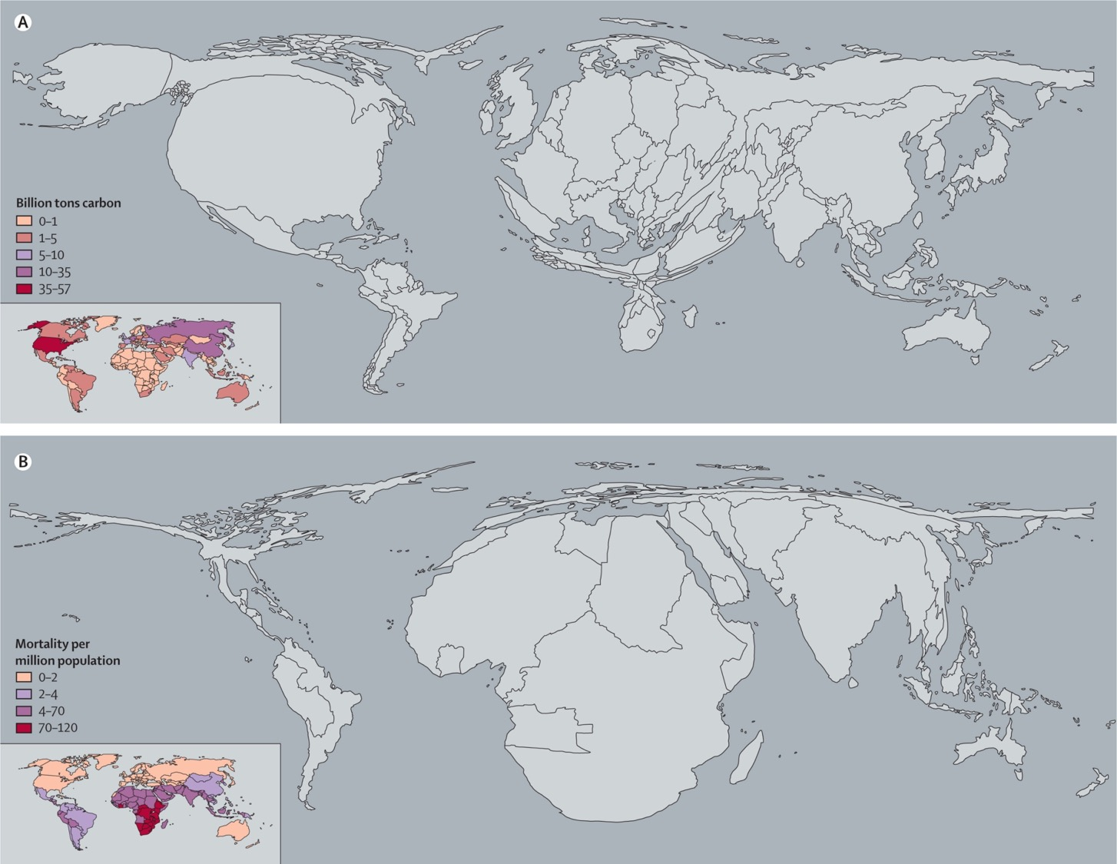
Costello. Lancet 2009
Notes:
Carbon emissions/ Mortality per million
Climate change since the 1970s was causing over 150,000 additional deaths per year (WHO, 2002), 400,000 according to DOHA.
Malnutrition; Gastro-enteritis; malaria
Sea level rise

Slide 12
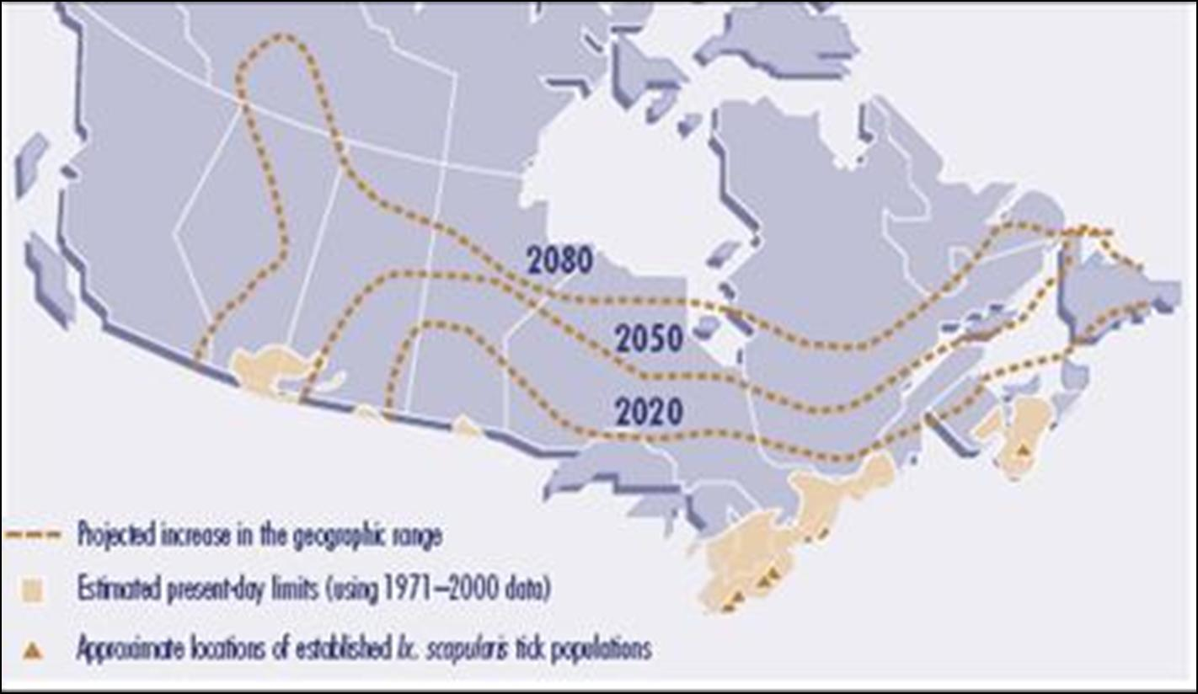
Role of Family Physicians: Clinicians
(Ogden, International Journal for Parasitology, 2006)
Notes:
Recent polls show that nearly half of Americans (49%) are “extremely or very sure” that climate change is happening versus only 7% who are “very sure” climate change is not occuring.69 Given that the bedrock of public health is education about threats to health, it is critical that health providers inform their patients, communities, and policy makers about the health harms of climate change. Evidence shows that primary care providers are among the most trusted voices to deliver this message (Figure 15)70, while nurses are the most trusted profession in the country across all sectors.71It has been shown that educating Americans about the health impacts of climate change can increase public engagement and decrease political polarization.72

Slide 13
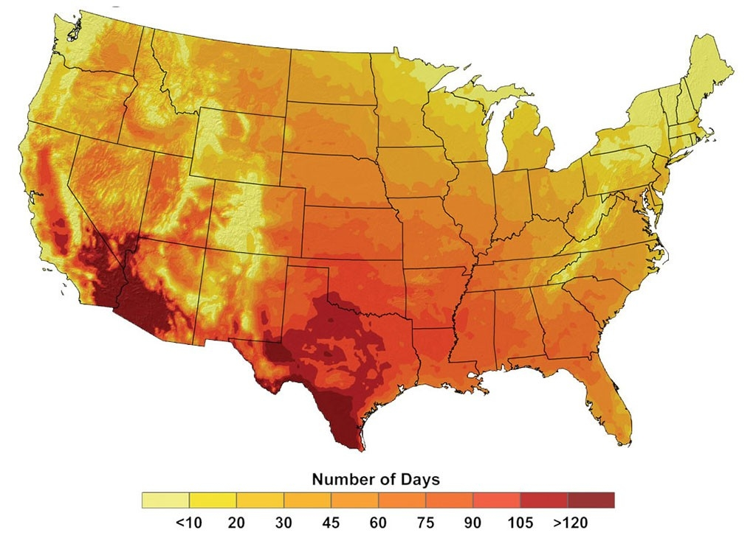
Notes:
The map depicts an estimate of the number of days that various parts of the United States can expect temperatures topping 100 degrees (38C) by 2100 if greenhouse gas emissions continue to increase unabated. U.S. Global Change Research Program

Slide 14
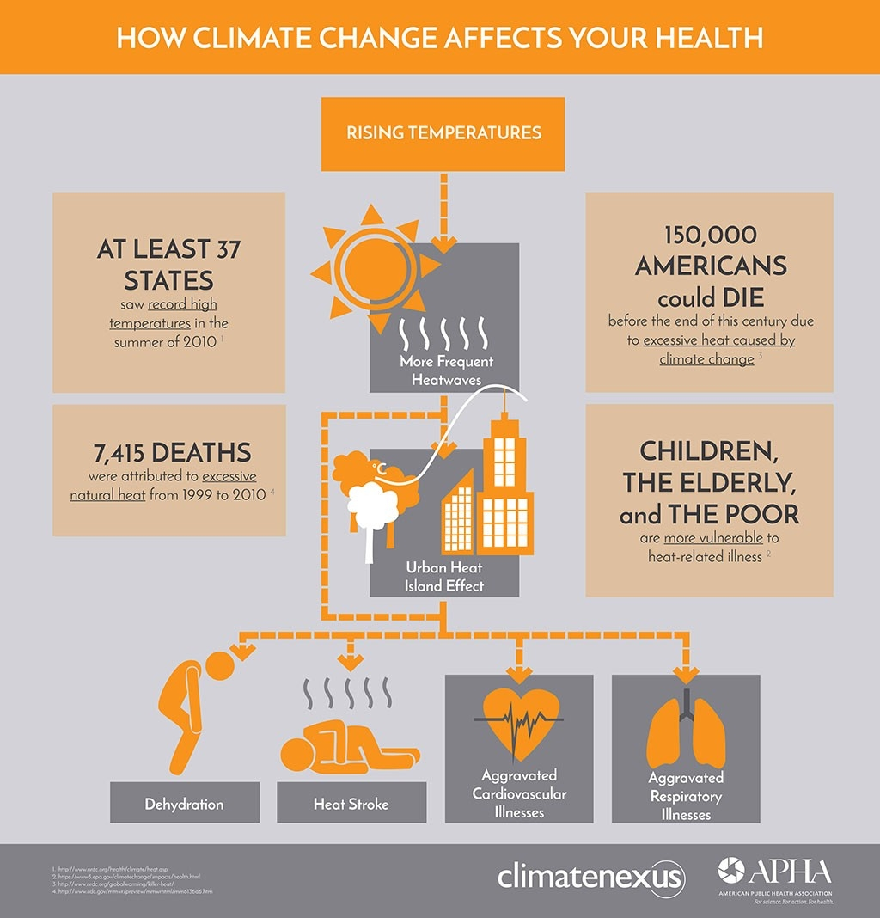

Slide 15
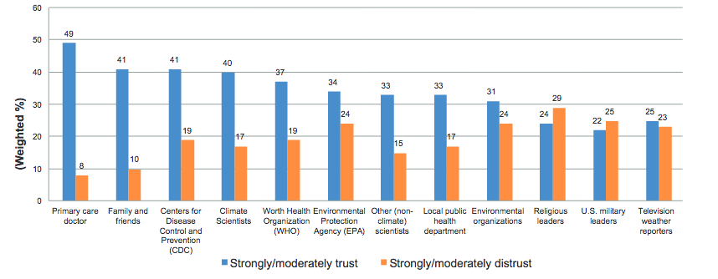
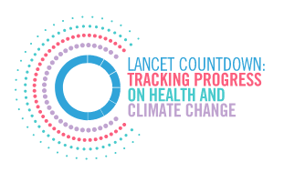
Role of Family Physicians: Advocates, Patient Educators
Notes:
Recent polls show that nearly half of Americans (49%) are “extremely or very sure” that climate change is happening versus only 7% who are “very sure” climate change is not occuring.69 Given that the bedrock of public health is education about threats to health, it is critical that health providers inform their patients, communities, and policy makers about the health harms of climate change. Evidence shows that primary care providers are among the most trusted voices to deliver this message (Figure 15)70, while nurses are the most trusted profession in the country across all sectors.71It has been shown that educating Americans about the health impacts of climate change can increase public engagement and decrease political polarization.72

Slide 16
Role of Family Physicians: Teachers
increasingly important, personally and professionally, especially for the next generation
rich evidence-base linking climate change and health
responsibility to reduce heath care’s environmental footprint (mitigation)
vulnerable people are being and will increasingly be affected (adaptation)
fosters necessary critical thinking and participation in global health and sustainability initiatives
Notes:
scope of the health today’s learners have an increasingly large stake in developing a strategic response to the many deleterious impacts of climate change
The U.S. health care sector itself contributes to U.S. greenhouse gas emissions at an estimated 9% to 10% per year.
If the U.S. health care system were a country, it would rank 13th in the world for greenhouse gas emissions.

Slide 17
Current State of Environmental Education
“environmental education is not included in the already crowded medical school core curricula in the United States"
“the curricula of medical and nursing programs were found to contain little or no health and environment content"

Slide 18
Environmental Health Knowledge: Canadian Family Medicine Residents
>90% highly concerned about health effects of environmental exposures
1/3 had specific training in taking environmental exposure histories
1/2 recognized link between climate change, flooding, and mould exposures
~10% believed supervisors had a good understanding of environmental exposures
no improvement in knowledge with years of training
Sanborn et al (in press)
Notes:
CH2OPD2
community
home
hobby
occupation
personal
diet
drugs

Slide 19
Notes:
Health Educators Climate Commitment
In addition to helping to recruit peer institutions, the Columbia University Mailman School of Public Health will announce the creation of a Global Consortium on Climate and Health Education to carry forward the Health Educators Climate Commitment to action. In addition to continuing to expand the reach of the commitment, the Consortium will be a forum through which Schools of Public Health, Medicine, and Nursing around the world share best scientific and educational practices, and curricula; develop core sets of knowledge for graduates; and foster the development of global academic partnerships to support training of health professionals and climate and health specialists throughout the world, particularly in under-resourced countries.

Slide 20
2018

Slide 21
Examples
Institution | Target | Topic | Format
Georgetown | 3rd-year medical students during family medicine | asthma (air pollution and climate change) | series of modules
Georgetown | 1st-year medical students | environmental health (climate change, air pollution, respiratory disease) | longitudinal series of workshops
Mount Sinai | 1st-year medical students | climate and global environmental change | lecture, small-group discussions, plans for cross-curricular infusion
Alberta | 1st & 2nd-year medical students | planetary health, climate & health | 1st year: didactic lecture 2nd year: case-based

Slide 22
Notes:
. This idea was first published in a 2015 Lancet article by the Rockefeller Foundation. They define planetary health as “… the achievement of the highest attainable standard of health, wellbeing, and equity worldwide through judicious attention to the human systems—political, economic, and social—that shape the future of humanity and the Earth’s natural systems that define the safe environmental limits within which humanity can flourish. Put simply, planetary health is the health of human civilisation and the state of the natural systems on which it depends.”

Slide 23
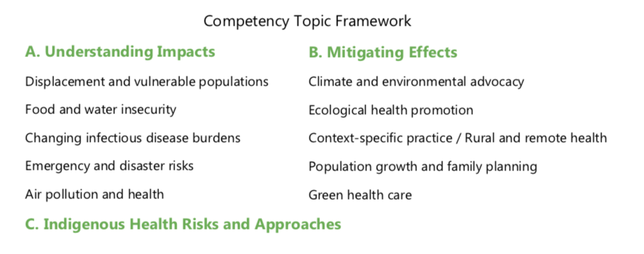

Slide 24
Example
Case 1: Individual Level
You are a family physician in Edmonton following up with one of your long-time patients, a 68-year-old woman named Dolores. Her medical history, well known to you, includes: type 2 diabetes on Metformin and insulin, with borderline renal function (Creatinine of 112 and eGFR of 55); COPD with emphysema and a long history of smoking (not on home oxygen); hypertension controlled on an ACE inhibitor (Perindopril) and diuretic (Hydrochlorothiazide); and some chronic back and knee pain for which she takes Tylenol or topical NSAIDs (Voltaren gel) as needed.
It is time for her annual health check and luckily things are looking pretty good for Dolores. Her last hospital admission was over three years ago, her blood pressure and sugars have been moderately well controlled, and her lab work and medication dosing have both been stable over the past year.
Socially, it has been a tough year for Dolores however. Her daughter moved to Vancouver for work and her husband passed 5 years ago, and she found lately she was not able to keep up with house maintenance (especially without her daughter around). About 3 months ago, she sold the old house and car and moved into an independent apartment which she can afford with her pension and some income from small personal investments. She cooks for herself with some assistance with grocery delivery. The apartment is in an older building, with good heating but no air-conditioning. She tries to stay active, but there are few pedestrian sidewalks or public transit routes in the area, and no park or green spaces nearby. Typically she calls a cab to do errands or asks a friend to drive her around.
Notes:
Case 2 – community level

Slide 25
Example
Case 1: Individual Level
What are some acute health risks Dolores would face from short-term climate/environmental events?
What are some chronic health risks she would face from long-term climate/environmental changes?
What actions you could take as primary care provider to prevent/mitigate these risks to this patient?
How could you expand to analyse environmental health risks to your entire patient panel? Can you think of any creative ways to identify and mitigate climate-related risks through your practice?
Notes:
E.g. summer smog/air pollution – worsening respiratory illness, extreme weather events – heat wave causing heat stroke or dehydration, potentially exacerbating renal function; trauma/injury from slipping walking in heavy winter/ice storms, foodborne illness from improper food transport/storage
E.g. poor nutrition due to lack of food security/available of fresh produce, mental health risks from social isolation – ex extreme heat/cold in winter/summer preventing her from leaving the apartment, global economic instability causing loss of income from investments- lack of affordable drugs/food
E.g. arrange to have someone check in on her regularly via phone/in person, particularly during extreme weather events, have her keep emergency and maintenance numbers on hand at home, counsel her about the risks of dehydration with heat or of respiratory illness with air pollution

Slide 26
Example
Case 2: Community Level
This case focuses on a First Nation community in northern Alberta, where logging and mining are the primary industries in the surrounding non-Indigenous area.
The community has become increasingly concerned about the health risks of degradation of their environmental resources and of potential climate-related events. This is particularly pressing because of a chemical spill which shut down the water supply system of a neighbouring community. The local water supply has remained clean, but community members suspect industrial standing ponds may be responsible for an uptick in mosquito populations as monitored by ecological and public health surveillance; however, there are limited data to support a causal connection. Furthermore, there has been controversy surrounding noticeable changes in migration and behavioural patterns of traditional game food sources in the local forested areas.
Heavy spring melt and rain caused flooding last year, which made the highway into the community dangerous and impassable for several weeks; non-perishable food and other supplies had to be temporarily airlifted in. The community’s leaders are also deeply concerned about the infringement of land rights in the approval of pipeline projects elsewhere in the country and their associated environmental risks, and the implications for local land sovereignty and environmental stewardship. Social isolation and economic stagnation have also contributed to increased emigration of young people to the city to look for work, and a recent increase in suicide attempts among those in the community, particularly among Indigenous youth.
The First Nation and local/regional health authority are interested in developing a health plan and analysing the short, medium and long-term risks to the community’s health and well-being over the coming 5-10 years. You are a public health consultant and have been asked jointly by the community’s leaders and the regional health authority to analyse these risks and make recommendations.
Notes:
Case 2 – community level

Slide 27
Example
Case 2: Community Level
To begin to understand the community and its surroundings, who do you talk to first? Whose voices do you need to hear? Which stakeholders and why?
List possible risks to public health related to climate and environmental changes for this community. What acute or chronic illnesses may be affected? Whose health will be most impacted?
How would you rank and prioritise these risks in the short, medium and long term?
Which risks can the community directly act on to prevent and mitigate harms? What kinds of health and social services will be necessary? Which risks will require cooperation and collaboration from other stakeholders, such as the provincial or federal government?
Notes:
Case 2 – community level

Slide 28
Tips for Implementation
make clinically-relevant connections
need for a faculty champion and institutional leadership
longitudinal integration into disease blocks vs. standalone sessions

Slide 29
Discussion

