Slide 1
Utilizing the
Single Accreditation System to
Advance Osteopathic Training
Melissa Penny, DO
Director of Osteopathic Education
Via Christi Family Medicine Residency
Cheryl Dobson, MD
Osteopathic Designated Resident PGY-2
Via Christi Family Medicine Residency
Notes:
2:30 minutes- M Penny & C Dobson

Slide 2
Learning Objectives
Understand how the implementation of the Single Accreditation System allows more residents to obtain training in Osteopathic Manipulative Medicine.
Explain basic program requirements for the training of osteopathic designated residents and know where to look for current information regarding Single Accreditation System requirements to ensure ongoing program compliance.
Obtain a basic understanding of how to implement an osteopathic designated training curriculum within an osteopathically recognized program for both osteopathic and allopathic residents and have at least one example to use as a guide.

Slide 3
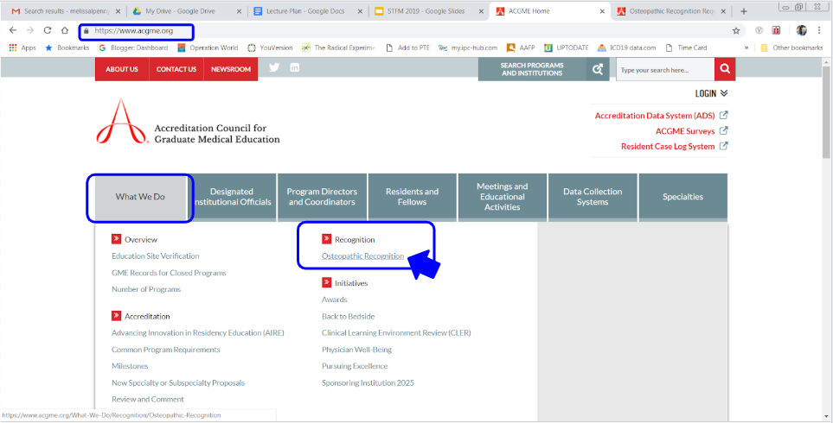
ACGME Website

Slide 4
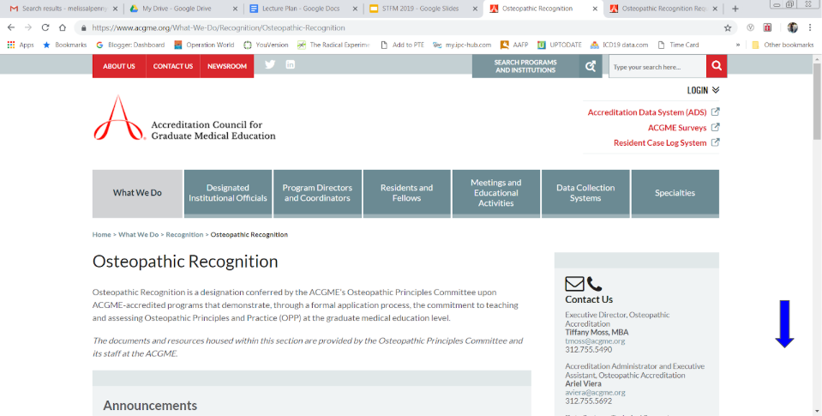
ACGME Website

Slide 5
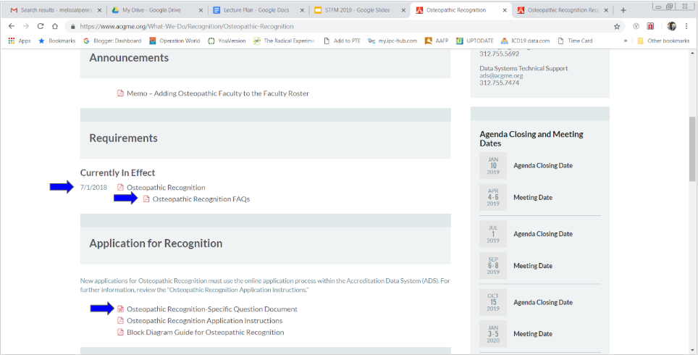
ACGME Website

Slide 6
ACGME Key Requirements
For Training Osteopathic Residents
~Please refer to the handout for detailed summary~
The Staff
The Residents (DO vs MD)
The Program
The Evaluations

Slide 7
Foundational Knowledge Training
This is the key distinguishing point between MDs and DOs in the ACGME Single Accreditation System
Programs have freedom & flexibility to meet this in a way that meets their resources
Examples of how this requirement can be fulfilled

Slide 8
An MD Resident in a DO World...
Foundational Training
OMM Didactics
Hands on Experience
OMT Specialty Clinic
Continuity Clinic

Slide 9
Learning Objectives
Understand how the implementation of the Single Accreditation System allows more residents to obtain training in Osteopathic Manipulative Medicine.
Explain basic program requirements for the training of osteopathic designated residents and know where to look for current information regarding Single Accreditation System requirements to ensure ongoing program compliance.
Obtain a basic understanding of how to implement an osteopathic designated training curriculum within an osteopathically recognized program for both osteopathic and allopathic residents and have at least one example to use as a guide.

Slide 10
Resources
There is an STFM Collaborative for
Osteopathic Medicine
https://connect.stfm.org/home

Slide 11
Questions?
Notes:
5 min

Slide 12
References
Accreditation Council for Graduate Medical Education. Osteopathic Recognition information and documents. From:
https://www.acgme.org/What-We-Do/Recognition/Osteopathic-Recognition.
Accreditation Council for Graduate Medical Education. FAQ. From:
https://www.acgme.org/Portals/0/PDFs/FAQ/801OsteopathicRecognitionFAQs2018.pdf?ver=2018-02-20-152439-463.

