Slide 1
Building a Culture of Engagement and Wellness in an Academic Family Medicine Practice
Ann Tseng, MD
Amanda Miller, PA-C
Karen Aiello, CMPE
Oregon Health and Science University
Family Medicine at Gabriel Park
Portland, OR

Slide 2
Disclosures
We have nothing to disclose

Slide 3
Our Story: The Start
It begins with the leaders!
Notes:
Leadership needs to buy in to wellness and employee engagement and start the culture and system change in the practice.
The first law of leadership: “If they don’t believe in the messenger, they won’t believe the message.”

Slide 4
X
Notes:
We have seen these graphs – high rates of burnout in medicine, esp primary care. We are not focusing on bad – we want to focus on the good parts of the employee engagement conversation. Our story is about leveraging our strengths as a group, focusing on our positives to build a stronger, more engaged, and less burned out team.

Slide 5
Notes:
Wellness does not happen overnight. It is about building a culture of wellness. Building a culture of wellness means giving it constant attention and growth over time. We hope our story gives you some tools that you can use to build a culture of wellness in your clinic and organization.

Slide 6
Begin at the Beginning…
What is your story of your practice?
How did your practice come about?
What is your mission?
What is your WHY?
Notes:
Culture starts with a mission, something that unites your group, your practice. So let’s begin at the beginning and reflect on the story of your practice… (reflect for 1-2 minutes, write it down, etc)

Slide 7
The Story of OHSU Family Medicine at Gabriel Park (GP)
Notes:
Situated at the intersection of 5 zip codes in SW Portland. Once a grocery store, 25 years ago the grocery store came down and we evolved into a family medicine clinic, part of the OHSU family medicine residency. At the heart of us though is a community based practice serving patients in our neighborhood and committed to a VIBE – 3 words that drive the service we deliver to our patients and the commitment to ourselves as a team: compassionate, professional, trustworthy.

Slide 8
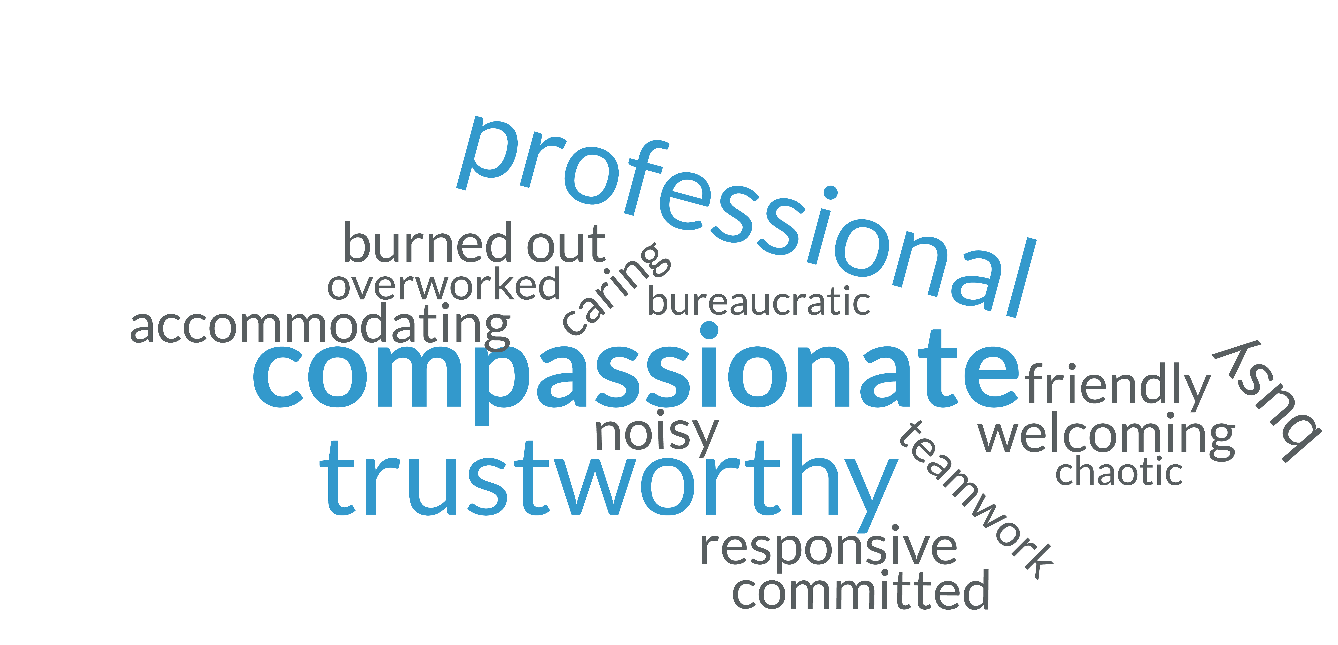
Gabriel Park VIBE

Slide 9
Our Story: Creating the VIBE (2016)
A journey to find an identity for the clinical staff to believe in, relate to and live by
Word cloud – don’t ignore the small words
Keep it alive – use it in your daily life
Build Trust
For relationship building in the teams
For relationships with patients

Slide 10
Relationships

Slide 11
Our Story: Colocation (January 2017)

Slide 12
Colocation Survey: Huddling frequency (MA/Provider)

Slide 13
Colocation Survey: Face to Face time in coordinating care

Slide 14
All Clinic Retreats:
Bringing Our Team Together…

Slide 15
Languages of Appreciation (February 2017)
Identifies individual’s “language”
for how one best responds to
appreciation
Tangible Gifts
Words of Appreciation
Acts of Service
Quality Time
Implemented at all-staff retreat
Woven through daily practice
Notes:
Facilitator training, 4 hr retreat, based on love languages. Received grant from Portland Interprofessional Association to fund this activity and the next activity.

Slide 16
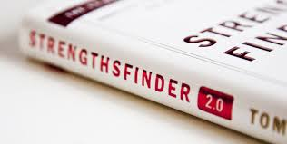
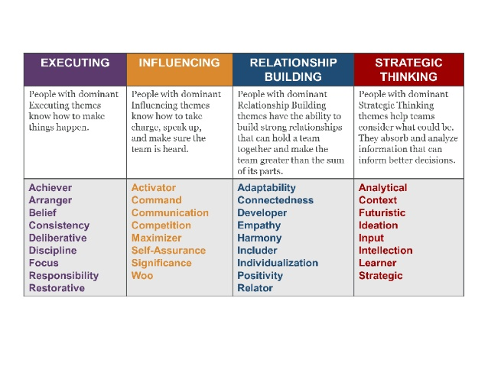
Strengths Finder 2.0 (October 2017)
StrengthsFinder → CliftonStrengths
Assessment tool used to identify personal attributes used to maximize potential
34 themes organized into 4 domains
All staff retreat
Provided book
Took assessment
Workshop lead by facilitator
Personal report
“Strengths” – annual reviews, staff evaluations
Notes:
Funded by Portland Interprofessional Association to fund a facilitator trained by Gallup (also happened to be a colleague that Karen and I did the STFM Emerging Leaders Fellowship with).
Gallup has developed strengths finder

Slide 17
Survey Data (2017)
Notes:
Team Culture = working well as a team, relying on others to do a good job, implementing change in the clinic

Slide 18
Survey Data (2017)

Slide 19
Notes:
2017 Fall proficiency with EMR – also lots of PJ time with EMR, insufficient time for documentation

Slide 20
Sustaining the Effort (2017-present)
Build the culture beyond the leadership… Getting a Faculty Wellness Champion!
Notes:
Through the same grant that funded strengths finder and languages of appreciation, this granted some time for a faculty to champion engagement and wellness in the practice for a year.

Slide 21
Amanda Miller, PA-C
Joined OHSU FM faculty at GP in 2007
QI Clinician Lead and faculty wellness champion
My own burnout and wellness journey
Finding joy in work
Working with teams
Making connections
Empowering change from where you are

Slide 22
Engagement
Four principles that drive engagement
Feel valued and understood
Express gifts and talents
and have them recognized
Understand the meaning/purpose of what we do
“The Why?”
Foster the internal drive for progress and development
Consistent accountability
Opportunity to grow

Slide 23
Lenses of Wellness/Engagement
Individual accountability
Goals/intentions
Resources
Positive habits
Gratitude
Journaling
Thank you notes
Yellow car
System/Clinic
Culture/Value
Wellness committee
Generational differences
Psychological Safety
Transparency

Slide 24
Our Story: Current State
All-Staff Meeting Series Reorganization
Monthly all-staff meeting transformation
Administrative
Quality Improvement
Wellness
Benefits
Lead by example
Protects time
Creativity by experimentation
Wellness committee
Multi-disciplinary
Notes:
Dr. Tseng tasked me the awesome job of talking about what I think are some of the coolest/most fun changes we have made at GP in the last several years.
I thank her for that
Preston’s story if time allows
First is reorganization of monthly staff meeting.
We have always met as a clinic the first Thursday of the month over the noon hour.
A year ago, we recognized that we could be more intentional with our time by narrowing our focus. Our monthly staff meetings are now theme based and rotate between three core topics:
Admin
QI
Wellness
Providing this concerted focus does three things:
Sets a tone that we lead by example – leadership prioritizes the value of addressing wellness
protects time – agenda doesn’t get pushed
Allows us to experiment
speaker
exercise
programs from “The Hill”
common activity/language
A spin-off committee developed out of this re-organization - the wellness committee.
Multi-d group led by one of our CM RNs (intentionally not a clinician or part of clinic leadership)
meets monthly
safe space for open communication around what wellness means to different people
used to brainstorm ideas
i.e. meditation/quiet corning, patio space, Mindful Meditation Monday

Slide 25
Our Story: Current State
Workflow Committee
Part of Quality Improvement
Engages multi-disciplinary cross section of employees
Meets monthly
Reviews and revises current workflows, develops new ones
PDSA/pilots
Increases number of employees in our practice who contribute to change
Notes:
Within the last year, we have also formed a monthly workflow committee, facilitated by QI lead.
Engages employees from all areas of staffing – front office, back office, clinician (me), panel manager, RN, BH
Reviews and revises current workflows, develops new ones (CPC+ metrics)
PDSA cycles and pilots to evaluate the effectiveness of what we develop
Increased number of employees who can contribute to real time change
Recent example: cognitive screening in patients with dementia – tailored proposed primary care workflow to GP, resulted in additional training for MA staff so they could safely and efficiently take ownership over the workflow

Slide 26
Our Story: Current → Future State
Creativity
Intention
Connection
Willingness to allow employees to work to the top of their licenses/potential
Notes:
Using team based care to develop a clinic culture that values wellness requires:
Creativity
Intention
Connection
Probably the most important - willingness to allow employees to do, to participate, and to work to their maximum potential

Slide 27
Our Story: Future State
Combining individual and system engagement efforts to promote a culture of connectivity
Acknowledgement and recognition
Psychological safety
Feedback loops
Generational differences in the workplace
EMR optimization
Transparency/visualization of goals and projects
Staff driven suggestion and change grounded in gratitude

Slide 28
Our Story: Future State
Leveraging our strengths
Thoughtful compilation of work groups
Helping to discover “The Why” —> Joy in Practice
Employee retention
Notes:
Example, 5Ds

Slide 29
Joy in Practice – IHI White Paper (2017)
Step 1: Ask staff and clinicians, “What matters to you?”
What makes a good day for you?
What makes you proud to work here?
When we are at our best, what does that look like?
What gets in the way of a ”good day?”
Step 2: Identify unique impediments to joy in work in the local context.
Step 3: Commit to a systems approach to making joy in work a shared responsibility at all levels of the organization
Step 4: Use improvement science to test approaches to improving joy in work in your organization.
Source: Perlo J, Balik B, Swensen S, Kabcenell A, Landsman J, Feeley D. IHI Framework for Improving Joy in Work. IHI White Paper. Cambridge, Massachusetts: Institute for Healthcare Improvement; 2017.
Notes:
Cannot be understated that investment in joy in practice, and helping both your employees and clinicians re-discover, discover, or reconnect with that joy is important.

Slide 31
Coming Full Circle…
Begin at the Beginning… What is your story of your practice?
Notes:
We will end this presentation where we started where– a challenge to you to begin at the beginning. What is your story? How will you build the culture of wellness in your practice?

Slide 32
Please evaluate this presentation using the conference mobile app! Simply click on the "clipboard" icon on the presentation page.

