Slide 1
Launching a Longitudinal Curriculum: Coordinator Survival Guide
Julie Golding
February 1, 2019

Slide 2
Disclosures
None

Slide 3
Goals and Objectives
Identify coordinator-specific challenges faced when launching a longitudinal curriculum
Identify best practices for overcoming these challenges
Identify which strategies could be successfully applied at your institution

Slide 4
Background and Context
Major curriculum changes at UNC SOM for our Central Campus – new format launched March 2016
Third year outpatient Family Medicine, Internal Medicine, and Pediatrics combined to become a 16-week longitudinal course called Community Based Longitudinal Care (CBLC)

Slide 5
Peer Collaboration
Come up with 1-3 coordinator-specific challenges to implementing curriculum* change
*longitudinal focus if possible

Slide 6
Coordinator-Specific Challenges
Preceptor recruitment (increased number of preceptors)
Orienting preceptors to the new curriculum
Coordinating with multiple departments to create integrated student schedules
Managing curriculum over a longer period of time

Slide 7
Best Practices: Preceptor Recruitment and Curriculum Orientation
Use your network
Advertise teaching benefits
Host preceptor orientations
Keep your communication consistent and concise

Slide 8
Best Practices: Multi-Department Coordination
Establish single faculty member and coordinator point-person
Follow-up quickly and focus on clear, concise, and accurate communication
Track your progress with each student’s schedule

Slide 9
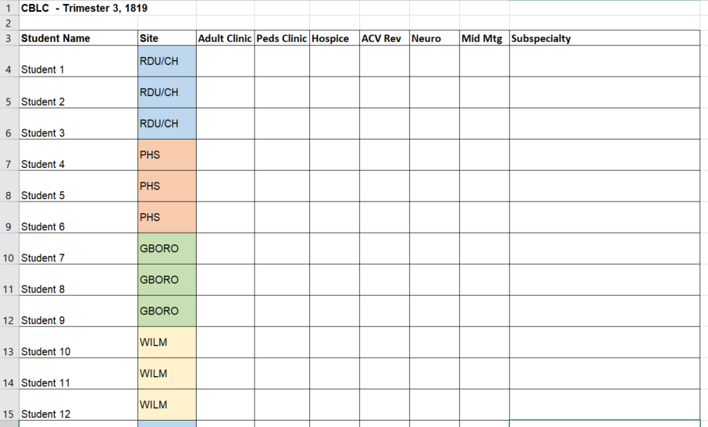

Slide 10
Best Practices: Managing a longer curriculum
Involve coordinators early in the planning process
Identify which course requirements are essential and which have more flexibility
Educate yourself on existing tools and resources
Prepare to adapt and be flexible
Simplify, streamline, and set attainable goals

Slide 11
Think about your institution
Similar or different challenges?
What are your best practices for overcoming these challenges?
Commit to [at least] one new best practice that you will begin using this academic year – write it down!

Slide 12
Please evaluate this presentation using the conference mobile app! Simply click on the "clipboard" icon on the presentation page.
Other questions/comments? Email me!
julie_golding@med.unc.edu

