Slide 1
Site Visits and Clerkship Coordinators – Defining a Best Practice
Uniformed Services University
Bethesda, MD
Notes:
Dana lead.

Slide 2
Disclosures
None

Slide 3
Learning Objectives
Review the LCME standards that relate to oversight of clinical activities at clerkship sites.
Modify a site visit interview tool to use at their home institution.
Perform and present a SWOT (strengths, weaknesses, opportunities, threats) analysis for individual clerkship rotation sites.

Slide 4
Relevance to Medical Student Education
Many of the LCME standard requirements directly or indirectly relate to oversight of medical students across clinical sites.
An organized system to conduct a formal site visit with the clerkship rotation sites will ensure the best rotational experience for our students.
An organized site visit will enhance and strengthen our relationship with the sites and ensure that checks and balances are in place.
It will also help us ultimately accomplish the mission and goal to educate, train and prepare each student for future physician careers.

Slide 5
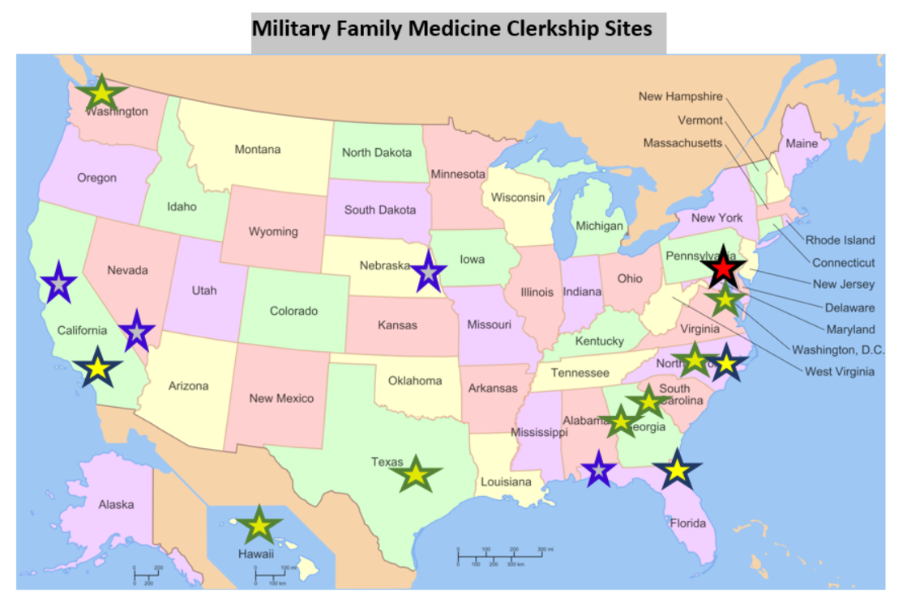
Background
(insert a picture of US with stars over our sites)
Notes:
Dana
-FM is a core clerkship, 6 weeks
-challenge is the geopraphically separated sites
Uniformed Services University Family Medicine Clerkship Director engages in ongoing planning and quality improvement of the Family Medicine Core Clerkship Program.
One part of this evaluation process is conducting annual visits to the locations where our medical students complete their clerkship rotations as part of their Core Clerkship requirements.
An organized system to conduct a formal site visit with the military treatment facilities will ensure the best rotational experience for our students.
An organized site visit will enhance and strengthen our relationship with the sites and ensure that checks and balances are in place.
An organized site visit can only help us accomplish mission and goal is to educate, train and prepare each student to take care of the military members to maintain the readiness of the military members.
A strong Family Medicine experience is an important foundation for the students as they graduate and go on to their next military assignment.

Slide 6
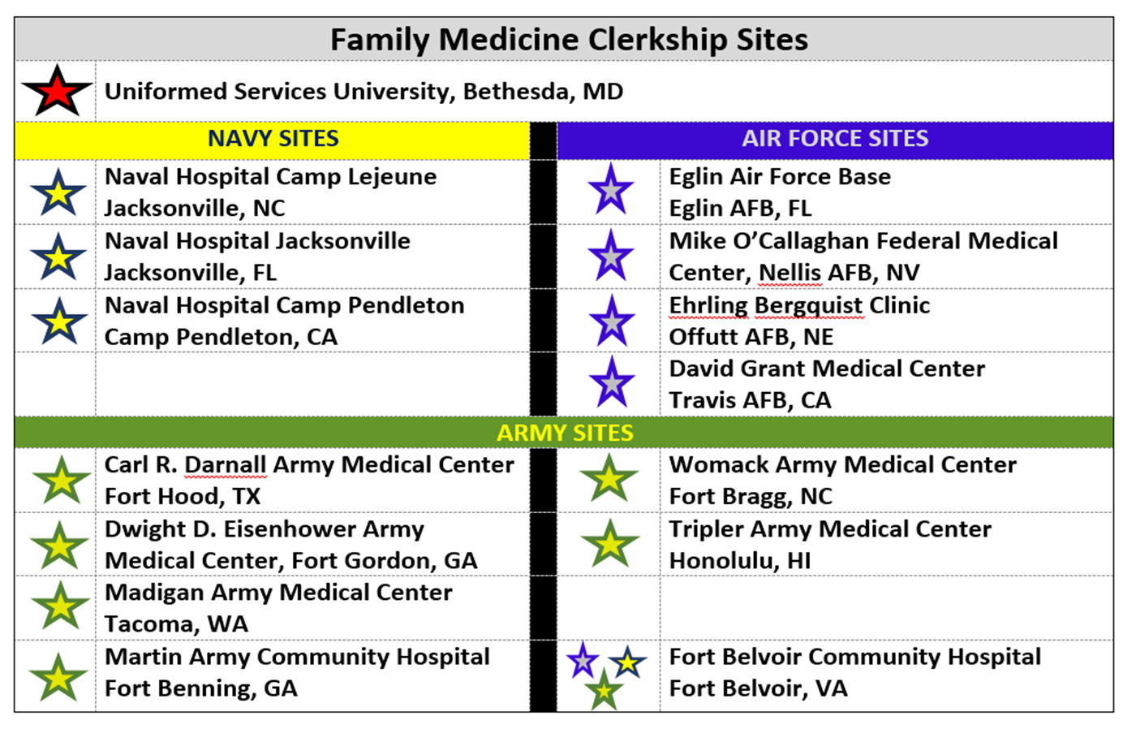
Background
Notes:
Dana
-FM is a core clerkship, 6 weeks
-challenge is the geopraphically separated sites
Uniformed Services University Family Medicine Clerkship Director engages in ongoing planning and quality improvement of the Family Medicine Core Clerkship Program.
One part of this evaluation process is conducting annual visits to the locations where our medical students complete their clerkship rotations as part of their Core Clerkship requirements.
An organized system to conduct a formal site visit with the military treatment facilities will ensure the best rotational experience for our students.
An organized site visit will enhance and strengthen our relationship with the sites and ensure that checks and balances are in place.
An organized site visit can only help us accomplish mission and goal is to educate, train and prepare each student to take care of the military members to maintain the readiness of the military members.
A strong Family Medicine experience is an important foundation for the students as they graduate and go on to their next military assignment.

Slide 7
LCME Standards
1.1 Strategic Planning and Continuous Quality Improvement
A medical school engages in ongoing planning and continuous quality improvement processes that establish short and long-term programmatic goals, result in the achievement of measurable outcomes that are used to improve programmatic quality, and ensure effective monitoring of the medical education program’s compliance with accreditation standards.
3.5 Learning Environment/Professionalism
A medical school ensures that the learning environment of its medical education program is conducive to the ongoing development of explicit and appropriate professional behaviors in its medical students, faculty, and staff at all locations and is one in which all individuals are treated with respect. The medical school and its clinical affiliates share the responsibility for periodic evaluation of the learning environment in order to identify positive and negative influences on the maintenance of professional standards, develop and conduct appropriate strategies to enhance positive and mitigate negative influences, and identify and promptly correct violations of professional standards.
4.5 Faculty Professional Development
A medical school and/or its sponsoring institution provides opportunities for professional development to each faculty member in the areas of discipline content, curricular design, program evaluation, student assessment methods, instructional methodology, and research to enhance his or her skills and leadership abilities in these areas.
Notes:
Dana to edit. List relevant LCME standards. 5 minutes.
5 minutes- review of relevant LCME standards to clerkship site visits (1.1, 3.5, 4.5, 5.5, 5.11, 6.1, 6.2, 6.4, 6.7, 8.4, 8.5, 8.6, 8.7, 9.1, 9.3) (Dana)
1.1 Strategic Planning and Continuous Quality Improvement
A medical school engages in ongoing planning and continuous quality improvement processes that establish short and long-term programmatic goals, result in the achievement of measurable outcomes that are used to improve programmatic quality, and ensure effective monitoring of the medical education program’s compliance with accreditation standards.
3.5 Learning Environment/Professionalism
A medical school ensures that the learning environment of its medical education program is conducive to the ongoing development of explicit and appropriate professional behaviors in its medical students, faculty, and staff at all locations and is one in which all individuals are treated with respect. The medical school and its clinical affiliates share the responsibility for periodic evaluation of the learning environment in order to identify positive and negative influences on the maintenance of professional standards, develop and conduct appropriate strategies to enhance positive and mitigate negative influences, and identify and promptly correct violations of professional standards.
4.5 Faculty Professional Development
A medical school and/or its sponsoring institution provides opportunities for professional development to each faculty member in the areas of discipline content, curricular design, program evaluation, student assessment methods, instructional methodology, and research to enhance his or her skills and leadership abilities in these areas.
5.5 Resources for Clinical Instruction
A medical school has, or is assured the use of, appropriate resources for the clinical instruction of its medical students in ambulatory and inpatient settings and has adequate numbers and types of patients (e.g., acuity, case mix, age, gender).
6.1 Program and Learning Objectives
The faculty of a medical school define its medical education program objectives in outcome-based terms that allow the assessment of medical students’ progress in developing the competencies that the profession and the public expect of a physician. The medical school makes these medical education program objectives known to all medical students and faculty. In addition, the medical school ensures that the learning objectives for each required learning experience (e.g., course, clerkship) are made known to all medical students and those faculty, residents, and others with teaching and assessment responsibilities in those required experiences.
6.2 Required Clinical Experiences
The faculty of a medical school define the types of patients and clinical conditions that medical students are required to encounter, the skills to be performed by medical students, the appropriate clinical settings for these experiences, and the expected levels of medical student responsibility.
6.4 Inpatient/Outpatient Experiences
The faculty of a medical school ensure that the medical curriculum includes clinical experiences in both outpatient and inpatient settings.
6.7 Academic Environments
The faculty of a medical school ensure that medical students have opportunities to learn in academic environments that permit interaction with students enrolled in other health professions, graduate and professional degree programs, and in clinical environments that provide opportunities for interaction with physicians in graduate medical education programs and in continuing medical education programs.
8.4 Program Evaluation
A medical school collects and uses a variety of outcome data, including national norms of accomplishment, to demonstrate the extent to which medical students are achieving medical education program objectives and to enhance medical education program quality. These data are collected during program enrollment and after program completion.
8.5 Medical Student Feedback
In evaluating medical education program quality, a medical school has formal processes in place to collect and consider medical student evaluations of their courses, clerkships, and teachers, and other relevant information.
8.6 Monitoring of Completion of Required Clinical Experiences
A medical school has in place a system with central oversight that monitors and ensures completion by all medical students of required clinical experiences in the medical education program and remedies any identified gaps.
8.7 Comparability of Education/Assessment
A medical school ensures that the medical curriculum includes comparable educational experiences and equivalent methods of assessment across all locations within a given course and clerkship to ensure that all medical students achieve the same medical education program objectives.
9.1 Preparation of Resident and Non-Faculty Instructors
In a medical school, residents, graduate students, postdoctoral fellows, and other non-faculty instructors in the medical education program who supervise or teach medical students are familiar with the learning objectives of the course or clerkship and are prepared for their roles in teaching and assessment. The medical school provides resources to enhance residents’ and non-faculty instructors’ teaching and assessment skills and provides central monitoring of their participation in those opportunities.
9.3 Clinical Supervision of Medical Students
A medical school ensures that medical students in clinical learning situations involving patient care are appropriately supervised at all times in order to ensure patient and student safety, that the level of responsibility delegated to the student is appropriate to his or her level of training, and that the activities supervised are within the scope of practice of the supervising health professional.

Slide 8
LCME Standards
5.5 Resources for Clinical Instruction
A medical school has, or is assured the use of, appropriate resources for the clinical instruction of its medical students in ambulatory and inpatient settings and has adequate numbers and types of patients (e.g., acuity, case mix, age, gender).
6.1 Program and Learning Objectives
The faculty of a medical school define its medical education program objectives in outcome-based terms that allow the assessment of medical students’ progress in developing the competencies that the profession and the public expect of a physician. The medical school makes these medical education program objectives known to all medical students and faculty. In addition, the medical school ensures that the learning objectives for each required learning experience (e.g., course, clerkship) are made known to all medical students and those faculty, residents, and others with teaching and assessment responsibilities in those required experiences.
6.2 Required Clinical Experiences
The faculty of a medical school define the types of patients and clinical conditions that medical students are required to encounter, the skills to be performed by medical students, the appropriate clinical settings for these experiences, and the expected levels of medical student responsibility.
Notes:
Dana to edit. List relevant LCME standards. 5 minutes.
5 minutes- review of relevant LCME standards to clerkship site visits (1.1, 3.5, 4.5, 5.5, 5.11, 6.1, 6.2, 6.4, 6.7, 8.4, 8.5, 8.6, 8.7, 9.1, 9.3) (Dana)
1.1 Strategic Planning and Continuous Quality Improvement
A medical school engages in ongoing planning and continuous quality improvement processes that establish short and long-term programmatic goals, result in the achievement of measurable outcomes that are used to improve programmatic quality, and ensure effective monitoring of the medical education program’s compliance with accreditation standards.
3.5 Learning Environment/Professionalism
A medical school ensures that the learning environment of its medical education program is conducive to the ongoing development of explicit and appropriate professional behaviors in its medical students, faculty, and staff at all locations and is one in which all individuals are treated with respect. The medical school and its clinical affiliates share the responsibility for periodic evaluation of the learning environment in order to identify positive and negative influences on the maintenance of professional standards, develop and conduct appropriate strategies to enhance positive and mitigate negative influences, and identify and promptly correct violations of professional standards.
4.5 Faculty Professional Development
A medical school and/or its sponsoring institution provides opportunities for professional development to each faculty member in the areas of discipline content, curricular design, program evaluation, student assessment methods, instructional methodology, and research to enhance his or her skills and leadership abilities in these areas.
5.5 Resources for Clinical Instruction
A medical school has, or is assured the use of, appropriate resources for the clinical instruction of its medical students in ambulatory and inpatient settings and has adequate numbers and types of patients (e.g., acuity, case mix, age, gender).
6.1 Program and Learning Objectives
The faculty of a medical school define its medical education program objectives in outcome-based terms that allow the assessment of medical students’ progress in developing the competencies that the profession and the public expect of a physician. The medical school makes these medical education program objectives known to all medical students and faculty. In addition, the medical school ensures that the learning objectives for each required learning experience (e.g., course, clerkship) are made known to all medical students and those faculty, residents, and others with teaching and assessment responsibilities in those required experiences.
6.2 Required Clinical Experiences
The faculty of a medical school define the types of patients and clinical conditions that medical students are required to encounter, the skills to be performed by medical students, the appropriate clinical settings for these experiences, and the expected levels of medical student responsibility.
6.4 Inpatient/Outpatient Experiences
The faculty of a medical school ensure that the medical curriculum includes clinical experiences in both outpatient and inpatient settings.
6.7 Academic Environments
The faculty of a medical school ensure that medical students have opportunities to learn in academic environments that permit interaction with students enrolled in other health professions, graduate and professional degree programs, and in clinical environments that provide opportunities for interaction with physicians in graduate medical education programs and in continuing medical education programs.
8.4 Program Evaluation
A medical school collects and uses a variety of outcome data, including national norms of accomplishment, to demonstrate the extent to which medical students are achieving medical education program objectives and to enhance medical education program quality. These data are collected during program enrollment and after program completion.
8.5 Medical Student Feedback
In evaluating medical education program quality, a medical school has formal processes in place to collect and consider medical student evaluations of their courses, clerkships, and teachers, and other relevant information.
8.6 Monitoring of Completion of Required Clinical Experiences
A medical school has in place a system with central oversight that monitors and ensures completion by all medical students of required clinical experiences in the medical education program and remedies any identified gaps.
8.7 Comparability of Education/Assessment
A medical school ensures that the medical curriculum includes comparable educational experiences and equivalent methods of assessment across all locations within a given course and clerkship to ensure that all medical students achieve the same medical education program objectives.
9.1 Preparation of Resident and Non-Faculty Instructors
In a medical school, residents, graduate students, postdoctoral fellows, and other non-faculty instructors in the medical education program who supervise or teach medical students are familiar with the learning objectives of the course or clerkship and are prepared for their roles in teaching and assessment. The medical school provides resources to enhance residents’ and non-faculty instructors’ teaching and assessment skills and provides central monitoring of their participation in those opportunities.
9.3 Clinical Supervision of Medical Students
A medical school ensures that medical students in clinical learning situations involving patient care are appropriately supervised at all times in order to ensure patient and student safety, that the level of responsibility delegated to the student is appropriate to his or her level of training, and that the activities supervised are within the scope of practice of the supervising health professional.

Slide 9
LCME Standards
6.7 Academic Environments
The faculty of a medical school ensure that medical students have opportunities to learn in academic environments that permit interaction with students enrolled in other health professions, graduate and professional degree programs, and in clinical environments that provide opportunities for interaction with physicians in graduate medical education programs and in continuing medical education programs.
8.4 Program Evaluation
A medical school collects and uses a variety of outcome data, including national norms of accomplishment, to demonstrate the extent to which medical students are achieving medical education program objectives and to enhance medical education program quality. These data are collected during program enrollment and after program completion.
8.5 Medical Student Feedback
In evaluating medical education program quality, a medical school has formal processes in place to collect and consider medical student evaluations of their courses, clerkships, and teachers, and other relevant information.
Notes:
Dana to edit. List relevant LCME standards. 5 minutes.
5 minutes- review of relevant LCME standards to clerkship site visits (1.1, 3.5, 4.5, 5.5, 5.11, 6.1, 6.2, 6.4, 6.7, 8.4, 8.5, 8.6, 8.7, 9.1, 9.3) (Dana)
1.1 Strategic Planning and Continuous Quality Improvement
A medical school engages in ongoing planning and continuous quality improvement processes that establish short and long-term programmatic goals, result in the achievement of measurable outcomes that are used to improve programmatic quality, and ensure effective monitoring of the medical education program’s compliance with accreditation standards.
3.5 Learning Environment/Professionalism
A medical school ensures that the learning environment of its medical education program is conducive to the ongoing development of explicit and appropriate professional behaviors in its medical students, faculty, and staff at all locations and is one in which all individuals are treated with respect. The medical school and its clinical affiliates share the responsibility for periodic evaluation of the learning environment in order to identify positive and negative influences on the maintenance of professional standards, develop and conduct appropriate strategies to enhance positive and mitigate negative influences, and identify and promptly correct violations of professional standards.
4.5 Faculty Professional Development
A medical school and/or its sponsoring institution provides opportunities for professional development to each faculty member in the areas of discipline content, curricular design, program evaluation, student assessment methods, instructional methodology, and research to enhance his or her skills and leadership abilities in these areas.
5.5 Resources for Clinical Instruction
A medical school has, or is assured the use of, appropriate resources for the clinical instruction of its medical students in ambulatory and inpatient settings and has adequate numbers and types of patients (e.g., acuity, case mix, age, gender).
6.1 Program and Learning Objectives
The faculty of a medical school define its medical education program objectives in outcome-based terms that allow the assessment of medical students’ progress in developing the competencies that the profession and the public expect of a physician. The medical school makes these medical education program objectives known to all medical students and faculty. In addition, the medical school ensures that the learning objectives for each required learning experience (e.g., course, clerkship) are made known to all medical students and those faculty, residents, and others with teaching and assessment responsibilities in those required experiences.
6.2 Required Clinical Experiences
The faculty of a medical school define the types of patients and clinical conditions that medical students are required to encounter, the skills to be performed by medical students, the appropriate clinical settings for these experiences, and the expected levels of medical student responsibility.
6.4 Inpatient/Outpatient Experiences
The faculty of a medical school ensure that the medical curriculum includes clinical experiences in both outpatient and inpatient settings.
6.7 Academic Environments
The faculty of a medical school ensure that medical students have opportunities to learn in academic environments that permit interaction with students enrolled in other health professions, graduate and professional degree programs, and in clinical environments that provide opportunities for interaction with physicians in graduate medical education programs and in continuing medical education programs.
8.4 Program Evaluation
A medical school collects and uses a variety of outcome data, including national norms of accomplishment, to demonstrate the extent to which medical students are achieving medical education program objectives and to enhance medical education program quality. These data are collected during program enrollment and after program completion.
8.5 Medical Student Feedback
In evaluating medical education program quality, a medical school has formal processes in place to collect and consider medical student evaluations of their courses, clerkships, and teachers, and other relevant information.
8.6 Monitoring of Completion of Required Clinical Experiences
A medical school has in place a system with central oversight that monitors and ensures completion by all medical students of required clinical experiences in the medical education program and remedies any identified gaps.
8.7 Comparability of Education/Assessment
A medical school ensures that the medical curriculum includes comparable educational experiences and equivalent methods of assessment across all locations within a given course and clerkship to ensure that all medical students achieve the same medical education program objectives.
9.1 Preparation of Resident and Non-Faculty Instructors
In a medical school, residents, graduate students, postdoctoral fellows, and other non-faculty instructors in the medical education program who supervise or teach medical students are familiar with the learning objectives of the course or clerkship and are prepared for their roles in teaching and assessment. The medical school provides resources to enhance residents’ and non-faculty instructors’ teaching and assessment skills and provides central monitoring of their participation in those opportunities.
9.3 Clinical Supervision of Medical Students
A medical school ensures that medical students in clinical learning situations involving patient care are appropriately supervised at all times in order to ensure patient and student safety, that the level of responsibility delegated to the student is appropriate to his or her level of training, and that the activities supervised are within the scope of practice of the supervising health professional.

Slide 10
LCME Standards
8.6 Monitoring of Completion of Required Clinical Experiences
A medical school has in place a system with central oversight that monitors and ensures completion by all medical students of required clinical experiences in the medical education program and remedies any identified gaps.
8.7 Comparability of Education/Assessment
A medical school ensures that the medical curriculum includes comparable educational experiences and equivalent methods of assessment across all locations within a given course and clerkship to ensure that all medical students achieve the same medical education program objectives.
9.1 Preparation of Resident and Non-Faculty Instructors
In a medical school, residents, graduate students, postdoctoral fellows, and other non-faculty instructors in the medical education program who supervise or teach medical students are familiar with the learning objectives of the course or clerkship and are prepared for their roles in teaching and assessment. The medical school provides resources to enhance residents’ and non-faculty instructors’ teaching and assessment skills and provides central monitoring of their participation in those opportunities.
9.3 Clinical Supervision of Medical Students
A medical school ensures that medical students in clinical learning situations involving patient care are appropriately supervised at all times in order to ensure patient and student safety, that the level of responsibility delegated to the student is appropriate to his or her level of training, and that the activities supervised are within the scope of practice of the supervising health professional.
Notes:
Dana to edit. List relevant LCME standards. 5 minutes.
5 minutes- review of relevant LCME standards to clerkship site visits (1.1, 3.5, 4.5, 5.5, 5.11, 6.1, 6.2, 6.4, 6.7, 8.4, 8.5, 8.6, 8.7, 9.1, 9.3) (Dana)
1.1 Strategic Planning and Continuous Quality Improvement
A medical school engages in ongoing planning and continuous quality improvement processes that establish short and long-term programmatic goals, result in the achievement of measurable outcomes that are used to improve programmatic quality, and ensure effective monitoring of the medical education program’s compliance with accreditation standards.
3.5 Learning Environment/Professionalism
A medical school ensures that the learning environment of its medical education program is conducive to the ongoing development of explicit and appropriate professional behaviors in its medical students, faculty, and staff at all locations and is one in which all individuals are treated with respect. The medical school and its clinical affiliates share the responsibility for periodic evaluation of the learning environment in order to identify positive and negative influences on the maintenance of professional standards, develop and conduct appropriate strategies to enhance positive and mitigate negative influences, and identify and promptly correct violations of professional standards.
4.5 Faculty Professional Development
A medical school and/or its sponsoring institution provides opportunities for professional development to each faculty member in the areas of discipline content, curricular design, program evaluation, student assessment methods, instructional methodology, and research to enhance his or her skills and leadership abilities in these areas.
5.5 Resources for Clinical Instruction
A medical school has, or is assured the use of, appropriate resources for the clinical instruction of its medical students in ambulatory and inpatient settings and has adequate numbers and types of patients (e.g., acuity, case mix, age, gender).
6.1 Program and Learning Objectives
The faculty of a medical school define its medical education program objectives in outcome-based terms that allow the assessment of medical students’ progress in developing the competencies that the profession and the public expect of a physician. The medical school makes these medical education program objectives known to all medical students and faculty. In addition, the medical school ensures that the learning objectives for each required learning experience (e.g., course, clerkship) are made known to all medical students and those faculty, residents, and others with teaching and assessment responsibilities in those required experiences.
6.2 Required Clinical Experiences
The faculty of a medical school define the types of patients and clinical conditions that medical students are required to encounter, the skills to be performed by medical students, the appropriate clinical settings for these experiences, and the expected levels of medical student responsibility.
6.4 Inpatient/Outpatient Experiences
The faculty of a medical school ensure that the medical curriculum includes clinical experiences in both outpatient and inpatient settings.
6.7 Academic Environments
The faculty of a medical school ensure that medical students have opportunities to learn in academic environments that permit interaction with students enrolled in other health professions, graduate and professional degree programs, and in clinical environments that provide opportunities for interaction with physicians in graduate medical education programs and in continuing medical education programs.
8.4 Program Evaluation
A medical school collects and uses a variety of outcome data, including national norms of accomplishment, to demonstrate the extent to which medical students are achieving medical education program objectives and to enhance medical education program quality. These data are collected during program enrollment and after program completion.
8.5 Medical Student Feedback
In evaluating medical education program quality, a medical school has formal processes in place to collect and consider medical student evaluations of their courses, clerkships, and teachers, and other relevant information.
8.6 Monitoring of Completion of Required Clinical Experiences
A medical school has in place a system with central oversight that monitors and ensures completion by all medical students of required clinical experiences in the medical education program and remedies any identified gaps.
8.7 Comparability of Education/Assessment
A medical school ensures that the medical curriculum includes comparable educational experiences and equivalent methods of assessment across all locations within a given course and clerkship to ensure that all medical students achieve the same medical education program objectives.
9.1 Preparation of Resident and Non-Faculty Instructors
In a medical school, residents, graduate students, postdoctoral fellows, and other non-faculty instructors in the medical education program who supervise or teach medical students are familiar with the learning objectives of the course or clerkship and are prepared for their roles in teaching and assessment. The medical school provides resources to enhance residents’ and non-faculty instructors’ teaching and assessment skills and provides central monitoring of their participation in those opportunities.
9.3 Clinical Supervision of Medical Students
A medical school ensures that medical students in clinical learning situations involving patient care are appropriately supervised at all times in order to ensure patient and student safety, that the level of responsibility delegated to the student is appropriate to his or her level of training, and that the activities supervised are within the scope of practice of the supervising health professional.

Slide 11
Preparation for Site Visits
Memorandum of Understanding between the medical school and the site to review.
Feedback from the anonymous student evaluation from the rotation over the year.
Checklist for Clerkship Directors to go over with GME Administrators, Director of Medical Education, Medical Students, Site Coordinators, Program Directors, Residents and Faculty, and Commander of Site.
How the Site compared to other sites in regards to their orientation process, clear expectations, promoting a learning environment, didactic teaching, etc.
A “SWOT” Analysis Report to include the Strengths, Weaknesses, Opportunities, and Threats will be compiled after the visit and sent to the Site
Notes:
Denise

Slide 12
Who Should You Meet With?
GME Administrators (30-60 mins)
Director of Medical Education (30 mins)
Medical Students (1 hr)
Site Coordinators (1 hr)
Program Directors (30 mins)
Residents and Faculty (1 hr)
Commander of Site or CEO (30 mins)
? Others…
Notes:
Dana

Slide 13
Site Visit Interview Tool
Notes:
Denise to brief this slide. Add snip it of Tool; reference handout during discussion; (5 Min)

Slide 14
Create an Agenda
Notes:
Denise to brief this slide. Add snip it of Tool; reference handout during discussion; (5 Min)

Slide 15
GME Administrators
Notes:
Denise to brief this slide. Add snip it of Tool; reference handout during discussion; (5 Min)

Slide 16
DIRECTOR OF MEDICAL EDUCATION
Notes:
Denise to brief this slide. Add snip it of Tool; reference handout during discussion; (5 Min)

Slide 17
MEDICAL STUDENTS
Notes:
Denise to brief this slide. Add snip it of Tool; reference handout during discussion; (5 Min)

Slide 18
SITE COORDINATORS
Notes:
Denise to brief this slide. Add snip it of Tool; reference handout during discussion; (5 Min)

Slide 19
PROGRAM DIRECTORS
Notes:
Denise to brief this slide. Add snip it of Tool; reference handout during discussion; (5 Min)

Slide 20
HOSPITAL CEO or COMMANDER
Notes:
Denise to brief this slide. Add snip it of Tool; reference handout during discussion; (5 Min)

Slide 21
RESIDENTS and FACULTY
Notes:
Denise to brief this slide. Add snip it of Tool; reference handout during discussion; (5 Min)

Slide 22
SITE VISITOR’S CHECKLIST
Notes:
Denise to brief this slide. Add snip it of Tool; reference handout during discussion; (5 Min)

Slide 23
Perform and Present a SWOT Analysis
Notes:
Dana

Slide 24
After the Site Visit
Compile your notes from the checklist and formalize into a final
report.
2. Make a Checklist of what the Site Visitor will need to follow up on.
3. Include a SWOT Analysis in the final report.
4. Present to your Department Chair for signature on the cover letter.
5. Send a copy of the final report to the Site.
6. Keep a copy of the report in your Site Visit Binder.
Notes:
Denise

Slide 25
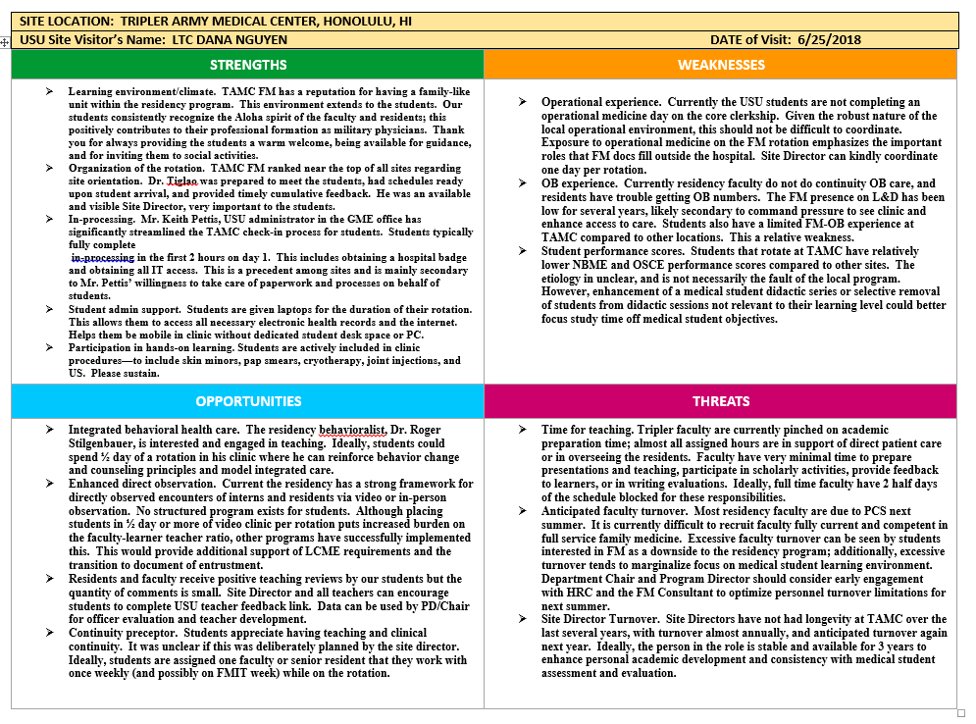
SWOT
Notes:
Dana

Slide 26
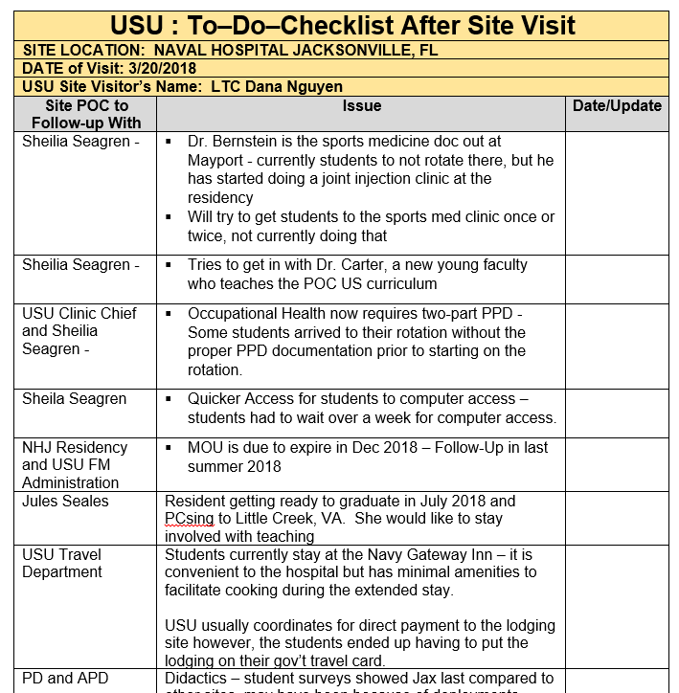
FOLLOW UP CHECKLIST
Notes:
Dana

Slide 27
Group Discussion
Notes:
You will work together with the people at your table to complete the assignment.
You are the team that will participate in a Site Visit:
When I say “STFM”, you will open the envelope in the center of your table to find out who you will be meeting with from the training site.
Come up with a checklist of questions and/or information that you would want to cover with them during the Site Visit.
You will have 15 minutes.
Pick a spokesperson to present to the larger group.

Slide 28
Please evaluate this presentation using the conference mobile app! Simply click on the "clipboard" icon on the presentation page.

Slide 29
Conclusions
What is New or Innovative?
No standard program or guideline exists to guide clerkship directors and coordinators toward effective site visits. We offer an interview guide that individuals can modify for their institution, to ensure appropriate oversight of LCME requirements at clinical sites.
We also offer a novel method of reporting and communicating the results of the visit, which assists site directors, clerkship coordinators, clerkship directors, and community preceptors toward actionable plans.

Slide 30
References
Liaison Committee on Medical Education. Functions and Structure of a Medical School: Standards for Accreditation of Medical Education Programs Leading to the MD Degree. Washington, DC: American Association of Medical Colleges; March 2018.
Sources Morrison M. SWOT Analysis, https://rapidbi.com/SWOTanalysis. 2006. Accessed April 6, 2017. Osita C, Onyebuchi I, Justina N. "Organization's stability and productivity: the role of SWOT analysis" International Journal of Innovative and Applied Research Jan 2014, 2(9):23–32. Accessed April 6, 2017.

