Slide 1
Responding to Inappropriate Patients
What to say when you don’t know what to say
Michelle Kane, PsyD
Lee Chambliss, MD
Cone Family Medicine,
Greensboro, NC

Slide 2
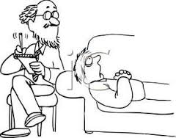
Disclosures / Disclaimers
Nothing to disclose except…
Some content could be distressing
We make mistakes
Notes:
But the first question is, What do you mean, by an IPCB?

Slide 3
Objectives
Upon completion, participants will:
Understand the potential scope of Inappropriate Patient Comments and Behaviors (IPCBs) in Family Medicine Residency (FMR) Programs
Generate potential responses to IPCBs
Consider the role of faculty in the support and education of residents when residents experience IPCBs
Notes:
But the first question is, What do you mean, by an IPCB?

Slide 4
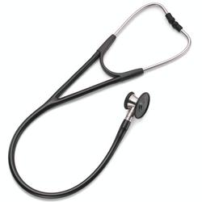
What do you mean by IPCB?
For OUR purposes, an inappropriate patient comment or behavior (IPCB) is one delivered by a patient that a health care provider finds offensive, hurtful, or upsetting due to its gender, sexual, racial, religious, ethnic, or other discriminatory content.
Notes:
Lee - What it is not…

Slide 5
Show of Hands
How many of you…
Have a process that works and are here to feel good about yourself and all you have accomplished?
Know of a process but maybe it is less than ideal? Situations may or may not have imploded.
Have no idea how IPCBs are handled in your program?
Notes:
No idea how these types of issues are handled in your

Slide 6
Our Story
December, 2018
Deeper dive via a small(ish) group meeting
Notes:
December, 2018 – We learned that a group of residents were planning to go to our DIO (Designated Institutional Official) to discuss concerns about how they were treated by patients. They were headed straight to the top because they didn’t think faculty would hear and respond appropriately to their concerns.
Thankfully, our chief residents got involved and spoke to the program director and from there, we had a meeting of people that had experienced this or were somehow involved.
And this is some of what we learned…

Slide 7
“Your husband is a very lucky man.”
“I like seeing you
down on your knees.”
Notes:
There were three others we heard that day. Not only were we devastated by the personal impact it had on our residents but we were dismayed that we were not considered a resource.
Another issue was that at least in a few of these instances, the residents had been limping along – providing care that was well below standard (theirs ours) because they did not want to deal with the situation at hand.

Slide 8
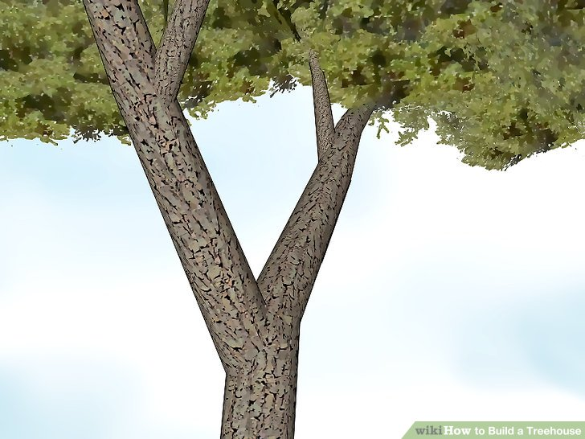
Our Story Continued…
Is it just us? If not, is there a need to develop an effective approach and train around it?
We need a change in our perceived culture. How do we get there?
Notes:
These revelations and the things we heard about them led us in two directions:
Our egos practically demanded us to see if other residency programs were experiencing a similar thing. We also wanted to develop an easy to remember effective way to respond to IPCBs.
The other thing we needed to do was shift our perceived culture to one where residents were empowered to disclose IPCBs because they knew they could get the support and education they needed. We needed a corrective experience.
Out Program Evaluation Committee chooses one or two action items each year to really drill down on and create change. We wanted to Led to PEC taking this on as an action minds
Lit search - #metoo really picked up steam in 10/2017. Mid 90’s there was NEJM article. More literature in the PT world

Slide 9
1st Branch: Devise, develop and disseminate a questionnaire
Notes:
24 programs asked
12 NC programs
Other programs across the nation chosen because we had a point of contact
18 programs actually disseminated the questionnaire
11 NC programs

Slide 10
Response Rates
Resident response rate:
Faculty response rate:
129 / 574 = 23%
148 / 469 = 32%
We did better than nature!
Notes:
Reminds me of a national geographic show on Crocodiles. Grossly speaking a female croc lays around 60 eggs. Only 10% of those actually hatch and out of the hatchlings, only 1% of those survive to adulthood. So depressing. All of this to say, we did slightly better with our survey than most mama crocodiles do with their offspring.

Slide 11
Questionnaire – Asked About:
Demographics
Age
Location of residency
Role at institution
Gender identification
Identify as a minority?
If so, which minority?
Notes:
Drop the Training since we don’t address?

Slide 12
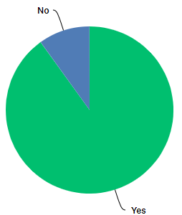
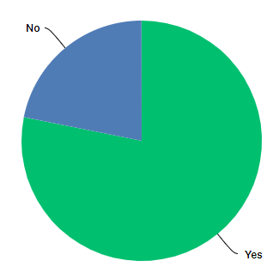
Have you been on the receiving end of an IPCB?
Faculty
Residents
90%
78%
Notes:
Faculty – 90%
Residents – 78%

Slide 13
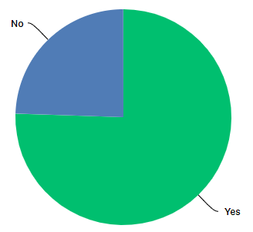
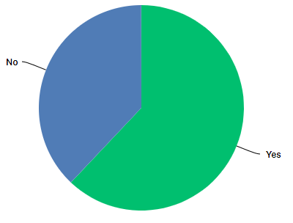
Have you witnessed an IPCB directed toward one or more of your colleagues?
Faculty
Residents
75%
62%
Notes:
Faculty – 75%
Residents – 62%

Slide 14
How satisfied did you feel with your response?
Residents
VERY DISSATISFIED WITH MY RESPONSE– | DISSATISFIED WITH MY RESPONSE– | NEITHER SATISFIED NOR DISSATISFIED WITH MY RESPONSE– | SATISFIED WITH MY RESPONSE– | VERY SATISFIED WITH MY RESPONSE–
3.30% | 19.78% | 42.86% | 34.07% | 0.00%
Faculty
VERY DISSATISFIED WITH MY RESPONSE– | DISSATISFIED WITH MY RESPONSE– | NEITHER SATISFIED NOR DISSATISFIED WITH MY RESPONSE– | SATISFIED WITH MY RESPONSE– | VERY SATISFIED WITH MY RESPONSE–
8.00% | 19.20% | 27.20% | 36.00% | 9.60%
Notes:
Residents – 65% not satisfied or dissatisfied
Faculty – 55% not satisfied or dissatisfied

Slide 15
How satisfied did you feel with the response of others who were present?
Residents
VERY DISSATISFIED WITH THEIR RESPONSE– | DISSATISFIED WITH THEIR RESPONSE– | NEITHER SATISFIED NOR DISSATISFIED WITH THEIR RESPONSE– | SATISFIED WITH THEIR RESPONSE– | VERY SATISFIED WITH THEIR RESPONSE– | THERE WAS NO ONE ELSE PRESENT–
1.7% | 21.4% | 28.5% | 42.9 | 5.3 | 38.46%
Faculty
VERY DISSATISFIED WITH THEIR RESPONSE– | DISSATISFIED WITH THEIR RESPONSE– | NEITHER SATISFIED NOR DISSATISFIED WITH THEIR RESPONSE– | SATISFIED WITH THEIR RESPONSE– | VERY SATISFIED WITH THEIR RESPONSE– | THERE WAS NO ONE ELSE PRESENT–
6.9% | 13.9% | 37.5% | 30.5% | 11% | 42.40%
Notes:
Residents – 51% not satisfied or dissatisfied
Faculty – 58% not satisfied or dissatisfied
Notably – about 60% of the time there are others who witness an IPCB – might be skewed by those who skipped this question if include these in the not present then someone else is present 40% of the time

Slide 16
How important is additional training on how to respond to IPCBs?
Residents
NOT AT ALL IMPORTANT– | SOMEWHAT IMPORTANT– | AVERAGE IMPORTANCE– | VERY IMPORTANT– | EXTREMELY IMPORTANT–
0.00% | 9.60% | 25.60% | 48.00% | 16.80%
Faculty
NOT AT ALL IMPORTANT– | SOMEWHAT IMPORTANT– | AVERAGE IMPORTANCE– | VERY IMPORTANT– | EXTREMELY IMPORTANT–
1.40% | 5.59% | 19.58% | 44.06% | 29.37%
Notes:
Residents – 64% felt was very or extremely important
Faculty 74% felt was very or extremely important

Slide 17
Suggestions for Responses to IPCBs
Using specific language, or a specific technique, what do you think is the best way to respond to an inappropriate patient comment?
97 out of 148 (65%) faculty respondents gave suggestions
52 out of 129 (40%) resident respondents gave suggestions
Notes:
Faculty – 65% gave suggestions
Residents – 40% gave suggestions

Slide 18
Discussion
What are essential “components” of an INITIAL response to an IPCB?
Think big picture - not specific language
Next step if:
The patient apologizes or is remorseful
If the patient remains inappropriate
Notes:
Our audience members are immensely valuable resources
What the receiver or witness immediately does after an IPCB
Acknowledgement of woundedness
Identifying that it was an inappropriate
Setting a limit of that behavior or language can’t continue
If the patient apologizes / is remorseful – then what?
Offer grace
Thank the person for being responsive
Simply move on…
If the patient remains inappropriate
If…then…(impact care, my ability to care for you, establish consequence).

Slide 19
Scenarios – Specific Language
63-year-old female patient presents with her husband for a blood pressure follow-up. The resident taking care of the patient is female and Muslim. She is wearing a hijab. Soon after the visit starts, the patient states, “I don’t want a foreign doctor taking care of me.”
50-year-old male in for a DM check-up. The female resident is starting a foot exam when the patient says, “I like seeing you down on your knees.”
Notes:
SHOULD WE LEAVE IT UP TO THEM TO ADDRESS ONE THAT OCCURRED IN THEIR PROGRAM IF THEY WISH??

Slide 20
Protocol - 2nd branch
Creating a culture shift
Can’t support and educate if we don’t know
Developed a standardized process for faculty response to IPCBs in the FMC
Trained faculty AND residents
Will use results from today and our Delphi study (currently in progress) to develop curriculum for residents

Slide 21
Protocol
In a time-crunched clinical teaching environment, what needs to be balanced when dealing with an IPCB?
Resident Support
Patient Care
Resident Education
Proper Response to the patient behavior
Liability minimization

Slide 22
Protocol – E3D3
Determine if immediate safety is an issue
Faculty EMPATHIZE
Faculty EMPOWER
Faculty and Resident ENSURE
Support / back up in clinic (schedule)
Good patient care
Appropriate limit setting around patient behavior
Resident hears faculty support of them as a medical provider
Faculty and Resident DOCUMENT
Faculty and Resident DEBRIEF (same day and later)
Other Faculty DETAILS
Notes:
Faculty EMPATHIZE / Support
Empathically recognize the resident’s discomfort
Make statements such as: This is hard. You don’t deserve to be treated this way. How are you feeling?
Faculty EMPOWER
Ask the resident: What is the next best step? How can I help? What role do you need me to play?
If resident is not in a place emotionally to problem solve, give options / make decision
Faculty and Resident ENSURE
You have support / backup
Resident’s CMA: what does the schedule look like; make arrangements for other physicians to see patients as necessary
Back-up preceptor If the attending is going into the room with the patient
Clinic leadership
Faculty psychologist
Good patient care
Resident hears faculty support
Patient behavior is addressed (limit has been set)
Faculty and Resident DOCUMENT
Faculty and Resident DEBRIEF
Same Day
Once all patient care is completed, the attending and resident should meet to discuss the episode and to ensure resident wellbeing and support.
Attending and resident should set up a time to meet later
Later
Ensure resident support and wellbeing
Reflect on the visit and discuss
Other Faculty DETAILS
Attending notifies clinic leadership who will review the documentation and ensure all policy steps have been followed and if any additional documentation or patient communication is needed

Slide 23
Conclusion
Per our questionnaire, residents (and faculty):
Experience IPCBs
Believe training is important
Our goals:
Standardize a response and train residents in it
Create a safe culture for learners to disclose IPCBs by training faculty to respond in a standardized fashion

Slide 24
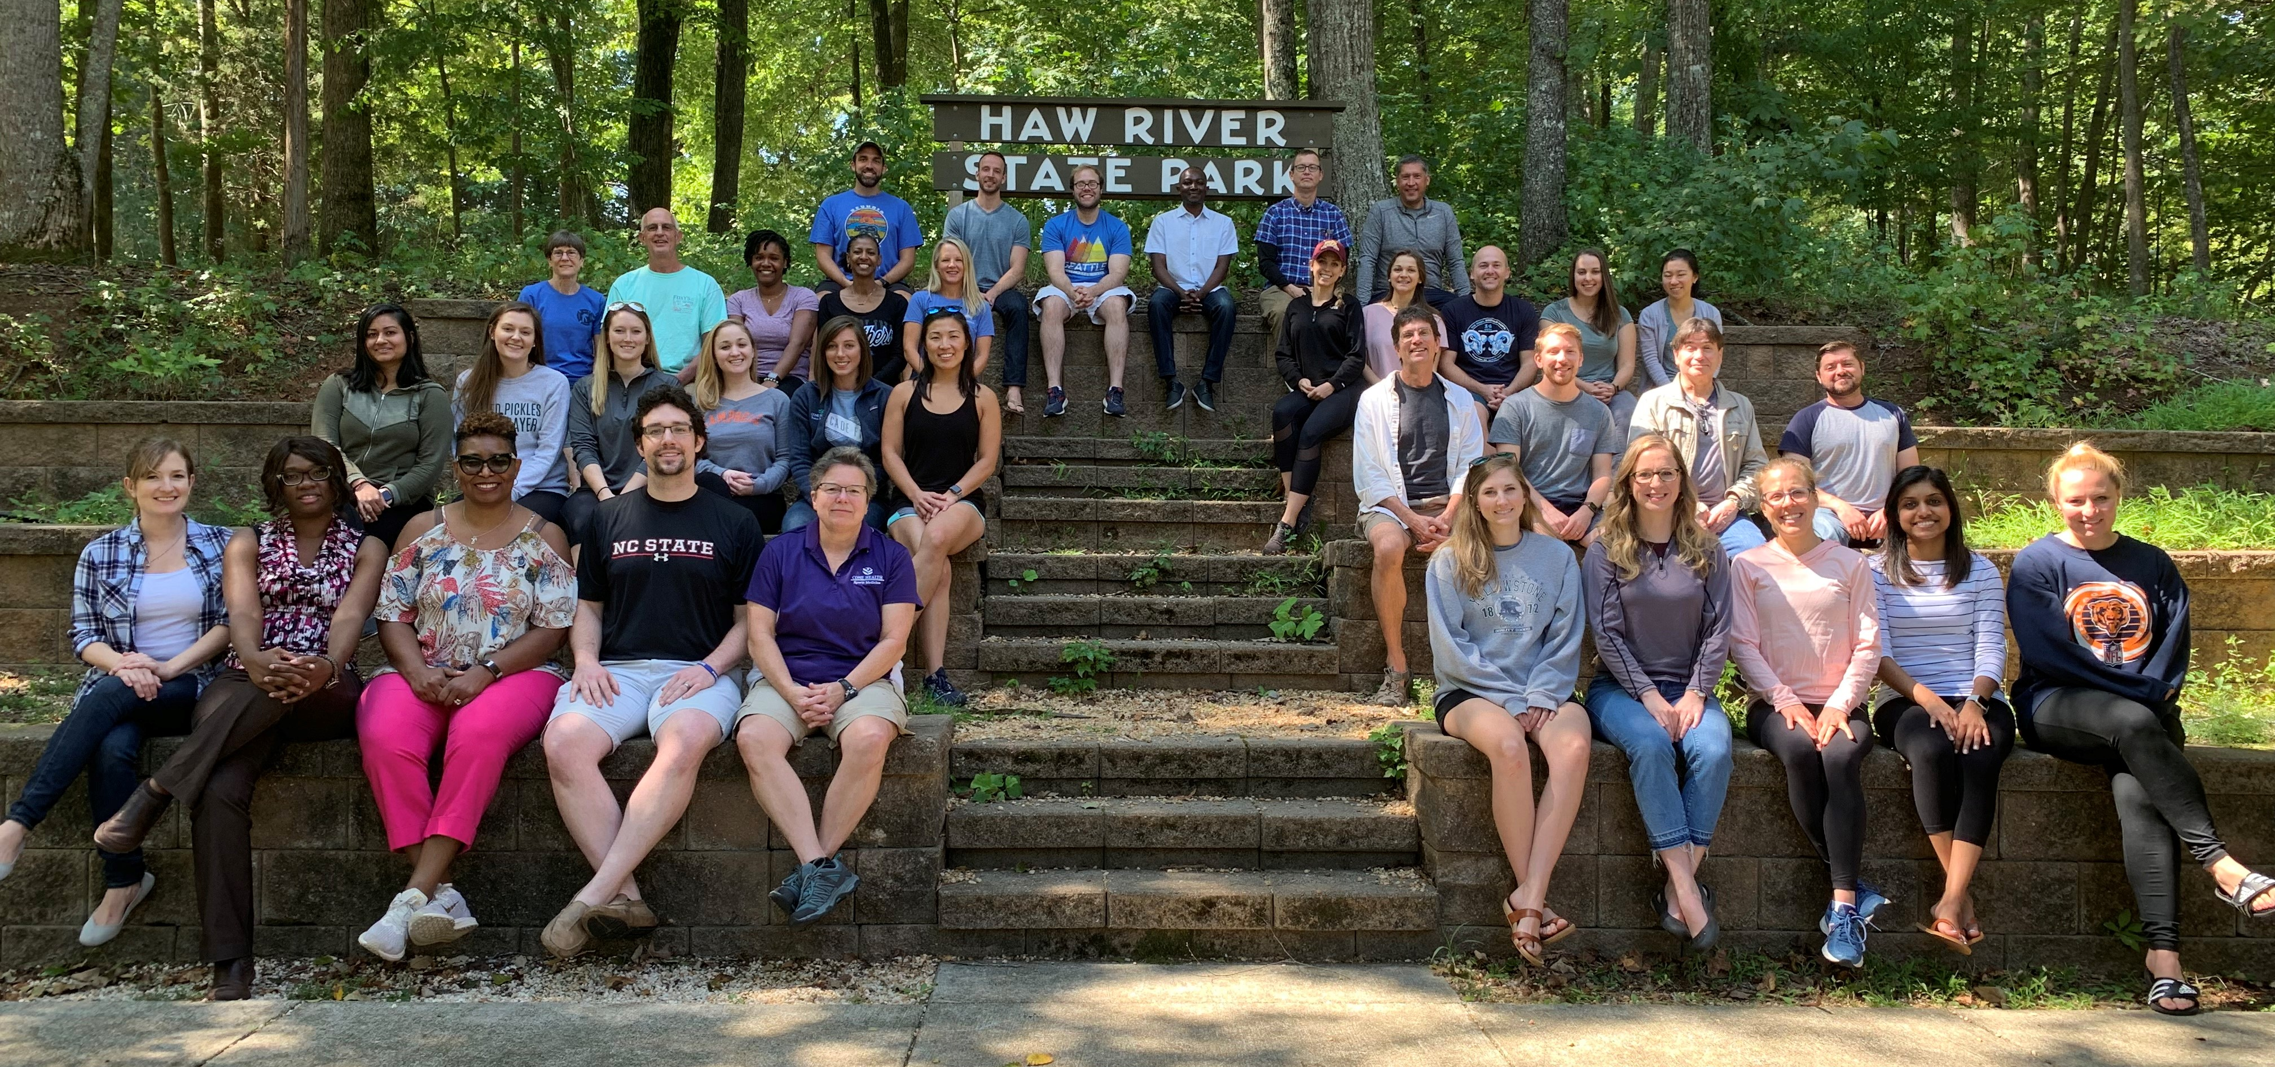
Questions – Comments - Contacts
We will upload the presentation and protocol to FMDRL
If you want to participate in this survey, let us know.
Contact info:
Michelle Kane
michelle.kane@conehealth.com
Lee Chambliss
lee.chambliss@conehealth.com
And thanks to…

Slide 25
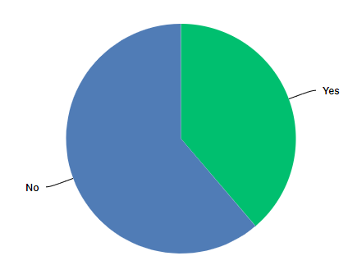
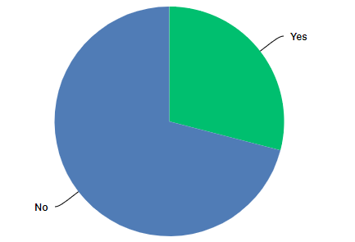
Do you identify as part of a minority group (e.g. gender, ethnic, racial, religious, sexual orientation)?
Faculty
Residents
29%
39%
Notes:
Faculty – 29% minority with 56% of these identifying gender as opposed to gender identify OR if exclude gender 13% were minorities
Residents – 39% minority with 36% of these identifying gender as opposed to gender identify OR if exclude gender 25% were minorities

