Slide 1
Escaping the Average Teaching Technique
Gretchen Shelesky, MD, MS; Rachael Cardinal, PharmD; Greg Castelli, PharmD; Ariel Ferdock, PharmD; Pooja Kirpekar, PharmD; Sehrish Panjwani, PharmD; Archie Raghavan, PharmD; Monica Schaffer, MD, Suzie Skef, MD, MS; Leah Stem, MD
UPMC St Margaret & University of Pittsburgh
Faculty Development Fellowship
STFM Annual Conference, Toronto, 2019

Slide 2
Objectives: Active participants will
Collect tools and resources needed to create an Escape Room.
Discuss pitfalls and solutions to implementing an effective Escape Room in their home institution.
Begin to create an Escape Room to use at their home institution.
Notes:
who has participated in an escape room?
Who has created an escape room?

Slide 3
Every Escape Room Has Some Rules
Notes:
**What rules will you want to set up in your game?**
--No searching the room (yes, you usually are allowed to search the room during typical Escape Room, but given time/space constraints, not today!)
--Accessory brains ARE allowed (cell phone, emailing, it’s all possible)
--Keep the spirit of the game—don’t rip open the envelopes that have locks on them. Don’t search the room. Play by the rules. Anything that is supposed to open will with minimal force.
--Stay with your group. Everyone will get to go through every station. Everyone has their OWN TASK in each station. If you get done EARLY, you can help someone else on your team

Slide 4
The Escape Room is a TOOL
Kemp Model
Topics
Learner Character
Evaluation
Goals
Support Services
&
Revise
Objectives
T & L Activities
Content
Pre-assess
Notes:
Need to design your session to fit your objectives and your evaluation. We like Kemp, but you can use any tool that makes sense for you. Don’t get caught up in making the room and forget what you want your learners to walk away with…

Slide 5
?
Can you escape
Notes:
Need the story here: Leah
Your facilitator will tell you where to go next
Some games are repeated—so be sure you get an unique game at each station (i.e. you can switch with your neighbors)
Don’t start until we say “go”

Slide 6
GOAL: To collect all of the tools from all of the stations to make your own Escape Room
Kemp | Supplies | Plans | ETools
White | Blue | Yellow | Black
Orange | Green | Red | Purple
Notes:
#1

Slide 7
GOAL: To collect all of the tools from all of the stations to make your own Escape Room
Kemp | Supplies | Plans | ETools
White | Blue | Yellow | Black
Orange | Green | Red | Purple
Notes:
#2

Slide 8
GOAL: To collect all of the tools from all of the stations to make your own Escape Room
Kemp | Supplies | Plans | ETools
White | Blue | Yellow | Black
Orange | Green | Red | Purple
Notes:
#3

Slide 9
GOAL: To collect all of the tools from all of the stations to make your own Escape Room
Kemp | Supplies | Plans | ETools
White | Blue | Yellow | Black
Orange | Green | Red | Purple
Notes:
#4

Slide 10
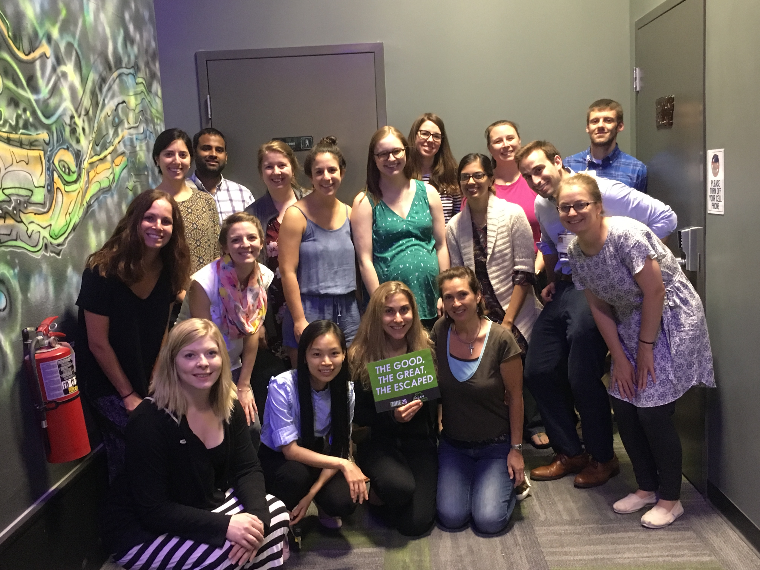
Notes:
Full disclosure—I LOVE escape rooms.
But…not everyone does.
Monica to talk about teaching between residents (force different groups)
NEED the debrief (Meta teaching)
Piloting it with the correct level audience
What worked well, what are pitfalls?

Slide 11
Lessons Learned
May be best as review/application
Start with context
Limit new information
Create check-ins/forced stops
Remember that not everyone likes games

Slide 12
Notes:
Back to your groups—we’ll have a facilitator with each one
Your facilitator has locks and electronic resources for you to use.
When we come back together, your facilitator will share one cool idea that you came up with.
Please work in your groups of 5--work together on a topic of interest to the group. If you don't have a topic off the top of your head, you can work on COPD/asthma.

Slide 13
Notes:
Debrief#2—what was hard? What was easy? What questions do you have?

Slide 14
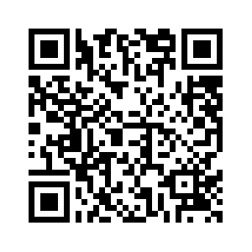
https://drive.google.com/open?id=1RgpZ37_DRymK5facJQdSPV4XIlENV-5d
Notes:
Kemp
supplies
plans
Etools
Monica's plan for the women's health escape room
Plans from other programs

Slide 15
Objectives: Active participants will
Collect tools and resources needed to create an Escape Room.
Discuss pitfalls and solutions to implementing an effective Escape Room in their home institution.
Begin to create an Escape Room to use at their home institution.

