Slide 1
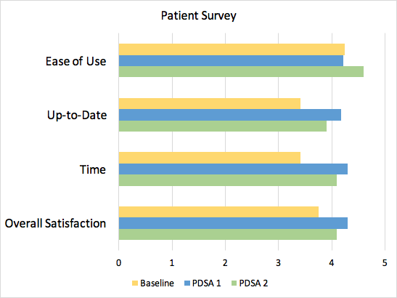
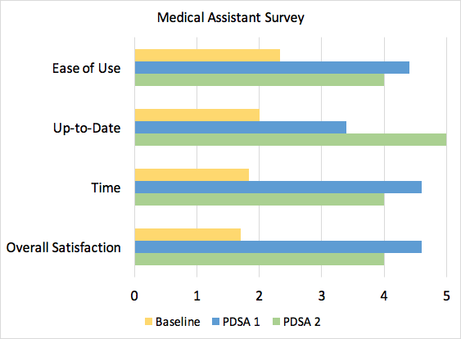
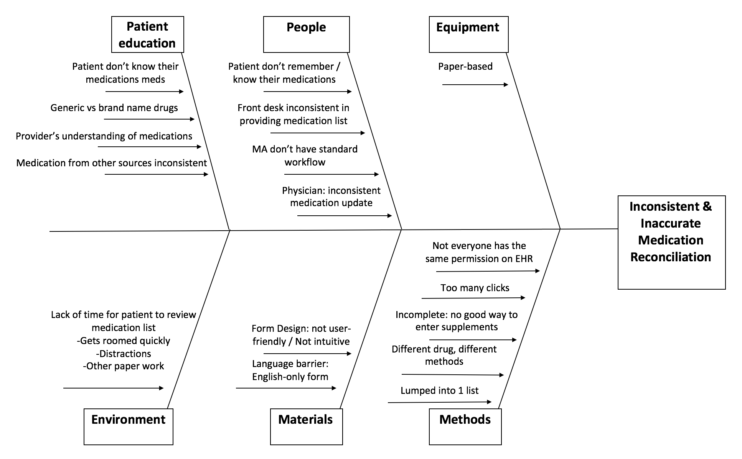
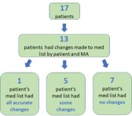
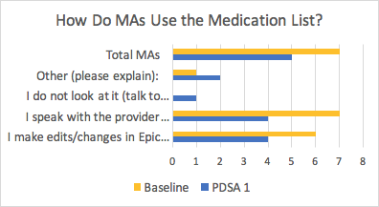
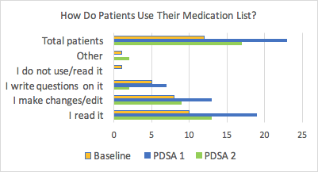
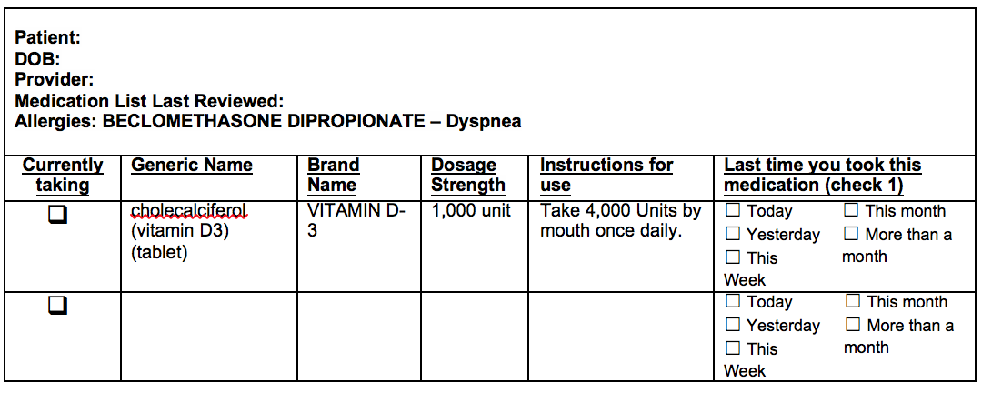
Whose Job is it Anyway? Improving the Medication Reconciliation Process for All
Rui Heng Chen, Cassandra Kasten-Arias, Gina Phillipi, Erin Urbanowicz MPH, Sherry Liang, Andrew Edsall, Melinda Luethe, Christopher Terndrup MD, Reem Hasan MD PhD
Oregon Health and Science University (OHSU), Student Navigator Project (SNaP) at the OHSU Internal Medicine Clinic (IMC)
Background
Team
The OHSU Student Navigator Project (SNaP) is an 18-month longitudinal preceptorship that includes medical assistant (MA) duties, patient navigation, and quality improvement. SNaP students work in the outpatient internal medicine clinic (IMC), performing many of the tasks typically assigned to MAs. Knowledge gained from this role informs a capstone quality improvement project in the IMC.
Project
At the OHSU IMC, medication reconciliation responsibility has been primarily assigned to the medical assistant. However, without the active engagement of providers and patients, the process can lead to inaccurate medication lists and possible medication errors. Medication errors are more likely to occur in patients with 5 or more medications and the elderly$.^{1}$ This population is of particular importance to the IMC as a large percentage of patients fit into these categories. A delayed / inaccurate medication reconciliation process could cause potentially conflicting and even dangerous situations that would jeopardize the patient’s safety. An integrated approach that addresses all people in the medication reconciliation process increases accuracy of medication lists and satisfaction with the process$.^{2}$
Aim
1. Increase satisfaction with the medication reconciliation process by 20% for medical assistants and patients with 5 or more medications by August 15, 2019.
2. Increase accuracy of outpatient medication reconciliation for patients with 5 or more medications by 20% by August 15, 2019.
Baseline Data
Baseline cycle:
Methods
Used Plan, Do, Study, Act (PDSA) framework to design and implement a new standardized medication reconciliation process.
Data was collected by SNaP students for 3 PDSA cycles.
Figure 3: Fishbone Diagram on Contributors Inconsistent and Inaccurate Medication Reconciliation
Measures:
Outcome
MA, patient, and provider satisfaction measured by 5-point Likert scale
Accuracy of medication reconciliation, as compared to after visit summary and chart medication list
Process
Completion rate of medication reconciliation form by patient
Completion rate of medication reconciliation form by MA
Balancing
Time (from start to finish) of medication reconciliation process
PDSA Cycles:
PDSA #1: Created a new medication reconciliation form that better reflected the electronic form MAs must fill out on EPIC electronic health record (EHR) and which provided more room for patient interaction (figure 4).
PDSA #2: Updated the medication reconciliation form to include more areas for patient interaction based on MA feedback from PDSA #1 (figure 5).
PDSA #3: Involved providers via a presentation on the medication reconciliation process, followed by a targeted intervention with 3 providers wherein each provider changed their personal EHR layout to more readily view medication changes made by MA.
Results
Figure 6: Patient and Medical Assistant survey results regarding the medication reconciliation form at baseline, PDSA 1, and PDSA2.
Timing:
PDSA 1: 2 min 17 seconds
PDSA 2: 1 min and 24 seconds
PDSA #1 showed a dramatic improvement of 170% in overall MA satisfaction, with MAs commenting that the form mirrored the EHR formatting. They also showed an improvement of 15% in overall patient satisfaction with the medication reconciliation process; patients said they liked and the ease-of-use of the new form.
PDSA #2 saw similar improvements as PDSA #1, albeit with a slight decrease in satisfaction but an improvement in correctness of medication lists.
PDSA #3 did not lead to any changes in the accuracy of medication reconciliation as compared to baseline. Medications that were prescribed as needed, duplicates on the patient's chart, and/or over the counter medications were less likely to be changed than medications that were stopped and/or started the day of the visit.
12 patients were tracked, of whom 7 made changes to their medication list.
Of these 7 patients, two had some changes on their list and five had no changes.
Conclusion
Changing the medication reconciliation process to a more user-friendly format that models the EHR form resulted in markedly increased satisfaction with the process.
These findings align with results from a project undertaken by the 2018 SNaP cohort, demonstrating the benefits of a new medication reconciliation form in the IMC. Sustainability of this change will require integration of the form into OHSU's EHR.
Limitations of this study include the measurement of accuracy, the participation of providers, and the limitation of EHR capabilities in the outpatient setting.
Acknowledgements
This project would not have been possible without the OHSU Internal Medicine Clinic staff, providers, and Quality Leadership.
References
Koper, D., Kamenski, G., Flamm, M., Bohmdorfer, B., & Sonnichsen, A. (2012). Frequency of medication errors in primary care patients with polypharmacy. Family Practice, 30(3), 313–319. doi: 10.1093/fampra/cms070​
Gaag, S. V. D., Janssen, M. J., Wessemius, H., Siegert, C. E., & Karapinar-Çarkit, F. (2017). An evaluation of medication reconciliation at an outpatient Internal Medicines clinic. European Journal of Internal Medicine, 44. doi: 10.1016/j.ejim.2017.07.015
We assessed the following aspects of medication reconciliation using a 5-point Likert Scale: Overall Satisfaction, Time, Up-to-date, Ease of Use
MAs and Patients were also asked how they use the printed medication list to help assess changes in the medication form (figure 2).
Figure 1: Baseline accuracy of PDSA #3, Med list changes in Epic and on After Visit Summary
Accuracy was measured in 17 patients to determine a baseline for PDSA #3 (figure 1).
Baseline medication reconciliation process time: 1 min 3 seconds
Figure 4: Medication reconciliation form for PDSA #1
Figure 2: How do MAs use the medication list? How Do patients use their medication list? This figure shows results of surveys given to MAs and Patients regarding how they interact with the printed medication list they receive from the front desk.
Figure 5: Medication reconciliation form for PDSA #3

