Slide 1
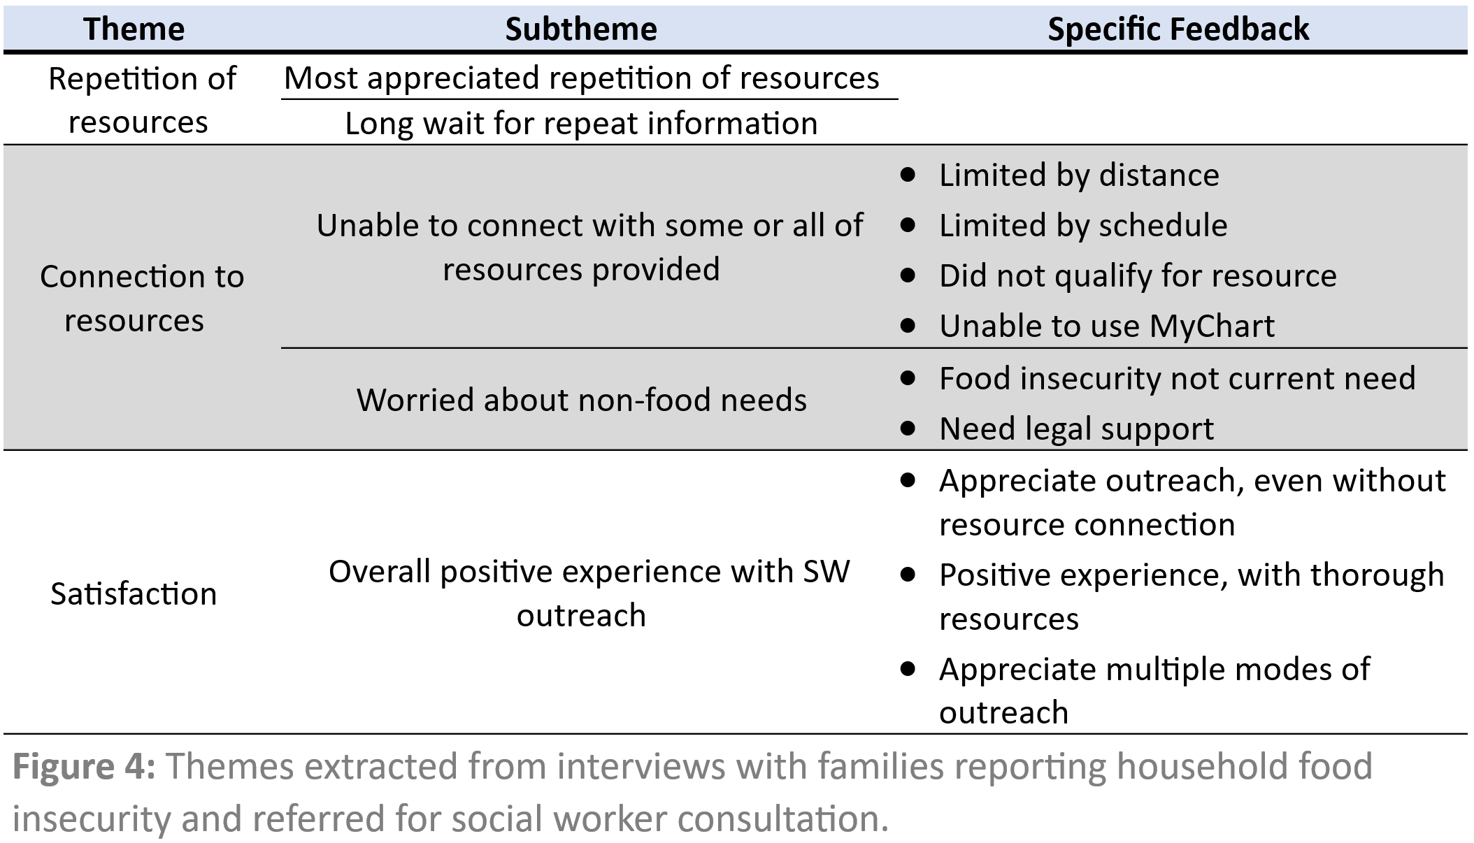
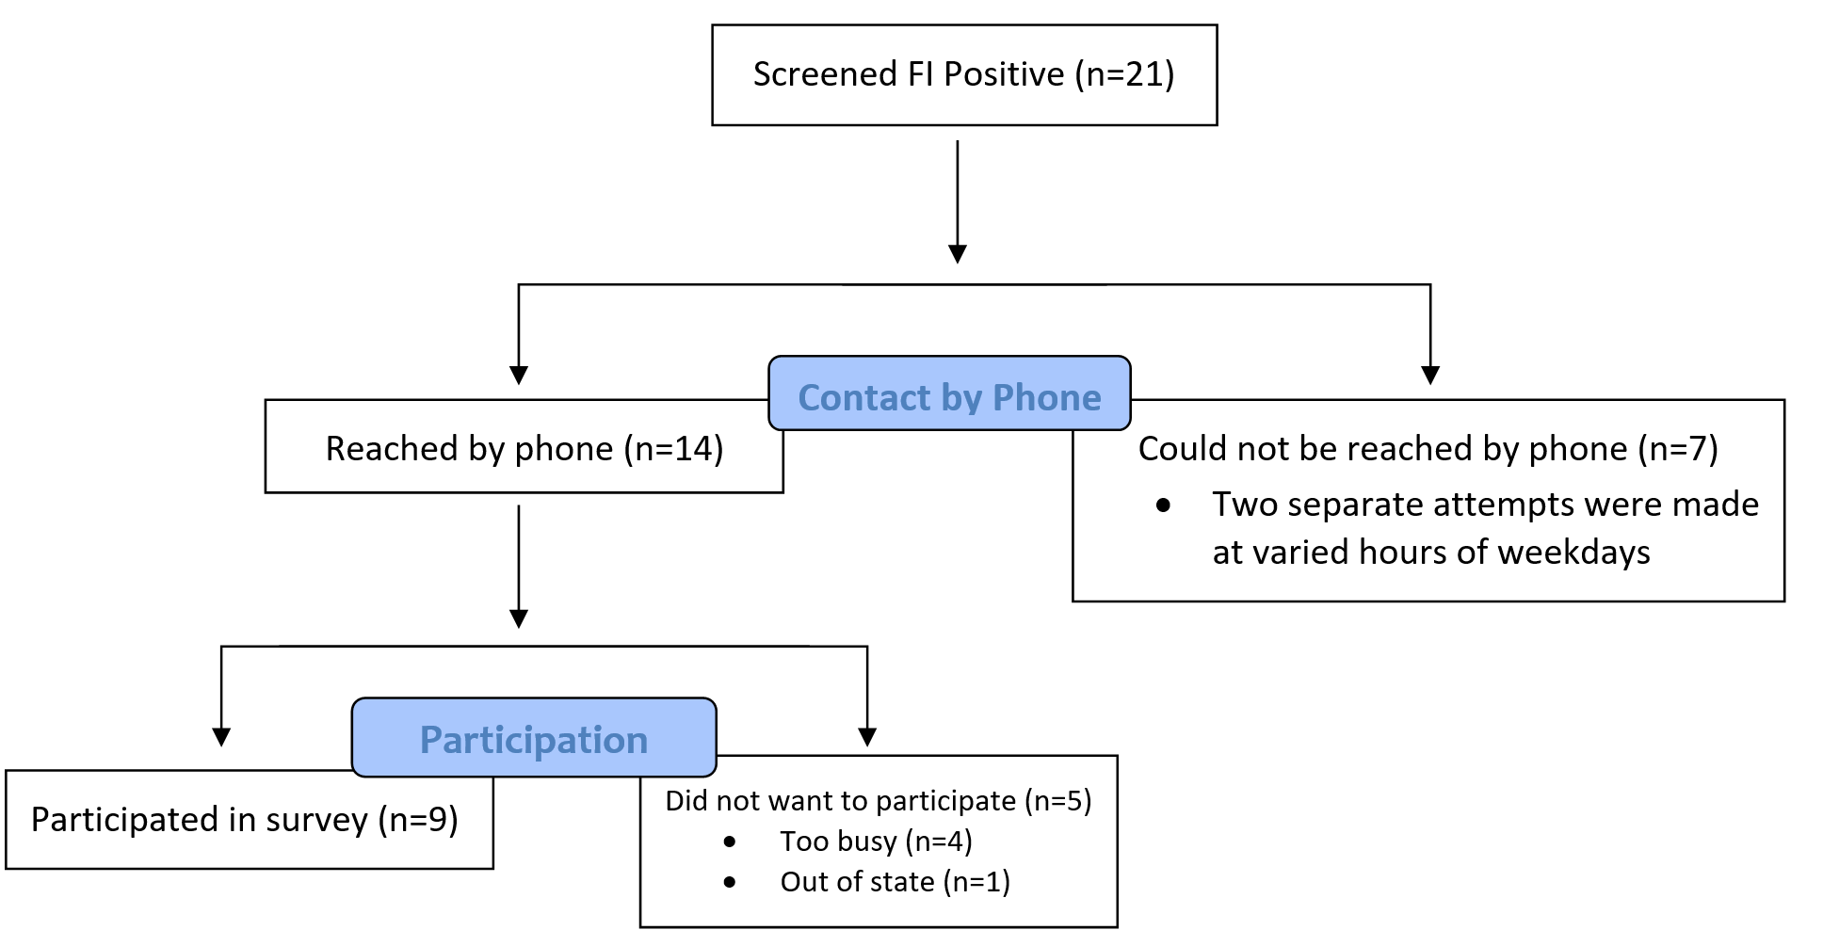
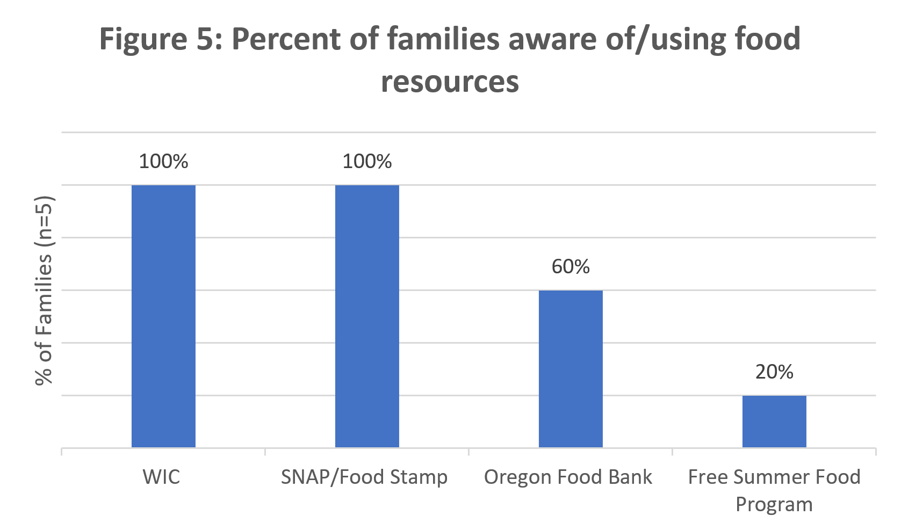
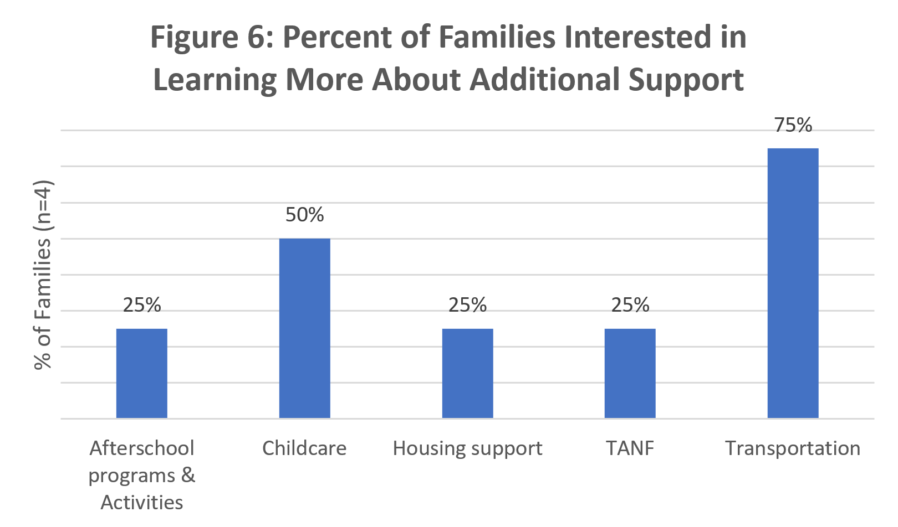
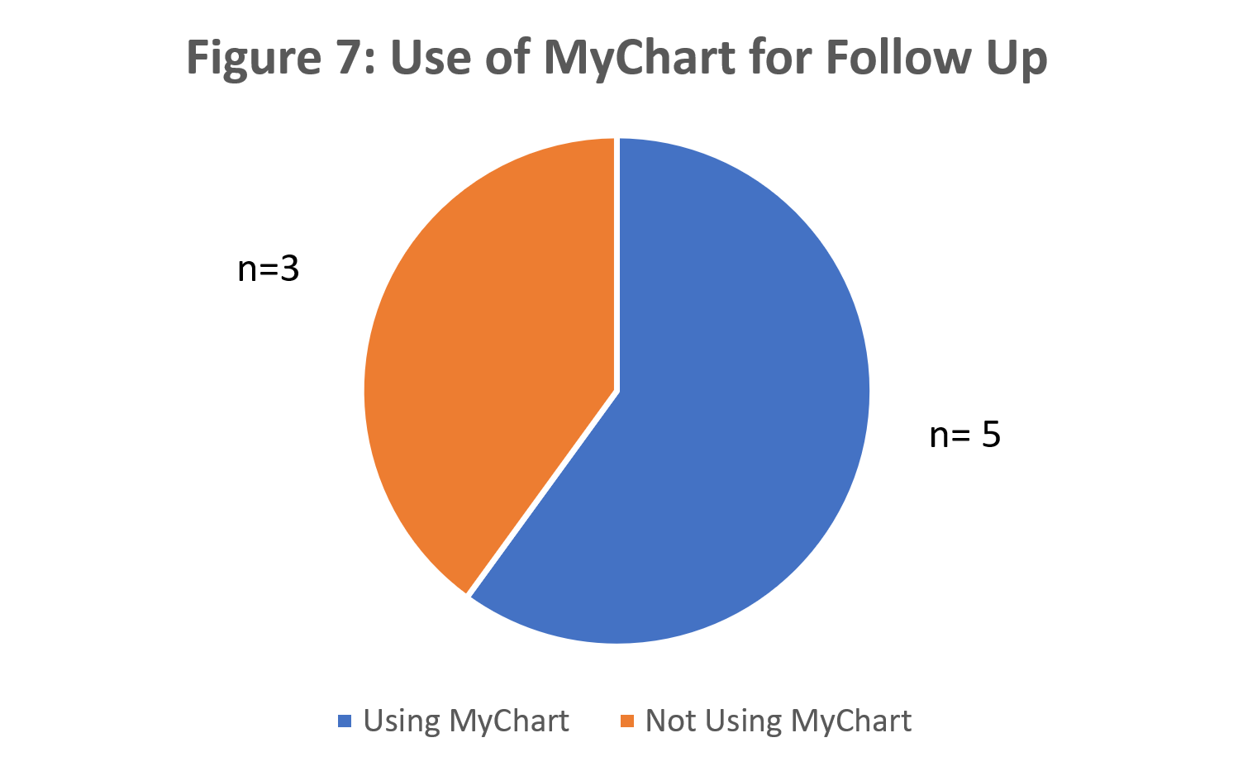
Beyond Food Insecurity: Lessons from Direct Family Outreach
Rachel Caron, Hannah Kim, Lauren Maloney, Kanwarabijit Thind MPH, Sherry Liang, Laurel Hoffmann MD MPH, Reem Hasan MD PhD
Oregon Health and Science University, Student Navigator Program (SNaP) at Doernbecher General Pediatrics Clinic
Aim:
To coordinate outreach and conduct an assessment of social needs among families who screen positive for household food insecurity (FI) in the General Pediatrics clinic at Doernbecher Children's Hospital (DCH).
Team:
The OHSU Student Navigator Program (SNaP) places first-year medical students in an outpatient pediatrics clinic where they work to improve outcomes through a Quality Improvement (QI) project. SNaP students additionally undertake patient navigation for a panel of assigned high-needs patients.
Background:
Food insecurity is defined as the lack of reliable access to a sufficient quantity of nutritional food. In 2017, 14.6% of Oregon households were identified as being food insecure.¹ The American Academy of Pediatrics recommends assessing for food insecurity at health maintenance visits to provide timely intervention.² FI has been shown to have a strong correlation with needs for other resources, such as transportation, healthcare, and childcare.³ Screening for FI in the General Pediatric Clinic at DCH is an established practice; however, non-food needs are often not thoroughly assessed and addressed for patients and families⁴ and it has been shown that many physicians are uncertain about how to proceed with positive food insecurity screens.³
Current Practice at General Pediatrics Clinic:
Two evidence-based questions assessing FI status
Questionnaires in English and Spanish
Documented in Electronic Health Record (EHR)
Social work (SW) intervention during visit or after visit phone call
Outcomes:
Conclusions:
We implemented a novel intervention in the General Pediatrics clinic at DCH, wherein medical students called families who had screened positively for food insecurity and assessed:
Their satisfaction with the experience
The usefulness of the resources with which they were provided and whether they were provided repeat information
Further need for resources other than food such as transportation assistance, legal and childcare assistance
The majority of patients who screened positive for FI were satisfied with the experience in the General Pediatrics clinic. Another major theme that emerged was the prevalence of needs other than FI. Next steps to address this need could include:
Resource pantry with dry goods, specifically diapers, in the pediatric clinic
Increased funding for qualified personnel focused on guiding patients through the resource acquisition process
”Despite everything [General Pediatric resource coordinator] was the best social worker we worked with at OHSU!”
“Love that you have social work at the clinic!”
Comprehensive social determinants of health screening
Clinic initiative to encourage MyChart enrollment, especially for social resource connection and follow-up
“I lost the paper [social worker] gave me by the time I got home”
For each statement, please tell me whether the statement was “often true, sometimes true, or never true” for your household:
A. “Within the past 12 months we worried whether our food would run out before we got money to buy more.”
B. “Within the past 12 months the food we bought just didn’t last and we didn’t have money to get more.”
References:
1. Adams E, Hoffmann L, Rosenberg K, Peters D, Pennise M. Increased Food Insecurity Among Mothers of 2 Year Olds with Special Health Care Needs. Maternal and Child Health Journal. 2015;19(10):2206-2214.
2. Sohlberg T, Loutit K, Hoffmann L, Houchen-Wise E, Stevenson E, Jaffe A, Adams E. Prevalence of Food Insecurity in Academic Pediatric Primary Care. Poster presented at: Oregon Public Health Association, 2017; Salem, OR.
3. Barnidge E, LaBarge G, Krupsky K, Arthur J. Screening for Food Insecurity in Pediatric Clinical Settings: Opportunities and Barriers. Journal of Community Health. 2015;42(1):51-57.
4. Bottino C, Rhodes E, Kreatsoulas C, Cox J, Fleegler E. Food Insecurity Screening in Pediatric Primary Care: Can Offering Referrals Help Identify Families in Need?. Academic Pediatrics. 2017;17(5):497-503.
Acknowledgements:
Joby Mahto, Christine Watson, Eliza Bakken, Jaime Warren
Figure 1: Food Insecurity screen
Timeline:
1
Figure 2: QI Food Insecurity timeline

