Slide 1
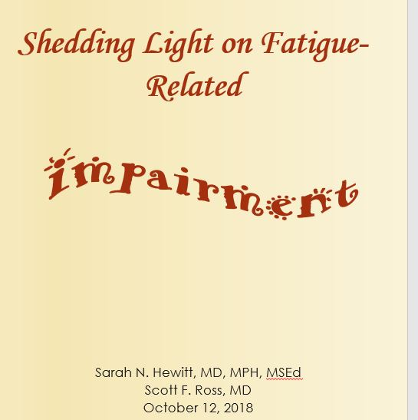
Shedding Light on Fatigue-Related
Impairment
Sarah N. Hewitt, MD, MPH, MSEd
Scott F. Ross, MD
October 12, 2018

Slide 2
Conflicts of Interest
Neither presenter has a conflict of interest

Slide 3
Objectives
By the end of the workshop, learners will be able to:
Explain 3 ways of identifying physician impairment as it specifically relates to fatigue.
Feel more comfortable admitting fatigue/impairment.
Demonstrate recognition and mitigation of impairment.
Notes:
Identify different modes of physician impairment
Recognize physician fatigue
Analyze the current environment and ways to improve the climate of acknowledging limitations

Slide 4
Background
Originally designed as a 3 hour didactic session
Selected video clips demonstrating obvious forms of impairment shown
Overuse of prescription medications
Lack of empathy
Anger outbursts
And then…
Notes:
For this session we will use a shortened version of the presentation to teach the basics

Slide 5
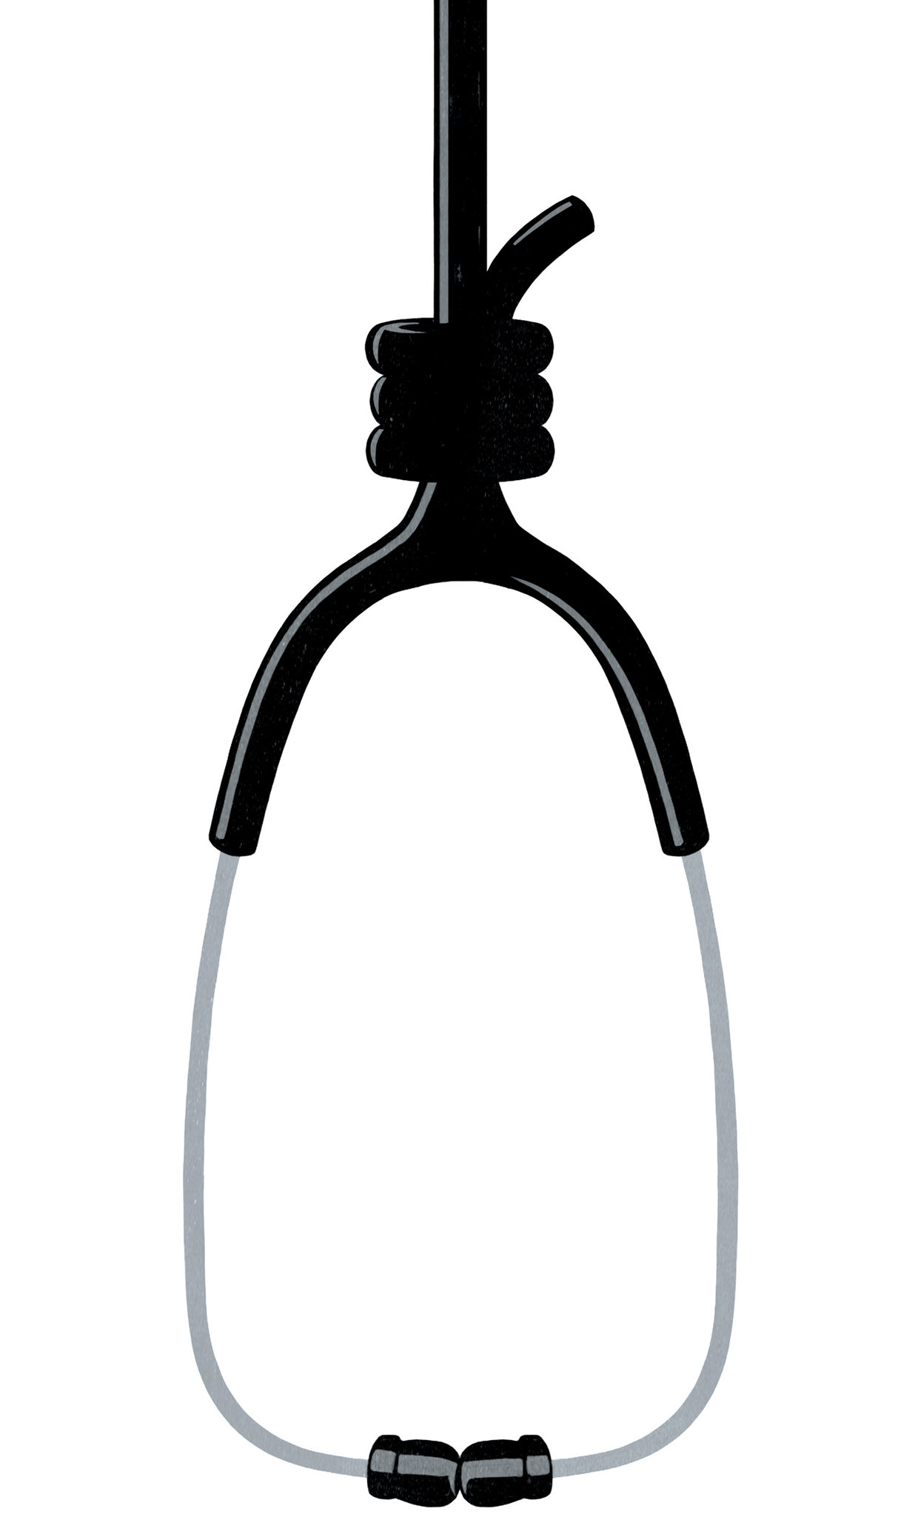
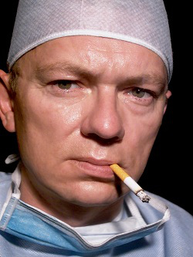
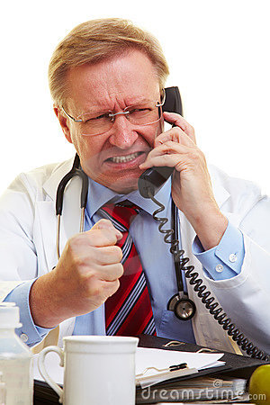
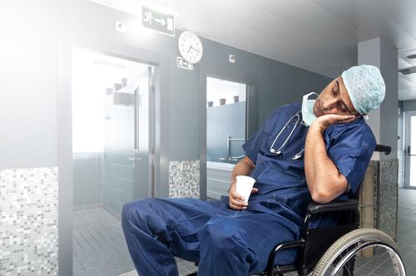
What else can it look like?
Work
Life
Notes:
First group discussion of ideas of impairment
Ultimately it can look like any of these and we hope to catch it before it comes to losing a license, harming a patient, or this… (pic of shot himself)

Slide 6
How do we recognize impairment in each other?
Not completing charts/tasks
Showing up late
Making errors, inattention to details
Falling asleep during lectures/yawning
Snapping at others/irritability
Responsibilities getting dropped (something has to give)
Passivity
Notes:
Second group discussion of how recognize impairment
Characteristics may be unrecognized:
Not completing charts/tasks (pic of full inbox/task box)
Showing up late
Making errors
Falling asleep during lectures/yawning
Responsibilities getting dropped (pulled too many directions and things giving way)
Snapping at others
Going to talk about what is done and what should be done in a little bit, but first going to narrow in the focus of types of impairment.

Slide 7
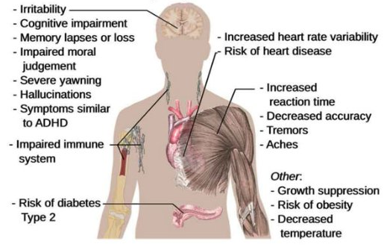
What’s the cause of these?
Hypoxemia
Insulin resistance
↑ sympathetic activity
Blunted arousal response
↓ motor coordination
https://www.howsleepworks.com/images/sleep_deprivation.jpg
SLEEP DEPRIVATION
Notes:
Specifically today going to focus on what causes these symptoms.

Slide 8
Focusing on physician fatigue
What is it?
Sleep disruption → sleep debt & its effects
Sleep inertia
ESS
Function akin to legal intoxication
Notes:
Here we expanded upon types of sleep habits that can lead to fatigue, effects of sleep disruption, and identified sleep inertia
Briefly:
What is it? Too little sleep, fragmented sleep, circadian rhythm disruption, primary sleep disorder
Sleep disruption: debt can occur w/in 2-3 nights of sub-optimal sleep; performance impaired w/ even 2hrs less of sleep/night; 1 of 1st skills lost is ability to do something quickly; vulnerable to errors 10min-2hr following arousal during night
Inertia: confusion & dysfunction upon awakening, typ when awakened during deep NREM sleep, sleep in middle of night, or following period of sleep deprivation; manifestation: slow speech, performance deficits, poor memory, impaired decision making; may have period of amnesia
We also discussed that an Epworth Sleepiness Scale score for residents is comparable to Pts w/ diagnosed sleep d/o (fell between sleep apnea and narcolepsy)
Discussed impact on skills in various specialties and self-reported resident changes in personality
Something found interesting: Psychomotor fxn after 24hrs w/o sleep = EtOH 0.08%

Slide 9
Something to consider…
American Medical Association Council on Ethical and Judicial Affairs considers physicians attending to their own health and wellness, as well as the health of their colleagues, an
ethical imperative.

Slide 10
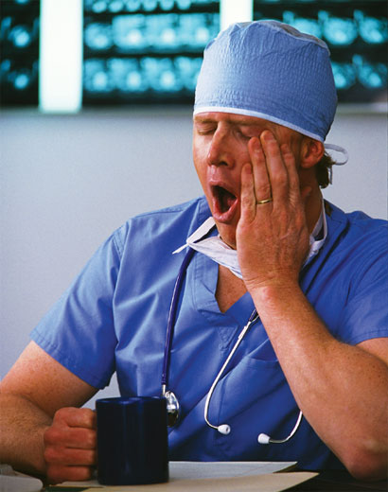
What’s the impact?
On professionalism:
PATIENTS = ENEMIES!
On medical education:
Stop learning after 12-14°
Don’t learn anything except how to cut corners & how to survive
Notes:
Pts = enemies: they are the one thing that stands b/n you & a few hrs of sleep

Slide 11
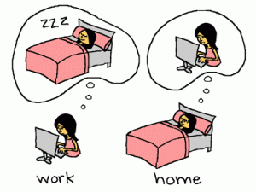
Focusing on physician fatigue
…improve fatigue?
Restrict duty hours
NO!
Other countries:
Australia: 72hrs/wk
UK: 48hrs/wk
Denmark: 37.5hrs/wk
Notes:
So what did they do…
One step taken was to restrict duty hours, but did it work?
Restricting to 80hrs/wk, which is still twice the duration of work week of average employed American; which means some programs may miss identifying persistent fatigue
Same or more work squished into fewer hours, which means spending more “off time” doing work and not actually sleeping or resting/recovering
d

Slide 12
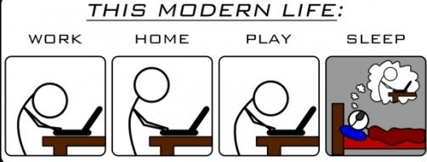
So…what do we do?
Anything we can!
Notes:
Group discussion on what currently happens for fatigue/impairment
Logging duty hours: not logging what hours we actually work (repercussions?)
Push through
Cover for each other…but at what cost to ourselves?
Tons of caffeine

Slide 13
Why handled this way?
Notes:
Group discussion on perceived barriers/repercussions if admit impaired/too tired
Concerns:
Losing significant learning opportunities, procedural experience, interaction w/ colleagues
Trapped by competing demands b/n work hrs & professionalism
Support lacking from sr. residents & faculty who may have an inadequate understanding of their mandate & perhaps are resentful of restrictions on duty hrs
Perceived weakness/inability to do work
Not logging correct hours: deemed inefficient, repercussions for residency & thus us
Long work hrs = time honored tradition
Demanding schedules = necessary for learning & development of professionalism
Use of resident physicians = inexpensive coverage = impt economical factor for teaching hospitals
h

Slide 14
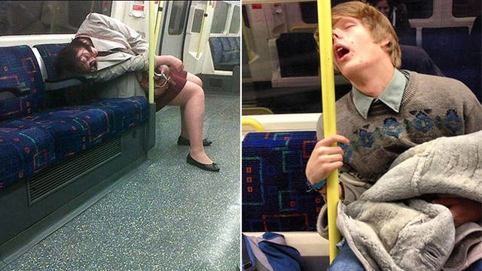
So…what next?
What could we do?
Questions to ponder
Habits for healthy sleep
Notes:
What could we do?
Better recognition in ourselves & each other
Create culture okay to admit impairment
Decrease non-essential tasks & interruptions
Set priorities for “time off”
Questions to ponder:
Is quality of Pt care being jeopardized?
Is well-being of residents @ risk? Burn out risk?
What are effective strategies for overcoming sleep loss?
Habits for healthy sleep
Aim: 7-9hrs/night
Sufficient catch up sleep
Sleep routine
Protected sleep time
Comfortable bedroom w/ relaxation rituals
Recent studies focusing on negative effects → questioning tradition

Slide 15
Show of hands…
“I’d rather just ‘power through’ when I’m tired; besides, when I nap, it just makes me feel worse.”
Notes:
How many of us say this?
In fact:
Some sleep is always better than no sleep.
At what time and for how long you sleep are key to getting the most out of napping.
Naps: can prevent & ameliorate some degree of fatigue
Brief (1-2h) prior to prolonged period of sleep loss, such as 24h on call, can enhance alertness
To be therapeutic during a shift, naps should ideally be frequent (q2-3h) & brief (15-30’)
Work best earlier they are in period of sleep deprivation (top off tank than catch up on empty)
Time naps during circadian window of opportunity, b/n 2-5AM and 2-5PM
Longer naps, such as those >30min may be counterproductive in terms of sleep inertia
Utilize quiet, environmentally comfortable location for naps
d

Slide 16
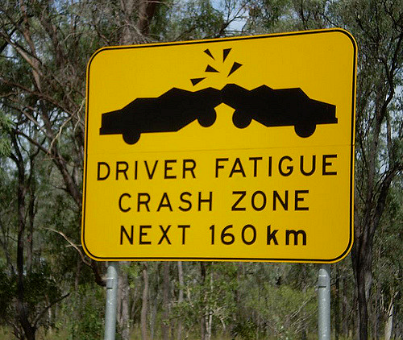
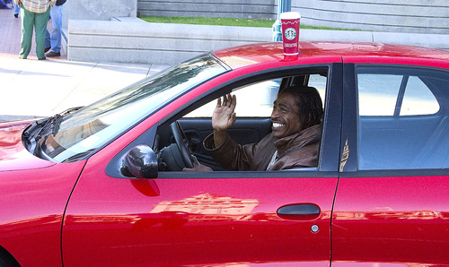
Other interventions…
Tired!
Strategic & prn
Not work!
Notes:
Ever forgotten how you got home or if the light you just went through was actually green?
MVAs increase w/ <5hrs of sleep
Signs: difficulty focusing on road or keeping eyes open, nodding off, yawning, drifting b/n lanes, missing exits, amnesia for period of drive
Cold air, loud music, rolling window down do not actually improve fatigue
Strategic caffeine use
Not a sleep substitute; tolerance quickly develops, therefore prn use
Effects w/in 15-30 min, lasts typ 3-5hrs
Usual dose 400-600mg (3-4c)—some overly sensitive
Adverse effects: disruption in sleep quality, tolerance, diuresis, irritability
d

Slide 17
Other interventions…??
Melatonin
Sedative hypnotics
Behavioral therapy
AVOID OTC stimulants
Notes:
Melatonin: induces sleep onset; few data for use in residents
Sedatives/behavioral therapy: certain sleep d/o; not indicated for chronic use
Adverse effects: H/A, drowsiness, disorientation, GI disturbance, dizziness
Avoid OTC stimulants

Slide 18
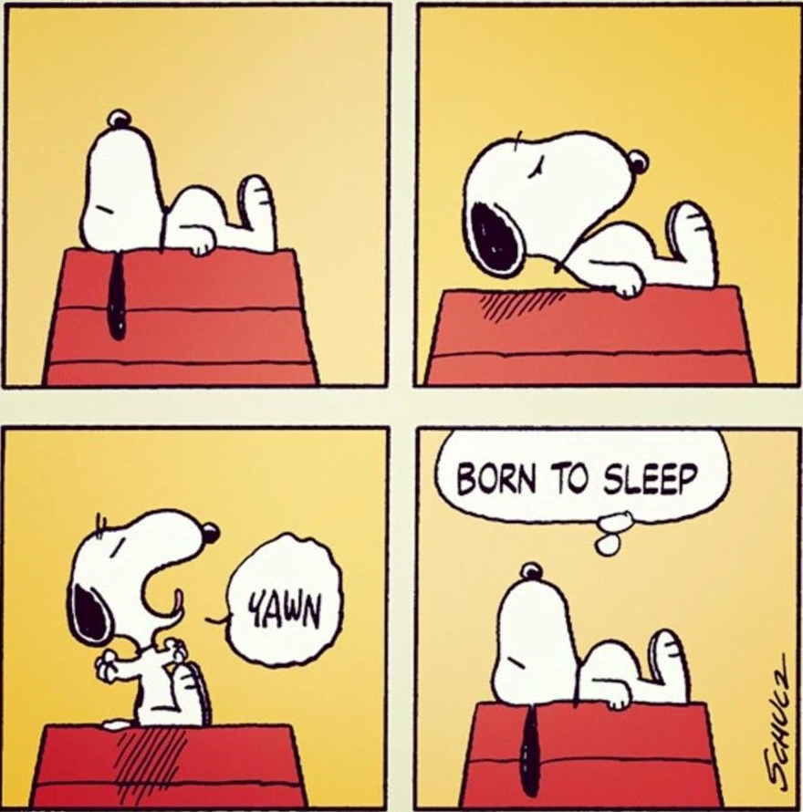
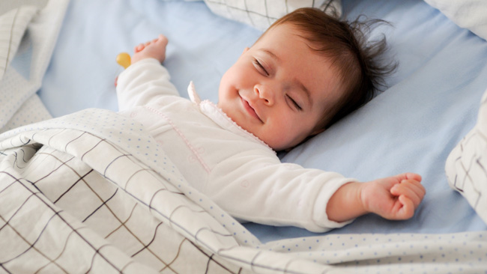
Best treatment?
SLEEP!!!

Slide 19
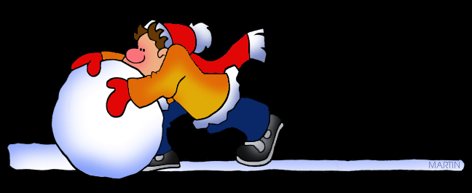
Snowball Groups: Step 1
Notes:
Pairs:
What are some areas of residency that are “encouraging” fatigue?
Sunday NFMS
Long work week hrs
d

Slide 20
Snowball Groups: Step 2
Notes:
Small groups:
What are some possible solutions to specific problems discussed/listed?
60h work wk
<10h shift
Prolong residency
L

Slide 21
Snowball Groups: Step 3
Notes:
Larger groups:
What are some possible questions/issues with these solutions?
Where does work go if change hours?
Shorten hrs change learning environment/opportunities
d

Slide 22
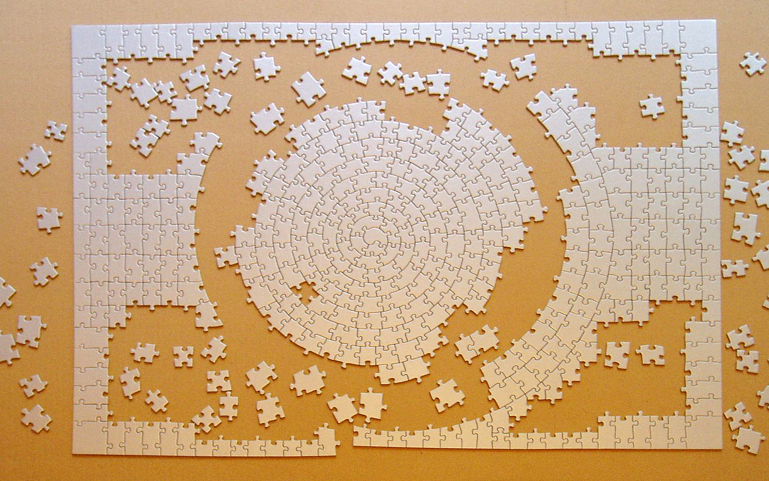
Round Table: Fix the Impossible
Notes:
Here we split the group into tables and gave each table a different difficult situation to solve
Table 1: You notice you are making mistakes because you’ve been working too many days in a row…to the point where you feel like you can’t come in the next day. What do you do?
Table 2: You are on a rotation where you can’t take time off and develop a medical concern that needs to be addressed…what do you do?
Table 3: You’ve worked so many hours in a row and you realize mid-shift that you are too tired to keep working…what do you do?
Table 4: You notice a colleague is too tired to work…what do you do?

Slide 23
Points to remember
We must recognize impairment in each other & in ourselves.
Need to work on culture of admission.
Need to work on implementing changes & support strategies.
Above all else…BE SURE TO SLEEP!
Notes:
Objectives:
Explain 3 ways of identifying physician impairment as it specifically relates to fatigue.
Feel more comfortable admitting fatigue/impairment.
Demonstrate recognition and mitigation of impairment.
Keep in mind:
What do you need to keep doing?
What do you need to stop doing?
What do you need to start doing?

Slide 24
References
DeBlieux, P. Recognizing signs of fatigue. Retrieved from: https://www.medschool.lsuhsc.edu/radiology/docs/Recognizing%20Signs%20of%20Fatigue.pdf
Taylor, T. S., Watling, C. J., Teunissen, P. W., Dornan, T., & Lingard, L. (2016). Principles of fatigue in residency education: A qualitative study. CMAJ Open 4(2): E200-E204.
University of Nevada, Reno. Prevention, identification, and management of fatigue in residents. Retrieved from: https://med.unr.edu/Documents/med/gme/handbook/PREVENTIONIDENTIFICATIONANDMANAGEMENTOFFATIGUE.pdf
Veasey, S., Rosen, R., Barzansky, B., Rosen, I., & Owens, J. (2002). Sleep loss and fatigue in residency training: A reappraisal. JAMA 288(0): 1116-1124.
Wang, T. The effects of sleep deprivation and implications for residency training. Retrieved from: http://medschool.ucla.edu/workfiles/site-GME/ResidentOrientation/sleeptalkdidactics.pdf

Slide 25
Questions

Slide 26
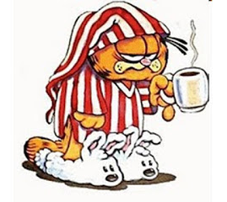
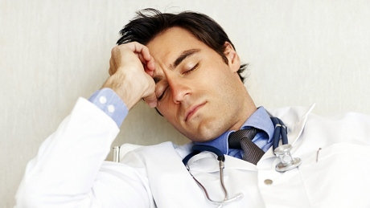
Focusing on physician fatigue
What is it?
Too little sleep
Fragmented sleep
Disruption of circadian rhythm
Primary sleep disorder
Other conditions masquerading as fatigue
Notes:
Facts about fatigue
Nationwide recognition/push for awareness on fatigue and burnout. Many programs are implementing educational curriculum and research is being done to evaluate effects of impairment and fatigue on physicians and patients.
So what is fatigue?
Too little sleep:
probably MCC in medical trainees;
Average sleep for each of us? (raise hands)
most adults require 8.2hrs sleep/night
National survey of 1st and 2nd yr residents found avg <6h/night
Fragmented sleep:
How many of us worry about missing our pages or calls when on 24h call or have an active OB near due date?
insufficient time in “deeper, restorative” stages of sleep; disruption for phone, pagers, work reqs (tasks, notes, logging, studying/reading, f/u on Pts); “worry” that will get a call or anticipating sleep interruption/or sleeping through call/page
Circadian rhythm:
Night float: may put on duty during periods w/ predictable mismatches b/n endogenous rhythms r/t sleep & awake
Energy lows occur around 3-7AM and 3-5PM→more prone to errors during these times
Difficult to adapt to “shift work”
>90% never adapt and may be at risk for sub-optimal performance
May have primary sleep d/o: OSA, narcolepsy, insomnia
Others: anxiety, depression, thyroid ds, medical conditions, medication side effects
d

Slide 27
Sleep disruption
→sleep debt
Occurs if sub-optimal sleep in just 2-3 nights
Requires several consecutive full nights to recover
Performance impaired w/ even 2hrs less
1 of 1st skills lost = ability to do something quickly
Vulnerable to errors 10min - 2h following arousal during night
Notes:
Sleep debt: adverse health consequences may occur if allowed to accumulate.
Sleep debt requires several nights depending upon # of days during which sleep debt was accumulated, susceptibility, and ability to “recover”
Performance can be impaired w/ 2hrs less than “normal” per night.

Slide 28
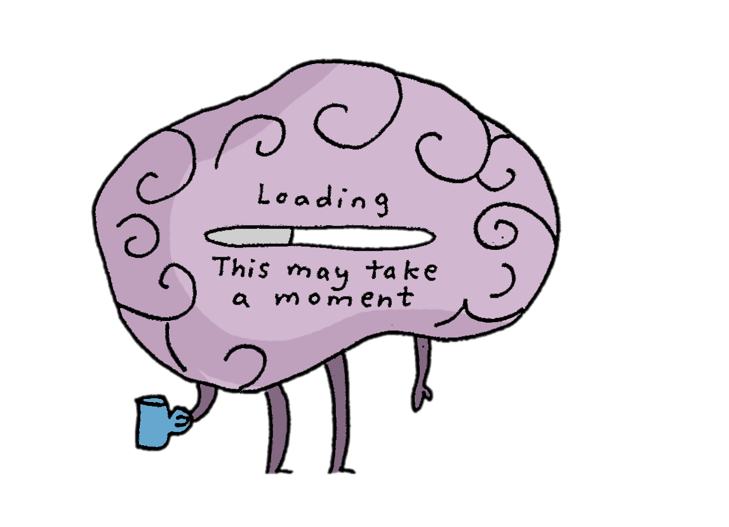
Sleep inertia
Confusion & dysfunction upon awakening
May occur after as little as 30 min of sleep
Impairment may be > than that from sleep loss
Notes:
Occurs upon awakening from sleep during deep NREM sleep, sleep in middle of night, or following a period of sleep deprivation
Disorientation may include period of amnesia for period of awakening.
Most likely to occur upon elicited arousal from sleep period lasting 3-6hrs
Manifests as slowed speech, substantial performance deficits, poor memory, impaired decision making
But can be reversed w/ time or sufficient stimulation

Slide 29
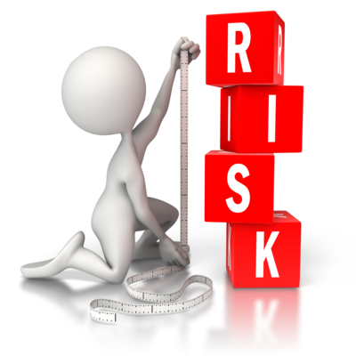
Fatigue impact
Sleep deprivation: ↑ tolerance for risk & ↓ motivation for learning
Epsworth Sleepiness scale = those w/ d/o
↓ skills and cognition
MVAs
Function akin to legal intoxication
Notes:
Facts about fatigue
So what is known…
ESS score comparable to Pts w/ diagnosed sleep d/o
Skills/cognition:
<5hrs/night→increased homeostatic drive to sleep→decreased cognitive performance
Period of lowest alertness after being up all night is b/n 6-11am
Most pronounced w/ tasks requiring great deal of attention
Issues w/ vigilance, verbal processing, complex problem solving, and learning
ITE scores in FM correlated w/ amt of “sleep” night prior to test
IM post call less accurate on EKG
EM fewer components of hx & PE depending upon shift; worse on intubation sim
Sx more errors & more time (increase of 30%) than usual during common procedures; measured postop complications increased by 45% for resident surgeons on day following night on call
20% of anesthesia indicated prevention from performing clinical duties & 12% attributed errors to fatigue
Residents self-reported decay of professionalism, empathy, & attentiveness to Pt well-being when tired; increased confusion and anger
In “off-duty” state (>6hrs of reported sleep previous night) & after 24hrs on call compared performances on simulated EKG, short-term recall of to-do list, & rxn times; all deteriorated after being on call; results similar for jr & sr residents, therefore lack of adaptation over time to sleep-deprived state
MVAs: ~15-20% of transportation accidents, which is more than the combo of drugs & EtOH
Takes approx. 4 secs to drive off road
In NJ, criminal not just civil offense for MVA after 24h w/o sleep
Medical errors = major cause of M&M, fatigue contribution?
Something I found interesting…
Psychomotor fxn after 24hrs w/o sleep = EtOH 0.08%

Slide 30
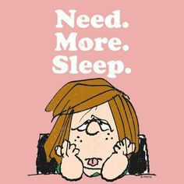
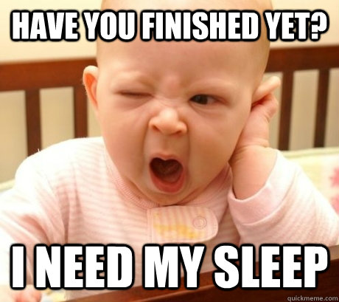
Fatigue impact
NOT normal to fall asleep in lecture…
If it’s a boring lecture, “You’ll be awake and annoyed but not asleep.” (David Dinges)

Slide 31
So…what could we do?
Recognize in ourselves & each other
Create culture okay to admit impairment
↓ non-essential tasks & ↑ learning during clinical time
↓ non-essential interruptions
Set priorities for “time off”
Notes:
Group discussion on what could happen, perhaps better ways to handle & ways to overcome current environment and perceived barriers; scenario/cases
Stats on research/ACGME recommendations—shorter hours, limiting 24h, etc.
Nap q12h; nap earlier in period of sleep deprivation “on call” the better
Recognize and help others
Create culture and environment where okay to admit impaired and too fatigued to safely care for Pts
Ideas:
Reduce non-essential tasks & enhance learning during clinical time
Decrease non-essential interruptions (ex: added ancillary services, triage of phone calls)
Assist residents to identify co-existing medical issues which impair sleep
Critically appraise best way to implement shift work
Minimize short term use of a night float system (ex: resident who does night float M-Th & has wknd “off” to be on own schedule, who returns to “night float” for another 4 nights); night floats should be designed to take advantage of the fact that it is easier to rotate from days to evenings to nights rather than vice versa
Improve recognition of vulnerability & sx
Impact of too little sleep is cumulative
Sleepiness is affected by amt of time since last slept, whether or not any pre-existing sleep debt, time of day reflecting circadian rhythm
People under-estimate level of sleepiness. By time think sleepy, probably profoundly affected.
Set priorities for “time off”
Temptation to cram way too much into hrs free from program responsibilities
Can honestly never read enough. Don’t short change sleep to try to “read it all”
Swapping schedules & helping colleagues, but consider own sleep needs

Slide 32
Questions to ponder…
Is the quality of Pt care jeopardized when residents deprived of sleep?
Is the well-being of residents @ risk when they have not had adequate sleep?
Burning out before really get started?
What strategies are effective for overcoming the negative effects of sleep loss?
Notes:
Recent studies = negative effects of sleep loss & fatigue = ??ing tradition
Deprived: research too new to know effect of insufficient sleep on house staff on preventable adverse events

Slide 33
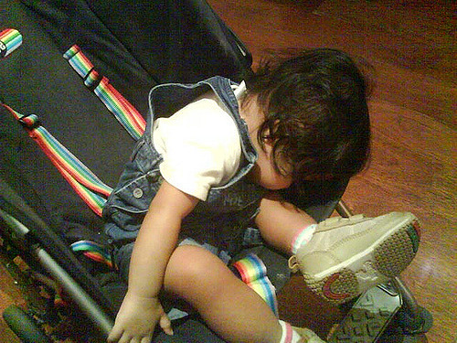
Habits for healthy sleep
Healthy sleep routine→healthy sleep patterns
Aim: 7-9hrs/night
Sufficient catch up sleep: “rested” when wake up
Sleep/awake at approx. same time
Adequate exercise
Eat right
Comfortable bedroom w/ relaxation rituals
Protect sleep time
Notes:
7-9 hrs, especially after period of sleep loss, such as busy rotation
Catch up: esp on days following “on call” and the 24h off time per week
Exercise: avoid directly before sleep
Eat: not go to bed hungry, avoid eating large meals w/in 3h of sleep
Relaxation: such as reading, medication, music
Protect sleep: turn off phone/pager; try not to incur sleep debt from nonwork activities

Slide 34
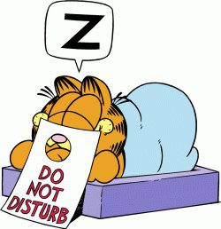
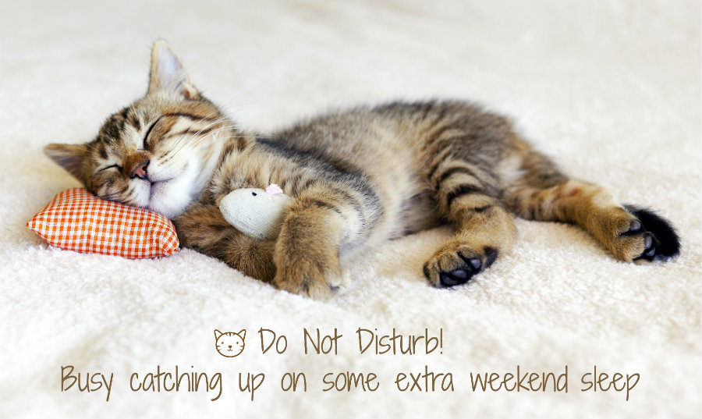
Other interventions…
NAPS!
Notes:
Naps: can prevent & ameliorate some degree of fatigue
Brief (1-2h) prior to prolonged period of sleep loss, such as 24h on call, can enhance alertness
To be therapeutic during a shift, naps should ideally be frequent (q2-3h) & brief (15-30’)
Work best earlier they are in period of sleep deprivation (top off tank than catch up on empty)
Time naps during circadian window of opportunity, b/n 2-5AM and 2-5PM
Longer naps, such as those >30min may be counterproductive in terms of sleep inertia
Utilize quiet, environmentally comfortable location for naps
d

Slide 35
Snowball Groups
Notes:
Pairs:
Small groups:
Larger groups:

