Slide 1
BEYOND THE COVID-19 PANDEMIC:
CAN PRIMARY CARE AND FAMILY MEDICINE
BECOME THE FOUNDATION OF U. S. HEALTH CARE?
John Geyman, M. D.
Professor emeritus of Family Medicine
University of Washington School of Medicine
Seattle, WA
2021 Annual Spring Conference
Society of Teachers of Family Medicine
May, 2021

Slide 2
ESSENTIAL ELEMENTS OF PRIMARY CARE
• First contact care
• Longitudinal continuity over time
• Comprehensiveness, with capacity to manage majority of health problems
• Coordination of care with other parts of the health care system
Source: Starfield, B. Is primary care essential? The Lancet, 344 (8930), 1129-30, 1994.

Slide 3
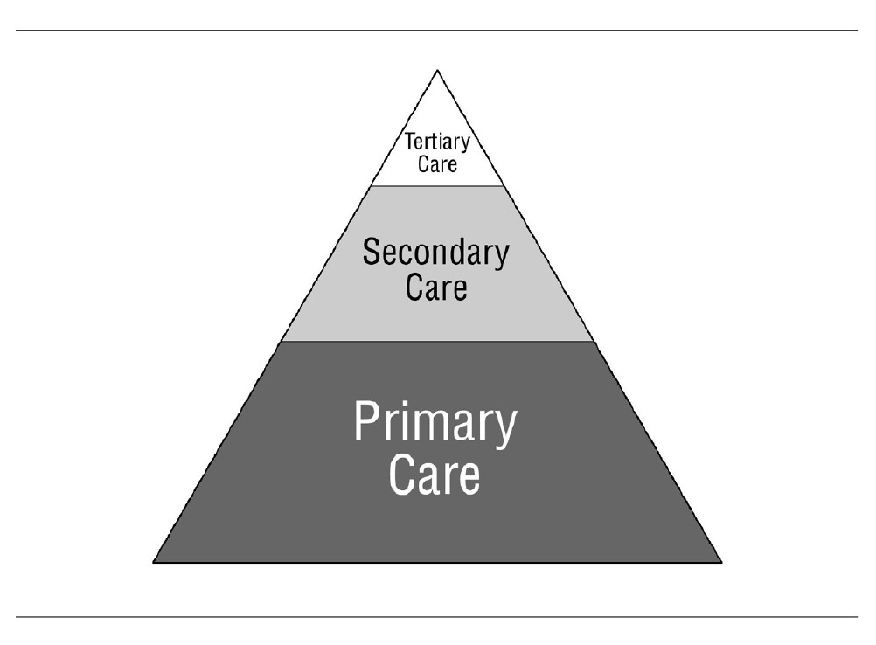
PRIMARY CARE AT THE FOUNDATION OF A HEALTH CARE SYSTEM

Slide 4
2008 REPORT FROM THE WORLD HEALTH ORGANIZATION
Essential features of a strong health system led by primary care are: accessibility (with no out-of-pocket payments), a person (not a disease) focus over time, universality, a broad range of services in primary care, and coordination when people do not have health care elsewhere . . . Evidence at the macro level (e.g. policy, payment, regulations) is now overwhelming: countries with a strong service for primary care have better outcomes at low cost. Systems that explicitly distribute resources according to population needs (rather than demands), that eliminate co-payments, that assume responsibility for the financing of services within the primary care sector are more cost-effective.
Source: Rawaf, S, DeMaeseneer, J, Starfield, B. From Alma-Ata to Almaty: A new start for primary health care. The Lancet on line, 372, October 18, 2008.

Slide 5
WHAT FAMILY PRACTICE IS:
The sine qua non is the knowledge and skill that allows a physician to confront relatively large numbers of unselected patients with unselected conditions and to carry on therapeutic relationships with patients.
Source: G Gayle Stephens in his classic paper, The Intellectual Basis of Family Practice, J Fam Pract 2 (4): 428, 1975.

Slide 6
HOW U. S. PRIMARY CARE HAS BEEN
BROKEN UP OVER LAST 50 YEARS
• Undervaluation of primary care services
• Financing “system” for physician reimbursement
• Lack of national system for physician workforce planning
• Financing non-system for graduate medical education
• For-profit “ethic” vs. service ethic
• Increased corporatization within medical-industrial complex
• Growth of investor-owned care

Slide 7
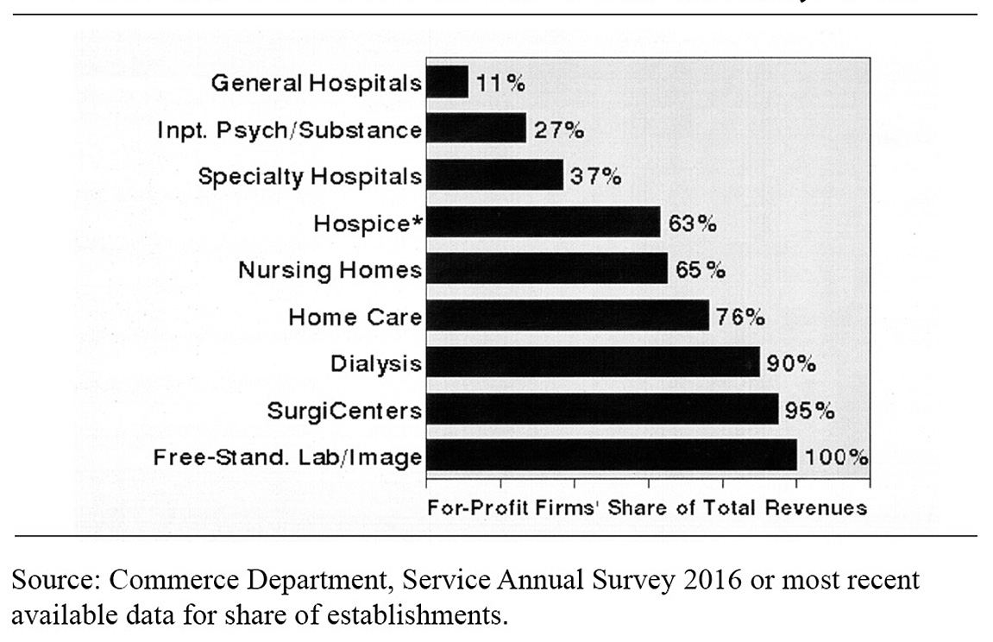
EXTENT OF FOR-PROFIT OWNERSHIP, 2016

Slide 8
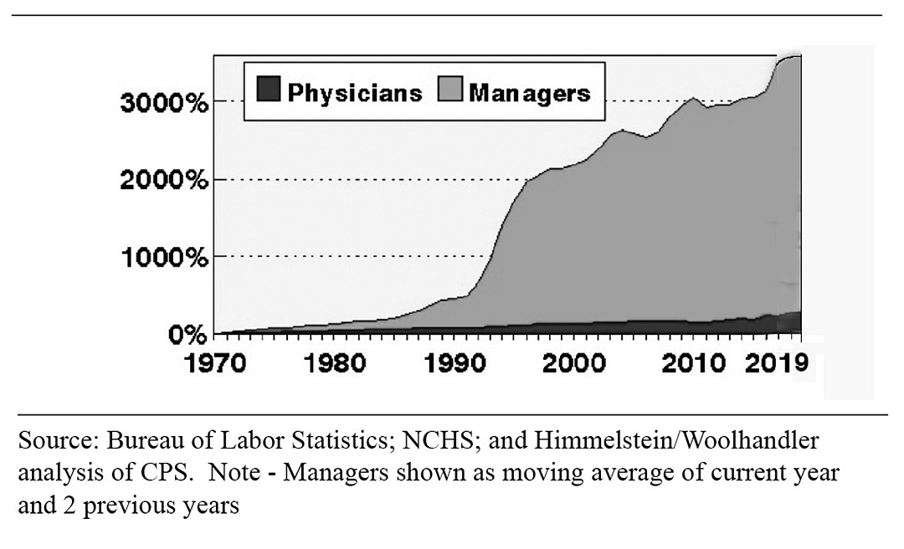
GROWTH OF PHYSICIANS AND ADMINISTRATORS, 1970-2019

Slide 9
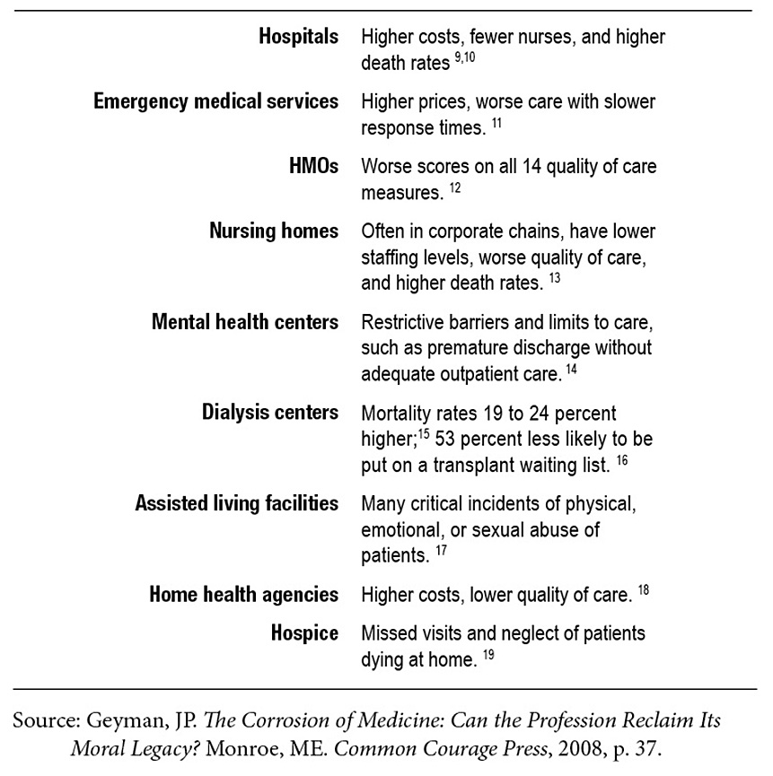
INVESTOR-OWNED CARE: COMPARATIVE EXAMPLES
VS. NOT-FOR-PROFIT CARE

Slide 10
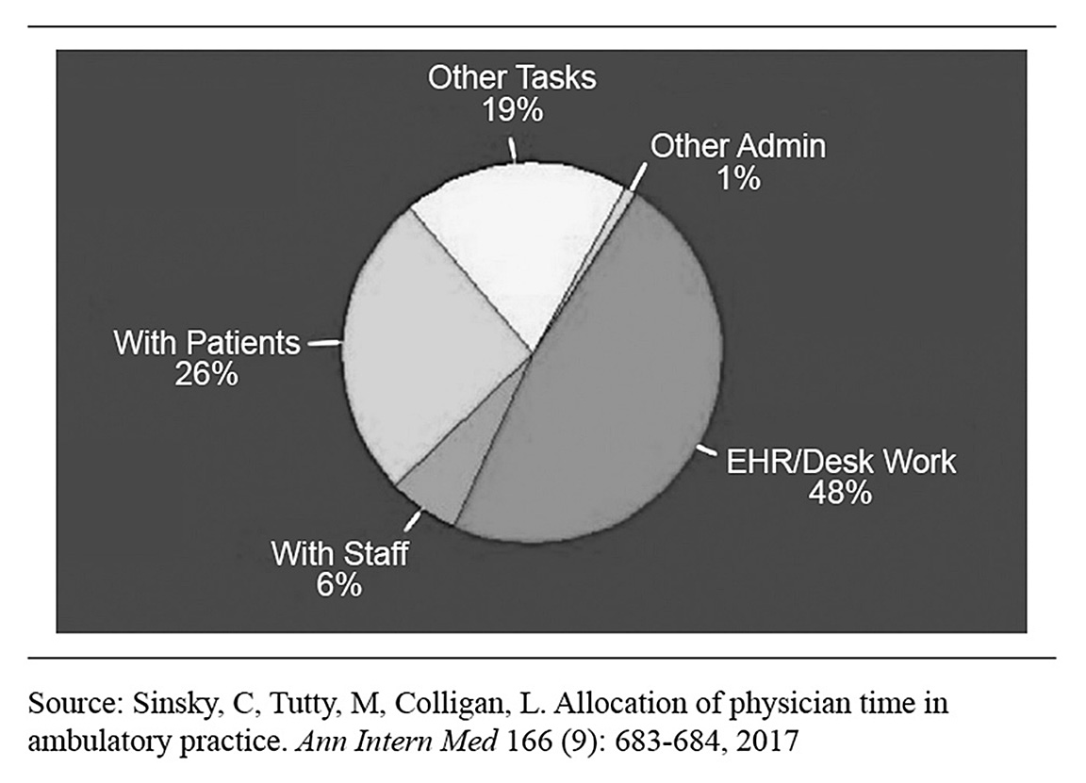
DOCTORS SPEND TWICE AS MUCH TIME
ON EHR/DESK WORK AS WITH PATIENTS

Slide 11
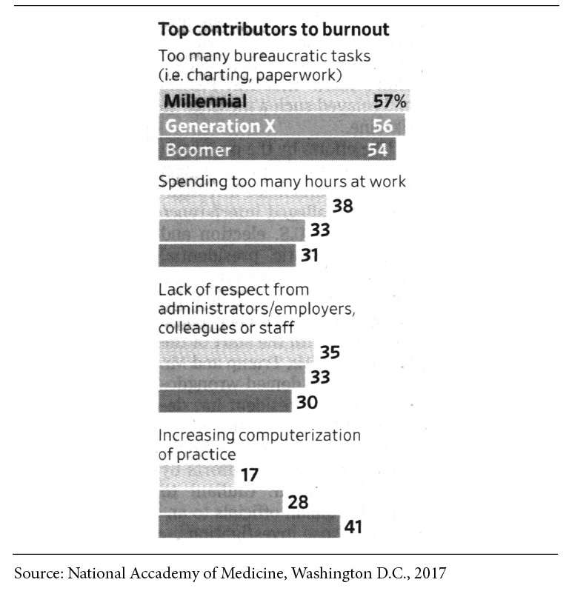
BURNOUT STRIKES MID-CAREER
PHYSICIANS HARD

Slide 12
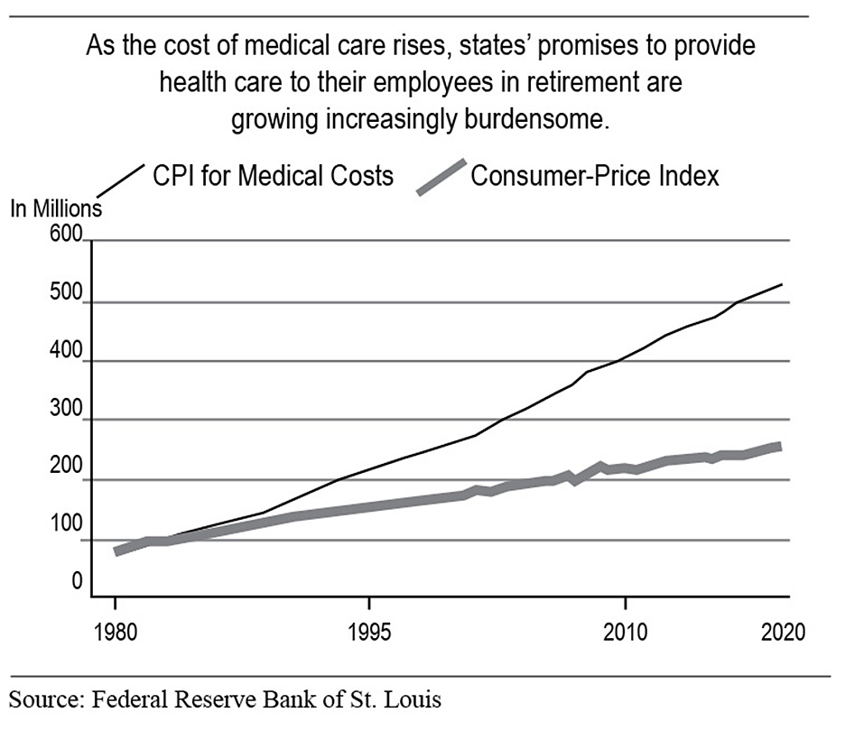
INCREASING BURDEN OF HEALTH CARE COSTS, 1980 TO PRESENT

Slide 13
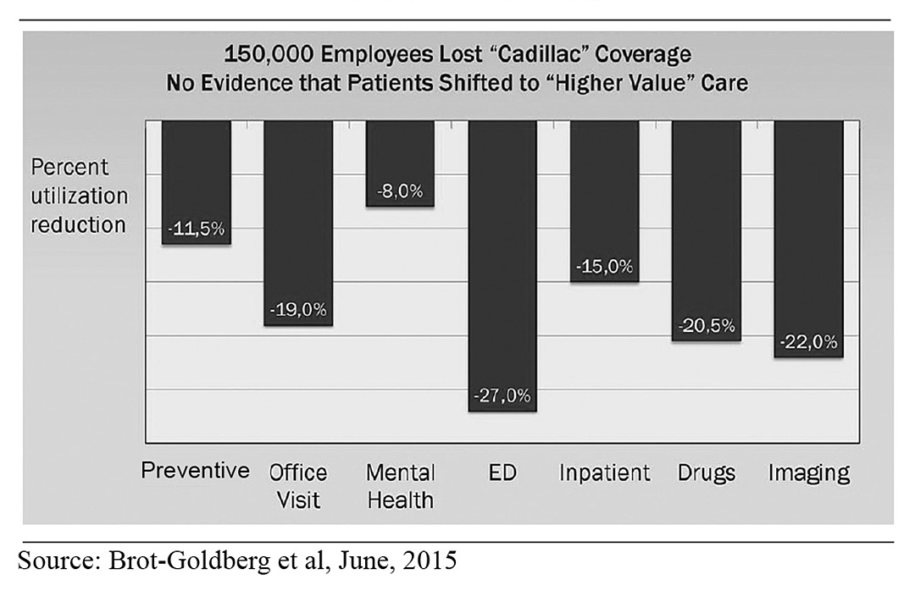
HIGH DEDUCTIBLES CUT
ALL KINDS OF CARE

Slide 14
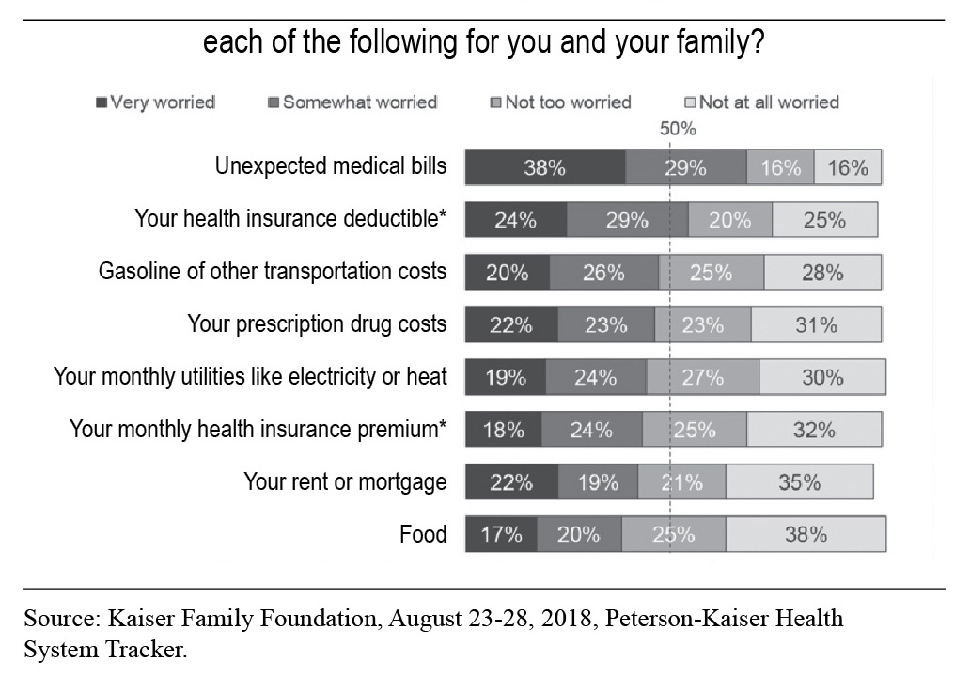
HOW WORRIED ARE YOU ABOUT
BEING ABLE TO AFFORD…

Slide 15
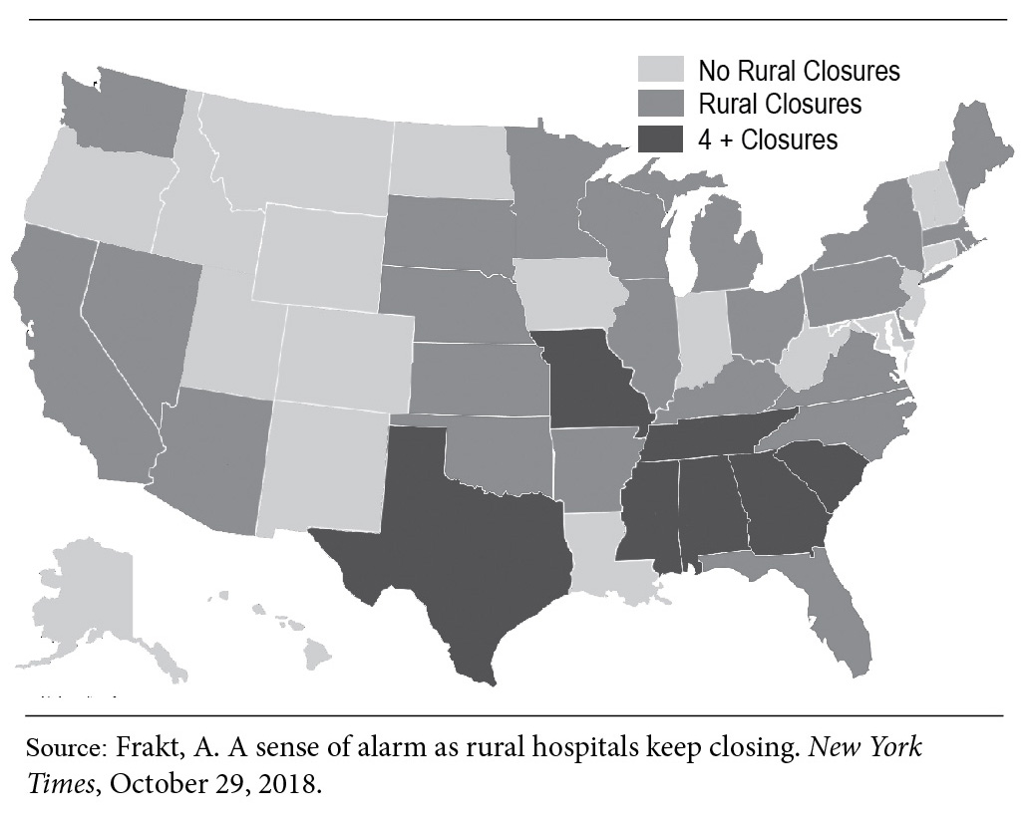
RURAL HOSPITAL CLOSURES SINCE 2010

Slide 16
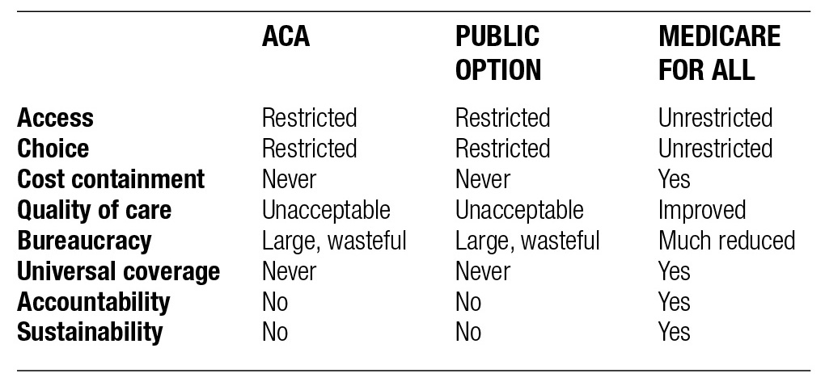
COMPARISON OF THREE REFORM
ALTERNATIVES BASED ON EVIDENCE

Slide 17
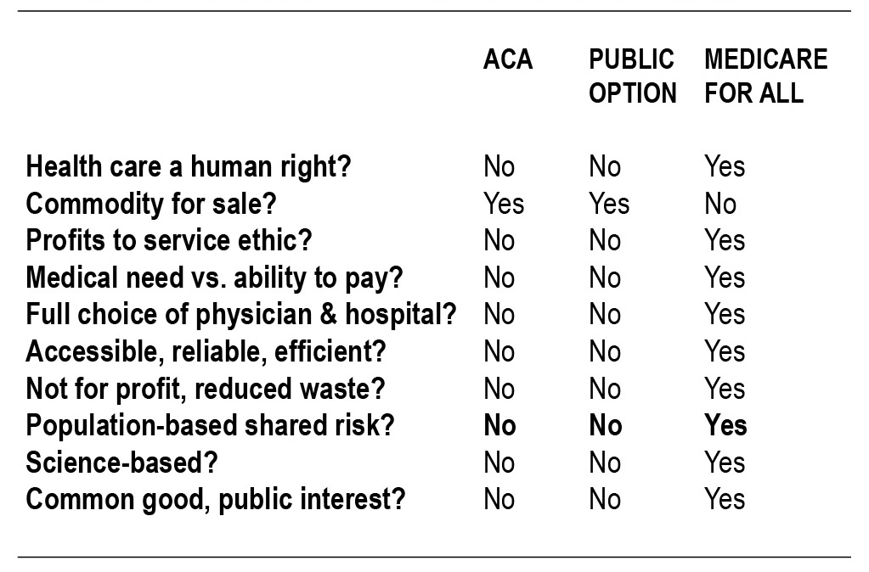
COMPARISON OF THREE REFORM ALTERNATIVES BASED ON VALUES

Slide 18
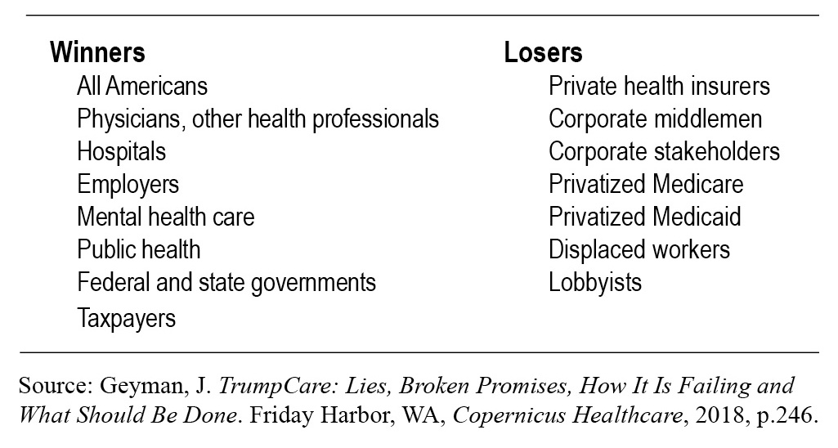
WINNERS AND LOSERS UNDER
MEDICARE FOR ALL

Slide 19
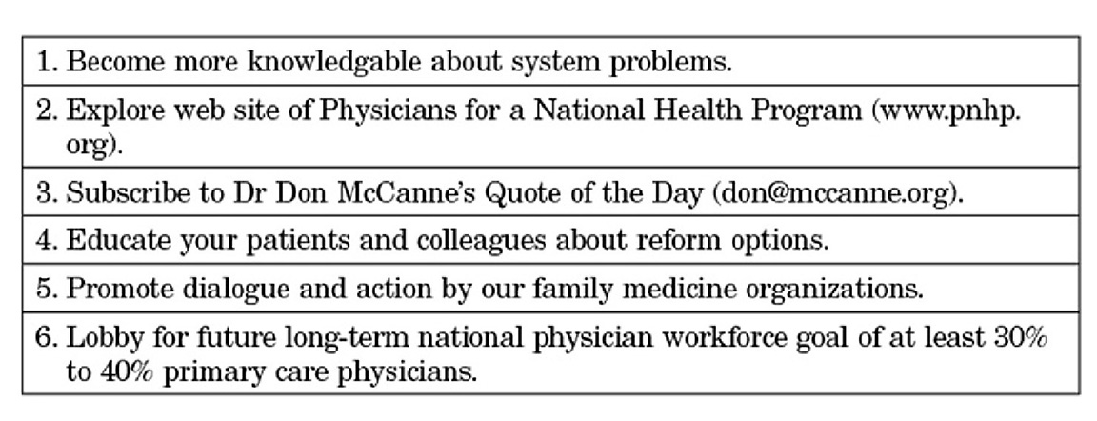
HOW FAMILY MEDICINE CAN LEAD TOWARD HEALTH CARE REFORM

