Slide 1
Cultivating Compassion Through the Teacher-Learner Relationship
Terri Dalton, MA, Cleveland Clinic/Fairview FMR, Cleveland, OH
Kathryn Fraser, PhD, Halifax Health FMR, Daytona Beach. FL
Janelle Von Bargen, PhD, St. Francis Hospital FMR, Wilmington, DE
Dael Waxman, MD, Carolinas Medical Center FMR, Charlotte, NC

Slide 2
No Disclosures

Slide 3
Objectives
Upon completion of this session, you should be able to:
Define the concept of hidden mentorship and its importance in the arena of compassionate care
Describe the parallel process of the teacher-learner and the learner-patient present in medical education
Design a personal plan for compassionate care that actively integrates parallel process and hidden mentorship

Slide 4
Personal and Professional Satisfaction in Medicine Matters

Slide 5
We replicate the experience we are given.

Slide 6
The Process is A Win-Win-Win
It is as much about the teacher.
It is as much about the learner.
It is as much about the patient.

Slide 7
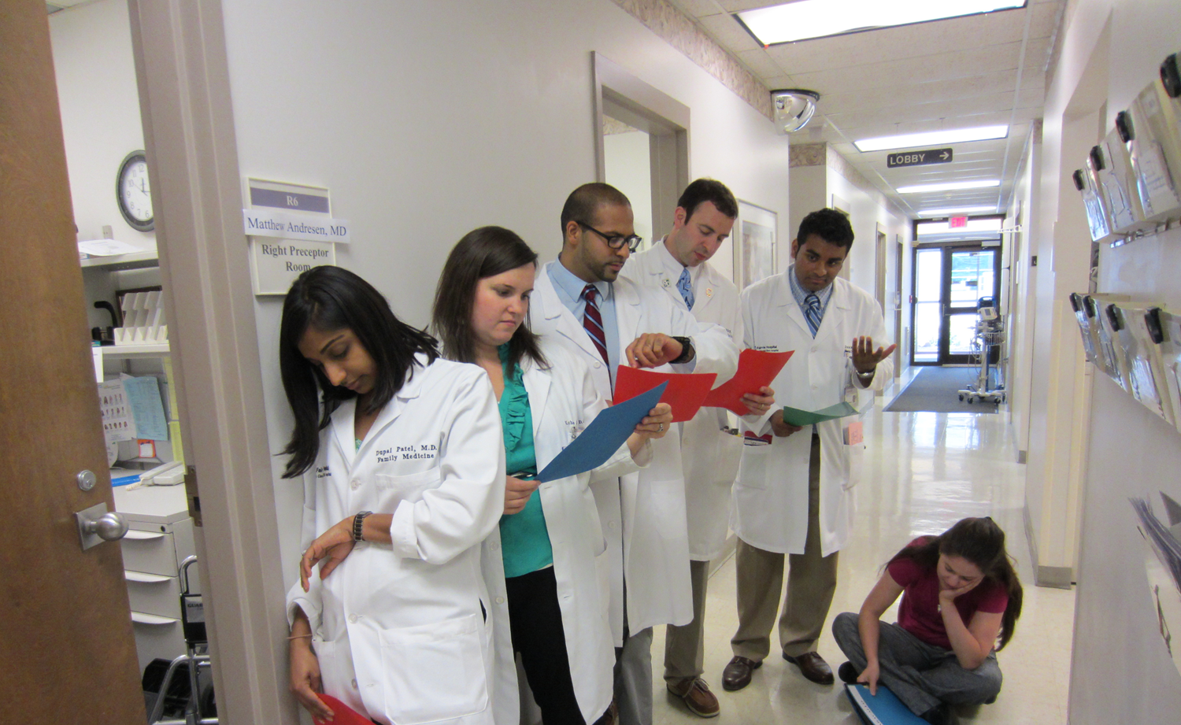
Peeking into the
Preceptor Room

Slide 8
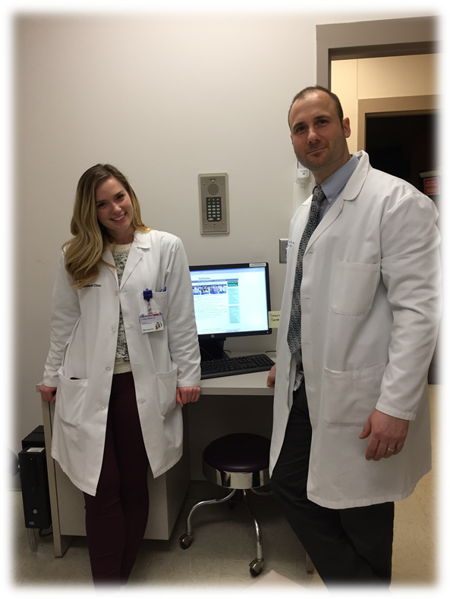
Auto-Pilot: Getting the Job Done
vs.
Dropping In: Being Fully Present

Slide 9
Hidden Mentorship defined as
We replicate with our patients the very experience we are given – teacher to learner, learner to patient, learner to teacher/peer. An infinite cycle of good that gets replicated.

Slide 10
Parallel Process defined as
Posted Jan 07, 2009
Awareness of your own issues/dynamics that may be similar to your patient or learner.
Self-reflections can help you avoid getting drawn into a spin by being attentive to parallel process. It is a teacher, a guide and a mentor.
Michael J Formica MS, MA, EdM Enlightened Living
The Me in You: Parallel Process in Psychotherapy
When the client is the mirror.

Slide 11
Dropping-In defined as
.
Awareness of two aspects of your moment-to-moment experience:
what’s going on around you and
what’s going on within you.
From mindfulness literature: to be consciously present in what you’re doing, while you’re doing it, as well as managing your mental and emotional state.
http://greatschoolspartnership.org/wp-content/uploads/2016/11/10-Ways-to-Be-More-Mindful-at-Work.pdf

Slide 12
Compassionate Care defined as
experiencing empathy
and wanting to do something about it

Slide 13
Narrative Medicine Informs
Compassionate Care
…it may be that the physician’s most potent therapeutic instrument is the self, which is attuned to the patient through engagement, on the side of the patient through compassion, and available to the patient through reflection.
Narrative Medicine – Charon

Slide 14
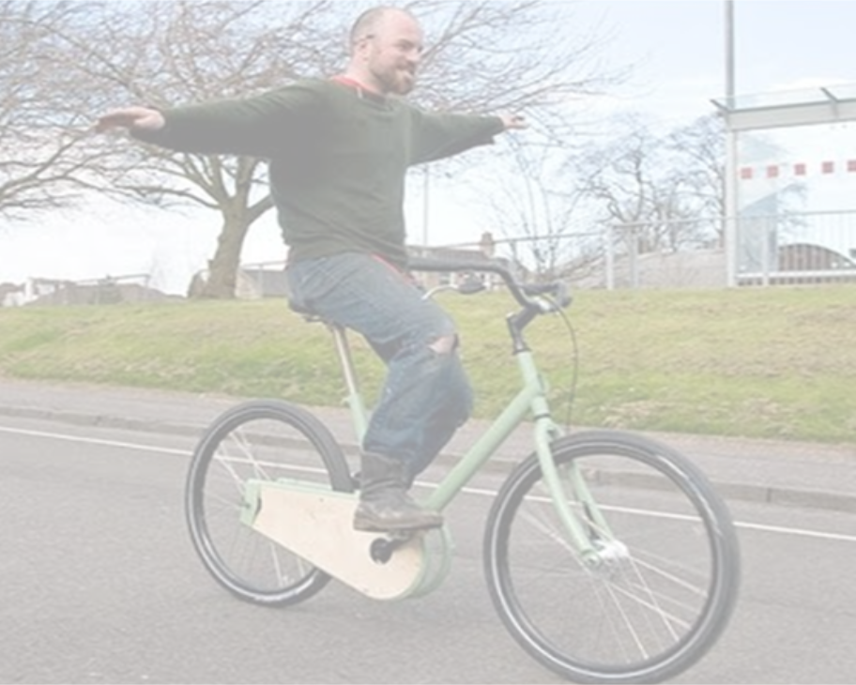
TIME FOR FREE- WHEELING
RECALL: Take 5-minutes to remember a time when you have had a teacher-learner interaction that you felt worked, that you felt you “dropped-in” with the learner.
WRITE: Self-Reflection
What qualities did you bring that made the interaction effective?
Notes:
A positive recall of things that work can be an antidote.
Write-Pair-Share

Slide 15
PAIR – SHARE
PAIR: Gather in dyads & share your recalled situation, first one person listens deeply and then trade when we announce it is time to switch
SHARE: Listen mindfully to your colleague’s story and ask them
What qualities did you bring to the interaction they shared?
What unique things could you describe that
helped you to get there?
Notes:
A positive recall of things that work can be an antidote.
Write-Pair-Share

Slide 16
Self-Reflection defined as
Take time apart from a situation to look back on emotional and spiritual reactions within yourself
Assess how it connects with events in your past
Imagine how will it affect your future responses
How does dropping-in shift gears and change the dynamic?

Slide 17
Mindfulness Informs Compassionate Care
By enabling physicians to be more attentive to patients and their needs, a mindful orientation holds promise for making clinical encounters more patient centered and for enhancing patient-clinician communication.
Multicenter Study of Physician Mindfulness -- Beach, Roter, Korthius,

Slide 18
Mindfulness Informs Compassionate Care
Epstein writes of mindful practice:
“This critical self-reflection enables physicians to listen attentively to patients’ distress, recognized their own errors, refine their technical skills, make evidence-based decisions, and clarify their values so they can act with compassion, technical competence, presence, and insight.”
Multicenter Study of Physician Mindfulness -- Beach, Roter, Korthius,

Slide 19
Is there an Elephant in the Room?

Slide 20
What are the barriers?
What are the benefits?

Slide 21
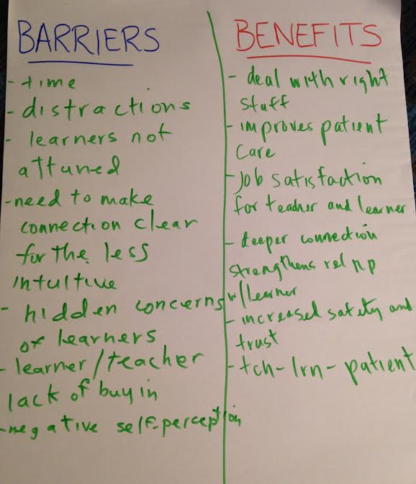
Group’s
Processing
During
Seminar

Slide 22
It begins with intentionality.
Plan one thing you can do to drop-in and cultivate compassion with your learners?

Slide 23
We thank you for joining us today!
Please evaluate this presentation using the conference mobile app! Simply click on the "clipboard" icon on the presentation page.

Slide 24
References
Charon R MD, PhD. JAMA. 2001;286(15):1897-1902. doi:10.1001/jama.286.15.1897. Narrative medicine a model for empathy, reflection, profession, and trust.
Epstein RM, Street Jr RL. Ann Fam Med March/April 2011 vol. 9 no. 2 100-103. doi: 10.1370/afm.1239. The values and value of patient-centered care.
Beach MC1, Roter D, Korthuis PT, Epstein RM, Sharp V, Ratanawongsa N, Cohn J, Eggly S, Sankar A, Moore RD, Saha S. Ann Fam Med. 2013 Sep-Oct;11(5):421-8. doi: 10.1370/afm.1507. A multicenter study of physician mindfulness and health care quality.
Krasner MS1, Epstein RM, Beckman H, Suchman AL, Chapman B, Mooney CJ, Quill TE.
JAMA. 2009 Sep 23;302(12):1284-93. doi: 10.1001/jama.2009.1384. Association of an educational program in mindful communication with burnout, empathy, and attitudes among primary care physicians.
Michael J Formica MS, MA, EdM, Enlightened Living, The Me in You: Parallel Process in Psychotherapy
When the client is the mirror.
A Conceptual Framework for the Use of Illness Narratives in Medical Education Arno K. Kumagai, MD 658 Academic Medicine, Vol. 83, No. 7 / July 2008
An Appreciative Inquiry Approach to Practice Improvement and Transformative Change in Health Care Settings Caroline A. Carter, BA, LSW; Mary C. Ruhe, BS, RN; Sharon Weyer, DNP, RN, NP-C; David Litaker, MD, PhD; Ronald E. Fry, PhD; Kurt C. Stange, MD, PhD Q Manage Health Care Vol. 16, No. 3, pp. 194–204 c 2007 Wolters Kluwer Health | Lippincott Williams & Wilkins

