Slide 1
Act Scholarly!
Embrace Your Inner
Behavioral Scientist

Slide 2
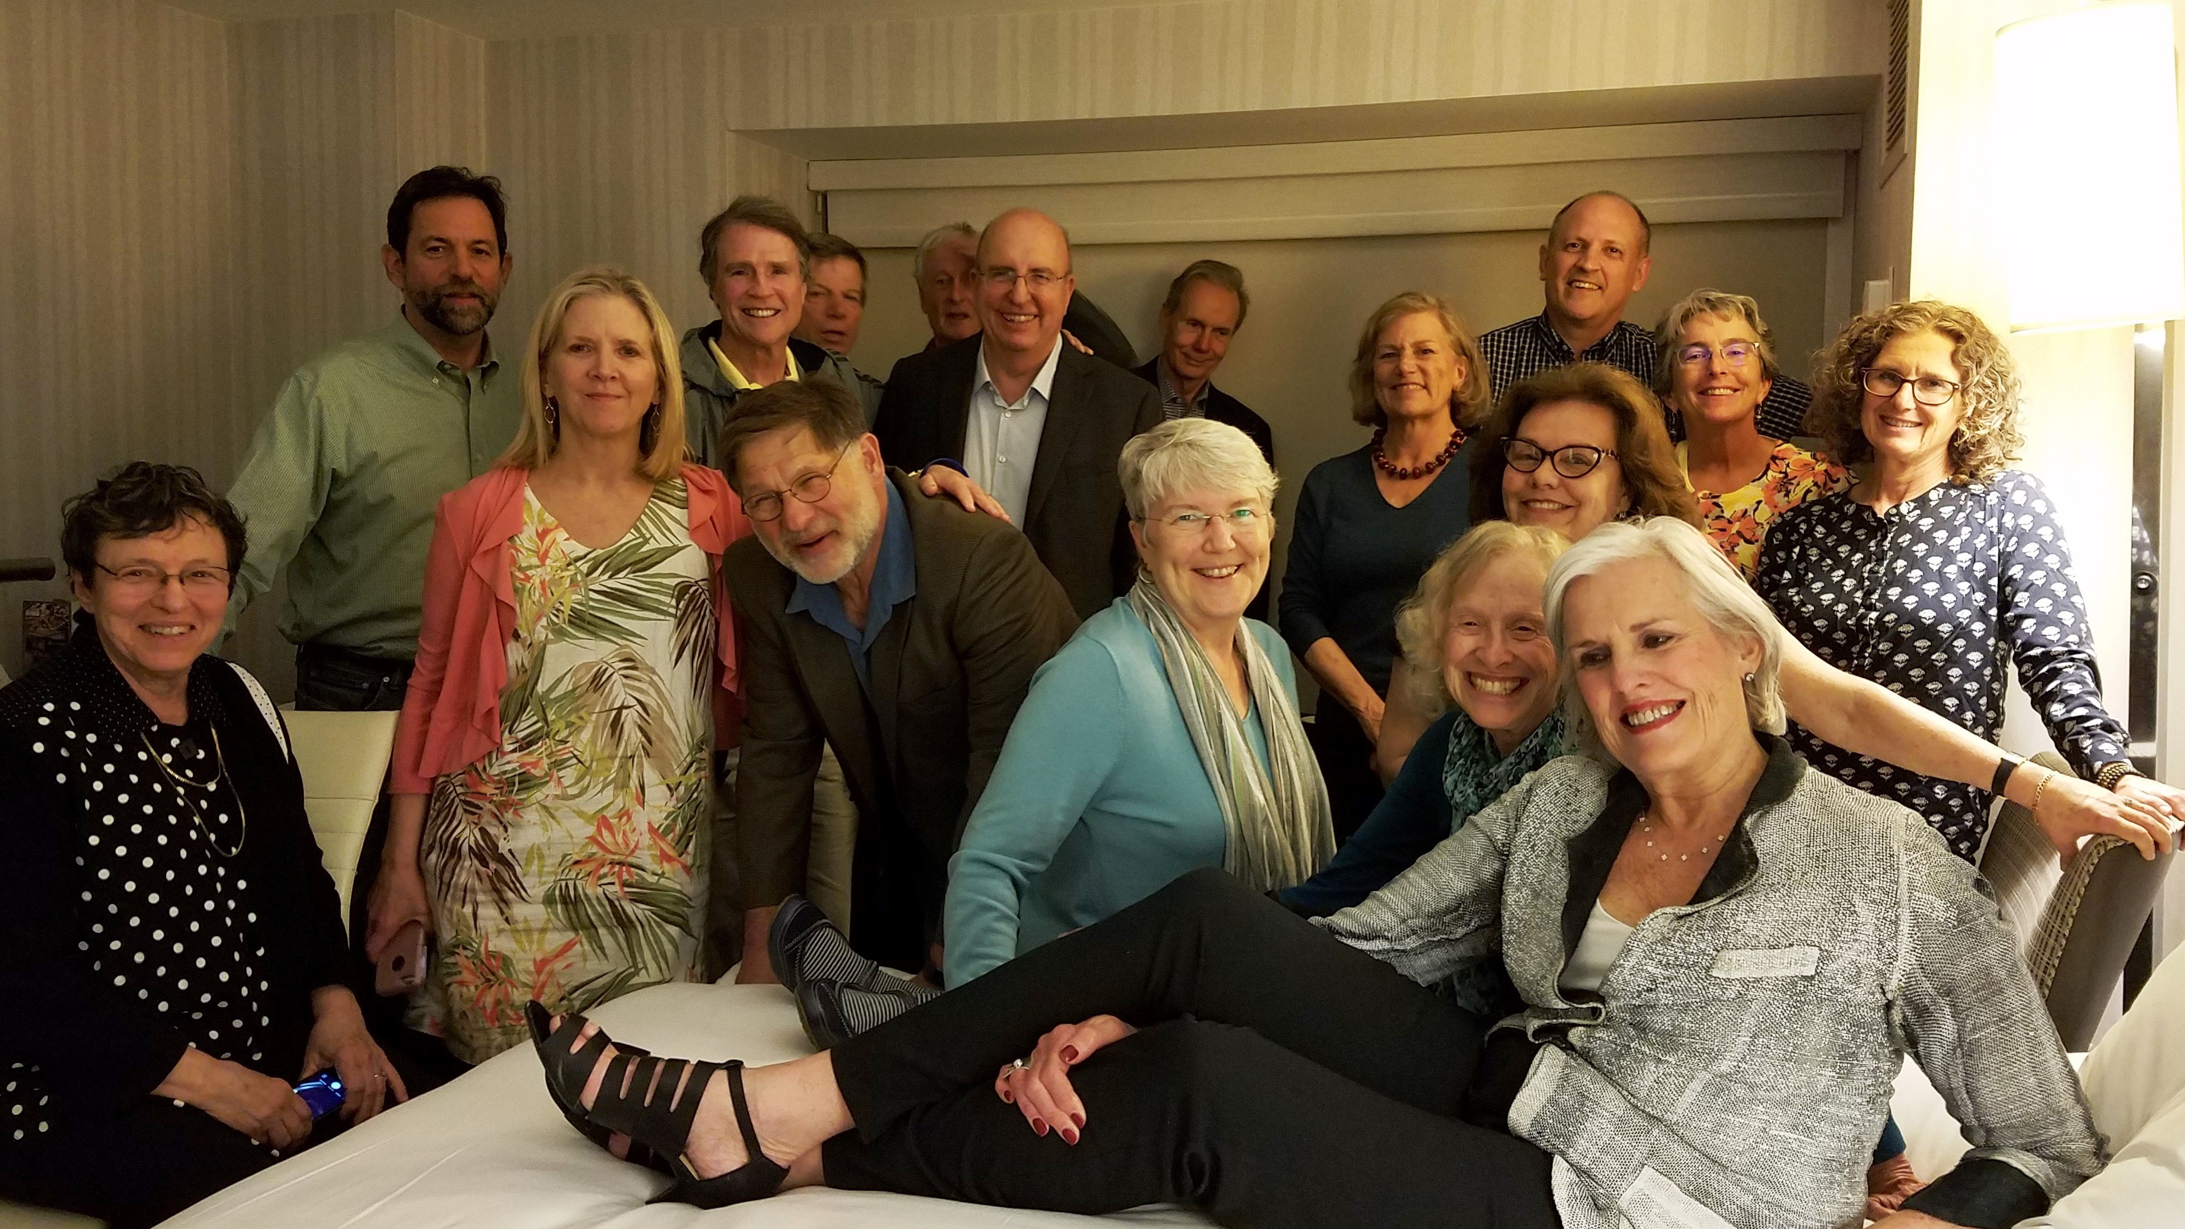
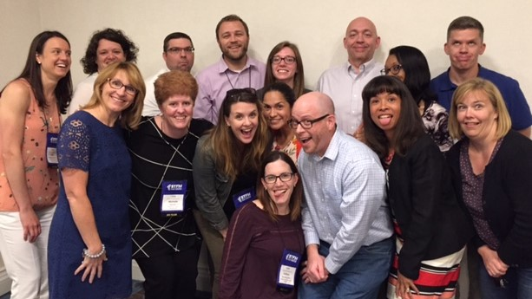
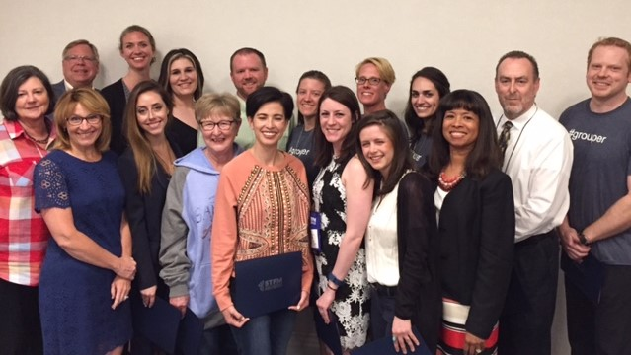
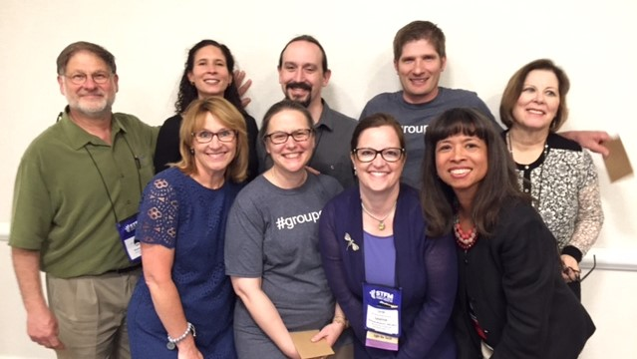
You
Notes:
I am so excited to be here with all of you! You are my people!

Slide 3
Objectives
Define “Scholarship”
Your history of scholarship
Research and scholarship – lessons learned
Positive affirmation

Slide 4
Act Scholarly!
Notes:
I realize I am speaking to the choir, when it comes to talking about scholarship.
OK, this is an audience participation exercise.
Please stand – and remain standing if…
you have ever written a grant for > $100,000 and got funded. (mentors!)
you have ever written a grant of any size and got funded.
published in a journal.
presented at a conference
if you are attending this conference.

Slide 5
Scholarship:
Excellence Built on
Peer Review

Slide 6
Scholarship:
Your Work
Excellence Built on
Peer Review
Shared with us
Notes:
If you are doing work that you are proud of – or work that is going well – come and share it with us!
To some people, “peer review” means peer critique – but in fact, it goes both ways.
Your peers are here to learn from you, and to improve their work – and you can learn from their feedback of your work.

Slide 7
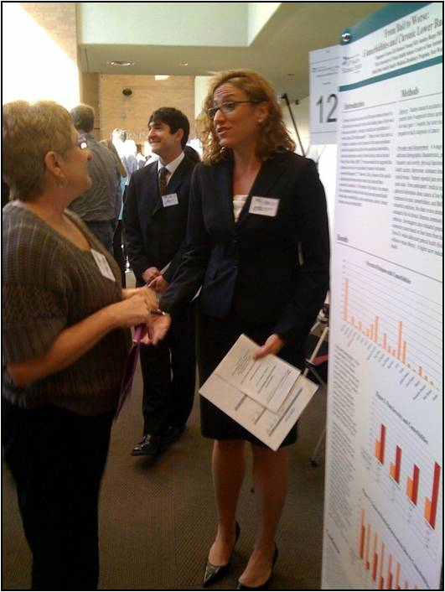
Excellence built on
peer review
Good Feedback!
My next project will build on that input.
Good Idea!
I want to borrow it to improve my work.

Slide 8
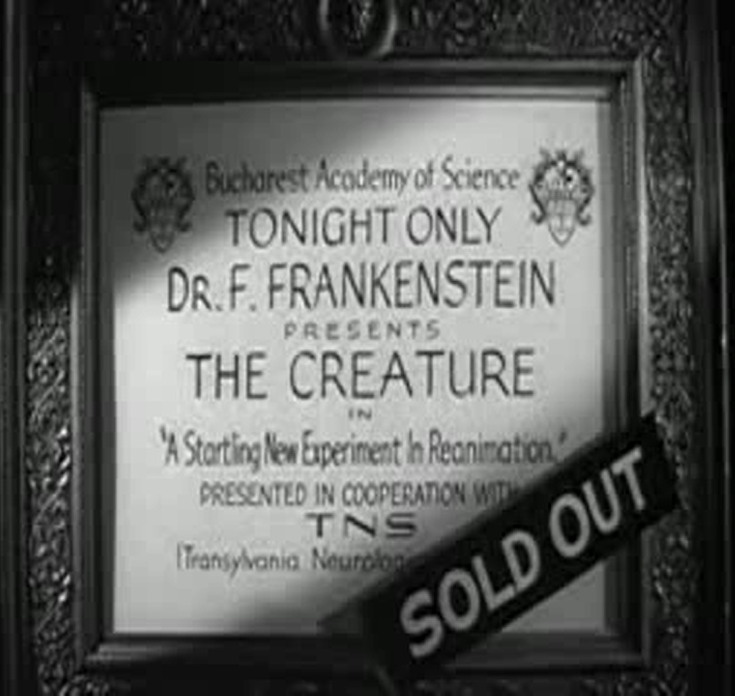
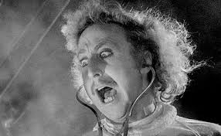
It's ALIVE!
From Young Frankenstein, starring Gene Wilder
Notes:
Even Young Frankenstein did not hide his discovery in a dark, spooky castle…

Slide 9
Even small contributions have an impact
Notes:
Do not feel modest about making a small contribution!
AIDS research began with a case report.

Slide 10
You
Notes:
YOU have made an impact on Family Medicine; you have shaped the discipline.

Slide 11
Notes:
These faculty have documented your contributions; and they have split the history of family medicine into early, middle and late periods.

Slide 12
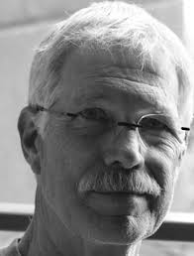
Scholarship: The Early Years (1966-1986)
1973
Notes:
Behavioral science people were there at the beginning. THIS GUY. Don Ransom.
He was a graduate student at Berkeley in 1969, and was hired as a teaching assistant to Herb Vandervoort at UCSF.
He helped them design an introductory course for ms1 and ms2.
in 1970, he taught the first course on family health, illness, and care in the country.

Slide 13
Scholarship: The Early Years (1966-1986)
I was trying to identify where family doctors should be looking and working: in that unclaimed space between what the specialist does and what the public health officer does—the personal physician, integrating biology on the one side and the community on the other.
Donald Ransom, Santa Rosa CA, interview published in 1992
Notes:
Don Ransom attended his first STFM conference in 1971, and was really irritated by the conversations – that family docs were still embracing the medical model, aiming for “jack of all trades.” In his mind, they had an opportunity to re-invent medicine, create a new kind of physician. He left the conference, rented a typewriter, and began writing an article that was published in JAMA IN 1973.

Slide 14
Scholarship: The Early Years (1966-1986)
1979
1986
1981
===================
The Family in Family Medicine
Graduate Curriculum
and Teaching Strategies
________________________
STFM Task Force on
Family in Family Medicine
First Forum for Behavioral Science
1980
First Families in Family Medicine Conference
1981
1999
Notes:
Scholarship in the early years focused on the basics: what should be in the curriculum, and who should teach it.
Several programs hired psychologists, family therapists, social workers and they came together to create curricula,
STFM published curricular guides; specialized conferences formed.
The 1999 Resource Guide can be found in the STFM Resource Library.

Slide 15
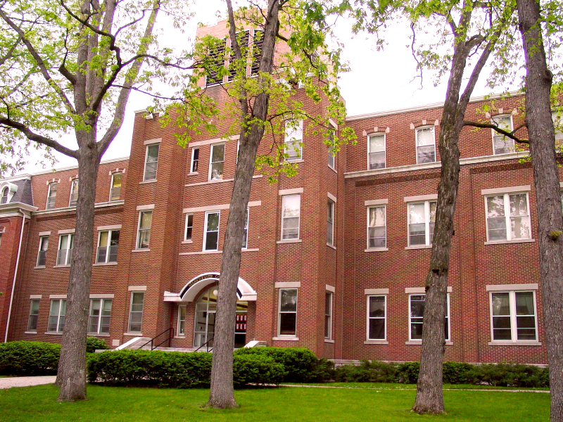
Sandra Burge: The Early Years Manchester College, 1970-1974
Double Major:
Math & Psychology
Notes:
So, where was I in those early years? Just starting college.
I majored in math, and then became so interested in psychology that it became my second major.

Slide 16
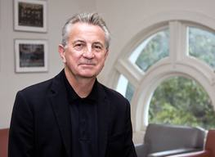
Sandra Burge: The Early Years Purdue University, 1980-1984
Dept Child Development & Family Studies
Charles Figley, Ph.D.
Notes:
A few years after graduation, I was living in Lafayette Indiana.
A college classmate introduced me to Charles Figley – who is well known for traumatic stress studies.
Purdue, as you may know, has a strong family therapy program – but I was not interested in doing therapy.
Dr. Figley introduced me to the idea of becoming a social science researcher, thus combining my math and psychology backgrounds.
While I was working on my doctoral dissertation, I got nervous about finding a job! A classmate pointed me to….

Slide 17
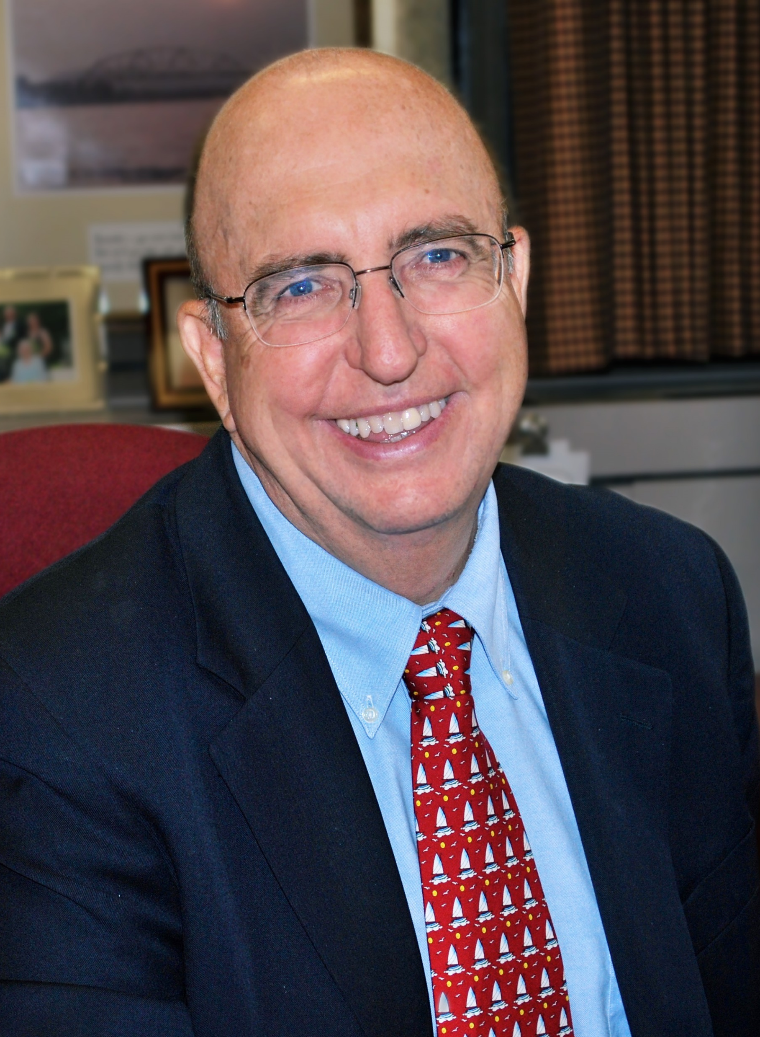
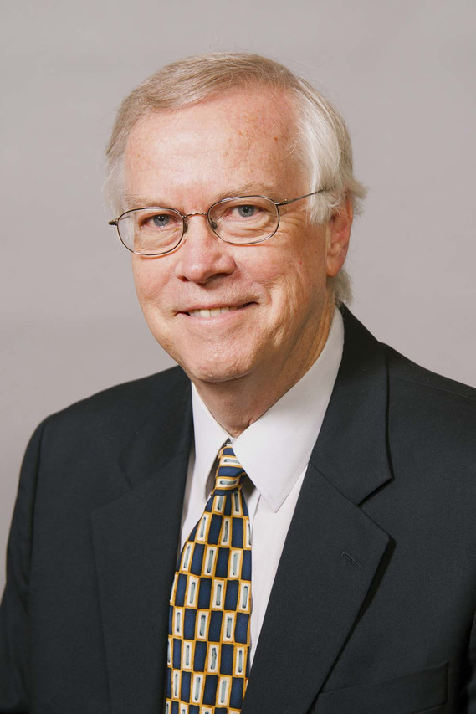
Sandra Burge: The Early Years University of Oklahoma, Dept Family Medicine, 1984-1986
Notes:
…This opportunity and I snapped it up! This was my first introduction to family medicine, total serendipity.
In these days, we still imagined that our job was to translate psychotherapy skills into brief strategies that family physicians could use.
We even imagined that someday, they wouldn’t need us.

Slide 18
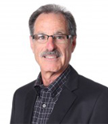
Sandra Burge: The Early Years UCSF Regional Campus at Fresno, “Families & Health Study,” 1986-1987
Notes:
The grant funding supporting my position in Oklahoma ended, but my colleagues pointed me to a fellowship in California – and I worked for these guys!
Larry Fisher is a family health researcher, and Don Ransom is… the guy!
They were lovely mentors, very inclusive, very supportive.

Slide 19
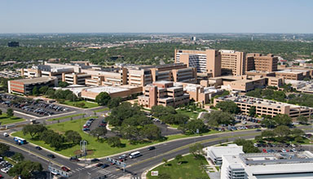
University of Texas Health Science Center at San Antonio, 1987-2017
Behavioral Science Faculty & Researcher
Notes:
And then I landed here. First PhD they ever hired. Before me, they had a part-time psychiatrist who sat in her office and waited for residents to consult her; she taught one lecture a month. These were “early days” for behavioral science in Texas, and they didn’t realize the shortcomings of hiring a not-clinician for the position. However, right-place-right-time, they were building behavioral science AND research at the same time, so I got a 50/50 teaching/research position.

Slide 20
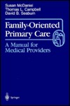
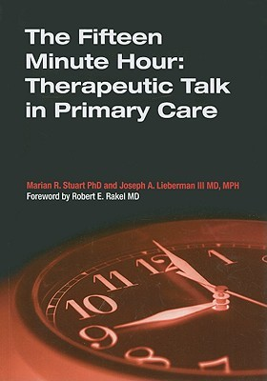
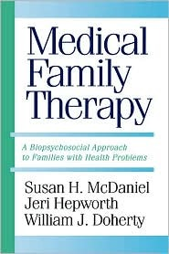
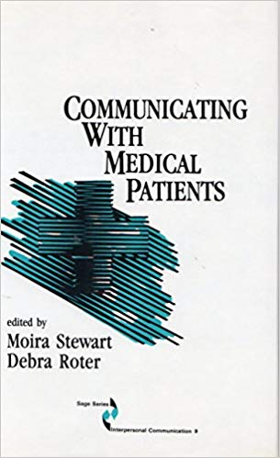
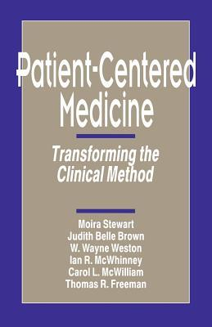
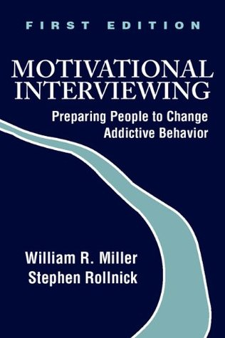
Scholarship: The Middle Years (1987-2001)
1993
1993
1990
1996
1992
1989
1995
1992
Notes:
Translating clinical skills for Family docs.
Great research focused on communication skills, by Debra Roter, Klea Bertakis, Moira Stewart, Wendy Levinson
Early research in SBIRT, Collaborative care for depression.

Slide 21
Clinics in Family Practice 2001; 3(1), 147-162
Do psychosocial problems present
in primary care practices?
Do psychosocial interventions work?
In mental healthcare settings
In specialty medical settings
In primary care settings
Communication skills
Brief counseling interventions
Health behavior change
Can skills be taught?
Notes:
I myself reviewed the research in 2000.

Slide 22
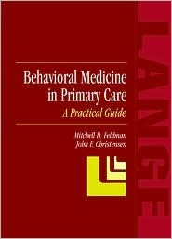
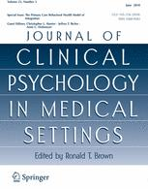
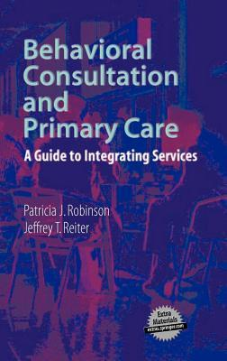
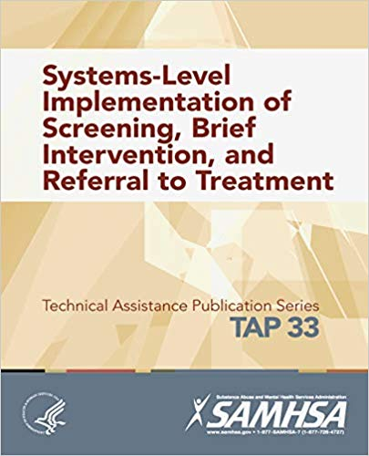
Scholarship: Recent Years (2002-2019)
2007
2013
2003
2018
2003
2007
2018
2011
Notes:
health behavior change, motivational interviewing, group visits, and SBIRT.
interventions became more sophisticated, evaluations, too.
Working alongside physicians, you invented integrated care, team-based health care.

Slide 23
PC Behavioral Health
Integrated Care
Collaborative Care
Motivational Interviewing
Brief Interventions
Health Behavior Change
SBIRT
Primary Care Counseling
Communication
Biopsychosocial
Patient-Centeredness
Family Oriented Care
Notes:
Our pathway of scholarship started with general approach – biopsychosocial; patent centered; family oriented.
Moved toward psychological skills translated for physicians to use;
Increased in sophistication, became more collaborative, more interdisciplinary.

Slide 24
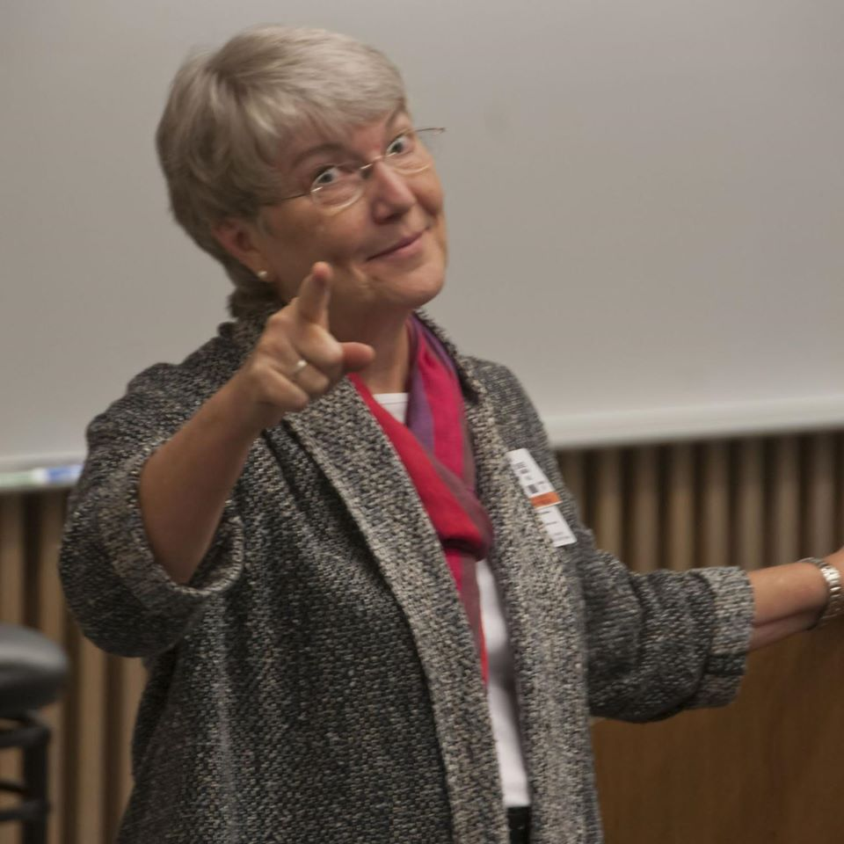
More work to do:
Team-based care
Behavioral science curricula
Interprofessional education
Social determinants of health
Brief interventions

Slide 25
You
Notes:
So – through scholarship – YOU have moved the behavioral sciences in family medicine along.
This would not have happened without that learning community that is YOU – US

Slide 26
Research and Scholarship
lessons learned after stumbling in the dark
people - approach - skills
Notes:
People – Approach – Skills

Slide 27
Find the right people
Mentors Collaborators Helpers IRB

Slide 28
Mentors
Notes:
One thing mentors can do is teach you the PROCESSES of research – how to apply for IRB approval, how to submit a manuscript to a journal, how to draft a grant budget, etc.
When I moved to San Antonio, there were only about 3 people doing research.
All of us were assistant professors, all of us were new.
And I was the only Ph.D.
There was no mentor material for me there. And, I had all this training. I thought I was supposed to know what to do.
WHAT I SHOULD HAVE DONE – and what you should do if you are in a similar situation – is look outside your program, your department
Look HERE at the Forum – or across your campus. Set up regular meetings.

Slide 29
Collaborators
Let’s study Family Violence
Let’s study Complexity Science
Notes:
My good friend David Katerndahl.
He and I did a few small projects together in early days,
Then as his interest and skills moved toward complexity science, we conceived of a line of research to map the day-to-day dynamics of intimate partner violence.

Slide 30
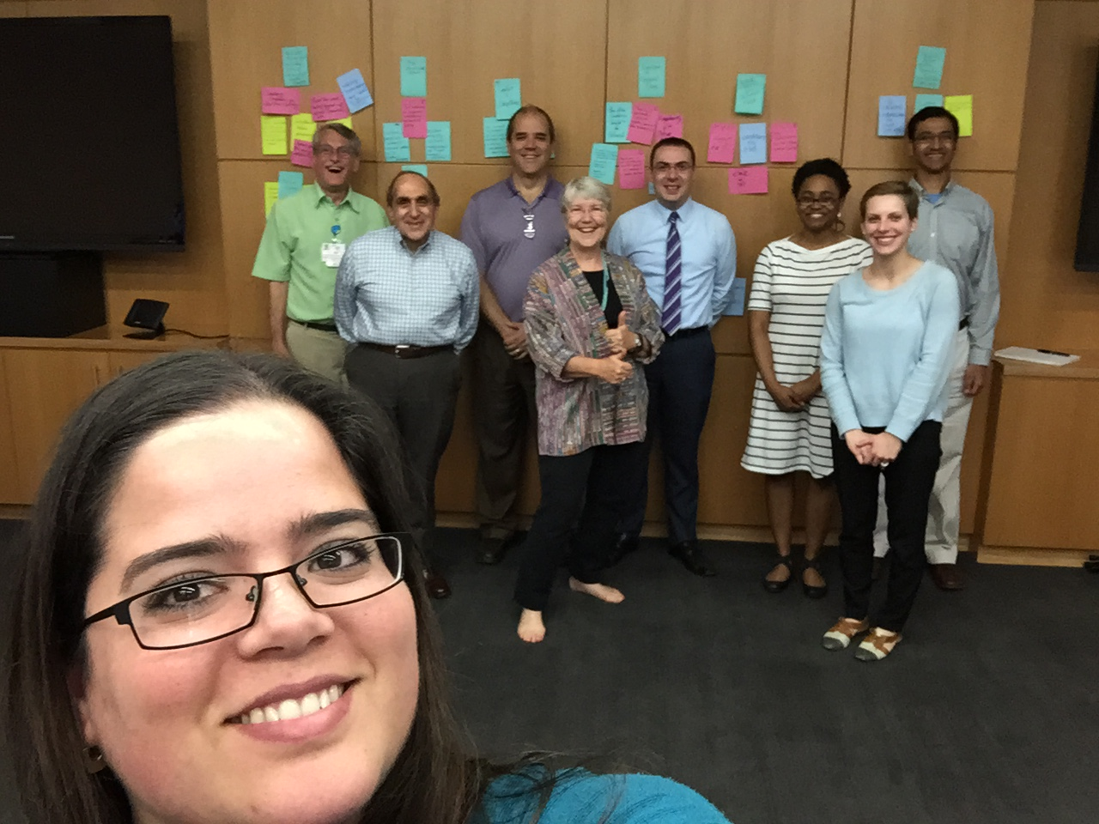
RRNeT: Residency Research Network of Texas
Notes:
I conceived a research network of residency programs in the 1990s, and got a HRSA grant to support us.
This is a network of 12 residency programs, in continuous collaboration for 21 years.
RRNeT conducts about 1 project per year, with a very democratic process for selecting topics to study.
Everyone collects data; everyone gets a chance to present findings at meetings or in journals.
Everyone trusts that they will get their turn at studying something of interest to them.
We have won 18 research awards over time!

Slide 31
SBIRT: Screening, Brief Intervention & Referral to Treatment
Notes:
And finally – it’s really OK to simply work with your friends. These are my psychologist pals – I’ve known them since I moved to San Antonio.
And, we completed 2 SBIRT training projects together.

Slide 32
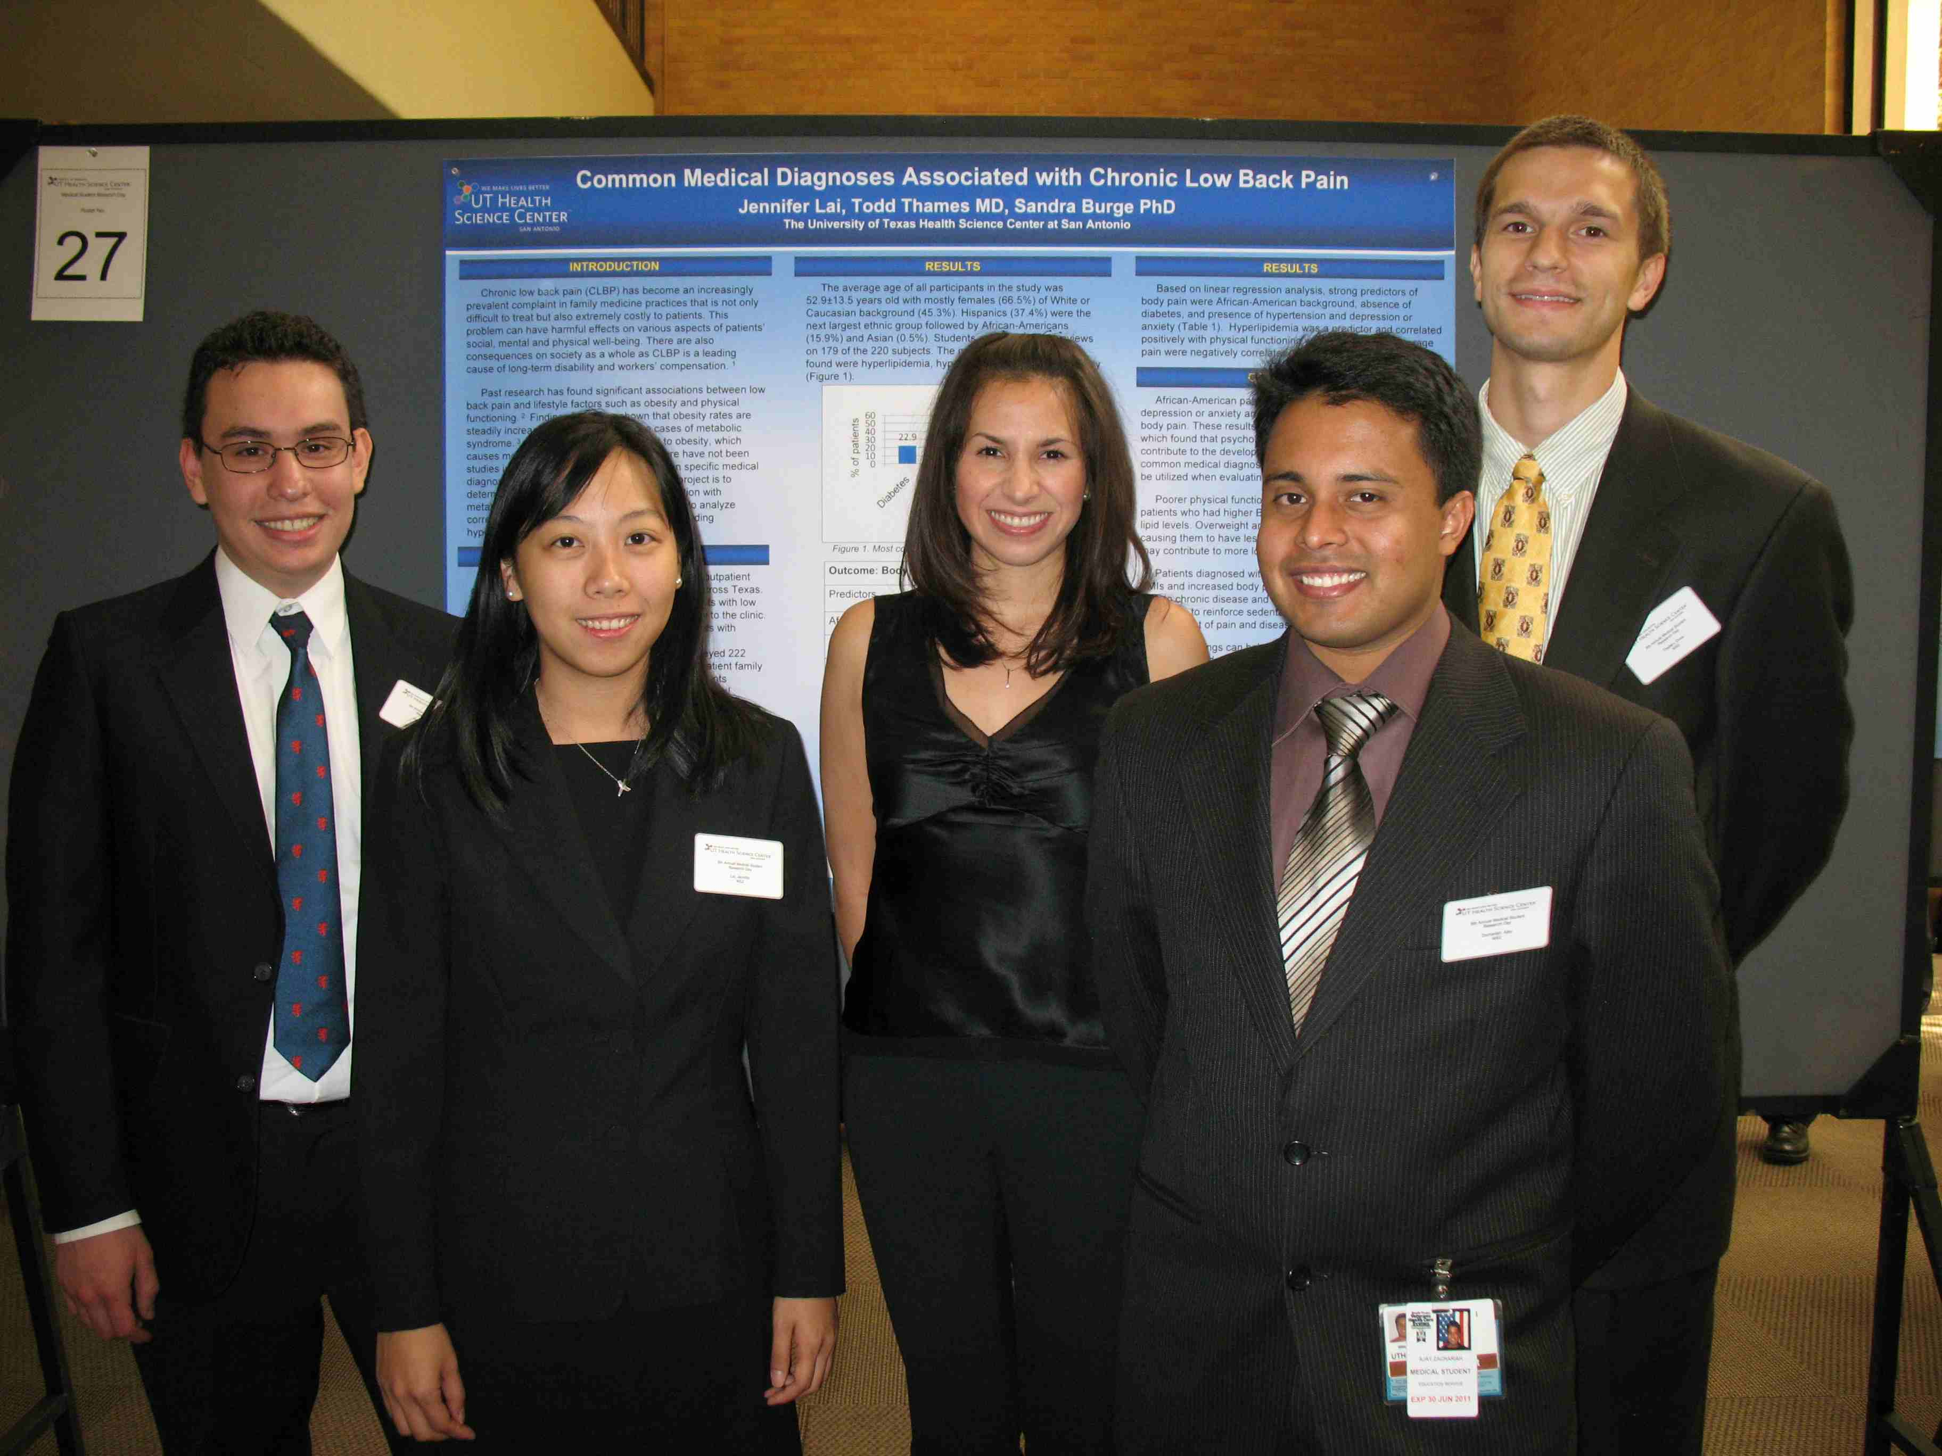
Helpers
Notes:
About 6 years into the partnership with RRNeT, data collection slowed down – no one had time to do it.
Then, I discovered MEDICAL STUDENTS – and they make great data collectors, data entry people, and great disseminators of our findings.
Also, ask your boss to get one staff member trained to help with tasks like IRB paperwork, grant budgets, etc.

Slide 33
IRB Are People too!
Notes:
Meet with IRB director – talk a bout the kind of work you plan to do, long term (Like QI with residents)
Get appointed to the IRB committee
Steer toward “not regulated research”

Slide 34
Define your approach
Focus Read Methodology Start Small Time

Slide 35
Focus!
Choose from the following:
What I do for a living
What I feel good about
A topic that feels important
A topic that intrigues me
A methodology
Notes:
I had a couple areas of focus:
PBRN – I did this the longest
Violence against women
Alcohol abuse . SBIRT

Slide 36
Read Research Articles
Note – Read for…
design
measurement
interventions
important findings
What else?

Slide 37
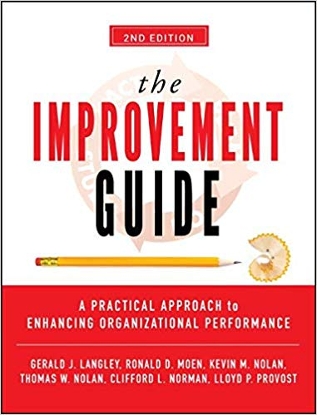
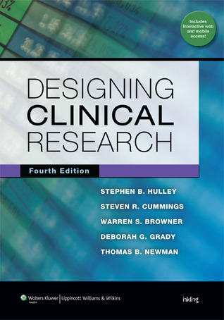
Select a Methodology
Responsible Research with Communities: Participatory Research in Primary Care
AC McCauley et al. 1998
NAPCRG website
Notes:
Choose a methodology that is comfortable to YOU.
You don’t have to do statistical clinical research if that structure is not comfortable to you.
Do qualitative instead.
If you time is limited, perhaps jump on the quality improvement train.
If you are engaged in community work, consider Participatory Action Research. Look on the NAPCRG website for a white paper by Ann McCauley.

Slide 38
Start Small, then Grow
Notes:
AIDS research began with a case report.
You will NOT get NIH grant funding if you have never done research before.
Start with small projects and grow them over time. Research is not about discrete projects, but about a series/continuum of work that expands over time.

Slide 39
If Time Is Limited…
QI projects
Chart Reviews
Case-Control
Case Studies
Curriculum Evaluation
Card Studies
Clinician gathers data from patients
Patient Surveys
Physician Surveys
CERA Surveys
Notes:
If time is limited, choose research methodologies that are simpler to achieve.

Slide 40
Notes:
Learn about CERA.
It is a time-saver because: you write the hypotheses and 10 questions.
CERA applies for IRB, tidies up the survey, conducts the survey, puts together a database and cleans it up.
They send you the clean database to analyze and write up – you have 90 days.

Slide 41
Sharpen your skills
Writing Analysis

Slide 42
Write! Share Your Work
Editorial
Commentary
Special Articles
Original Articles
Brief Reports
Narrative Essays
Book and Media Reviews
Letters to the Editor
2019
Vol. 51 (7)
July/August
Notes:
You are not limited to writing one type of piece.
This issue includes opinions, philosophy, research results, brief reports, poetry, a narrative of a quality improvement project, book reviews. Also includes both qualitative and quantitative research.

Slide 43
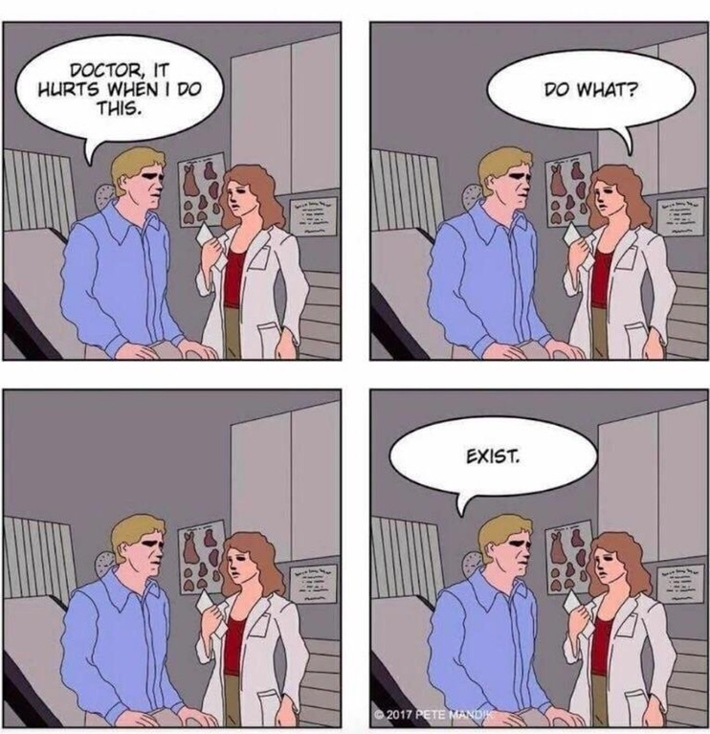
Do you have Math Anxiety
?
STATISTICS
DON’T DO THEM
Notes:
Find a numbers person to collaborate with
Do qualitative research.
Write other types of work (see next slide)

Slide 44
Book Chapters
Quality
Improvement
Letters to the Editor
Case Reports
Opinion/
Commentary
Qualitative Research
Clinical
Innovations
5-Minute Clinical Consults
Poetry
Systematic Review of the Literature
Narrative/
Personal Reflections
Notes:
Things you can do that don’t involve statistics.

Slide 45
Stats: Let’s Break it Down
3 main types of hypotheses
Group A will be different than Group B.
I predict change over time.
Phenomena X and Y are associated (correlated) with each other
Notes:
Let’s simplify…

Slide 46
Stats: Let’s Break it Down
Chi-Square (X²)
3 main types of hypotheses
Group A will be different than Group B.
I predict change over time.
Phenomena X and Y are associated (correlated) with each other
T-test
Paired T-test
Correlation (r)
Notes:
If you understand these 4 statistics, know when to apply them and know how to interpret them,
This will take you a long way.
All other stats are based on these 4.

Slide 47
Stats Made Easy
Notes:
I have these books on my shelf.
They describe statistics using the ENGLISH LANGUAGE

Slide 48
Resources
Forum Research Sessions & workshops
STFM Resource Library
https://resourcelibrary.stfm.org/home
Grand Canyon University
https://cirt.gcu.edu/research/developmentresources/tutorials
Notes:
More resources.
Find “Research Minutes” (one-page mini-lessons) on the STFM Resource Library.
Nice research tutorials on the Grand Canyon University website.

Slide 49
Want to up your game?
Surround yourself with the right people
Define your approach
Qualitative, quantitative, community-based, QI?
Focus your reading
Sharpen your skills
Start small, then build
Share your work with us
Notes:
You are doing scholarship right now!
Challenge the Forum to provide skills workshops to up your game.

Slide 50
You
Notes:
EMBRACE YOUR GOOD WORK – EMBRACE YOUR SCHOLARSHIP! EMBRACE YOUR INNER BEHAVIORAL SCIENTIST!

Slide 51
Act Scholarly
Yes!
Notes:
Now, in the interest of taking a risk and putting one’s work out there for peer review…
Here is your positive affirmation.
(Sandy sings) – On iTunes, buy a Karoke version of “Act Naturally” – by Buck Owens.
Note – iTunes also has a Ringo Starr version of “Act Naturally,” but it includes voice backup – not my lyrics.

Slide 52
Act Scholarly!
I’m gonna publish in a journal.
They’re gonna make a big fuss over me.
I’ll write my draft, and then I’ll make revisions.
And all I gotta do is - Act Scholarly.
Well I bet you it’s gonna be impressive.
Might win a Nobel, you can never tell.
The work I do will get me promoted
‘Cause I can write it down so well.
Well, I hope you come and read me in the journal.
Then I know that you will plainly see.
The work I do is really gonna change things.
And all I gotta do is – Act Scholarly.
And all I gotta do is – Act Scholarly.
Notes:
Lyrics for “Act Scholarly,” to the tune of “Act Naturally.”

Slide 53
Act Scholarly!
Embrace Your Inner
Behavioral Scientist

