Slide 1
Leadership Strategies: Finding your Why
Katherine Holmes, MD
April 26, 2020

Slide 2
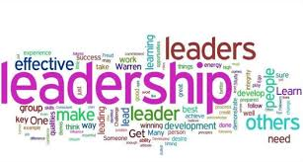
Learning Objective**
Explore Key Question: What characteristics separate effective leaders from ineffective leaders?
**Based on a TED Talk By Simon Senak**

Slide 3
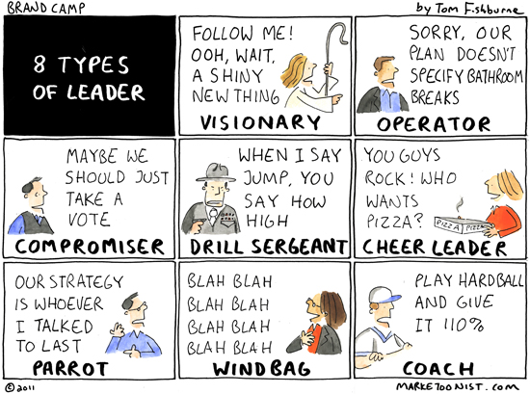
Personality and leadership: Individual personality types VS. Communication of Ideas

Slide 4
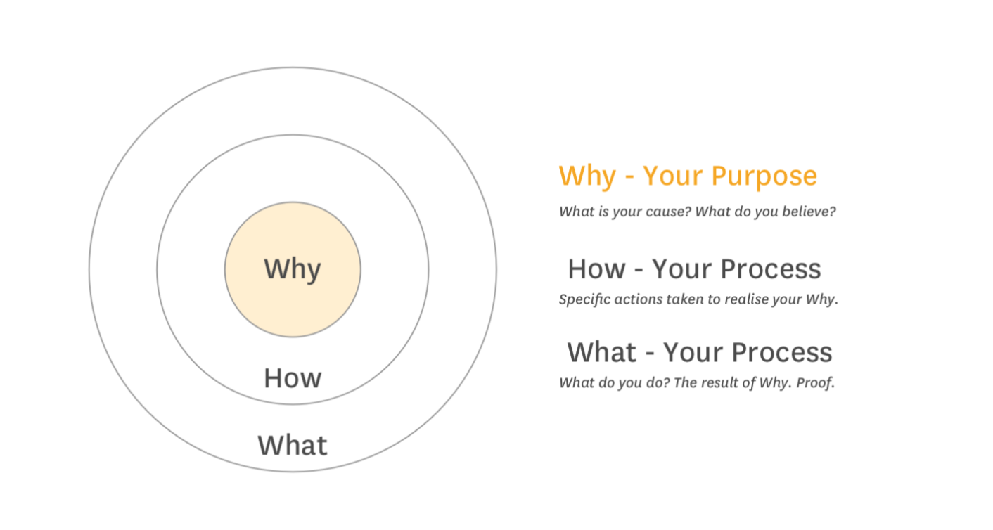
The Golden Circle
WHY: PURPOSE
What is your cause? What is the belief you hold about why you do what you do?
HOW: PROCESS
Specific actions you take to realize your why
WHAT: RESULT
What service/action/behavior is realized?

Slide 5
Leadership Communication
“We aim to take the best possible care to medically complex vulnerable people in our community. In order to do this, we ask that you start seeing your patients at 6AM in order to have time to develop thoughtful medical management plans “
“ We see patients starting at 6 AM. Plan to be prepared to rounds with all your notes finished and have your management plan outlined by 10 AM. The senior residents will review your plans before rounds”

Slide 6
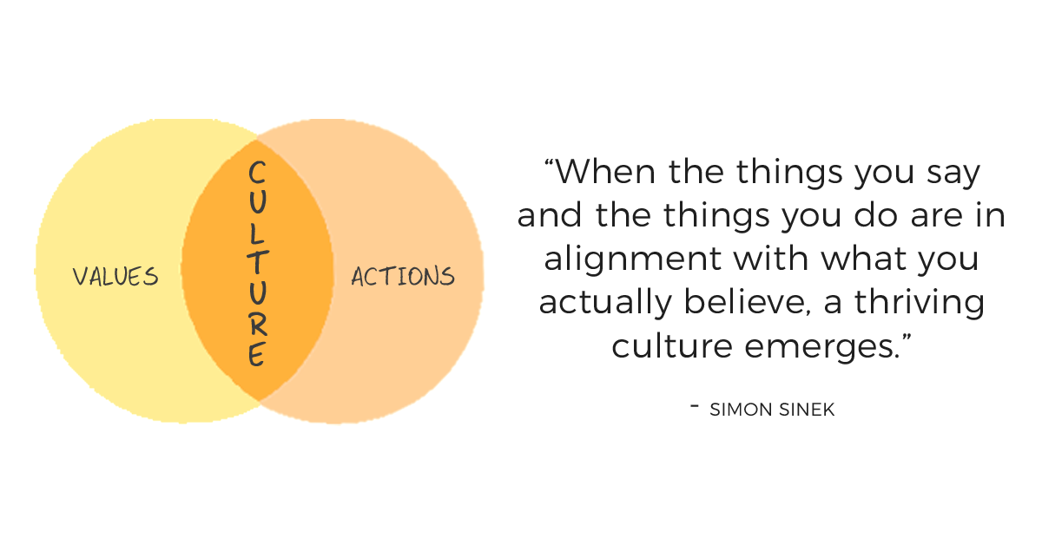
Organizational Culture Is the Result Of Leadership

Slide 7
Breakout Rooms
Questions:
1. Can you begin to develop your WHY: What is your driving motivation for what you do?
2. What are you hoping to accomplish as chief?

