Slide 1
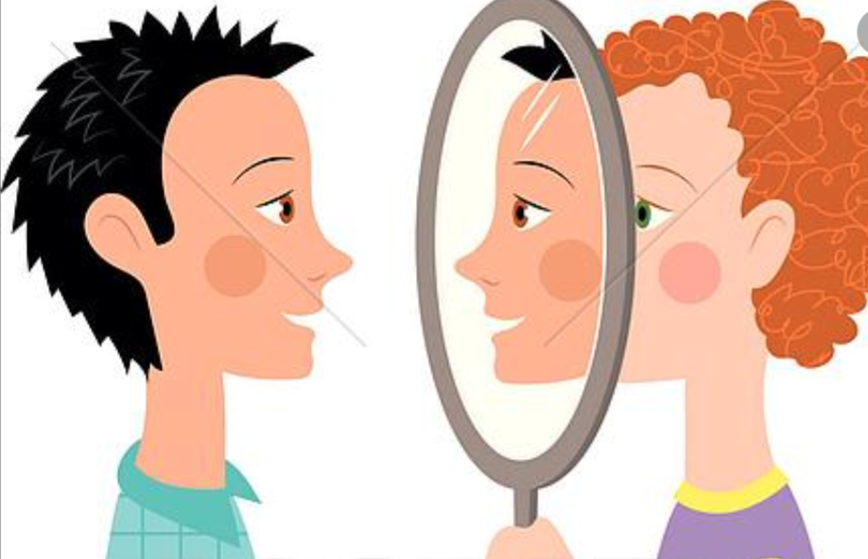
The Art of Giving Feedback
Chief Conference
June 6, 2020
Sujana Bhattacharyya DO and Molly Warren MD
Family Medicine

Slide 2
Objectives
Review why feedback is important
Understand what makes good feedback
Practice giving and critiquing feedback

Slide 3
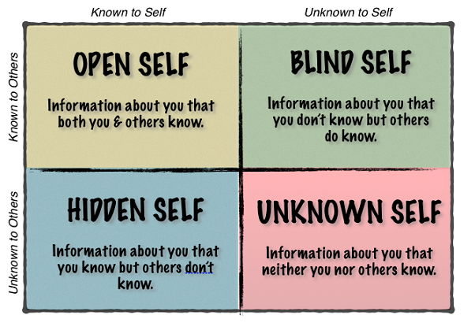
The Importance of Feedback: Johari Window Model
Notes:
A technique, often used in self-help groups, helps people better understand their relationship with themselves and others. It was created by psychologists Joseph Luft (1916–2014) and Harrington Ingham (1916–1995) in 1955, (JOHARI = combo of their first names)

Slide 4
“Without feedback, mistakes go uncorrected, good performance is not reinforced, and clinical competence is achieved empirically or not at all.”
“The important things to remember about feedback in medical education are that (1) it is necessary, (2) it is valuable, and (3) after a bit of practice and planning, it is not as difficult as one might think.”
- Jack Ende, MD
Prior President of ACP

Slide 5
What Are Characteristics of Effective Feedback?

Slide 6
Characteristics of Effective Feedback: SOMETLC
S - Specific O - Objective
M - Modifiable behaviors E - Expected (scheduled)
T- Timely
L - Limited (1 or 2 points) C -Constructive

Slide 7
Feedback Framework
ASK
TELL
ASK
Ask learner to assess their own performance
How do you think you did?
What do you think went well?
Did you have any problems?
Would you have done anything different?
Tell/Teach (short pearls)
I observed...
It seems as though…
When you do ___ I feel ___ …
Consider…
In my experience
Ask learner to reflect and analyze
What do you think of my comments & observations?
What would you do differently?
What can we do to improve?

Slide 8
Potential Barriers to Effective Feedback
Developed metacognitive capacities
Where is the feedback coming from?
Where is the receivers’ emotional capacity, self awareness, and self assessment?
Lack of time / timing
Personal biases and cultural differences
Institutional culture surrounding feedback
Harvard Business School Case Review: The Whys and Hows of Feedback

Slide 9
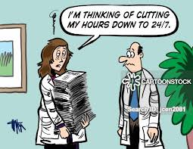
Case 1: The Overcommitted Intern
One of your interns you’ve noted has great rapport with her patients, and patients often rave about their experience with this physician. However, in the resident work-room, this resident has difficulty prioritizing tasks and completing notes on time, which limits her from being a team player.
For example, for one week, your intern has been staying 2 hours past sign out just to talk to patients, yet you have had to write all of this intern’s discharge summaries. She is so burned out at the end of the week, she calls out sick.
It is now time for your weekly feedback group session.
What feedback would you give this resident, and how
would you say it?
(HINT: use SOME TLC)

Slide 10
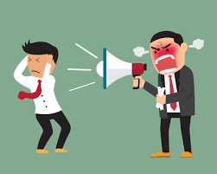
Case 2: The Over Critical Senior
One of your co-senior residents, who is also your friend, is often criticizing his interns for not completing notes on time, being unprepared for rounds, and not completing tasks in a timely matter.
One day, you find one of the interns crying because your co-senior was overly harsh during rounds about their knowledge of sick and complicated patient.
How do you give feedback to this peer and co-resident to better improve the learning environment for your team?
(Hint: Use SOME TLC)
Hi

Slide 11
Final Feedback on Feedback
Effective feedback is essential for helping our learners grow
Practice both giving and receiving feedback
The recipient may not process the feedback immediately, or ever, and that’s ok.
People generally want feedback (consider barriers)
Effective feedback requires preparation and framework
Give SOME-TLC via Ask-Tell-Ask-Act
Notes:
The ability to receive feedback gracefully is a large component of success as a resident

Slide 12
Resources and Contributors:
Burket, Jefferey. “The Need to Feed(back).” (ppt presentation). Available at: https://www.aafp.org/dam/AAFP/documents/events/rps_pdw/handouts/res-76-burket.pdf. Accessed 6/3/2020.
Desai, Krishna, “The Art of Giving Feedback.” (ppt presentation). Accessed 5/30/2020.
Notes:
https://www.aafp.org/dam/AAFP/documents/events/rps_pdw/handouts/res-76-burket.pdf
The Need to Feed(back) MAJ Jeffrey Burket, MD Madigan Faculty Development Fellowship Madigan Army Medical Center

