Slide 2
The American Academy of Family Physicians (AAFP) Improving Adult Immunization Rates within African American Communities
Denee Moore, MD, FAAFP: Assistant Professor, Department of Family Medicine & Population Health, Virginia Commonwealth University School of Medicine
Martha Shepherd, DO, MPH, FAAFP: Assistant Professor of Clinical Medicine & Pediatrics, Vanderbilt University Medical Center, Nashville, TN
Mina Khan, MD, FAAFP: Managing Partner, Primary Care Services-Blount, LLC, Oneonta, AL
September 12, 2022
Notes:
Welcome to the American Academy of Family Physicians (AAFP) Improving Adult Immunization Rates within African American Communities Quality Improvement Project Presentation. My name is Denee Moore. I’m a family physician on faculty at Virginia Commonwealth University School of Medicine in Richmond, VA. Also, I maintain a clinical practice at the VCU Health Hayes E. Willis Health Center.

Slide 3
Setting
The AAFP recruited family medicine practices to participate in the "Improving Adult Immunization Rates within African American Communities project.” The aim of this quality improvement (QI) project is to educate practices on how to establish goals, measure results, implement interventions, track their progress, and sustain their results.
A key component of this QI project is that the family medicine practices utilized a web-based Office Champion Quality Improvement Model, which walked the health care teams through Plan-Do-Study-Act (PDSA) cycles, step by step, by providing tools that measure, and resources to educate clinicians and patients.
Notes:
This project aims to increase immunization rates within African American communities using the AAFP’s Office Champion Quality Improvement Model which we will discuss in detail later in the presentation.

Slide 4
Disclosures
No Conflicts of Interest to Disclose

Slide 5
Evaluation
Please be sure to complete an evaluation for this presentation.

Slide 6
Introduction
Purpose of the project
Participants
What the AAFP and practices plan to accomplish with the project
What you should take away from the project
Notes:
While adult immunization rates have increased nationally, there is wide variation in immunization rates at the state and local levels. Family physicians have reported numerous barriers and challenges to providing all immunizations recommended by the Advisory Committee on Immunization Practices to this population, especially within underserved communities. Data from the Centers of Disease Control and Prevention show that African Americans have lower adult vaccination coverage against pneumonia, tetanus, shingles, influenza, and COVID-19 than whites. These disparities in vaccination adversely impact health outcomes and perpetuate health inequities in African American communities. To address this need, the AAFP developed the "Improving Adult Immunization Rates among African Americans” project.
10 family physician practices, including residency practices, across the United States are participating in this project.
Through a cooperative agreement from the CDC, the AAFP and participating practices are working to improve immunization rates in African American adults through a multi-faceted approach including: improving strong recommendations for immunization, reducing missed opportunities for immunization, increasing public awareness and acceptance of vaccines, and implementing evidence-based interventions to improve vaccine coverage such as changes in practice workflow.
The QI concept and results from the project will assist you in improving vaccination rates in your practice by providing evidence-based strategies and interventions that are known to increase immunization rates.

Slide 7
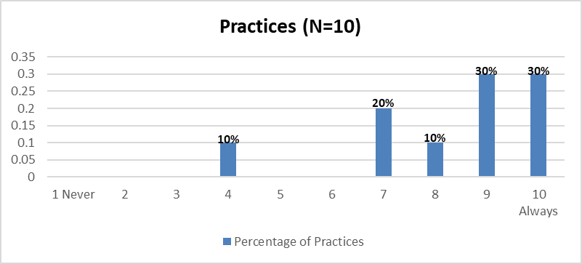
Practice Self-assessment Survey
On a scale from 1 (never) to 10 (always), rate how often do healthcare professionals in your practice give a "Strong Recommendation" to African American adult patients for vaccines
Notes:
At the beginning of the project, each participating practice completed a self-assessment survey, and I will briefly review the key findings.
When asked to rate how often healthcare professionals in the practice give a "Strong Recommendation" to African American adult patients for vaccines, 90% of practices reported doing this always or almost always

Slide 8
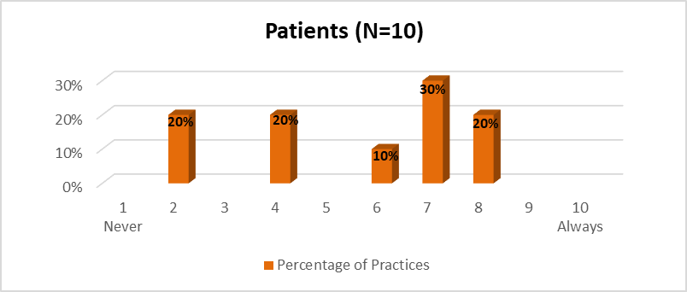
Practice Self-assessment Survey
On a scale from 1 (never) to 10 (always), rate how often do African American patients refuse vaccines in your practice
Notes:
When asked how often adult African American patients refuse vaccines, 60% of practices indicated that these patients refuse vaccines more than half the time.

Slide 9
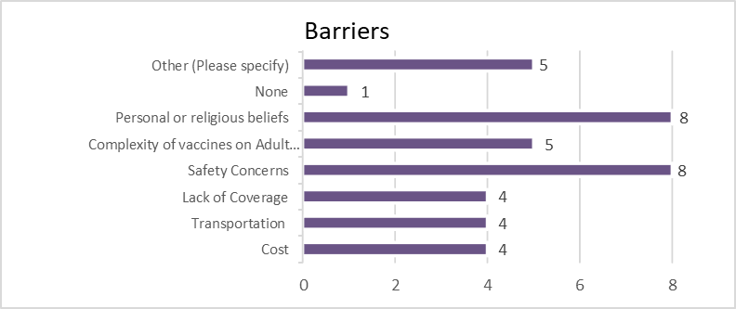
Practice Self-assessment Survey
What are the barriers to immunizing African American adult patients in your practice? (Select all that apply)
Notes:
When asked what are the barriers to immunizing African American adult patients in the practice, most practices cited personal or religious beliefs and safety concerns as the reasons why these patients are not receiving recommended vaccines

Slide 10
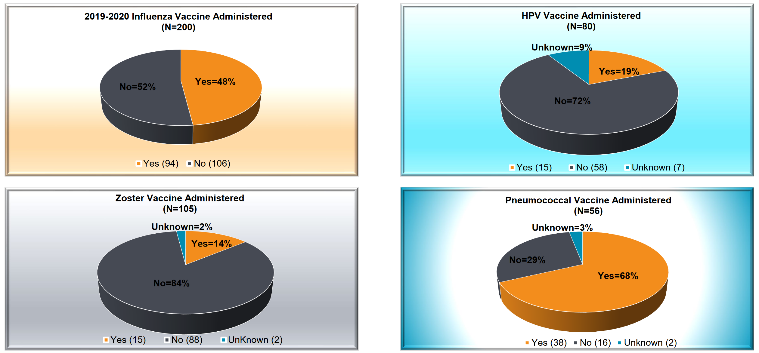
Aggregated Baseline Data
Notes:
Each practice conducted a baseline review of 20 randomly selected adult African American patient charts. This slide shows the aggregated baseline vaccine administration rates in the charts that were reviewed.
The number of eligible patients receiving an influenza vaccine was roughly equal to the number who did not. Vaccination rates for HPV and Zoster were quite low in those who were eligible to receive these vaccines. The number of eligible patients receiving a pneumococcal vaccine (either PCV 13 or PPSV 23) was relatively good.
The most common reasons why vaccines were not given were patient refusal, the patient planning to return to the office later for vaccination, and patient immunization status not documented. For the Zoster vaccine, referral elsewhere, like to a pharmacy, and vaccine availability were also frequently cited as reasons why the vaccine was not given.
It’s important to note that national level data on vaccination coverage for Zoster and Pneumococcal show similar patterns to our baseline data.

Slide 11
Key Initiatives
Improving Adult Immunization Rates within African American Communities Project
Notes:
Now, Dr. Shepherd will talk more about how the AAFP Office Champions Quality Improvement Model can be used to improve immunization rates in adult African American patients

Slide 12
AAFP Office Champion Quality Improvement Model
Designed to help family physician practices replicate this project
Utilizes PDSA cycle
Includes a project template and data collection tool
Offers a resource library with payment codes, nationally accepted performance measures and evidence-based intervention options
Includes a plan for sustainability
https://www.aafp.org/family-physician/patient-care/prevention-wellness/immunizations-vaccines/office-champions.html
Notes:
My name is Martha Shepherd. I am a family medicine physician on faculty at Vanderbilt Medical Center
Brief description of practice: I direct onsite medical clinics for Metro Nashville Public School employees & family members. (5 locations in Nashville)
I want to take a few minutes to share with you the AAFP Office Champion Quality Improvement Model that we used for this project.
This resource is available online and provides a model for practices to replicate in their offices.
This model could be applied towards any quality improvement project. It utilizes the PDSA cycle and includes project templates, data collection tools and a helpful resource library. It also includes a plan for sustainability.
I’ll walk you through the six steps and then provide some real-life examples of how this was used in my practice in Nashville.

Slide 13
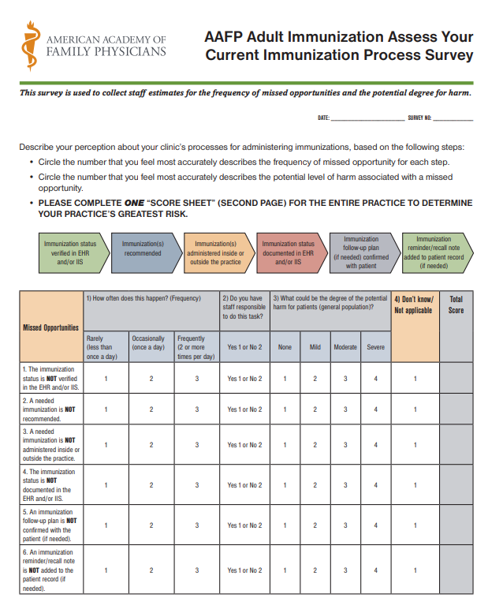
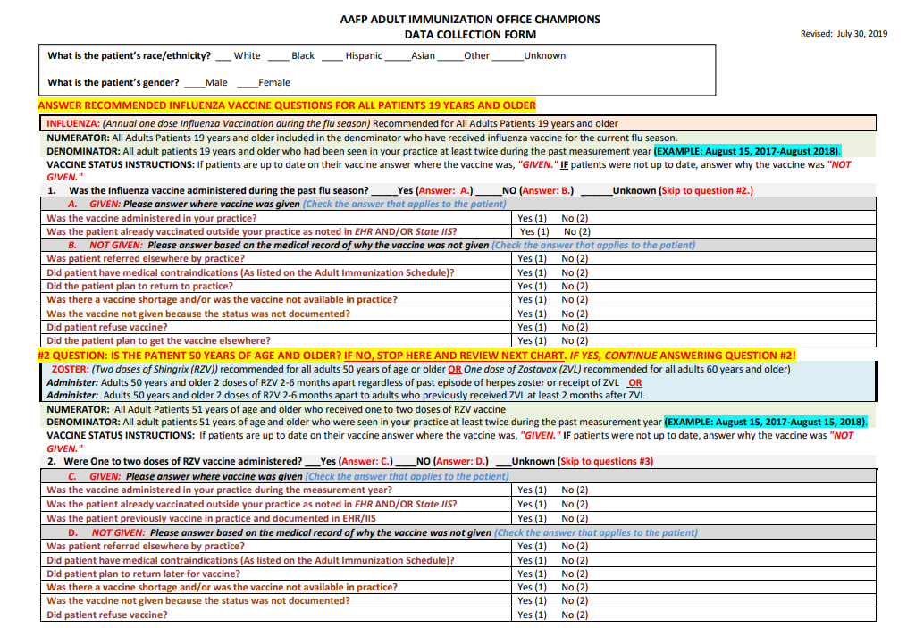
Assess Your Practice and Collect Baseline Data
Step 1
Practice self-assessment survey (we built into REDCap and surveyed the entire staff)
2. Determine process for collecting a random selection of patients meeting criteria for the topic (we used Slicer Dicer in Epic)
3. Collect and assess baseline data-retrospective data pulled to obtain baseline performance
Notes:
Step 1: Assess Your Practice and Collect Baseline Data
The project began with a survey that evaluates how your office currently functions. This gives you an idea of where to begin to make small changes.
In our practice, we built the survey into REDCap and administered it to the entire staff- from the schedulers and front desk, to the nurses and providers- and then complied the answers.
I think this was helpful because it allowed people to respond anonymously, and we received very honest answers and even uncovered some unconscious bias (ex: some admitted to spending less time discussing vaccines with people if they felt they were less likely to accept a vaccine). If you only ask those in a leadership position to complete the survey, you might get very different responses. We found feedback from the whole team to be important here.
Next, baseline data was collected by a retrospective, randomized chart review. Our institution has Epic as our EMR, so we used a tool called Slicer Dicer in Epic to collect a random sample. Whatever randomization technique you decide to use, you will want to remain consistent throughout the project to minimize any bias.

Slide 14
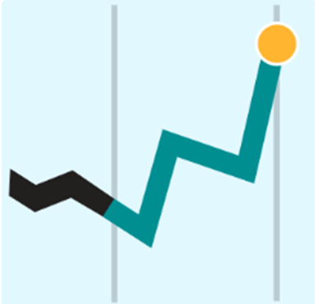
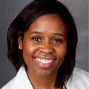
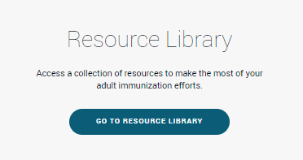
Determine Your Goal
Step 2
Form a Quality Improvement team
Create a SMART goal
Determine desired level of improvement over baseline
Tools for benchmarking (Ex: Healthy People 2030, PQRS)
Rhonda Hollins-Dortch, FNP-BC
MNPS Immunization Project Office Champion
MNPS Quality Improvement Team
Notes:
The next step involves forming your Quality Improvement Team and selecting an Office Champion for the project. This helps with clinic buy in. We recruited volunteers from every job description in each of the 5 clinics-front desk, nurses, providers) to be a part of the team.
This is a picture of our QI team. One of our NP’s, (Rhonda- also pictured here) felt passionate about the project and has been our Office Champion.
Then you set your goal- initial goals will depend on your baseline & what feels achievable, and target goals can be set using benchmarking, or comparing to similar organizations or nationally recognized targets/goals (like Healthy People 2030 or PQRS measures). In value-based systems, you might set goals that allow you to receive quality incentives. The resource library can be helpful as you set your goals.
(for personal reference)
Healthy People 2020 Immunization Targets:
Influenza: Adults > 18 years – 70% (PQRS measure)
Pneumococcal: Adults > 65 years – 90% (PQRS measure)
Zoster: > 60 years – 30%

Slide 15
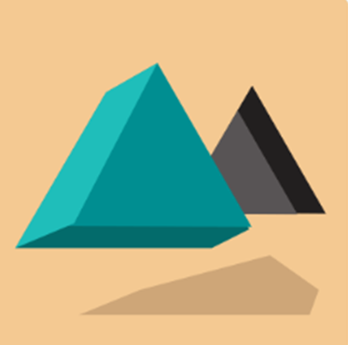
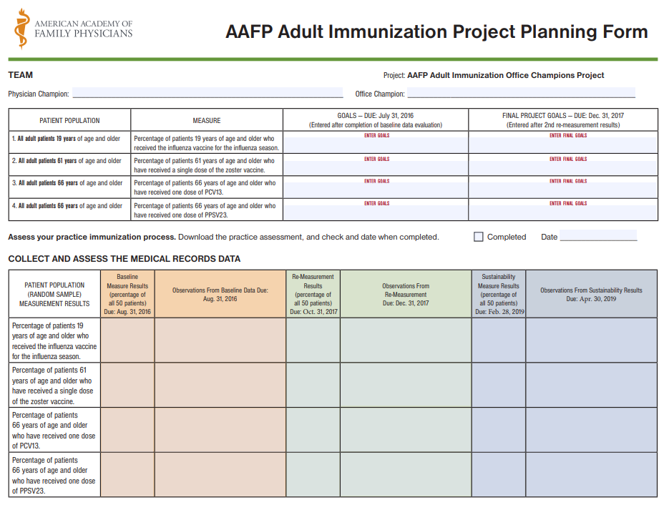
Implement and Test Interventions
Step 3
Include the entire staff and patients
Ensure roles and responsibilities are clear to increase buy-in and success
Test the intervention on a small scale before full implementation (we piloted two out of five clinics)
Conduct several rapid test cycles and adjust as needed to address workflow issues
Notes:
In Step 3 you will begin to implement and test interventions. You want to include the staff and the patients in selecting these next steps.
We started with 2/5 clinics so we could clarify roles and troubleshoot. Start small to avoid mass frustration & streamline processes.
After moving through a few PDSA cycles, we felt ready to implement our refined interventions at all clinics.
There is a link on the website to a sample planning form that can be used for this.

Slide 16
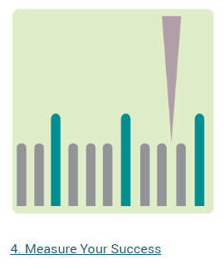
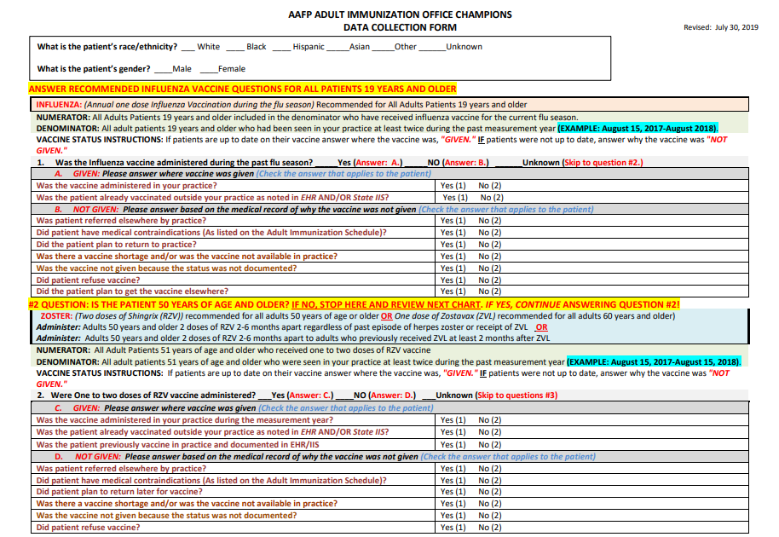
Measure Your Success
Step 4
Include practice team in measurement strategy
Perform small frequent checks during the intervention cycle
Gain insight into how specific practice improvements may or may not impact goals
Notes:
Step 4 Involves Measuring Your Success.
It’s important to explain the measurement strategy and goals to the team and to share results of those measurements as you move through these cycles.
Staff should be included in the process so they share in the understanding of what may/may not be working to make improvements.
We had some interim checks to ensure we were on track and to add new interventions before our formal re-measurement.
This is a screenshot of the data collection form available on the website for re-measurement.
You’ll want to use the same randomization process and criteria as you did for your baseline measurement.

Slide 17
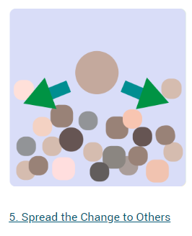
Spread the Change to Others
Ask these questions to determine if changes are ready to implement on a larger scale:
Does the team support the rationale behind the need for change?
Have the interventions resulted in positive change?
How will staff resistance to change be addressed?
How will the Quality Improvement team engage the staff?
Does the project have leadership support and financial resources?
How will results be shared with the team?
Step 5
Notes:
When you have tested the interventions on a small scale and have documented positive change, you can check in with the team to ask these questions.
Does your QI team support the change?
Do they feel prepared to engage the staff and meet resistance?
After 6 months, were ready to implement our interventions in all 5 locations.
Communication to the staff from clinic leadership about goals, timeline and how results will be shared and face-to face support from QI Champions is important.

Slide 18
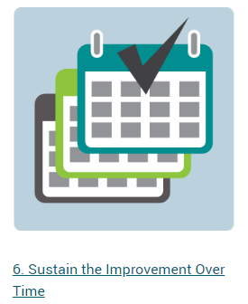
Sustain the Improvement Over Time
Step 6
Periodically monitor performance for the selected measures
Ensure system changes are sustainable and do not have unanticipated consequences
Establish a schedule for periodic monitoring and reporting (this may include evaluation by staff)
Develop reports to communicate clearly and establish a procedure for acting on any problems identified
Notes:
And Step 6 involves Sustaining Your Improvements Over Time
It helps to streamline reports- (don’t overwhelm with data) and provide them in an established cadence to staff.
Include staff in the measurement of data. Have an established procedure to act on problems identified. The project is never really over!

Slide 19
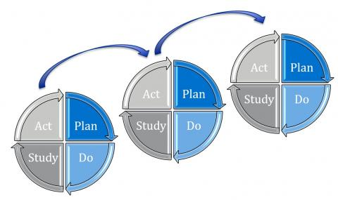
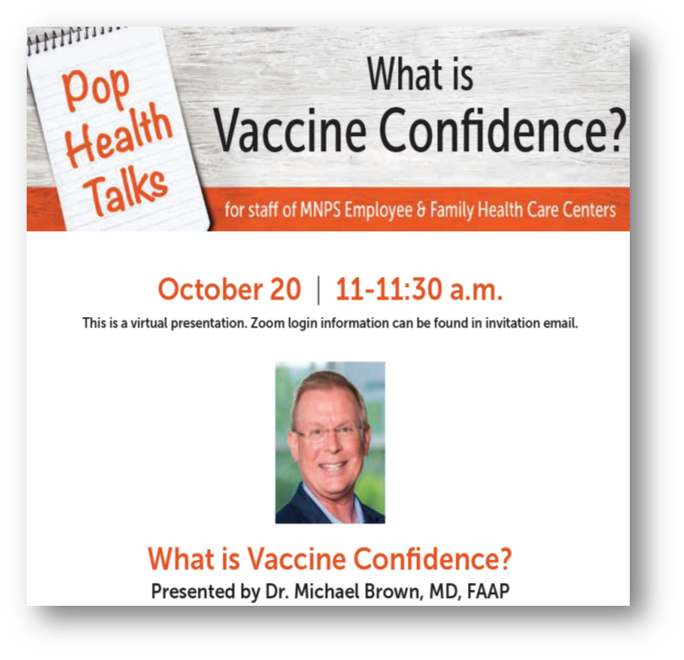
Improving Immunization Rates in African American Communities
January 2021-September 2022 (?)
P→ January 2021-June 2021
Select Office Champions/QI team
Complete practice self-assessment survey
Baseline chart review (measurement period 10/1/2019-10/1/2020)
Project intervention plan
D→ July 2021-August 2022
Implement interventions 7/3/2021-8/3/2022
Pilot first at Fessey & Two Rivers, then extend to all
S → August-September 2022
Interim data checks
Second medical chart review (measurement period 7/3/2021-8/5/2022)
A → October 2022- funding extended?
Evaluate, reassess interventions, continue PDSA cycles
Submit sustainability plan
Third medical records chart review?
PDSA Cycle 1 Interventions-MNPS Clinics
AAFP CME & educational resources distributed
Epic Training on reconciling outside immunizations from TennIIS and Care Everywhere (role-specific training conducted August 2021 Teams meeting)
Population Health Talks for staff:
Vaccine Confidence (October 2021) with Dr. Michael Brown
Unconscious Bias Training (November 2021) with Dr. Arie Nettles
Review needed vaccines in daily clinic huddles
Review standing order policies with staff
Add HPV to the intake form
Call pharmacy to obtain outside vaccination records if needed
Notes:
This is an example of a slide that was shared in one of our All-Staff meetings, informing the team about the project and our interventions to-date, celebrating successes.
Some of our early interventions that were a direct result of the practice self-assessment and the early work with the QI team were:
All-staff training on Unconscious Bias
All-staff training (with role playing) on How to Make a Strong Vaccine Recommendation
The AAFP has a free CME module that was made available to all the staff
We had IT support to come in and provide role specific training on reconciling outside immunizations from TennIIS and Care Everywhere
We provided refresher training and reviewed policies on standing orders for nurses to give vaccines
Staff began to make more of an effort to look at vaccine status in daily huddles
I’ll now turn it over to Dr. Khan to discuss interventions, strategies and health equity.

Slide 20
Evidence-based Interventions and Strategies
Known to Improve Adult Immunization Rates within African American Communities
Notes:
Thank you, Dr. Shepherd
A brief introduction of myself, I am a family physician practicing in rural Alabama.
Dr. Shepherd has talked about the interventions employed in her practice in order to increase vaccination rates in the targeted population. I am going to summarize various steps that can be taken through quality improvement programs to improve immunization coverage in the population in general, and then we will discuss health equity.

Slide 21
QI strategies to Increase Immunization Rates
Reminder/Recall process.
Walk-in/immunization only visits
Routine measurement of immunization levels
Schedule next vaccine appointment while patient is in office
Designate an immunization champion to focus on QI
Document vaccine refusals
Educate patients about the disease
Print and electronic resources
Involve staff at every level
Standing orders for RNs and Mas
IIS vaccine forecasters
Accurate reporting to IIS
Document historical vaccines
Notes:
- Specific QI strategies to increase immunization rates include:
- Having a Reminder/Recall process. The EHR can be instrumental for this
- Offering walk-in or immunization only visits
- Routinely measuring immunization coverage level and sharing this data with staff
- Scheduling the next vaccination visit before the patient leaves the office. So the patient is essentially automatically opted-in to their next vaccine. This may be done for visits prior to flu season, or booster doses of vaccines such as Zoster or COVID-19
- Having an immunization champion at the practice who focuses on QI measures, reducing barriers and improving coverage
- Documenting vaccine refusals and the reasons for refusals. This keeps the door open for further discussions in the future regarding immunizations
- Educating patients about the disease even if they are declining the vaccine.
- Providing print and electronic resources as well as providing strong verbal vaccine recommendations.
- Involving the office staff at every level, from the front desk to the physicians
- Having clear standing orders for nurses and medical assistants to identify opportunities to administer vaccines
- Leveraging Immunization Information Systems (IIS) to improve immunization practice, for example using a vaccine forecaster, which is built in to many immunization registries
- Ensuring accurate reporting of every vaccine administered
- Documenting historical immunizations in the chart and in the IIS, if missing from either.

Slide 22
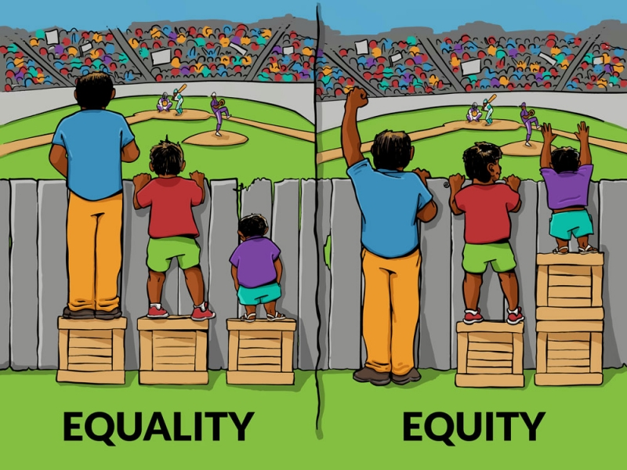
Equality vs Equity
Equality: Each individual or group of people is given the same resources and opportunities, regardless of their circumstances.
Equity: allocating resources and opportunities as needed to create equal outcomes for all community members.
Notes:
There is a difference between equality and equity that needs to be understood in the context of provision of health care
Equality means that each individual or group of people is given the same resources and opportunities, regardless of their circumstances.
On the other hand, equity means allocating resources and opportunities as needed to create equal outcomes for all community members.

Slide 23
Health Equity
CDC Definition
Health equity is achieved when every person has the opportunity to attain his or her full health potential and no-one is disadvantaged from achieving this potential because of social position, or other socially determined circumstances.
Causes of Health Inequity
Race and Ethnicity
Gender
Education level
Income level
Employment status
Notes:
There are various definitions of health equity, but according to the Centers for Disease Control, Health equity is achieved when every person has the opportunity to attain his or her full health potential and no-one is disadvantaged from achieving this potential because of social position, or other socially determined circumstances.
Inequity may occur due to the following factors:
Race and Ethnicity
Gender
Education level
Income level and
Employment status
Health inequities are reflected in differences in length of life; quality of life; rates of disease, disability, and death; severity of disease; and access to treatment.
For the purpose of this talk we will discuss discrepancies in immunization coverage due to race and ethnicity

Slide 24
Disparities in Vaccination Coverage
Pneumococcal vaccination PPV 23 >65 years (2016)
White 75.3%
Black 62%
Tetanus Td and Tdap (2016)
White 63.1%
Black 51.8%
Shingles >60 years (2017)
White 42.7%
Black 23.9%
Influenza >6months (2019-2020)
White 54.8%
Black 45.7%
COVID >18years (through August 2022)
White 49.7%
Black 43.1%
Notes:
According to data from the CDC’s adult vaccine trend report, there is a large disparity in vaccination coverage between White and Black populations
According to CDC data tracker’s vaccine administered data for COVID vaccines which is updated weekly, the rates of completed vaccination for whites and blacks was 49.7% and 43.1% respectively. Unfortunately race and ethnicity data were not available for about 1/4th of the recipients so there may be a significant underestimation there.
Unless the race data is documented, we cannot identify the extent and hence address the problem.
There is an extensive list of issues that can contribute to health inequity among the African American population, but these are beyond the scope of this presentation.
I will hand off to Dr. Moore to discuss the preliminary post-intervention data collected from the practices that are participating in the Office Champion project

Slide 25
Key Findings
Improving Adult Immunization Rates within African American Communities Project

Slide 26
Preliminary Post-intervention Data
As of August 30, 2022, an aggerate total of 80 medical charts have been assessed for post-intervention measurement.
Notes:
I will share the aggregated post-intervention data we’ve received from participating practices as of August 30, 2022.
Each practice has been asked to conduct a second review of 20 randomly selected adult African American patient charts.
So far, we see that:
Influenza vaccinations increased 37% over baseline
HPV vaccinations increased 100% over baseline
Zoster vaccinations increased 80% over baseline
Pneumococcal vaccination decreased 6% under baseline. We hypothesize that the decrease is due to recent changes in pneumococcal vaccination recommendations and formulations

Slide 27
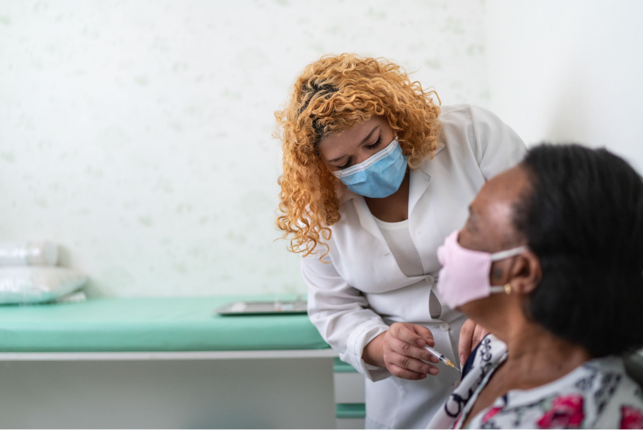
Discussion / Q&A
Notes:
Now that we’ve come to the end of the presentation, we want to hear your thoughts and questions about this project and your ideas for increasing immunization rates in your African American adult patients.

Slide 28
References
AdultVaxView. Cdc.gov. Published May 20, 2021. Accessed July 13, 2022. https://www.cdc.gov/vaccines/imz-managers/coverage/adultvaxview/data-reports/general-population/index.html?CDC_AA_refVal=https%3A%2F%2Fwww.cdc.gov%2Fvaccines%2Fimz-managers%2Fcoverage%2Fadultvaxview%2Fdata-reports%2Fgeneral-population%2Ftrend%2Findex.html
The National Vaccine Advisory Committee (NVAC). Standards for Adult Immunization Practice (2013).
Centers for Disease Control and Prevention: https://www.cdc.gov/vaccines/hcp/adults/forpractice/
standards/index.html. Accessed 2021.
The Community Guide. Community Preventive Service Task Force Vaccination Findings and Systematic Review on Evidence-based Interventions: https://www.thecommunityguide.org/topic/vaccination. Accessed 2021.
U.S. Department of Health and Human Services (HHS) Action Plan to Reduce Racial and Ethnic Health Disparities. A Nation Free of Disparities in Health and Health Care: https://www.minorityhealth.hhs.gov/assets/pdf/hhs/HHS_Plan_complete.pdf. Accessed 2021.
U.S. Department of Health and Human Services (HHS). The National Vaccine Program Office. National Adult
Immunization Plan: https://www.hhs.gov/vaccines/national-adult-immunization-plan/index.html. Content last reviewed June 10, 2019. Accessed 2021.

Slide 29
Thank you

