Slide 1
L9B A Beginners' Guide to Using Technology in Family Medicine Clerkship Didactic Sessions
Magdalena Pasarica MD, PhD
Family Medicine Clerkship Director
Magdalena.Pasarica@ucf.edu
Ken Staack
Family Medicine Clerkship Coordinator
Ken.Staack@ucf.edu

Slide 2
Disclosures
Both authors report no conflict of interest.

Slide 3
Please evaluate this presentation using the conference mobile app! Simply click on the "clipboard" icon on the presentation page.

Slide 4
Sessions objectives
30 min
Describe the use of various technology for teaching, challenges and advantages and outcome data
20 min – small group active application
Develop ideas for integrating technology for teaching at your institution
10 min
Take home points

Slide 5
Why do we use technology?
Convenient for students and some teachers
Equivalent experience at multiple sites
Increased engagement
Increased learning
Data collection for research

Slide 6
Examples of teaching technology
Chat - learning management system
Discussion board – learning management system
Zoom – videoconferencing technology
Turning point cloud – audience response system

Slide 7
Chat– what is it and why use it?
What?
Any number of participants entering data at the same time
Identified by name
Can be seen by all participants at the same time
Why?
To deliver active learning interventions or to assess learners
Local or away locations

Slide 9
Chat- what do learners say?
They like to use a familiar technology
Allows participating to a discussion without having to be singled out in a group
Allows the review of peers ideas and later review if needed
Some don’t like the fact that they may be singled out in class after answering in chat
Some perceive this as a delay in class progress

Slide 10
Chat- what do teachers say?
It enhances the discussion with:
multiple ideas and clarification of misconceptions
multiple learners
Easy to use after first try
Enhanced with the use of another instructor who can review all the answers and point out important learning lessons

Slide 11
Chat – Challenges and advantages?
Challenges/needs
teacher training and buy-in
technical support
wifi
two facilitators
Advantages
Easy to use in learning management system
Allows for quick review of multiple answers
Can be saved for further review or assessment

Slide 12
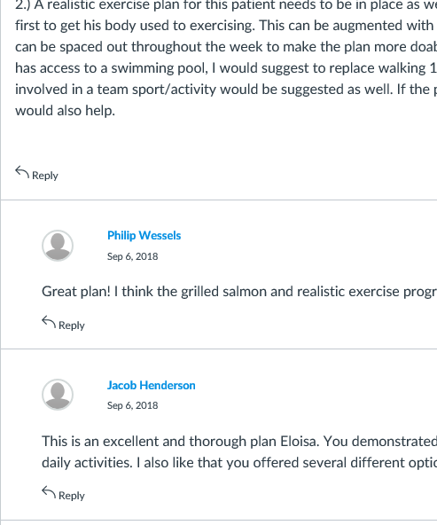
Discussion – what and why?
Clinical scenario
Clinical scenario
What?
Multiple participants or cases
Synchronous (in-class) or
asynchronous (on line)
Allows for “liking” and “reply”
Learner’s answer
Learner’s answer
Peer feedback
Peer feedback
Peer feedback by endorsement
Why?
To teach/assess learners
Collaborative learning

Slide 13
Discussion – what do learners say?
Like reviewing products created
Like the collaborative function
Like when an in-class collaborative activity is replaced by asynchronous collaborative discussion board activity
They like to receive feedback from the instructor (in addition to peer feedback)

Slide 14
Discussion – what do teachers say?
Increases the quality a learner’s product
Increases learner’s participation in collaborative activities
Allows for adapting sessions for asynchronous delivery

Slide 15
Discussion – Challenges and advantages?
Challenges/needs
teacher training
time to develop the activity
Advantages
Easy to use for learners
Can be saved for later review or assessment
Allows for collaborative learning and asynchronous delivery

Slide 16
Zoom – what is it and why use it?
What?
Video conference
up to 100 participants
Only 1 person can talk at a time
All can see the other participants and the slides
Why?
To teach/assess learners from away locations

Slide 18
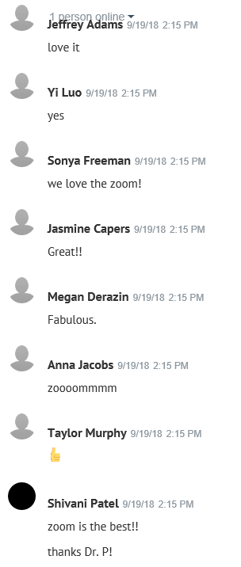
Zoom- what do the learners say?
LOVE IT!!
do not have to travel to teaching site (save precious time)
are not distracted by their peers (increased perception of learning)
feel accountability due to personal individual exposure (increased engagement)
are more comfortable in their own environment (increased engagement and satisfaction)

Slide 19
Zoom – why do teachers say?
Increases learner engagement
Active/engaged learners → happy teachers
Initial difficult to get used to this approach
Prefer either all in class or all outside the class virtually connected

Slide 20
Zoom – Challenges and advantages?
Challenges/needs
teacher training and buy-in
A participation “etiquette”
technical support
wifi
Advantages
Easy to use (click on a link)
High video quality
Can be watched in real-time and recorded for future use (review or assessment)

Slide 21
Zoom/online learning – etiquette
Good things to do!
Use a wired connection (not wireless)
Create a good video image of yourself by proper camera position and using good lighting
Use the “Self View” option to verify that you look great!
Quiet background to minimize background noise
Dress and act like you are in class, using current professionalism guidelines
https://classtech.calpoly.edu/web-conferencing-dos-and-donts

Slide 22
Zoom/online learning – etiquette
Things not to do!
Do not use a wireless connection unless no other option is available.
Be prepared to use phone audio as a back up.
Do not use a smartphone. iPads or tablets are ok as long as you have an external webcam.
https://classtech.calpoly.edu/web-conferencing-dos-and-donts

Slide 23
Turning point cloud – what and why?
What?
Interactive answers
Multiple users
Data projected in real-time
Allows MCQ, short answers, ranking
Why?
To record attendance
Teaching: Clinical case scenarios
For research: Short answer, Multiple choice questions, Ranking
For assessment of knowledge and skills- exams

Slide 25
Turning point cloud- what do learners say?
like the ability to answer a question anonymously (especially in pre-clinical years)
ease to use
do not like the fact that the question and answers cannot be saved for later review

Slide 26
Turning point cloud – what do teacher say?
Increases engagement of most learners
Real time correction of misconception
Does not allow for essay answers
Time consuming to save answers for research or assessment

Slide 27
Turning point cloud – challenges and advantages ?
Advantages
Increasing engagement for learners at local and away sites
Immediate feedback for learners and teachers
Answers can be saved for research
Challenges
Students/ attendings forget their password and/or ID
wifi needed
It is anonymous, so learners can hide “temporarily”

Slide 28
Example of active learning and engagement from multiple locations
 | ppt and oral q | + chat for q | + Individual zoom
Session format | Progressive clinical case presented by instructor Learners are asked questions to manage the case
Technology used | Local students in class, group zoom for away students Oral Q&A | Local students in class, group zoom for away students Chat for individual answers | Chat for individual answers Option for individual/group zoom or in-class participation
Lessons learned
Student like using chat and have increased engagement
~ 90% of students preferred individual zoom, even if a group was present at the same site and they had a dedicated didactic room
only ~10% of students preferred to be in class, and they were disruptive to the session flow
M3: primary care case

Slide 29
Example of collaborative learning from multiple locations and online delivery
 | Chat for group q | +individual in group discussion | + on-line delivery
Session format | Learners solve 4 separate parts of a clinical scenario then discuss best answers and how to improve them in large group
Technology used | Local students in class, away students use group zoom Group answers in chat | Individual answers in group discussion Use of reply and endorsement for collaborative learning | solve the case online individually Use reply to give feedback for collaboration
Lessons learned
Same learning and confidence outcome
Group discussion after individual answers – allows engagement of all learners
Online delivery - Increased engagement for voluntary sessions and complexity of answers and feedback
M3: Prevention session

Slide 30
Example of on-line and in-class synchronous session
 | Ppt and turning point and oral for q and video for out of class | Zoom for out of class, and chat for questions
Session format | In class lecture with individual MCQ and short answer questions
Technology used | In-class learners participate with turning point and oral Out of class learners view a video recording after 1 h | Out of class learners use zoom to directly view the lecture Both in class and out of class learners participate for MCQ with Turning point cloud and for short answers with chat
Lessons learned
Zoom and chat preferred by learners who will not normally came to class
Most liked to respond in chat, but some still felt uncomfortable when asked to discuss
M2: Endo

Slide 31
Active application exercise
answer after discussion within small group
note your answers in the individual handouts

Slide 32
Q1. What needs can be addressed by using technology in your clerkship?
active learning
increased learner engagement
equivalent experience at multiple sites
Learner satisfaction
Teacher satisfaction
Data collection
other

Slide 33
Q2. What technology would you like to integrate in your clerkship?
Video conferencing (zoom)
Audience response system (turning point cloud)
Chat
Discussion
others

Slide 34
Q3: What session format would you like to use for the interventions integrating technology?
Discuss within your small group
Present in large group
Develop a SMART goal for your institution
Technology to be purchased, training needed, design to be implemented, when, how, who

Slide 35
Take home points
Know what is available
Determine your objectives for adapting teaching intervention to technology
Choose the technology to integrate and design the intervention
Test, test and test…..
Get buy-in from stakeholders
Measure the learning outcomes
Measure learners’ perception

Slide 36
For more information please contact us
Magdalena Pasarica MD, PhD
Family Medicine Clerkship Director
Magdalena.Pasarica@ucf.edu
Ken Staack
Family Medicine Clerkship Coordinator
Ken.Staack@ucf.edu

