Slide 1
Curriculum Design and Development: From Principles to Practice
Julie M. Schirmer, LCSW
Kathryn Fraser, PhD
Grace Pratt, PhD
Robert McKinney, PhD

Slide 2
Disclosures
We have no disclosures.

Slide 3
Objectives
1) Apply the Core Principles of Behavioral Science and Family Medicine residency requirements to guide curriculum design.
2) Familiarize yourself with behavioral science curricula in three separate FMRPs to learn available resources and other factors that contribute to effective curriculum design.
3) Access resources to develop a beginning action plan, with multiple stages, that will guide curriculum efforts immediately and in the years to come.
Notes:
We use behavioral science curriculum to demonstrate the key components that go into curriculum design in Family Medicine. We have created a an accompanying workbook that includes worksheets, resources, summaries and written curriculum examples to help behavioral science faculty where ever you are in your career stage. To enhance your experience, we recommend that you pause the presentation now to download and print the worksheets prior to moving forward.

Slide 4
When you have seen one FM residency…
Notes:
Every Family Medicine residency has to impart a core set of knowledge, skills, and attitudes to help their residents achieve competency. But the distinctive nature of each residency’s setting demands a unique curriculum design. On the Program Characteristics worksheet we have identified some of the program characteristics relevant to curriculum design. Key factors that influence curriculum include the background, interests and number of residents and faculty, along with the culture and organization of the residency program. University-based versus community-based programs typically have different expectations and supports. The presence of fellowships can greatly influence who is recruited and the organization of the program. At MMC, our fellowships in Integrative Medicine, Preventive Medicine and Sports Medicine greatly influences who and how the behavioral science curriculum is organized.

Slide 5
Requirements, Guidelines, and Milestones
Notes:
So we mentioned that every Family Medicine residency has to impart a core set of knowledge, skills, and attitudes to their residents. So where do we find what that core set is?

Slide 6
Covering the Basics
ACGME Requirements for Family Medicine (July, 2019) https://www.acgme.org/Portals/0/PFAssets/ProgramRequirements/120_FamilyMedicine_2019.pdf?ver=2019-06-13-073936-407
Curriculum Guidelines: Human Behavior and Mental Health (AAFP-July,2015) https://www.aafp.org/dam/AAFP/documents/medical_education_residency/program_directors/Reprint270_Mental.pdf
Family Medicine Milestones (ACGME & ABFM- October, 2015) https://www.acgme.org/Portals/0/PDFs/Milestones/FamilyMedicineMilestones.pdf?ver=2017-01-20-103353-463
Notes:
So, in summary, these 3 resources are useful to review as you plan your curriculum. We gave you the references on our Resource List. Now Matt will review some principles to keep in mind as you design your learning activities.

Slide 7
Family Medicine Milestones
ACGME Competency | Family Medicine Sub-competencies
PATIENT CARE | 5
MEDICAL KNOWLEDGE | 2
SYSTEMS-BASED PRACTICE | 4
PRACTICE-BASED LEARNING AND IMPROVEMENT | 3
PROFESSIONALISM | 4
COMMUNICATION | 4
Notes:
The third resource, the Milestones, are competency-based developmental outcomes. They are important because resident progress is assessed using these milestones.
The Milestones, are organized around the 6 core ACGME competencies (Patient Care, Medical Knowledge, etc).
And Family Medicine has identified sub-competencies within each of these areas, resulting in 22 sub-competencies.
--Note if someone asks: EPAs (Entrustable Professional Activity) may incorporate multiple competencies.

Slide 8
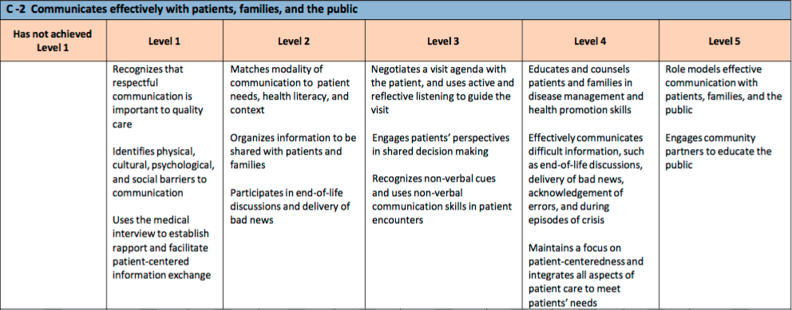
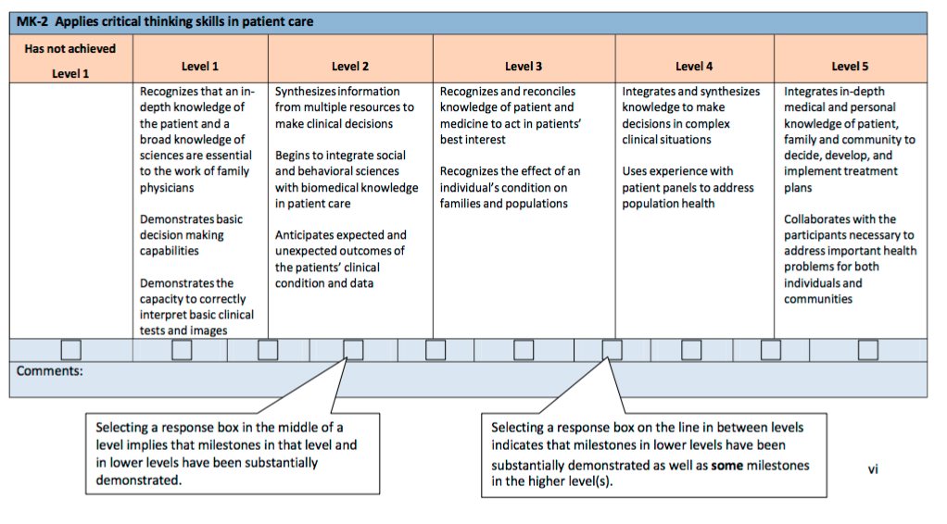
Family Medicine Milestones
Notes:
Here is an example of one Communication sub-competency: C-2 Communicates effectively with patients, families, and the public.
Each sub-competency has specific behavioral milestones, such as this one in Level 2: Matches modality of communication to patient needs, health literacy, and context.
There are 5 levels of competency, and Level 4 is designed to be the graduation target. Level 5 is aspirational.

Slide 9
Core Principles
Notes:
The Core Principles of Behavioral Science originated in 2008, after a Vietnamese colleague asked, “Given we know the Core Principles of Family Medicine, what are the Core Principles of Behavioral Medicine?” I (Julie) was lucky to have spent 12 years teaching and consulting with the Ministry of Health and 7 developing residency programs in Vietnam to develop the behavioral medicine curriculum in their new Family Medicine residency programs. Upon investigating, there were none developed at the time. After multiple focus groups (live and through the list serve), the STFM Group on Behavioral Science, the total listserve of behavioral science faculty and STFM board approved the Core Principles of Behavioral Science (finalized in November, 2008), which were published in the STFM Messenger (February 2009). Having a universal set of behavioral medicine principles 1) clarifies practice; 2) guides curriculum; 3) establishes standards from which to evaluate curriculum.

Slide 10
Halifax Health FMRP
What we do well:
Brief BH techniques for
physicians
Self-reflection/self-awareness
Professionalism
Health equity/implicit bias/anti-racism
Curriculum Development Goals:
Expand wellness for comprehensive focus
Agenda setting-more direct observation
Community/cross cultural health
Notes:
8-8-8 Community based, Spts Med fellowship, AOC’s in Women’s Health, Health Disparities, Spts Med and Hospice

Slide 11
University of Alabama FMRP
What we do well:
Social determinants of health
Interplay of psychological and biological systems
Biopsychosocial case formulations
Curriculum goals:
Substance use: screening (SBIRT)
Wellness

Slide 12
Integris Great Plains FMRP
What we do well:
Physician resilience & well-being
Integrated behavioral health
BPSS View of health
Chronic Pain treatment
Curriculum Development Goals:
Video observation
Experiential wellness

Slide 13
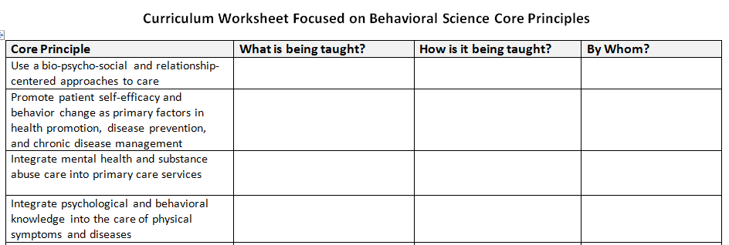
Individual Curriculum Worksheet

Slide 15
Next steps for you
Download and print the toolkit
Complete your curriculum design worksheets
Identify and ask the help of a mentor
Share worksheets and meet with mentor
Implement plan
Continuous Quality Improvement—assess effectiveness and change as necessary

Slide 16
Take Home Points
Curriculum building is an ongoing developmental process
Standards and department resources guide what you do and how you build
Identify mentor(s) for your curriculum development plan
Maintain national standards and also tailor to your residency’s needs
Notes:
Internal mentors include formal mentors (residency director, department chair) and informal mentors (faculty or residents with a passion for behavioral science.
External mentors include one of the presenters, a behavioral faculty who’s opinions you value and who you personally connect with nearby or nationally.
If not already connected to formal mentors, consider apply to the Behavioral Science, Family Systems Medicine Fellowship program or other STFM program that focused on mentorship.
https://stfm.org/facultydevelopment/fellowships/behavioralsciencefamilysystemseducatorfellowship/overview/

Slide 17
Thank you
Julie Schirmer, LCSW jschirme4@gmail.com
Kathryn Fraser, PhD Kathryn.Fraser@halifax.org
Grace Pratt, PhD Grace.Wilson@integrisok.com
Robert McKinny, PhD rmckinney@ua.edu

