Slide 1
MoneyTalks! Show Us the Money: Women and Salary Negotiation
Cathleen Morrow, MD
Natascha Lautenschlaeger, MD, MSPH
Amber Gilmore, MD
Poll Everywhere:
text natL336 to 22333
Notes:
Associate Professor
Chief Medical Informatics Officer
Chair, Department of Community and Family Medicine
Chief Resident
Faculty, Community Faculty, Core Faculty
Soon to be C-Section OB fellow
Chair of Medical Executive Committee
Assistant Professor

Slide 2
MoneyTalks! Show Us the Money: Women and Salary Negotiation
OD018 Addressing the Misidentification of Female Physicians in the Hospital Setting.
OD139 Let’s Talk about Sex(ism): Constructive Advice for Women in Medicine
OD 208 Speed Group Mentoring for Women Faculty
OD086 Medical Sexism and Racism in Early Anatomy

Slide 3
Disclosures: None

Slide 4
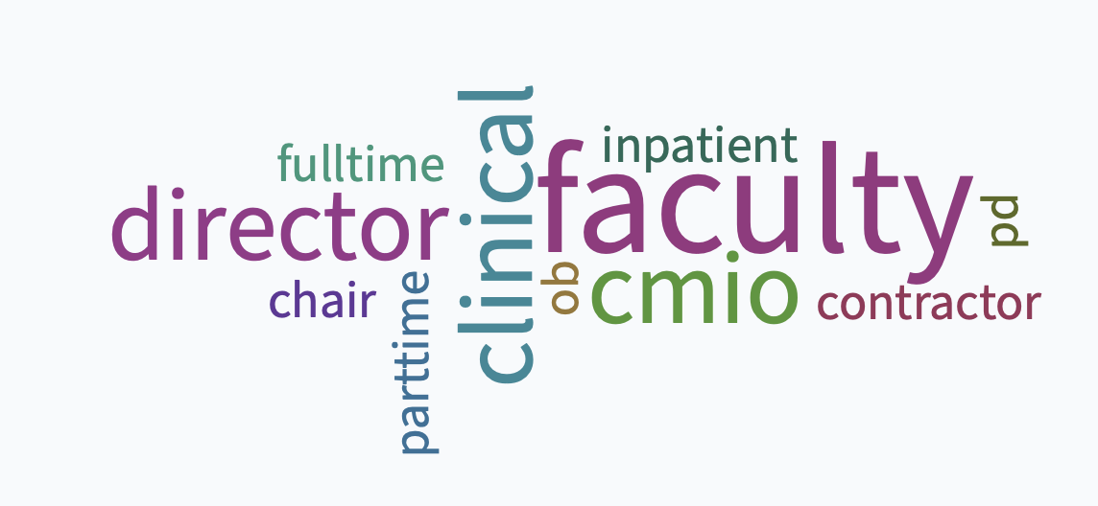
Who are we to talk about money?

Slide 5
Notes:
Do not modify the notes in this section to avoid tampering with the Poll Everywhere activity. More info at polleverywhere.com/support Know our Audience: Where are you in your career?
https://www.polleverywhere.com/multiple_choice_polls/6EupmQRQ8lmAEOkP1jNci

Slide 6
Learning Objectives
Participants will acquire core knowledge about gender and salary inequity in medicine.
Participants will explore social constructs and family of origin values about money and ‘worthiness’.
Participants will examine, through case studies, challenges for women across the career spectrum in negotiating salary and potential long term consequences of such negotiations.
Participants will gain new language, skills and resources for addressing gender inequities (and others) in salary negotiations for themselves and their colleagues.
Participants will understand new employment situations arising as a result of the COVID-19 pandemic.
Notes:
Talk about structure: review some background /a bit of data and then break into 3 groups dependent on where you are in your career and do some role play
And then report out
In the report out we have lots of resources and information that we will utilize as the questions and issues arise
All this will get on FMDRL so do not worry if you want a respource – you’ll be able to find it

Slide 7
Notes:
Do not modify the notes in this section to avoid tampering with the Poll Everywhere activity. More info at polleverywhere.com/support Word cloud: Discussions about money and salary make me feel
https://www.polleverywhere.com/free_text_polls/JOmr7A2i2tuLBTaxOrDo2

Slide 8
Gender gap in salary persists: $1.28 male physician for every $1 made by woman
Lack of transparency: If there are industry standards, women negotiate equitably; when there are no standards women negotiate for lower compensation.
In practices where female physicians predominate there is less of a gender gap than those where male physicians predominate.
Women start low and impact continues throughout career
(BMJ 2020)
Notes:
BMJ July 2020: The analysis showed that in nonsurgical specialty practices with at least as many women as men, men earn 12 percent more than women. However, that gap nearly doubles—to 20 percent—for practices with more than 90 percent male physicians on staff.
Teaching points:
No change
Women start low and impacts them forever
Transparency matters – but elusive in medicine
Gender of providers in practices makes a difference

Slide 9
Gender Gap worsened & Males average 116 K more than females.
Reflects data from > 70% of physicians in US (135K)
Overall wages stagnate (2017-2019) for men but rose 2% for women
Women harder hit in work / career by pandemic: Gender gap worsened 2020: 28% lower female (25.2% for year 2019)
July 2020 McKinsey report: Women make 43% physician workforce but accounted for 56% of covid-related job losses
Male physicians make, on average 116K more than females – across all specialties.
Highest compensation mid-sized cities situated closer to rural areas; Larger cities with major AMC’s = lower compensation
(Doximity, Mckinsey report 2020)
Notes:
McKinsey report July 2020: women make up 43% of workforce but accounted for 56% of covid-related job losses
In a paper published in 2017 in Gynecologic Oncology, researchers compared gynecologic and urologic procedures and found that 72% of male procedures were weighted more for work and total RVUs, and 84% of procedures were compensated at a higher rate for male-specific procedures. For instance, a biopsy of the prostate is worth 4.61 RVUs while a biopsy of the endometrium is 1.53 RVUs. Even the same procedure — a total urethrectomy — has different RVUs for men and women. For men, it’s 16.85; for women, 13.72. The differences may not be nefarious, but Parangi suspects they reflect a male-dominated culture in medicine. “The committee that establishes RVUs has 30 voting members. Only two are female,” she says

Slide 10
AAMC Faculty Annual Salary Survey finds gender gap discrepancy in basic sciences to clinical sciences.
Basic sciences: F:M ratio $0.90 / $1.00
Clinical sciences: F:M $0.77 / $1.00
AIM Nov 2018 study: Mean salary 17K higher for males vs females straight out of residency across specialties
Notes:
jama_oakes_2021_vp_210036_1617829740.14655.pdf
AAMC annual faculty salary survey

Slide 11
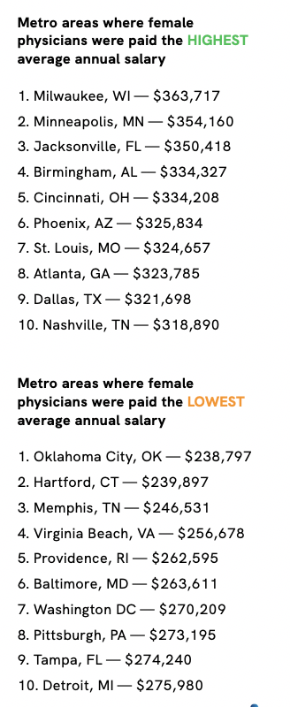
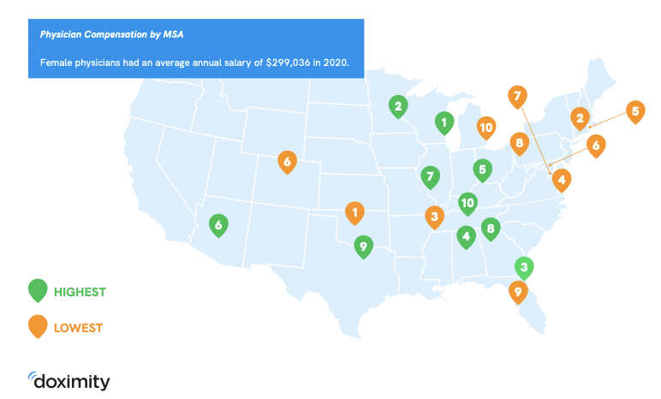

Slide 12
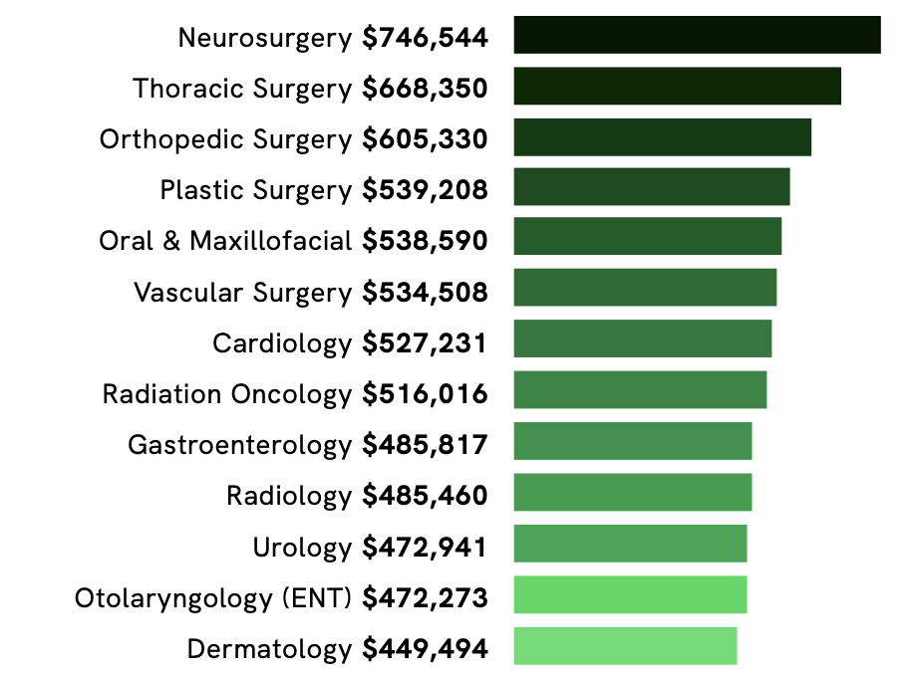
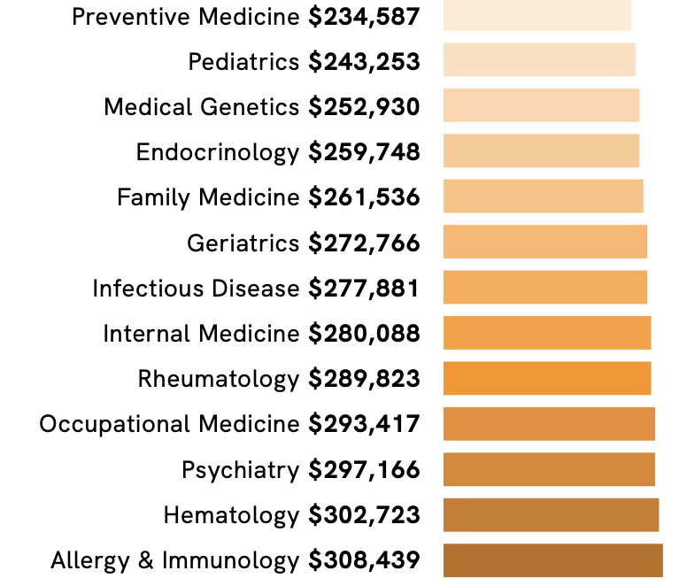
Top Twenty HIGHEST and LOWEST annually compensated specialties

Slide 13
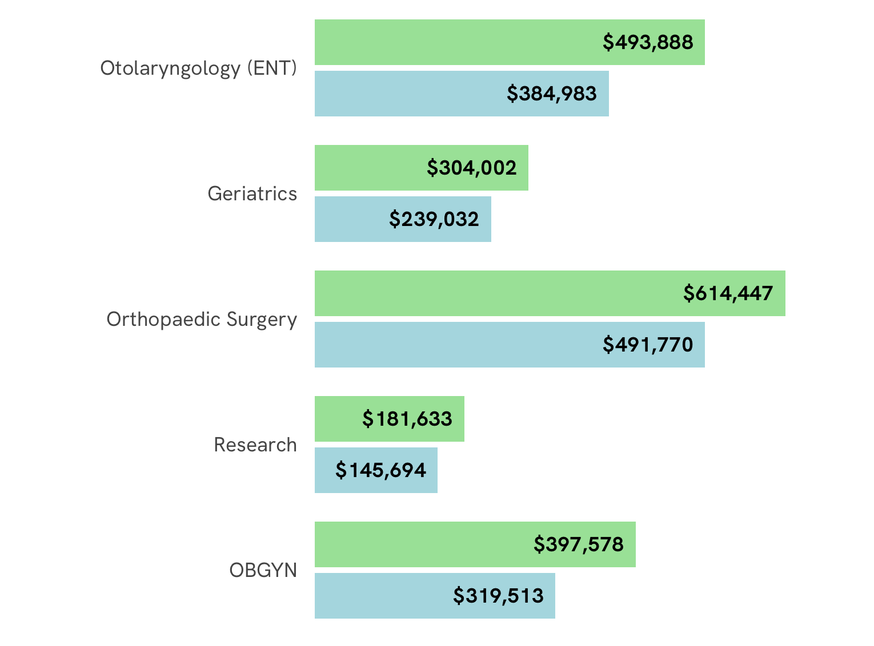
The gender wage gap persists regardless of specialty.

Slide 14
Why Does the Gender Gap Exist?
Sexism?
Valuing ‘women’s work’ ?
Specialty choices?
Negotiation skills?
Values? Whose ?
Different mother / fatherhood penalties and rewards
(Bowles 2014)

Slide 15
Primary Care Data: Women spend more time with patients and generate less revenue than male colleagues in the same practices.
24 million PCP office visits in 2017
Female PCP’s generated 10.9% less revenue; conducted 10.8% fewer visits and had 2.6% fewer clinical days
Female PCP’s spent 15.7% more time with patients
Female PCPs spent 15.7 % more time with patients.
Lower volume of visits yet spent more time in direct patient care per visit, per day, and per year.
Female PCP’s under-coded more than male PCP’s
(NEJM 2020)
Notes:
Taken together, we found a nearly 11% gender gap in annual visit revenue among otherwise-similar physicians in the same practices. The gap was due primarily to male PCPs providing more visits, although female PCPs spent more time with patients per visit and overall. The disconnect between time spent and revenue generated may help to explain why female physicians (especially PCPs) face a greater risk of burnout than their male counterparts.³³ This disconnect also presents an additional barrier to building and sustaining the increasingly female primary care workforce, given concerns that primary care is already undervalued relative to other specialties^{28,29} yet is important for improving population health outcomes and health care reform
1. Gender differences persisted within specific intensities of visits.
2. Female PCPs missed more opportunities to bill higher-intensity visit codes on the basis of time spent: among level 3 visits,
3. 14.6% of those with female PCPs could have been billed as level 4 according to the time spent, as compared with 11.1% of those with male PCPs; among level 4 visits, 6.1% of those with female PCPs could have been billed as level 5, as compared with 4.2% with male PCPs.

Slide 16
Why the Gap?
Specialty choice:
63% pediatricians are female; 95% orthopedists are male
Priorities: Males rank optimal workload and salary as 1st and 2nd. Females rank 1st/2nd/3rd priority: optimal collegiality; control of personal time; salary
Child Tax - work hours: presence/absence of children:
reduced work hours for women but not for men – men increased work hours.
Geography: Region of country; size of city, presence Academic Medical Centers, demand for specialty
(JAMA 2017)
Notes:
MSA’s= Metropolitan service areas
If you are most interested in money: look to smaller cities
Stay away from prestigious academic medical centers
In other jobs and census and Bereau of Labor Statistics employed males increased work hours with presence of children. (2020 data)

Slide 17
Notes:
Do not modify the notes in this section to avoid tampering with the Poll Everywhere activity. More info at polleverywhere.com/support How often have you change jobs or responsibilities?
https://www.polleverywhere.com/multiple_choice_polls/VZzuv0ohzl0NNF9L1yV0f

Slide 18
Gender differences: Negotiation
Women don’t ask – especially at the beginning of their careers; long term cumulative impact
More likely to ask indirectly and value collaboration
Assume that by working harder they’ll be rewarded
Doubt they are deserving
Roles
Women worry more about impact of asking on personal relationships - Penalty
(Bowles 2007 & 2014)
Copyright P&G Pantene and BBDO Guerrero, Manila
Notes:
Story about first negotiation – making VP uncomfortable
Point 1: your salary history has influence on the future; if you start low your expectations may remain in line with that starting salary – (next slide emphasizes).
Point 2: be conscious about how uncomfortable you are about making others uncomfortable; here’s where role playing ahead of time (trusted colleague; friend in suit; man) might help a lot
Point 3:
Nat: Women must weight the social cost of negotiation – Scandinavian study showed that women are seen negatively when negotiating for themselves, yet positively if negotiating for the benefit of a group or others. This is in contrast to a male negotiator (using the same scripts, regardless if judged by F/M).

Slide 19
Small groups –Time to Negotiate!
First Job after training
New faculty after experience in the ‘real’ world
Program director / mid-career
(pick your group and room)

Slide 20
Case Study #1: First job out of residency
3rd year FM resident looking for your first job
Community clinic in Southwest New Mexico
8 half-days in clinic; 5 days / hospital service, call shared
Opportunity to precept residents as community faculty
Concerns about loan repayment (Owes over $100K)
You have 2 other offers
You interview with the clinic director who has been there for 20 years
“Covid Clause”
Notes:
Some places provide large-sign on bonus instead of loan repayment program – this allows you to pay off your debt sooner

Slide 21
Case Study #2: Early Career
4-year career outpatient clinician in a large health system hoping to pursue academics
Faculty position with community FM residency in the Midwest
Time half days: 4 clinical, 3 precepting, 3 admin
You interview with the Residency Program Director and the first salary offer is 15% lower than your current salary
Notes:
Negotiation strategies?
Importance of verifying the truthfulness of above statement – how do you find out?????

Slide 22
Case Study #3: Established Career
12 year career FM faculty with OB and outpatient procedures, curriculum design/development, considerable administrative background, and national experience
Being recruited for Program Director of FM residency out West
First round of interviews are complete, no discussion yet of salary and benefits. You are now in the second interview. “We would love to have you join us."
Notes:
How often salary is not even mentioned untll the very end, or for the interviewee to bring up.

Slide 23
Group Rooms: I. After Residency, II. Early Career, III. Established Career / PD
Discuss your group case for 20 minutes
Time check at 5 min & 2 min remaining, then return to large group
Each group will elect 1-2 people to present
Barriers to salary negotiation / how did you feel?
How might it be different if “you” were a man? A minority woman of color?
Solutions

Slide 24
Negotiation Pearls
Data / Know the numbers
Salary History Bans
Pause
Other Offers
How to say it
Early – unknown salary
Low offer
History
How Not to say it

Slide 25
Research salary/benefits
Public websites: Salary.com, Glassdoor
Medical websites: AAFP, STFM, SHM, AFMRD, New Physician
Job recruiters
Ask mentors, colleagues
Social networking groups: Facebook

Slide 26
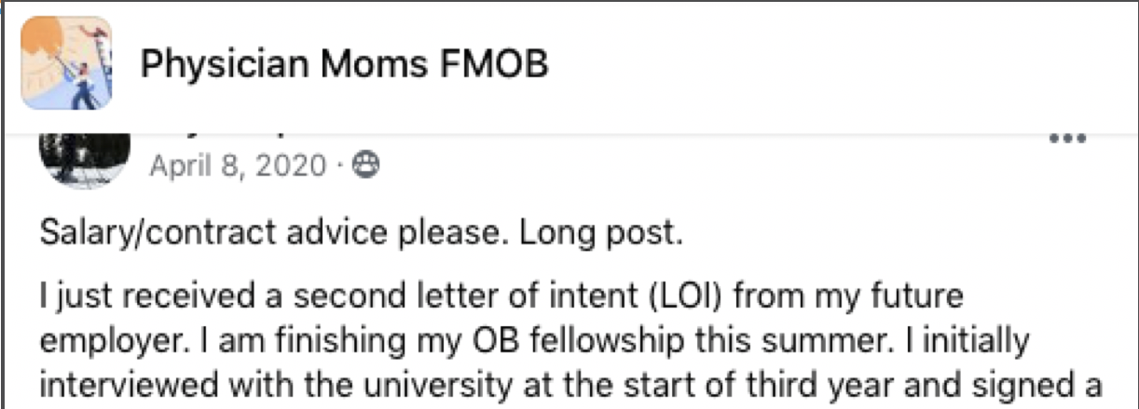

Slide 27
DATA – Research the Job’s Value
AAMC Faculty Salary Report – Annual; Cost $1,150.00 if not a member
Others in comparable jobs salaries; region is very important
Talk about it – huddle with women at the same level and ASK!
Specialty differentials are significant
University, public information websites
Notes:
Your medical school likely has access; the majority of LCME accredited medical schools in the US do; these are ‘members’
Deans and senior deans office administrators get gratis access to the report
To purchase the version of this publication that is accessible online, please click “add to cart” above. Individuals at member institutions may purchase the online publication for an annual subscription fee of $40 per year; non-members can purchase the report for $1,125.
Faculty salaries at medical schools increased an average of 2.7% in the last fiscal year, from $273,400 in FY 2017 to $280,700 in FY 2018
Caveat: this dataset is only relevant to physician faculty hired within medical school environment. Many physician FM faculty live in community based programs where the salaries are much more closely tied to the salaries of practicing physicians in the communities in which they live. If you are negotiating for a community based faculty position be sure you obtain local knowledge!

Slide 28
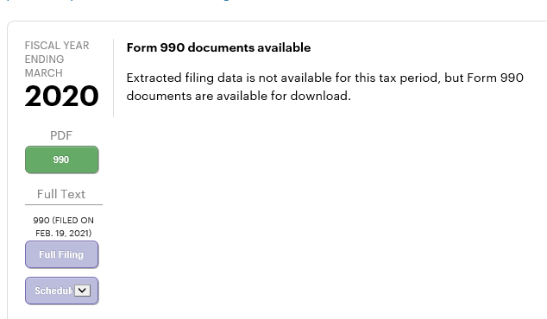
Projects.propublica.org – non profit explorer gives information on key personnel and the board members.
Notes:
Scroll down to about 2/3s and look for Schedule J Part II and III Supplemental Information – lists at least 10 of the most highest compensated employees

Slide 29
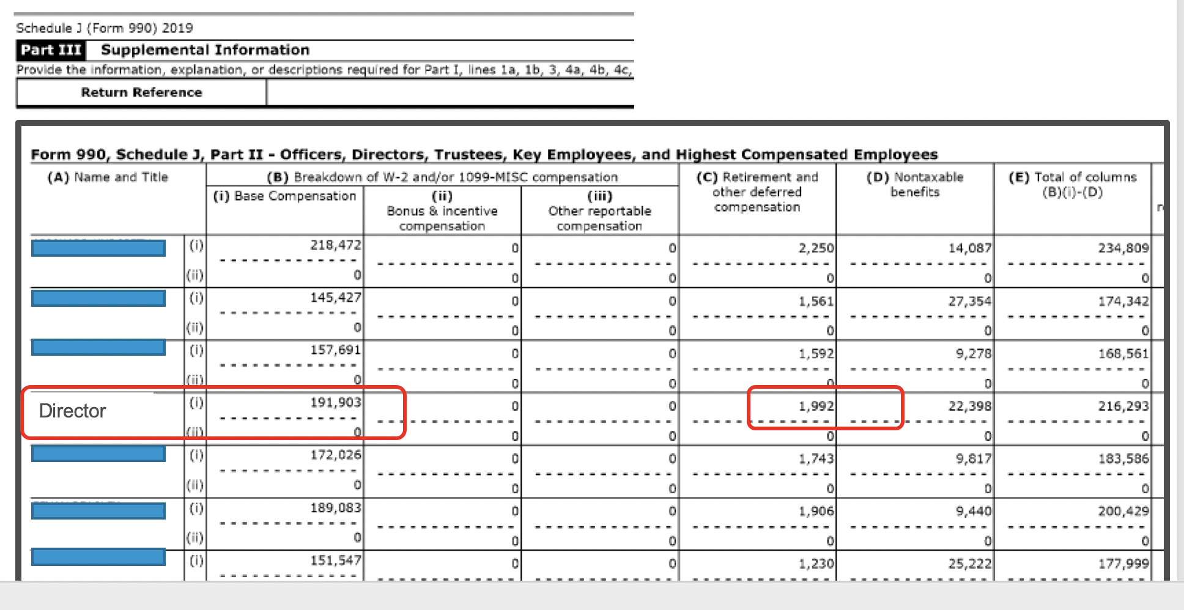
Form 990 gives salary insight and also clues to benefits…
Director

Slide 30
Universities are also public – be persistent.
Search by Name
Research the employer’s website and find similar people
Health and Education often split – creative searches
University vs University Health Plan vs School of Medicine
https://govsalaries.com/salaries/NC/unc-health-care-system

Slide 31
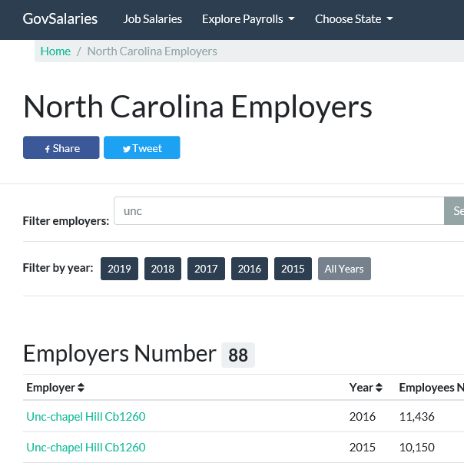
Search Variations:
UNC
UNC Health
University of North
School of Medicine
SOM

Slide 32
Legalities: Employees can discuss salaries and MAY not have to share previous salary with interviewer.
National Labor Relations Act, enacted in 1935
"concerted activities for the purpose of collective bargaining or other mutual aid or protection.”
Exceptions: supervisors, independent contractors, agricultural workers, railway (and airline), state / federal / government
Several states and municipalities do not allow past salary history.
Notes:
50 % of employees are forbidden / discourage in discussing pay
Paycheck Fairness Act (mid 1990s) just passed in the house March 2019:
Prohibits retaliation against workers for disclosing wages, prohibit salary history, requires employers to ensure job relatedness(pay gap is due to job not sex), allows the equal pay act lawsuits to be opt out versus often which is common in civil rights cases,clarifying comparable establishments, providing pay data (which recently current administration removed).

Slide 33
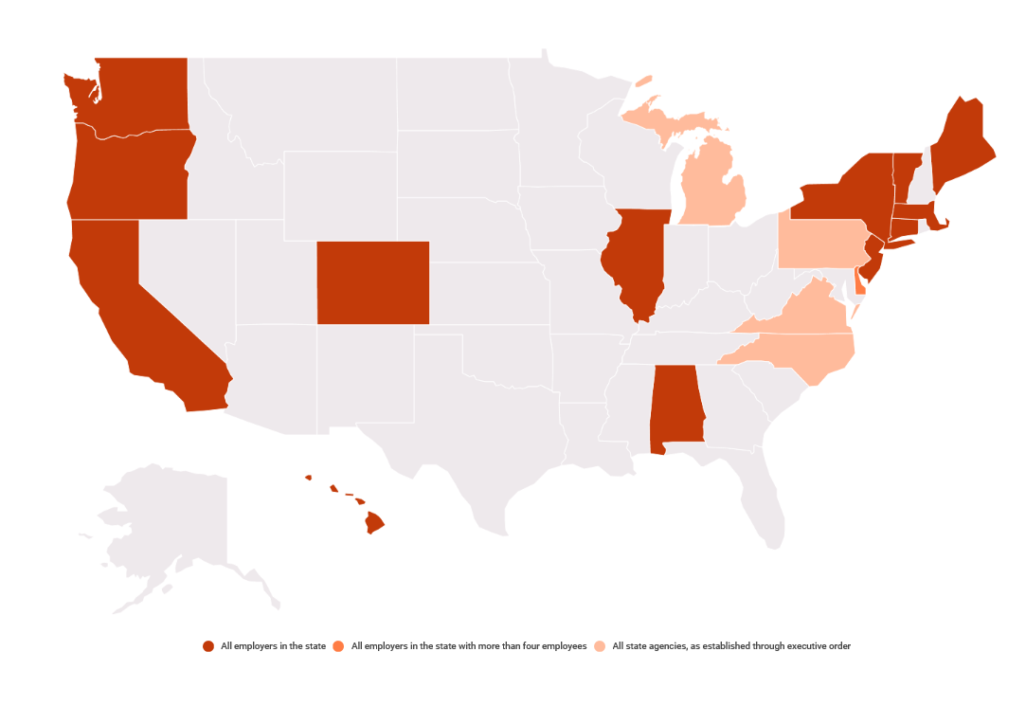
Salary History Bans All employers All state agencies
https://www.aauw.org/resources/policy/state-and-local-salary-history-bans/
Notes:
As of December 2020 – added Colorado, Alabama, Maine. Strengthened in existing states

Slide 34
Pause.
Notes:
Glaciers melt, suns collapse
Stop. Talking.

Slide 35
Pause and Breathe: Buy Time!
“I am excited about this opportunity. Everyone has made a great impression. I will review the offer and look over the benefits and let’s plan on talking next week, perhaps Wednesday.”
“Okay, well I appreciate you telling me that. I have some other questions about the offer. When would you like to talk again?”
Notes:
Intonation
End with a period – NOT a question or ….
You can also use human nature to your benefit – place the burden on them to reach back out to you in the future. However if you are not interested, do tell them next time or when you realize that.

Slide 36
How to Say it: Early
“Before I let you pay for my travel, can we touch base on the salary range for this position?”
“I was wondering what the salary ranges are for the position to make sure we are aligned.”
Actual Quotes….”I’m not getting on the plane for that’…..male

Slide 37
How to say it: Previous Salary history (and know your range)
“Since this is opportunity is different from my current job, I’m expecting to be paid what’s fair for this specific job and my experience.”
”I am looking for a range of 180-200K.”
“I keep that information confidential. I …”
I’m really interested in…
Notes:
Most will stop with the previous salary question if you deflect once. If they inisist, then consider ”My employer considers that confidential”
If you are comfortable (and it may give you insight depending on how they answer), ”Research has shown that salary history can perpetuate gender and salary inequities, and I don’t
Practice with the group: keep pushing:
I’m looking to make $X-Y at my next position and wouldn’t like to leave my current job for less than that.”
Push back “We really need to know what you are making now”
“That’s not something I disclose. However, I know that in my next position I’d like to be making $X-Y.”
Rinse and repeat
“Research shows that salary history can perpetuate gender and racial pay discrepancies. I do not share that information.
Remember, if they keep asking, they are making it awkward – NOT you.

Slide 38
How NOT to say it: Low salary offer
NOT THIS: “Thank you. Any chance you could go up to $150?”
INSTEAD: Thank you. I believe a salary of 150K would be a reasonable offer.

Slide 39
How NOT to say it: Low salary offer – avoid yes / no and be confident.
NOT THIS: “Do you have any flexibility on salary? I had something closer to $210 in mind.”
INSTEAD: I feel 210K would be a solid place to start.

Slide 40
How NOT to say it: Low salary offer – lay out salary expectations
Maybe NOT THIS: “I’m really excited about the job, but I had hoped the salary was higher. I am excited about joining your team and the number I had in mind was $X. I think I am worth this because of my varied experience in Z, 1, 2.”
Option #1: I am really excited about the job and was expecting a salary offer in the range of ______.
Option #2: I am currently making _____ and would expect, given all the additional responsibilities of this job to make an additional _____

Slide 41
How to Say It: Low offer
Thank you. I believe a salary of 150K would be a reasonable offer.
I feel 210K would be a solid place to start.
I am really excited about the job and was expecting a salary offer in the range of ______.
I am currently making _____ and would expect, given all the additional responsibilities of this job to make an additional _____
Notes:
Declarative sentences without apology.
Practice this with friends- it is NOT easy

Slide 42
How NOT to say it: why you need $ just don’t! (and same applies to the employer)
“That won’t cover my loans or mortgage.”
“I am taking care of my sick Y, and need at least 180K.”
“I’m planning to get pregnant in the next 2 years.”
Employer version: “We’re a ___ and take care of maligned population – that’s our mission and why the salary is150K.

Slide 43
Do we gaslight our own? Family Medicine’s bias – relationship based, may perpetuate the discomfort in discussing salary
Watch your own judgement and bias when evaluating women. In all stages (residency to faculty to C-suite).
“It is not about the money.” Jobs = always the money; money is trade for house, food, and needs. Only an extreme minority does not require $ to work.
Oh, so you do not take a salary?
“Don’t want residents like that here.” Money concerns often more pronounced in lower SEC background, phrase often used to justify lower salaries / benefits.
Residents like what?
“We are here to take care of INSERT WORD people.” All populations deserve excellently trained and appropriately compensated family medicine and behavioral health clinicians.

Slide 44
Use other job offers to your advantage for salary and more
Apply broadly and use several offers for negotiation power
“I have similar job offers for salary of $___”
If salary/compensation not negotiable, advocate for more admin time or vacation – other jobs help here too.
Increase one-time bonuses (sign-on, moving stipend time)
Request new employer cover other expenses: malpractice tail coverage, COBRA insurance
Pick your start date – together

Slide 45
Large Group Case: The COVID Saga
Female FP who works FTE 0.8 outpatient only. Mother of 2 children, ages 8 & 10. Her children's school closed last March and has been online ever since. She has used up all her annual PTO helping her children in virtual school. Her husband works full-time, usually from home, but now with tax season is having to return to the office. The grandparents help out 2 days/week. She is covering some for the medical director who also cut his hours.
Her options are: decreasing clinical hours, taking less call, hiring a nanny?
How would you approach this scenario?

Slide 46
COVID-19 threatens Mothers in Medicine
Prior to the COVID-19 pandemic, research showed childcare disruptions fall disproportionately on women physicians, who report having to take time away from work to care for children significantly more frequently than male peers (42.6% v. 12.4%).
J Gen Intern Med. 2020 Dec; 35(12): 3681–3684.
Physician Mothers Facebook Group survey conducted from April 27-May 11, 2020; involved 2,709 physician mothers from across 48 US states, 7% were international
80% had at least one child in elementary school or younger; 26% had at least one child in middle/high school

Slide 47
Throughout medicine, women have the main responsibility for domestic Tasks
JAMA 2019 study - 1712 respondents, 99% partnered
No difference in specialty
Physician mothers in procedural specialties primarily responsible for 5 or more domestic tasks reported a desire to change careers more often than those responsible for less.
What was the invited commentary response was to these findings?
(Lyu 2019, Freishlag 2019)
Notes:
JAMA Surgery
The invited commentary is an astonishing admonishment to mothers to hire more help: absolutely no critique of the medical system and no suggestion that there is anything wrong with the reality that women have the majority of domestic responsibilities……..Makes you remember exactly WHY you did not choose to go into surgery!
Physician mothers in procedural specialties primarily responsible for 5 or more domestic tasks reported a desire to change careers more often than those responsible for fewer than 5 tasks (105 of 191 [55.0%] vs 114 of 271 [42.1%]; P = .008). This difference was not noted in physician mothers in nonprocedural specialties.

Slide 48
COVID-19 threatens Mothers in Medicine
Childcare disruptions fall disproportionately on women physicians, who report having to take time away from work to care for children significantly more than male peers (42.6% v. 12.4%).
Physician Mothers Facebook Group survey conducted from April - May 2020; involved 2,709 physician mothers from across 48 US states, 7% were international
68% with younger children changed work schedule due to COVID-19, compared to 32% with older children
55% modified work schedule to provide telehealth visits, 38% worked from home, and only 25% did NOT change their work schedule
“The portion of women lead authors in 2020 on COVID-19-related papers was 23% lower than their representation among lead authors in 2019.” Even going on right now there is a concurrent session on Association of Gender in Family Medicine Scholarship During COVID Pandemic

Slide 49
Negotiation Tips: Summary
Data – what is the expected pay? Laws in that state?
Try and find out range before interview (difficulty in Family Medicine) but inquire early! Do not wait until the end of the whole interview process to discuss $$$$$
Prepare for the questions – your salary (use to your advantage or not at all), your salary expectations, practice.
Pause.
Return with a number and pause some more.
Social Capital
Notes:
The key to a relational account (or “I-We”) strategy is to explain why your counterpart should perceive your negotiating as legitimate in terms that also communicate your concern for organizational relationships.
I should acknowledge that this idea of using “relational accounts” or “I-We” strategies drives some women crazy. It makes them feel like they are bending to unjust stereotypes or simply being inauthentic. I sympathize with that reaction. We were surprised while doing the research that it would be so hard to make the backlash effects go away. But, every movement needs its idealists and pragmatists, and I am playing the pragmatist here.
It is good advice for any negotiator – male or female — to ask for what they want in terms that their counterparts will perceive as legitimate and mutually beneficial. But for women, it is especially helpful because it unburdens them from the social costs of self-advocating

Slide 50
Women in Medicine – On Demand Sessions
OD018 Addressing the Misidentification of Female Physicians in the Hospital Setting.
OD139 Let’s Talk about Sex(ism): Constructive Advice for Women in Medicine
OD 208 Speed Group Mentoring for Women Faculty
OD086 Medical Sexism and Racism in Early Anatomy

Slide 51
Contact Info:
Natascha Lautenschlaeger, MD, MSPH
natascha.lautenschlaeger@unchealth.unc.edu
Pardee Hospital at UNC, CMIO, Chief of Staff
MAHEC Hendersonville Family Medicine Residency - Community Faculty
Cathleen Morrow, MD
Cathleen.morrow@Dartmouth.edu
Geisel School of Medicine at Dartmouth – Family Medicine Dept. Chair
Amber Gilmore, MD
gilmorah@ah.org
Adventist Health Ukiah Valley Family Medicine Residency – Core Faculty
UC-Davis Affiliate

Slide 52
References and additional Material

Slide 53
Please download handouts for more useful resources
National Committee on Pay Equity https://www.pay-equity.org/
https://salary.aauw.org
Institute for Women’s Policy Research https://iwpr.org
I am the Boss. Ban Bossy https://www.youtube.com/watch?v=6dynbzMlCcw
Youtube:
What are Girls Made of. https://www.youtube.com/watch?v=Y_iCIISngdI
Labels - https://www.youtube.com/watch?v=kaB3BT9v-P4

Slide 54
Institutions and Specialty Organizations have tasks and behaviors they can do to improve salary equity for women and minority applicants.
Drained pool effect – No one can benefit.
Physician leaders push for change and partner with nursing, etc.
Interview committees include diverse women
Minimum: data on employees, all.
Advocate for yourself and other women, other minorities. Sometimes your advocacy helps those coming after you more than yourself.
Watch your own judgement and bias when evaluating women. In all stages (residency to faculty to C-suite).
CCC, evaluations
Family Medicine’s bias – relationship based.
Do we gaslight when it comes to salaries?
Policies unfriendly to women: leave, childcare, dress code.

Slide 55
Do we Gaslight our own? Family Medicine’s bias – relationship based, may perpetuate the discomfort in discussing salary
Watch your own judgement and bias when evaluating women. In all stages (residency to faculty to C-suite).
“It is not about the money.” Jobs = always the money; money is trade for house, food, and needs. Only an extreme minority does not require $ to work.
“Don’t want residents like that here.” Money concerns often more pronounced in lower SEC background, phrase often used to justify lower salaries / benefits.
“We are here to take care of poor people.” All populations deserve excellently trained and appropriately compensated family medicine and behavioral health clinicians.

Slide 56
Public information: nonprofit 990 and Universities
Nonprofit explorer: Projects.propublica.org
Form 990 schedule A
Board members
Key personnel, highest paid employees
Gov websites
Usually NOT on the University webpages.
Often 2 buckets: health care system, education
Notes:
As state employees, UNC faculty salaries are a matter of public record. However, they can make it difficult – such as requiring a phone call to HR with a name or two – more may require an email. Recommend on-line searches with various browsers.

Slide 57
Consider Advocating for the Paycheck Fairness Act for national prohibition of asking for salary history
Paycheck Fairness Act Passed in US House by 217 to 210 votes in April 2021.
Goes to Senate.
Ideally should be bi-partisan
Has been in committee since early 2000s.

Slide 58
Opposition to the PAYCHECK Fairness Act – Their Top Five Reasons to Oppose it:
Individual Choices Made by Women
Gap disappears when comparing apples to apples
Already illegal to discriminate against women in the workplace
PFA exposes small businesses to frivolous lawsuits
PCA could increase female unemployment (because will hire less women)
www.freedomworks.org

Slide 59
Business Groups & Many Republicans Oppose PFA
HoR passed 217 to 210
Rep. Brian Fitzpatrick, R-Pa voted for it.
When woman are paid equally, business gains
AAFP = no response
STFM = not education focused
AMA = no response to my email.

Slide 60
Advocacy – the gender gap is predicted to close in 2059 for white women to white men. Averaged out in 2106.
Latina women close the gap in 2220 (to white men).
A Black woman has to work 7 extra months to equal her white male counterpart’s one year earnings.
More Black women work than white women.

Slide 61
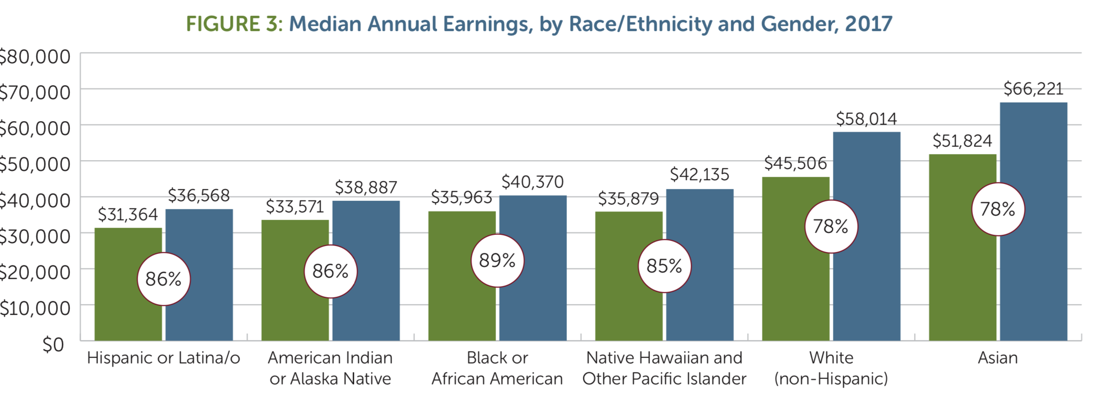
Gender pay gap – valid across races
(Miller 2018)

Slide 62
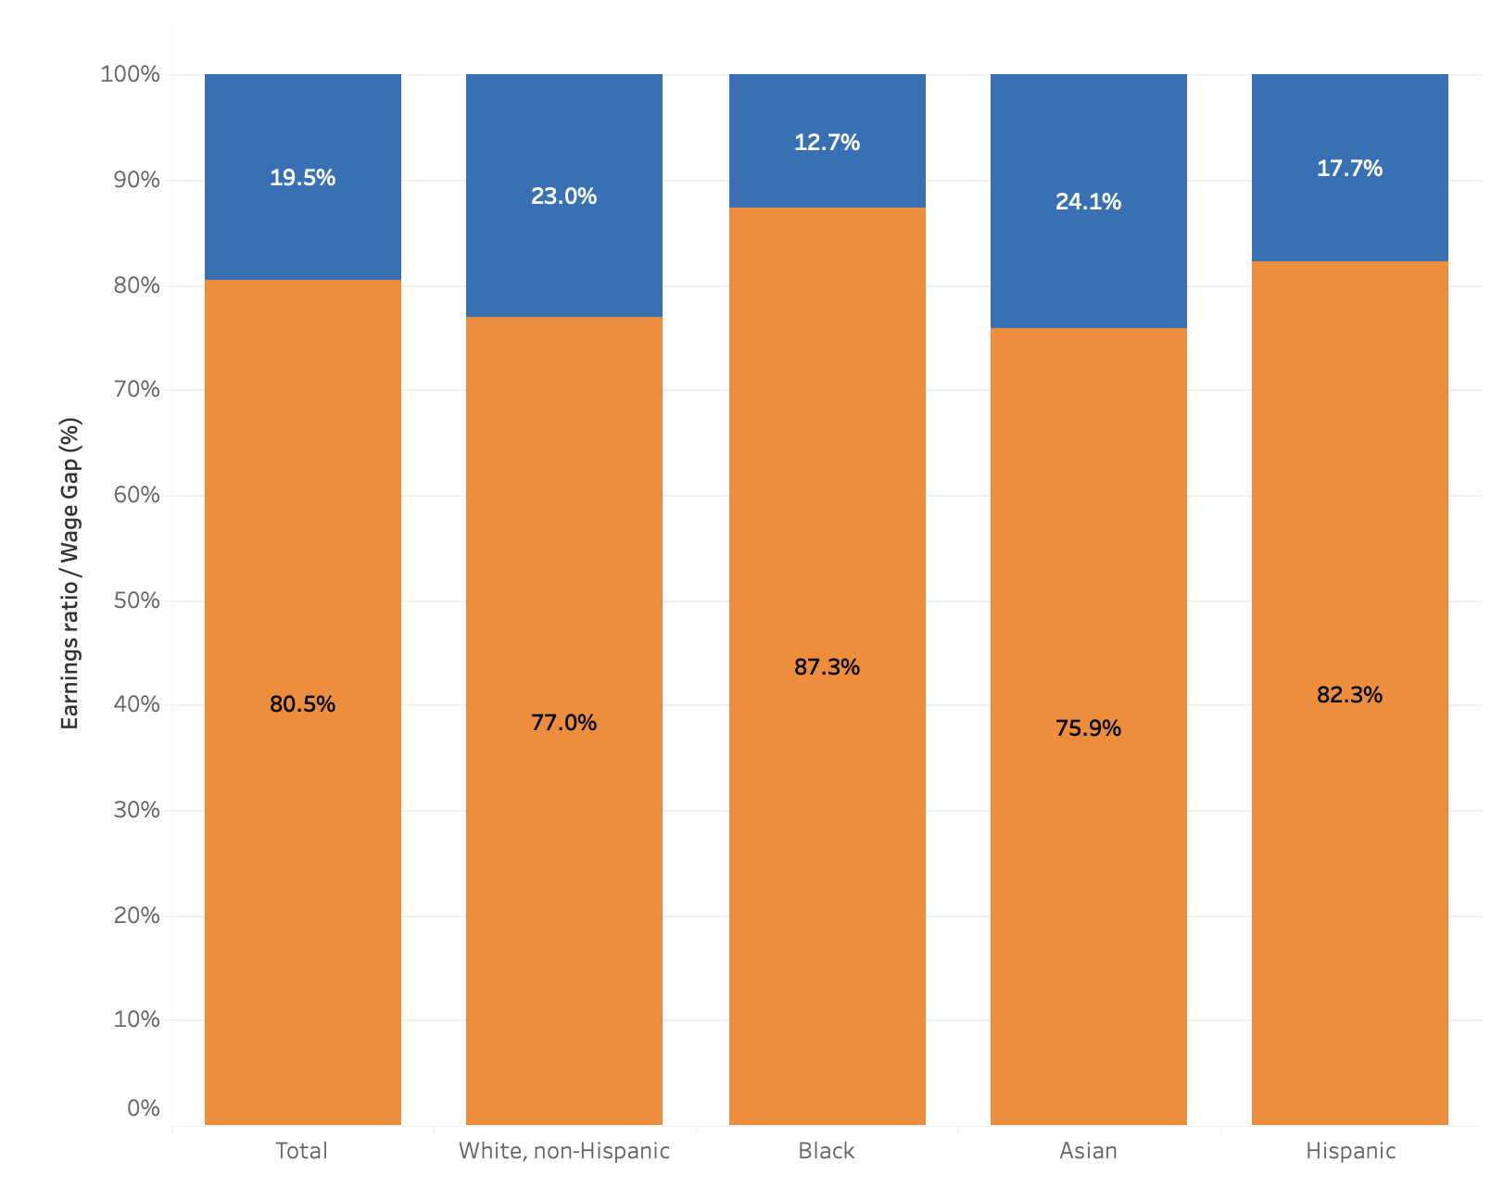
Gender pay gap – valid across races
https://www.dol.gov/agencies/wb/data/earnings

Slide 63
Male to female transgender experience a drop in pay
(Miller 2018)
Notes:
Female to Male transgender tend to remain the same or see a slight increase. Data ongoing.

Slide 64
Opportunity Gap increases over Women’s careers
(Lautenberger AAMC 2020)

Slide 65
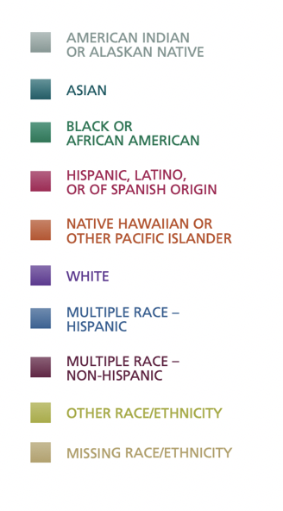
Opportunity Gap also follows Black women and minorities.
(Lautenberger AAMC 2020)

Slide 66
RVU’s and Gender: Are female procedures valued at lower RVUs than a similar male procedure (uterus vs prostate)
2017 in Gynecologic Oncology, comparing gynecologic and urologic procedures and
72% of male procedures were weighted more for work and total RVUs.
84% of procedures were compensated at a higher rate for male-specific procedures.
For instance, a biopsy of the prostate is worth 4.61 RVUs while a biopsy of the endometrium is 1.53 RVUs. Even the same procedure — a total urethrectomy — has different RVUs for men and women. For men, it’s 16.85; for women, 13.72. The differences may not be nefarious, but Parangi suspects they reflect a male-dominated culture in medicine. “The committee that establishes RVUs has 30 voting members. Only two are female.”

Slide 67
References
Bowles HR, Babcock L, Lai L. Social incentives for gender differences in the propensity to initiate negotiations: Sometimes it does hurt to ask. Org Behav & Human Decision Processes. 2007:103(1)84-103.
Bowles HR. Why women don’t negotiate their job offers. Harvard Business Review. June 19, 2014 https://hbr.org/2014/06/why-women-dont-negotiate-their-job-offers
Freischlag JA. Domestic Responsibilities of Physician Mothers: Chores, Catsup Sandwiches, and Snacks. JAMA Surg. Published online April 10, 2019. doi:10.1001/jamasurg.2019.0535
Doximity 2020 Physician Compensation Report Fourth Annual Study. October 2020. https://c8y.doxcdn.com/image/upload/v1/Press%20Blog/Research%20Reports/compensation-report-2020.pdf
Hegewisch A, Mefford E. The Gender Wage Gap by Occupation, Age and Ethnicity 2020. Institute for Women’s Policy Research. https://iwpr.org/wp-content/uploads/2021/03/2021-Occupational-Wage-Gap-Brief-v2.pdf (accessed March 2021)
Hegewisch A, Phil M, Williams C, Drago R. Pay Secrecy and Wage Discrimination. June 2011, https://iwpr.org/wp-content/uploads/wpallimport/files/iwpr-export/publications/Q016%20(1).pdf
Institute for Women’s Policy and Research Quick Figures: Despite Record Job Growth in March 2021, Gender Gap in Economic Recovery Widened. https://iwpr.org/wp-content/uploads/2021/04/Quick-Figure_Womens-Employment-in-March_April-2021_FINAL-to-website.pdf (accessed April 2021)
Institute for Women’s Policy and Research. Fact Sheet: Latinas Projected to Reach Equal Pay by 2220. October 22, 2020. https://iwpr.org/iwpr-issues/race-ethnicity-gender-and-economy/latinas-projected-to-reach-equal-pay-in-2220/

Slide 68
References
Lautenberger DM, Dandar VM. The State of Women in Academic Medicine 2018-2019. AMMC 2020. https://store.aamc.org/downloadable/download/sample/sample_id/330/
Lautenberger DM, Dandar VM, Garrison G. Promising Practices for Understanding Salary Equity at U.S. Medical Schools 2019. AMMC. https://store.aamc.org/downloadable/download/sample/sample_id/278/
Lo Sasso AT, et al. Differences in Starting Pay for Male and Female Physicians Persist; Explanations for the Gender Gap Remain Elusive. Health Affairs January 2020:39;(2); https://www.healthaffairs.org/doi/abs/10.1377/hlthaff.2019.00664
Lyu HG, Davids JS, Scully RE, Melnitchouk N. Association of Domestic Responsibilities with Career Satisfaction for Physician Mothers in Procedural vs Nonprocedural Fields. JAMA Surg. Published online April 10, 2019. doi:10.1001/jamasurg.2019.0529
Miller K, Vagins DJ, Hedgepeth A, Nielson K, Nelson R. The simple truth about the gender pay gap. AAUW. Fall 2018. https://www.aauw.org/aauw_check/pdf_download/show_pdf.php?file=The_Simple_Truth
Narayana S, Roy B. Minding the Gap: Organizational Strategies to Promote Gender Equity in Academic Medicine During the COVID-19 Pandemic. J Gen Intern Med. 2020 Dec; 35(12): 3681–3684.
National Labor Relations Act https://www.nlrb.gov/how-we-work/national-labor-relations-act
US Department of Labor. Women’s Bureau. https://www.dol.gov/agencies/wb/data/earnings (Accessed April 2021).
Women in Medicine Summit October 9-10 Virtual. Survey reveals impact of COVID-19 on physician mothers. Oct. 2020. https://www.healio.com/news/primary-care/20201013/survey-reveals-impact-of-covid19-pandemic-on-physician-mothers
Weiner S. How COVID-19 threatens the careers of women in medicine. AAMC Nov. 2020. https://www.aamc.org/news-insights/how-covid-19-threatens-careers-women-medicine

