Slide 1
HIV PrEP Family Medicine Clerkship
Kento Sonoda, MD, FASAM, AAHIVS
Assistant Professor
Department of Family and Community Medicine
Saint Louis University

Slide 2
What’s PrEP?
Pre-Exposure Prophylaxis (PrEP)
For those who are HIV-NEGATIVE & At-Risk
Does NOT protect against other STDs

Slide 3
Where do patients receive PrEP?

Slide 4
HIV Surveillance - Prevalence/New Cases (US)
1.2 M people aged 13 years or older living with HIV infection
32 K people newly diagnosed with HIV infection
13% of HIV pts are unaware of their status.
Notes:
Data 2021
Reference: Estimated HIV incidence and Prevalence in the US, 2017-2021
Released: May 2023
https://www.cdc.gov/hiv/library/reports/hiv-surveillance/vol-28-no-3/index.html

Slide 5
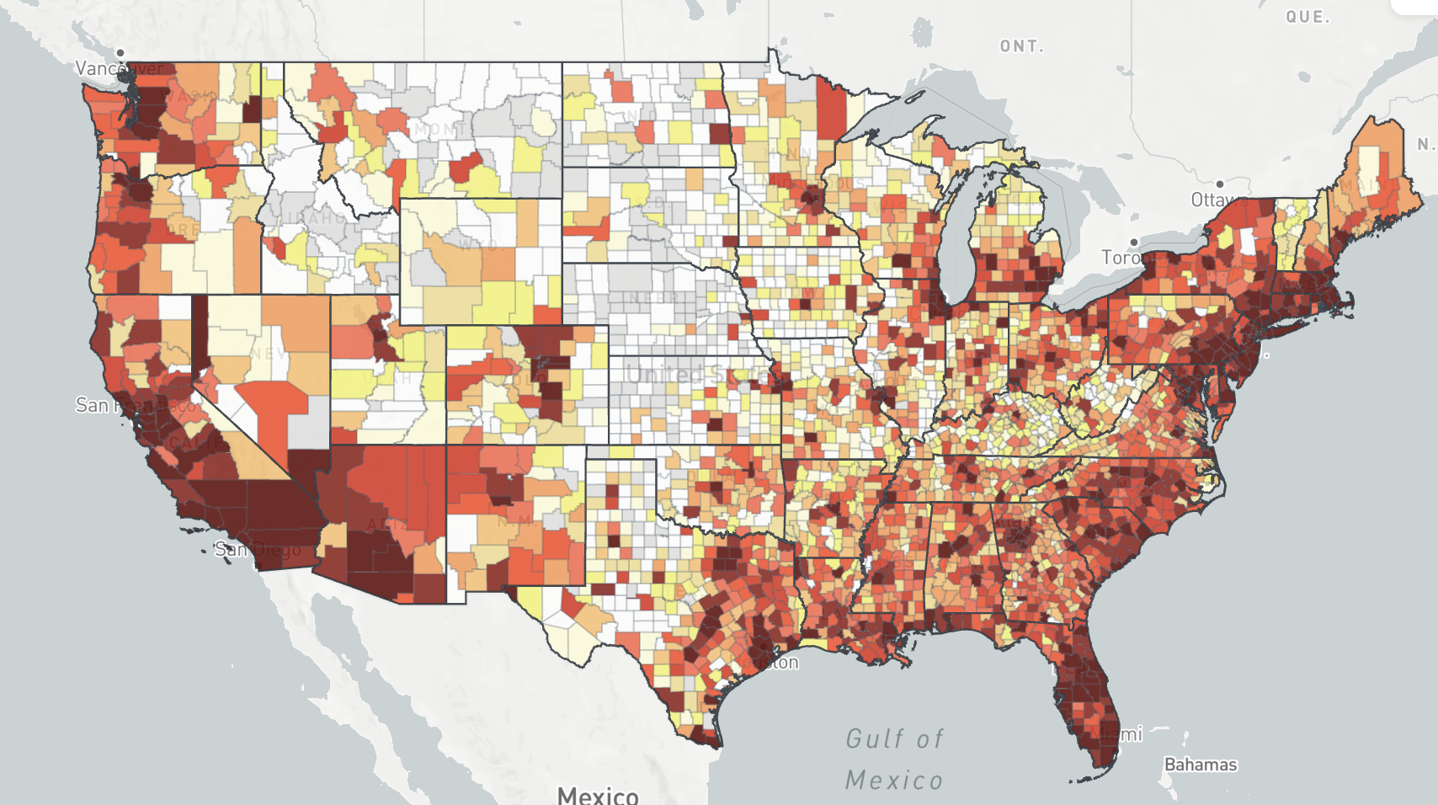
AIDSVu
Notes:
More than 50 % of cases are in the South

Slide 6
HIV Surveillance - Prevalence/New Cases (MO)
13 K people aged 13 years or older living with HIV infection
549 people newly diagnosed with HIV infection
AIDSVu
Notes:
In 2021, 13,103 people living in MO
/ 549 new diagnoses in 2021

Slide 7
Prevalence - people living with HIV Infection
(every 10,000)
St. Louis County
346 per 100K
Total - 2,910
Jackson County:
494 per 100K
Total - 2,956
St. Louis City
1,074 per 100K
Total – 2,717
Mississippi County
460 per 100K
Total - 49
AIDSVu
Notes:
Last update Nov 29 2023

Slide 8
Number of PrEP Users in MO (2012-2022)
5,095
58
2012
2022
AIDSVu

Slide 9
Percentages of PrEP Users (2022)
Hispanic/Latinx
Women
Black
Men
White
AIDSVu
Notes:
What kinds of image do you have? Typical pts?
Gender – male 94%, female 6%
Race / ethnicity

Slide 10
PrEP-to-Need Ratio (PNR)
Number of PrEP Users
Number of New HIV infections
Lower PNR = more unmet need
AIDSVu
Notes:
The 2021 PrEP-to-Need Ratio (PNR) is the ratio of the number of PrEP users in 2021 to the number of people newly diagnosed with HIV in 2020. PNR serves as a measurement for whether PrEP use appropriately reflects the need for HIV prevention. A lower PNR indicates more unmet need.
8 or higher – good

Slide 11
PrEP-to-Need Ratio (PNR) in MO (2022)
Gender: Male – 11, Female – 4
Race/Ethnicity: White – 18, Hispanic/Latinx – 4, Black – 3
AIDSVu
Notes:
Bias

Slide 12
Barriers to HIV PrEP?
Notes:
Word cloud (mentimeter)

Slide 13
What can we do to improve our care?
Notes:
Let students talk about it – next to them
Then circle back to the large group
Knowledge
Physician workforce (family medicine & understanding about PrEP – referral)

Slide 14
Barriers to PrEP
Stigma
Cost
Knowledge
Notes:
Stigma – prep itself
Cost – financial burden? Daily medications
Knowledge – Patient (may not think that the individual is eligible for PrEP) & Physicians (unfamiliar with PrEP; hesitate to talk about it)

Slide 15
Indications (“At-Risk”)
Partner with HIV infection
Recent STI with syphilis, gonorrhea, or chlamydia* within 6 months
Inconsistent condom use
Drug use

Slide 16
Notes:
Important – shared decision making

Slide 17
History Taking
General questions: Gender? Identify? Pronouns?
5 P
Partners: gender, numbers, HIV status, change
Practices: types, vaginal/oral/anal
Past hx: STDs, risk factors (needle sharing), last testing
Protection: Condom use
Pregnancy plans
Drug use
Knowledge about PrEP and HIV infection
Notes:
How many sexual partners do you have for the past 6 months?
What are/is the gender of your partner?

Slide 18
PrEP Options
TDF/FTC (Truvada®)
TAF/FTC (Descovy® )
Cabotegravir (CAB)
Apretude® - IM
Notes:
Explain what they need to understand
--- help them explain what options are

Slide 19
TDF/FTC v.s. TAF/FTC
Truvada®
Descovy®
Tenofovir disoproxil fumarate (TDF) + Emtricitabine (FTC)
Approved in July 2012
Tenofovir alafenamide (TAF) + Emtricitabine (FTC)
Approved in October 2019

Slide 20
Dosing – renal impairment
Truvada®
Descovy®
CrCl ≥ 60 No dosage adjustment necessary
CrCl < 60 Not recommended
CrCl ≥ 30 No dosage adjustment necessary
CrCl < 30 Not recommended
Notes:
Truvada: ESRD Not recommended
Descovy
End-stage renal disease on hemodialysis: One tablet (emtricitabine 200 mg/tenofovir alafenamide 25 mg) once daily; administer after hemodialysis on dialysis days (HHS [adult] 2019).
#HIV infection CrCl ≥50 mL/minute: No dosage adjustment necessary CrCl 30 to 49 mL/minute: Increase interval to every 48 hours. CrCl <30 mL/minute: Not recommended. #PrEP CrCl ≥60 mL/minute: No dosage adjustment necessary CrCl <60 mL/minute: Not recommended

Slide 21
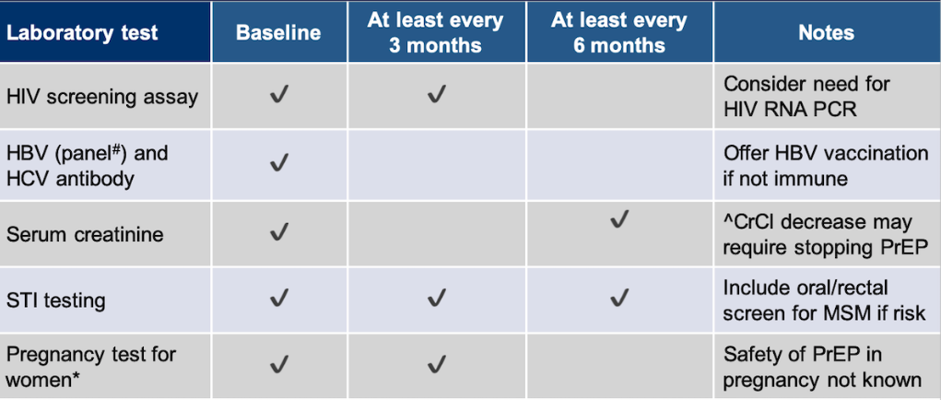
Lab Monitoring (Oral PrEP)
*Check BMP at 3 months and every 6 months thereafter:
→ Avoid Truvada® if eCrCl < 60 mL/min
National HIV Curriculum. Preexposure prophylaxis.
Notes:
- HIV testing window: (4th) 15-20 days (5th) 10-15 days
- STD testing – three sites
Initial visit
HIV Screening test, HBV panel (HBs Ag, HBs Ab, HBc Ab), HCV antibody
BMP, GC/CT pharynx/urine/rectum if receptive anal sex+, Syphilis screening, pregnancy test
Follow-up visit every 3 months
HIV Screening test, repeat pregnancy test
STI testing: if indicated, symptomatic or asymptomatic MSM at high risk for recurrent bacterial STIs *high risk: history of GC/CT/syphilis, multiple sex partners
Assessment of side effects, adherence, and HIV acquisition risk behaviors
HCV antibody if high-risk
At least every 6 months
BMP, STI testing (GC/CT pharynx/urine/rectum if receptive anal sex+), Syphilis screening
*Please check BMP at 3 months and every 6 months thereafter
At least every 12 months
Evaluate the need to continue PrEP as a component of HIV prevention
# Hepatitis B: Offer HBV vaccination if not immune
# CKD: Avoid PrEP if eCrCl < 60 mL/min
*Based on clinician’s judgement, you can check BMP every 6 months.

Slide 22
Cabotegravir (CAB) – Apretude®
Approved – December 2021
Extended-release injectable PrEP
Every Two Months
No Renal or Hepatic Dosage Adjustment needed
Optional 4-week PO before injectable PrEP
Adverse reaction: hepatotoxicity, injection site reaction

Slide 23
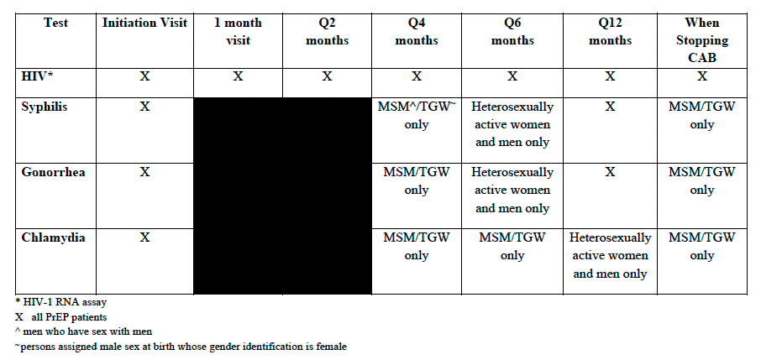
Lab Monitoring (CAB)
CDC. US Public Health Services. PrEP for the prevention of HIV infection in the US. 2021 Update.
Notes:
No hepatotoxicity reported. LFT monitoring recommended.

Slide 24
Steps – Initiation of PrEP
History & Physical Exam
Labs (HIV, HBV/HCV, BMP, GC/CT, Syphilis, pregnancy )
Follow-up in 1-3 months
Follow-up Q 3 months
Evaluate the need to continue PrEP Q 12 months

Slide 25
References
Centers for Disease Control and Prevention. Estimated HIV Incidence and Prevalence in the United States, 2017-2021. HIV Surveillance Report. May 2023. https://www.cdc.gov/hiv/library/reports/hiv-surveillance.html
AIDSVu: https://aidsvu.org
Centers for Disease Control and Prevention: US Public Health Service: Preexposure prophylaxis for the prevention of HIV infection in the United States—2021 Update: a clinical practice guideline. https://www.cdc.gov/hiv/pdf/risk/prep/cdc-hiv-prep-guidelines-2021.pdf
Savoy M, O'Gurek D, Brown-James A. Sexual Health History: Techniques and Tips. Am Fam Physician. 2020;101(5):286-293.
Dubov A, Galbo P Jr, Altice FL, Fraenkel L. Stigma and Shame Experiences by MSM Who Take PrEP for HIV Prevention: A Qualitative Study. Am J Mens Health. 2018;12(6):1843-1854. doi:10.1177/1557988318797437
Landovitz RJ, Donnell D, Clement ME, et al. Cabotegravir for HIV Prevention in Cisgender Men and Transgender Women. N Engl J Med. 2021;385(7):595-608. doi:10.1056/NEJMoa2101016

Slide 26
Resources
PrEP Resources for Missouri: https://www.pleaseprepme.org/missouri
National HIV Curriculum: https://www.hiv.uw.edu
American Academy of HIV Medicine. PrEP Guidelines and Recommendations. https://education.aahivm.org/product_bundles/2470
Centers for Disease Control and Prevention: US Public Health Service: Preexposure prophylaxis for the prevention of HIV infection in the United States—2021 Update: a clinical practice guideline. https://www.cdc.gov/hiv/pdf/risk/prep/cdc-hiv-prep-guidelines-2021.pdf

Slide 27
Any Questions?
Kento Sonoda, MD, FASAM, AAHIVS Email: kento.sonoda@health.slu.edu

Slide 28
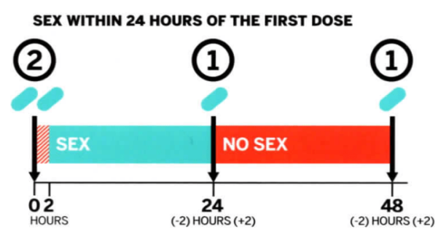
On-Demand PrEP

Slide 29
PEP - Medical EMERGENCY
Start within 72 hours of exposure
Test the source if available

Slide 30
PEP Regimen (28-day)
Tenofovir Disoproxil fumarate (TDF) / Emtricitabine (FTC) (Truvada®)
Tenofovir Alafenamide Fumarate (TAF) /FTC (Descovy®)
+
Dolutegravir (DTG)
Bictegravir (BIC)
Raltegravir (RAL)
Notes:
Clinical Guidelines: https://clinicalinfo.hiv.gov/en/guidelines

Slide 31
FAQ - Adolescent?
Needs to be at least 35 kg
Notes:
Truvada

