Slide 1
Building a Faculty 'A' An Opportunity for Behavioral Science Faculty to Lead
The 2016 Forum Conference ~ Chicago
Deborah Taylor, PhD
Central Maine Medical Center FMR

Slide 2
Disclosures
NONE
Really!

Slide 3
Objectives
Understand the value of a cohesive faculty team to your program’s overall well-being
Know and use assessment tools available to evaluate your current faculty team’s function
Develop and implement a systematic measurable leadership approach to improve your faculty team

Slide 5
We can all relate to this...

Slide 6
What makes an Effective Team?

Slide 7
HOWEVER..
“Teamwork. A few harmless flakes working together can unleash an avalanche of destruction.” Justin Sewell

Slide 9
What makes an Ineffective Team?
“After all is said and done,
more is said than done.“ Aesop

Slide 10
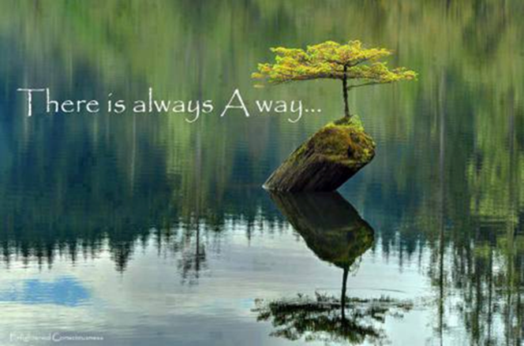
Think-Pair-Share
You are starting from scratch - Using narrative or bullet list technique:
Describe your ideal faculty team (4 minutes)
Compare your list with 1-2 other attendees
Discuss how close you are to your ideal faculty team?
Examine what it would take to get you to your idea? (attempt as much realism as possible!)

Slide 11
Team Assessment Tools
http://flpbs.fmhi.usf.edu/pdfs/Five%20Dysfunctions%20of%20a%20Team.pdf
http://www.mindtools.com/pages/article/newTMM_84.htm
http://www.insead.edu/facultyresearch/research/doc.cfm?did=49811
http://www.kent.ac.uk/careers/sk/teamwork.htm

Slide 12
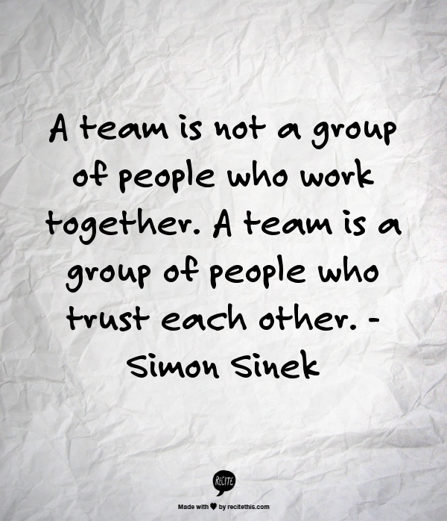

Slide 13
Five Dysfunctions of a Team (Lencioni)
The Positive Approach
They trust one another.
They engage in unfiltered conflict around ideas.
They commit to decisions and plans of action.
They hold one another accountable for delivering against those plans.
They focus on the achievement of collectible results.
Handout
http://flpbs.fmhi.usf.edu/pdfs/Five%20Dysfunctions%20of%20a%20Team.pdf

Slide 14
Anyone have any experience with
this kind of “team” philosophy?

Slide 15
Mind Tools
Team Assessment Tool (handout)
Components:

Slide 16
“GRPI” Team Assessment [simple (1-low to 4=high) scale; frames conversation]

Slide 17
G = Goal(s)
The shared goal(s) are clear and the individuals are committed.

Slide 18
R = Roles/Responsibilities
- The work is organized in a way that clearly leads to achieving the team’s goal(s).
- Everyone is clear about expectations and the job s/he has to do.
- There is balanced use of the different leadership talents.

Slide 19
P = Processes/Procedures
- Decisions are timely and effective.
-Conflict on the team is addressed openly and constructively.
-The leader monitors team performance, making adjustments to assure team and individual effectiveness.

Slide 20
I = Interpersonal Relationships
- There is trust in communication and relationships.
- Flexibility and creativity are encouraged.
Capabilities are developed and used.

Slide 21
Your Role as a Behavioral Science Faculty Leader

Slide 22
Leadership Assessment: The Importance of Having This in Place
Handout

Slide 23
12 C’s of Team Building
Clear expectations
Context
Commitment
Competence
Charter
Control
Collaboration
Communication
Creative innovation
Consequences
Coordination
Cultural change

Slide 24
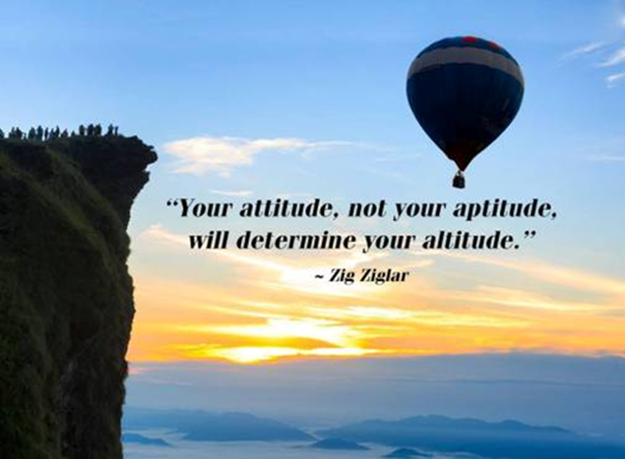
Building Blocks (to add to the 12 C’s)
Consider each faculty’s ideas as valuable.
Be aware of faculty’s unspoken feelings

Slide 25
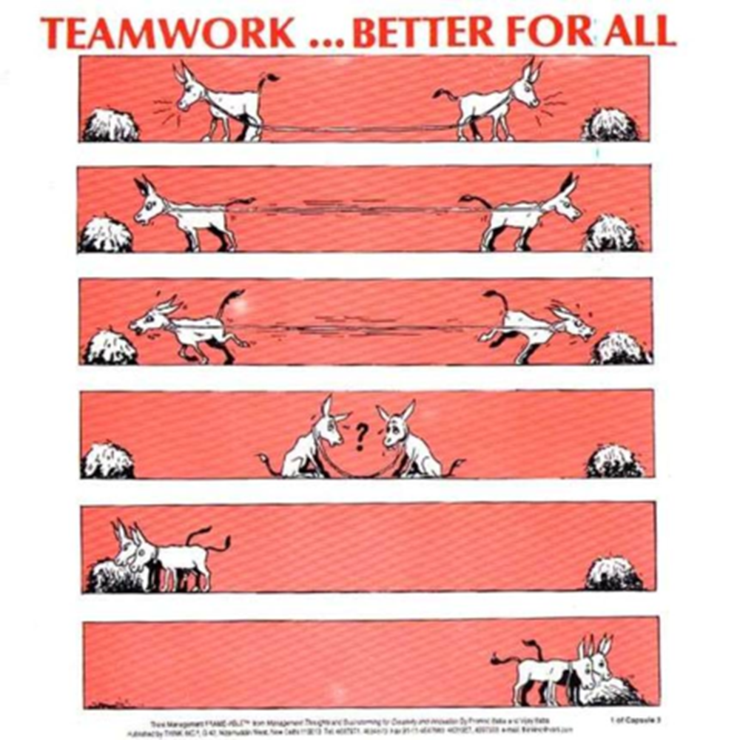
Building Blocks (to add to the 12 C’s)
Act as a harmonizing influence
Delegate effectively to enhance buy in

Slide 26
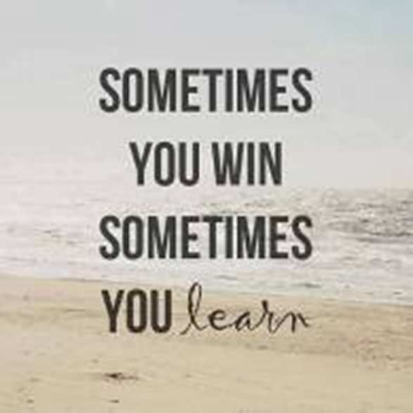
Building Blocks (to add to the 12 C’s)
Collaboratively establish team ground rules
Establish team goals & evaluate team performance

Slide 27
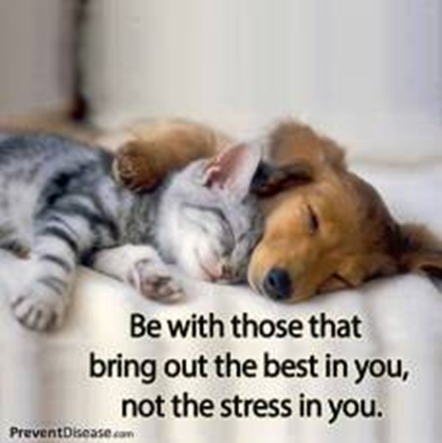
Building Blocks (to add to the 12 C’s)
Clearly communicate your vision and goals
Articulate your expectations around decision making (what do you decide, what is decided by committee/subgroup, what is decided by majority, what is decided by consensus)

Slide 28
The “Central Maine Way”
5 Dysfunctions of a Team
Goal: Improve Culture of Trust
Faculty Team Development efforts
Faculty Balint
Long Range Planning Retreat Days
Annual Peer Feedback System
Expectations in day to day contact
Ex. Increased appreciation for need to address conflicts

Slide 29
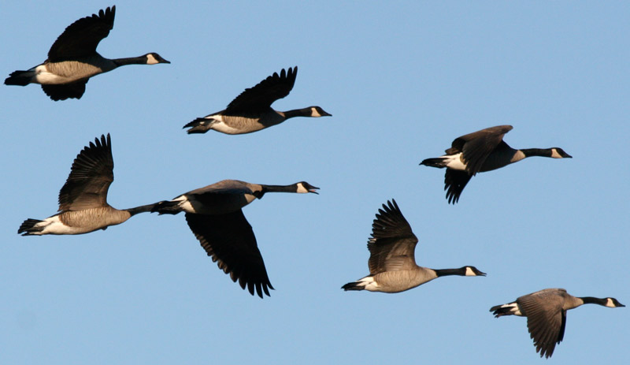
What will be your contribution to building your residency’s Faculty “A” Team?
Let’s learn some
strategies from

Slide 30
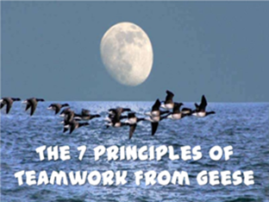
Let’s fly together!

Slide 31
Share a Common Goal
As each goose flaps its wings it creates “uplift”, an aerodynamics orientation that reduces air friction, for the birds that follow. By flying in a V-formation, the whole flock achieves a 70% greater flying range than if each bird flew alone.
The lesson we can learn here is that people who share a common direction and goal can get where they are going quicker and with less effort because they benefit from the momentum of the group moving around them. Make sure you take time to devote to a clear and unanimous vision.

Slide 32
Increase Visibility
Flying in a V-formation increases the visibility as every goose can see what’s happening in front of them.
The lesson here is to make our organizations visible in both directions – top down, bottom up, side to side.

Slide 33
Having Humility to Seek Help
When a goose falls out of formation, it suddenly feels the friction of flying alone. It then quickly adjusts its mistake and moves back into formation to take advantage of the lifting power of the bird immediately in front of it.
The lesson we can learn here is to be humble to admit the challenges we face and to seek help as soon as we get stuck.

Slide 34
Empowering Others to Lead
When the lead goose in the front gets tired, it rotates back into the formation and allows another goose to take the leadership position.
The lesson here is to empower others to also lead. People have unique skills, capabilities, and gifts to offer. Give them autonomy, trust and a chance to shine, and you will be surprised with the outcomes.

Slide 35
Always Recognize Great Work
The geese honk to recognize each other and encourage those up front to keep up their speed.
The lesson here to make sure we praise our teammates and give them the recognition they deserve. It’s very common for people’s efforts to go unnoticed by colleagues in a busy work environment.

Slide 36
Offer Support in Challenging Times
When a goose gets sick or wounded, two geese drop out of formation and follow it down to help and protect it. They stay with it until it dies or is able to fly again. Then, they launch out with another formation or catch up with the flock.
The lesson here is to stand by each other in difficult times.

Slide 37
Stay Committed to Core Values and Purpose
The geese migration routes never vary. They use the same route year after year. Even when the flock members change, the young learn the route from their parents. In the spring they will go back to the spot where they were born.
The lesson to learn here is to stay true to our core values and purpose. Strategies & tactics may change, but great teams stick to their core purpose and values, and preserve them with vigor.

Slide 38
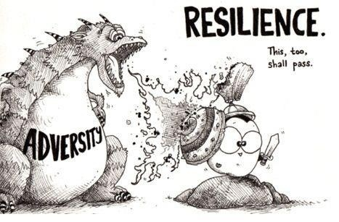

Slide 39
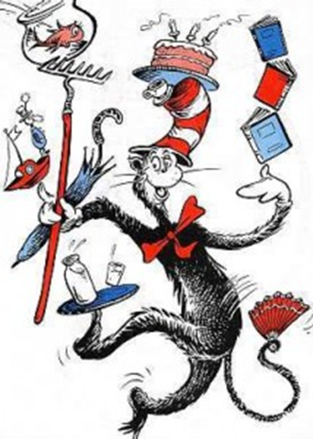
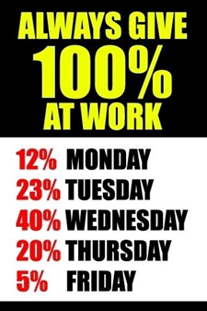
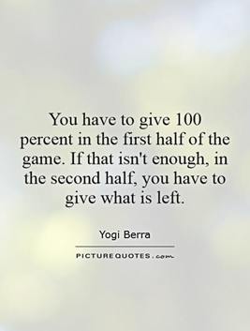
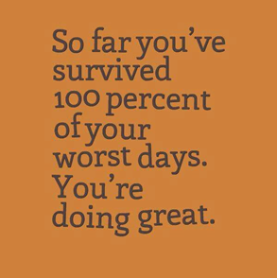
How many of
you have heard
this as an expectation?

Slide 40
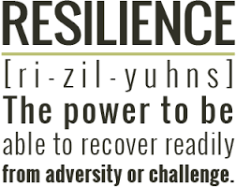
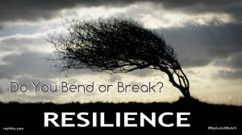
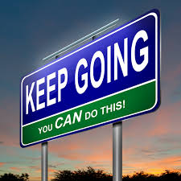
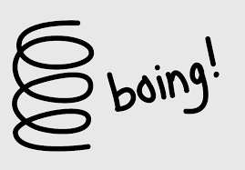
Notes:
Handout
Few pearls
Taking your temperature, reflecting on enhancers and detractors, maximize enhancers, minimize detractors

Slide 41
Small Group Activity
What are things that you focus on, value or engage in some type of practice or activity that helps you stabilize & sustain you for the work that you do?
Make a list for yourself.
Share with 1-2 attendees.
Similarities? Differences?

Slide 42
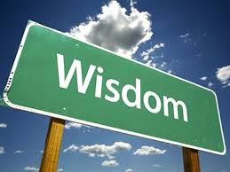

Slide 43
Everything I needed to know I learned in kindergarten!

Slide 44
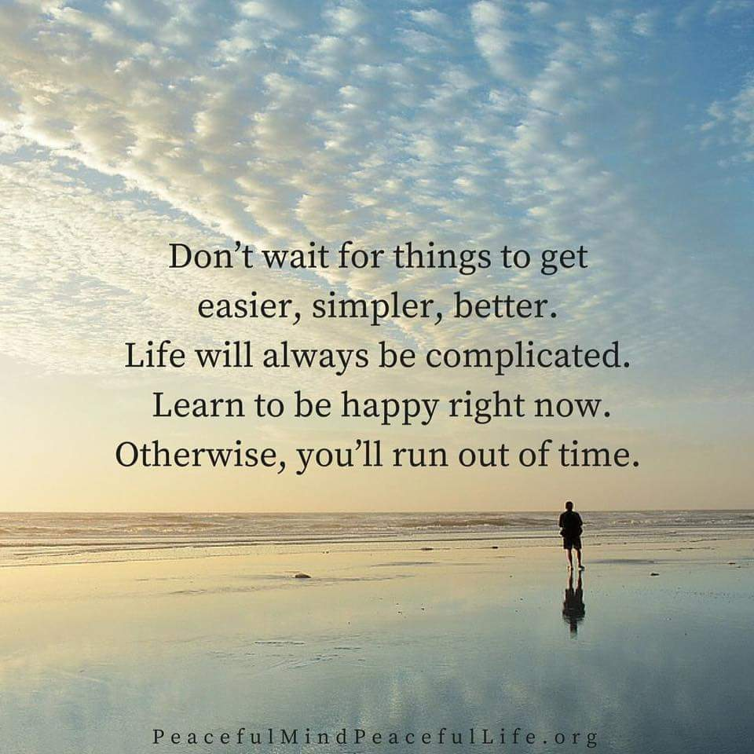

Slide 45
Next Steps
What is 1 thing you could commit to doing in the next month that would strengthen your faculty team?
What is 1 thing you could commit to doing as a team in the next 3 months to improve your team’s well-being and meet its mission?
When you look back 1 year from now, what will be the signs that your team is stronger?

Slide 46
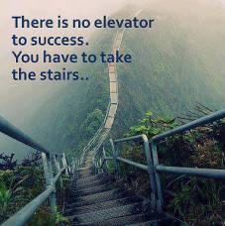
QUESTIONS?
COMMENTS?
THANKS
FOR
COMING
Please evaluate this session. I would appreciate it.

