Slide 1
The Great Debate: Should We Dismiss Vaccine Hesitant Families From Our Practices:
Victoria Boggiano, MD, MPH
Suzanna Hosein, DO, MS
Ashley Rietz, MD
And thank you to Care of Infant, Children, and Adolescent Collaborative Chair Sutton Hamilton, MD

Slide 2
Disclosures
None

Slide 3
Definitions
Vaccine Acceptance - timely receipt of all childhood vaccines as recommended by the ACIP
Vaccine Hesitancy - delay in acceptance or refusal of vaccination despite availability of vaccination services
Vaccine Confidence - the trust that parents or health-care providers have in the recommended immunizations
Notes:
Humans place a lot of weight on anecdotal evidence and that leads them to assume causal relationships where none actually exists. This creates confirmation bias
Medical professionals are trained to think probabilistically where the general population tends to think heuristically
This can create a divide when we are discussing the science behind immunization practices and we are butting up against emotional and anecdotal stories of why parents should accept the recommended primary immunization series.

Slide 4
Notes:
https://www.polleverywhere.com/

Slide 5
The Great Debate

Slide 6
Current Trends

Slide 7
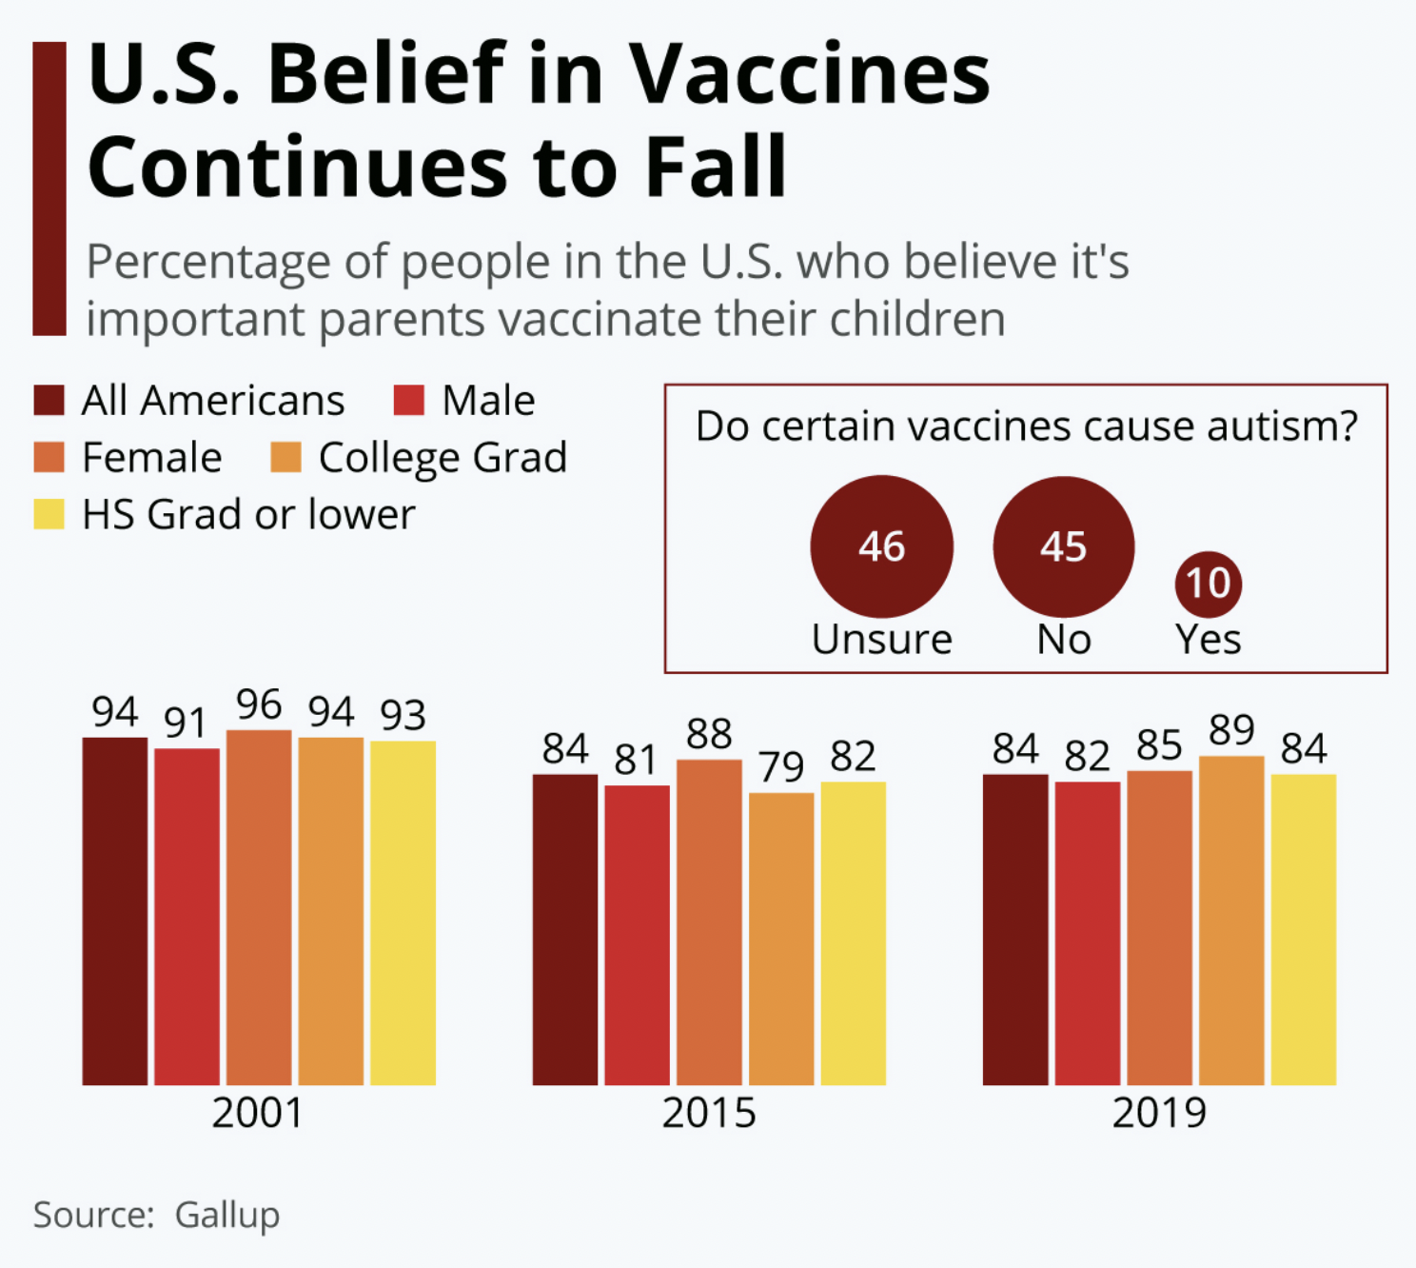
Notes:
Widespread public support for childhood vaccines creates a wall preventing contagious diseases like measles and polio from spreading in the U.S., but a breach in that wall appeared in 2015 and it has not been repaired.
84% in U.S. say vaccinating children is important, down from 94% in 2001
86% say vaccines are not more dangerous than the diseases they prevent
45% of Americans say vaccines do not cause autism in children

Slide 8
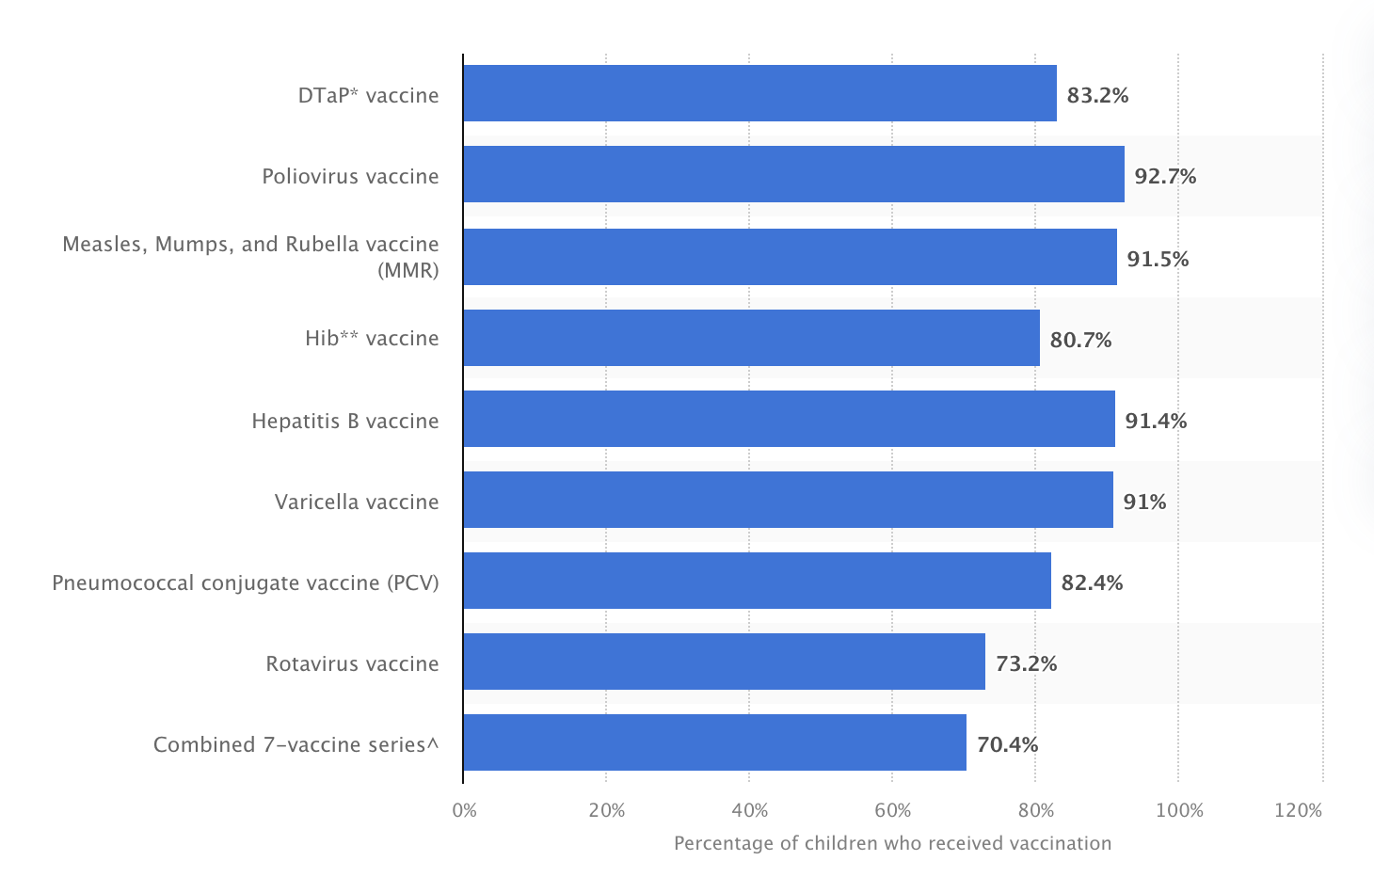
Percentage of U.S. children aged 19-35 months who received all doses of recommended vaccines in 2017
Hill HA, Elam-Evans LD, Yankey D, Singleton JA, Kang Y. Vaccination Coverage Among Children Aged 19–35 Months — United States, 2017. MMWR Morb Mortal Wkly Rep 2018;67:1123–1128.
Notes:
https://www.cdc.gov/mmwr/volumes/67/wr/mm6740a4.htm#T1_down
Only about 70.4% of children aged 19-35 months in the US were fully vaccinated as per guidelines from the Advisory Committee on Immunization practices. Many are able to opt out of school required vaccinations by obtaining nonmedical exemptions due to religious or philosophical beliefs.

Slide 9
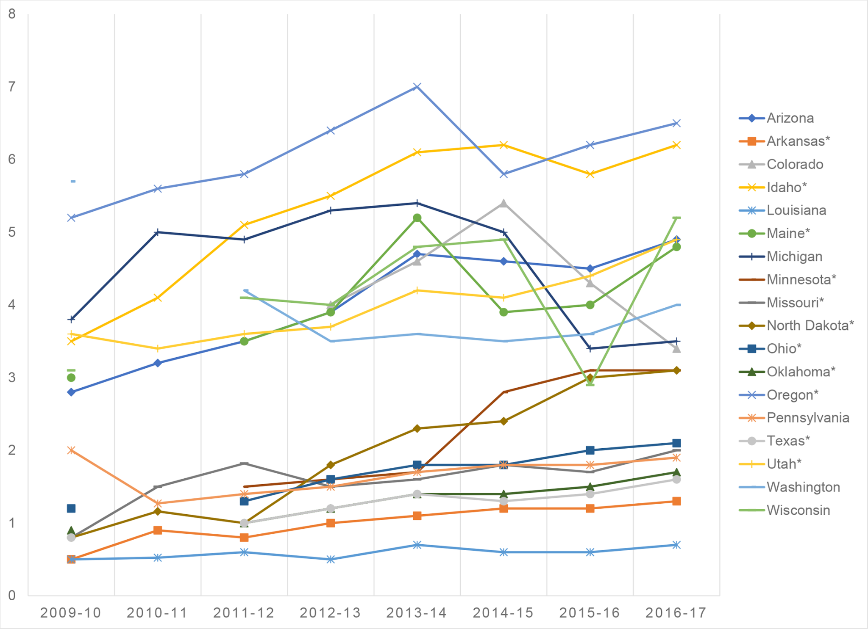
Increasing rates of non-medical exemptions
The state of the antivaccine movement in the United States: A focused examination of nonmedical exemptions in states and counties
Olive JK, Hotez PJ, Damania A, Nolan MS (2018) The state of the antivaccine movement in the United States: A focused examination of nonmedical exemptions in states and counties. PLOS Medicine 15(6): e1002578.
Notes:
According to the National Conference of State Legislatures, 44 states have provisions that allow parents to exempt their children from receiving a vaccine if it contradicts their religious beliefs, and 15 states permit philosophical exemptions based on moral, personal or other beliefs.
The researchers investigated this last group of states using data collected from the CDC and state health departments for school years 2009-2010 to 2016-2017. These data were used to establish NME rates among entering kindergarteners in each state and, where possible, at the county level.

Slide 10
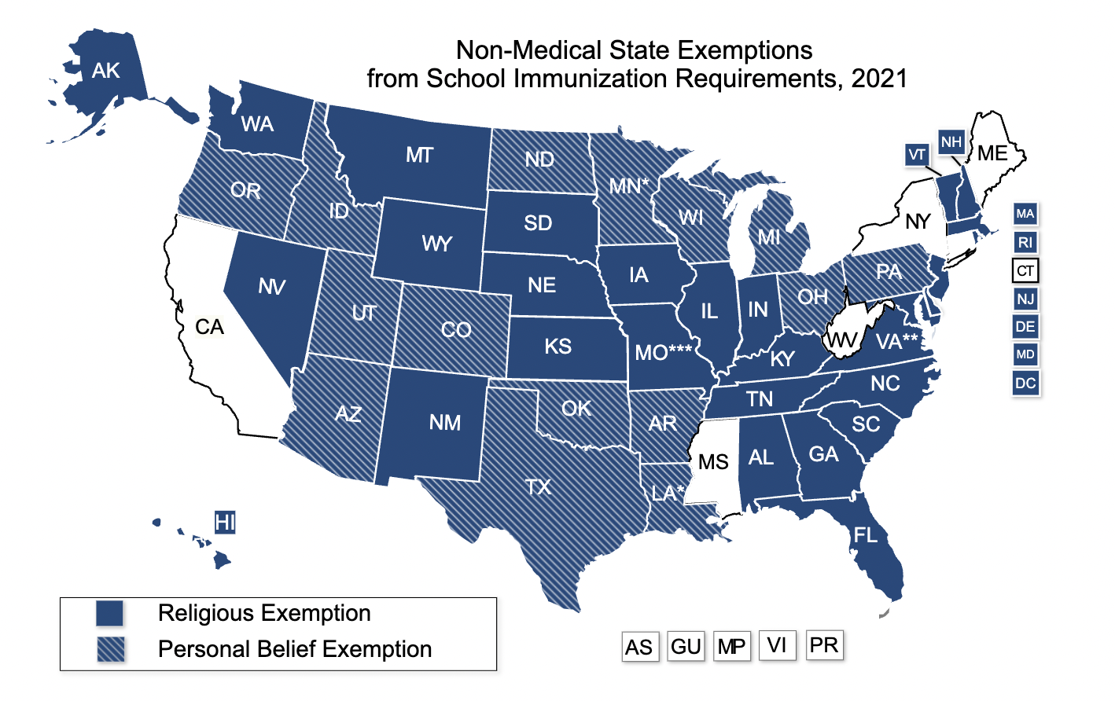
States with religious and philosophical exemptions
Source: Adapted from the LexisNexis StateNet Database and the Immunization Action Coalition, May 2019.
Notes:
This shows the pervasiveness states that allow non-medical exemptions.

Slide 11
Notes:
Nevertheless, the CDC reports that more than 90% of US children up to age 24 months are immunized via injection against several diseases, including measles, mumps, and rubella; almost 93% have received at least 3 of the 4 recommended injections of polio vaccine. And approximately 95% of kindergarteners had received state-required vaccines for the 2019-2020 school year.
The vaccine rate fell by 1% for the 2020-2021 school year for kindergarteners to 94% for required school vaccinations. This equates to around 35,000 more children entering school without completed vaccinations.

Slide 13
AAP Policy changed in 2016
In 2016, the AAP changed its policy, stating that “a pediatrician may consider dismissal of families who refuse vaccination as an acceptable option” while acknowledging that the decision to dismiss should not be made without contemplating and respecting the beliefs of the family in question.
Edwards KM, Hackell JM. Countering vaccine hesitancy. Pediatrics. 2016;138(3):e20162146–e20162146. doi:10.1542/peds.2016-2146.

Slide 14
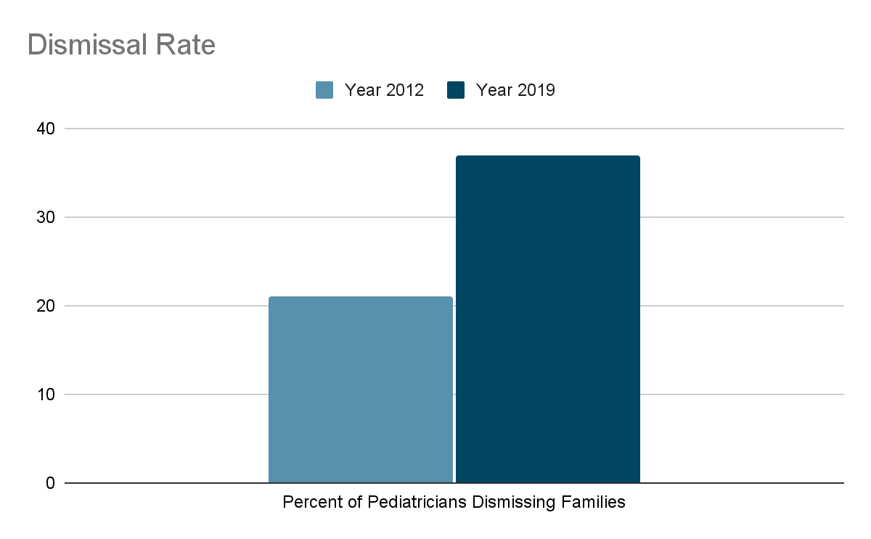
More patients and families are being dismissed from practices
COVID19 vaccine refusal has deepend divides
O’Leary ST, Cataldi JR, Lindley MC, et al. Policies Among US Pediatricians for Dismissing Patients for Delaying or Refusing Vaccination. JAMA. 2020;324(11):1105–1107. doi:10.1001/jama.2020.10658
Notes:
(51%) of pediatric offices in the United States have a policy to dismiss families that refuse childhood vaccines, whereas 37% of physicians reported often/always doing this themselves. Physicians more often dismissed patients for refusing rather than spreading out vaccines in the primary series.

Slide 15
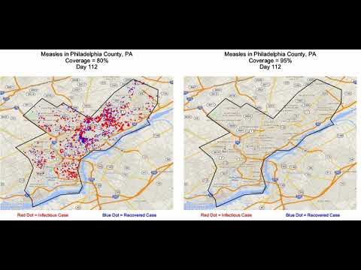
Protecting everyone
Due to pandemic pediatric vaccinations have fallen lower than previous years due to disruptions in well visits and children entering school.
Notes:
Whereas measles was thought to have been eliminated from the US in 2000, we have seen local outbreaks of this vaccine preventable illness and others in recent years. A child that is not vaccinated is 35 times more likely to contract measles than is a vaccinated child. Slipping vaccination rates weaken herd immunity that protects the population at large, particularly children who are unable to get vaccinated for medical reasons. The target vaccination coverage rate to achieve ideal herd immunity is 90-95% depending on the infectious agent. For measles because it is so contagious 95% vaccination is ideal.

Slide 16
Parental concerns
Reside on both sides:
Some families pro-dismissal
Some families against
'I don't want to bring my child to an office that accepts nonvaccinators because I don't want my child to get sick.'

Slide 17
Best Practices

Slide 18
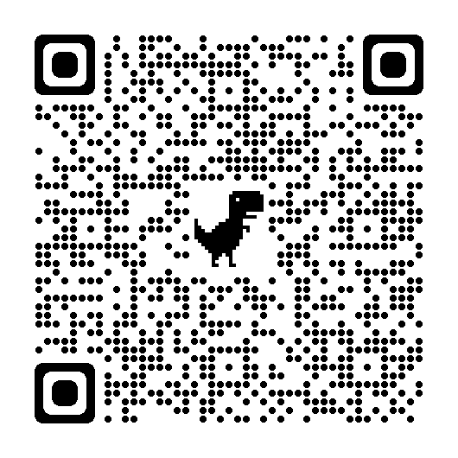
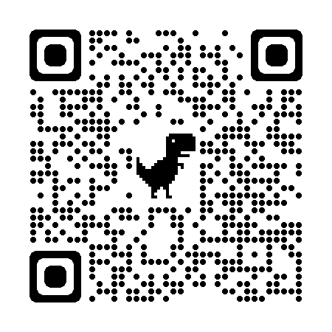
How to care for vaccine hesitant families
Invest time into understanding the concerns and misinformation that families have about vaccines

Slide 19
Misinformation
For as much as there is, nothing goes further to change minds than a deep trusting relationship with a physician
Assess barriers/concerns
Do your homework (CHOP website is a great resource)
Notes:
Many families will spend hours performing research and will see you as less credible if you are not able to respond to your exact concern. It is important to be seen as a credible resource of reliable information to vaccine questioning and hesitant families.

Slide 20
Presume Acceptance
Notes:
One of the strongest recommendations is to change how we present vaccination within a visit. Instead of “would you like your infant to get their Hep B today?” use a statement like, “today we are going to give George his Hep B shot that is due.” This is called a presumptive approach.

Slide 21
Utilize a Framework
Consider using CASE
Corroborate, About me, Science, Explain/Advise
Learn more: 1.https://www.aap.org/en/patient-care/immunizations/communicating-with-families-and-promoting-vaccine-confidence/talking-with-vaccine-hesitant-parents/
2. Let’s Talk Vaccines by Gretchen LaSalle, MD
Notes:
One great resource is a book by a fellow family physician Dr. Gretchen LaSalle. In one part of her book she shares multiple frameworks that providers can use in vaccine discussions. One of those frameworks is also highlighted by the AAP called CASE, which stands for corroborate, about me, science, and explain/advise. Acknowledge their concern and find something you CAN agree with them on. Then describe what you have done to become an expert on the topic. Follow that with what science says about their question and finish with your recommendation.

Slide 22
Talk about vaccines early and often
start educating importance during prenatal care
use all visits (not just well child)
leverage continuity (small chunks at multiple visits)
Notes:
As family physicians we can begin conversations about the importance of childhood vaccines before birth. One great thing to tie this discussion to is the tdap vaccine in the third trimester. Then after the baby is born, don’t just talk about vaccines at well child checks. Bring this up at any visit in the office. And it can be overwhelming to dig into these conversations. Instead, consider spending small amounts of time over multiple visits to work on this issue with families.

Slide 23
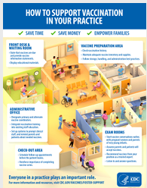
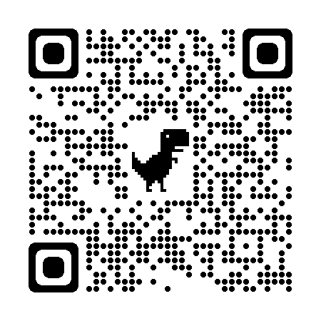
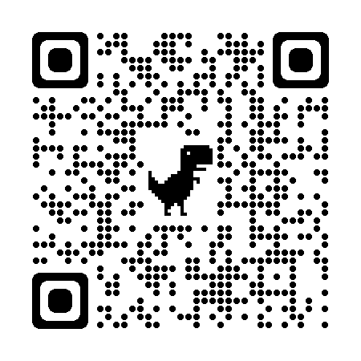
Make your Immunization Program Shine
Notes:
Make sure your vaccine program is a well oiled machine. There are MANY things we can all do to make our vaccine programs run well and demonstrate our commitment to effective and efficient vaccination. Some highlights include joining the Vaccines for Children program (QR code to the CDCs website about this below). On the right is a link to the CDCs resource page on how to foster vaccination in your clinic. Some of my favorite points include identifying vaccine champions, using standing orders, and scheduling next dose before patient leaves the clinic.

Slide 24
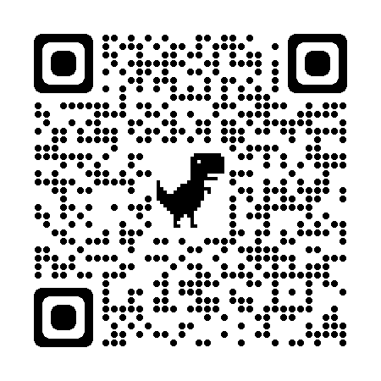
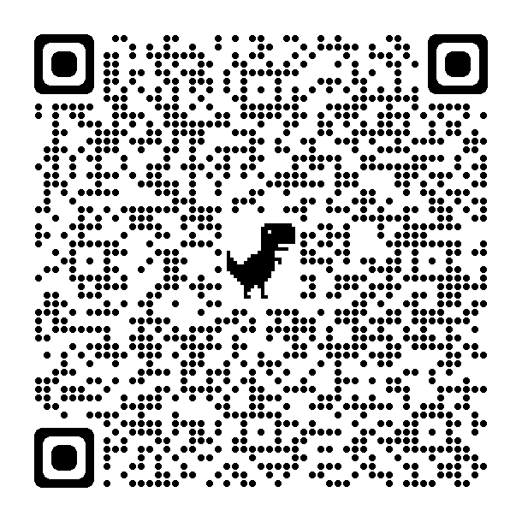
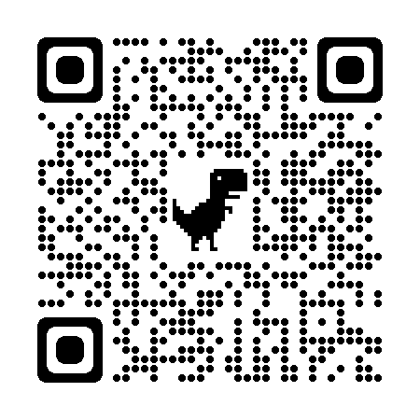
Educate clinicians, care team partners, families
CHOP patient facing app
Notes:
It is really important to educate your entire team. We really like the resources from the Pediatric Infectious Diseases Society, highlighted on the left of this slide. It includes self directed modules as well as info about “the purple book” app which is a great point of care resource. On the right you can access the AAP’s communication toolkit which includes resources for patients and providers. And at the bottom is CHOP’s patient facing app to help connect families to accurate information about vaccines.

Slide 25
Guidance from the AMA regarding patient dismissal
Do NOT terminate a relationship with a patient because of gender, race, religion, or sexual orientation.
Do NOT terminate a relationship with a patient who is in physical, emotional, or psychiatric crisis. For example, a psychiatrist may not terminate a patient who is in a suicidal state or a state of extreme agitation or depression.
Do NOT terminate a relationship with a patient who is past 20 weeks gestation until after resolution of the pregnancy and completion of any requisite postpartum care.

Slide 26
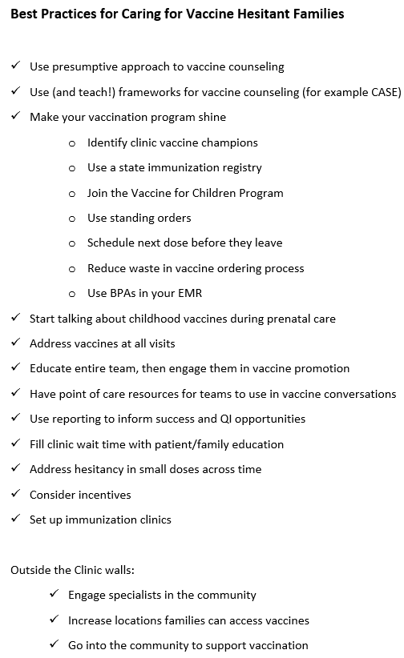
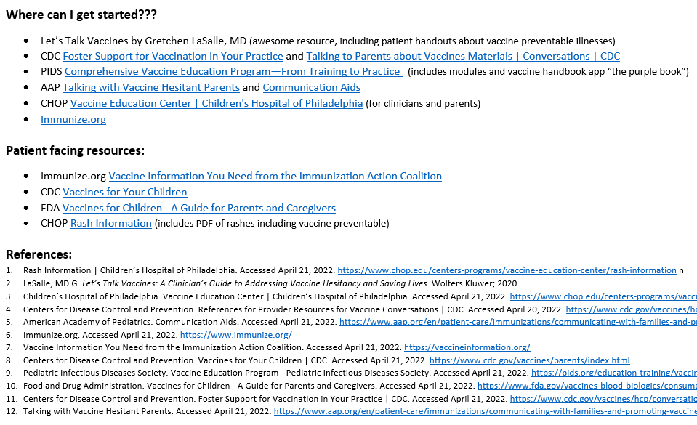
See STFM App for Handout!

Slide 27
The bottom line:
Nothing goes further than having a deep knowledge of the issues; a sincere, meaningful and trustworthy connection with the family; and a strongly held personal conviction that vaccines save lives and prevent misery.
Begin the discussion early
Have a plan
Start strong
Take an affirmative posture
Normalize vaccination
Be consistent

Slide 28
References:
LaSalle, MD G. Let’s Talk Vaccines: A Clinician’s Guide to Addressing Vaccine Hesitancy and Saving Lives. Wolters Kluwer; 2020.
Children’s Hospital of Philadelphia. Vaccine Education Center | Children’s Hospital of Philadelphia. Accessed April 21, 2022. https://www.chop.edu/centers-programs/vaccine-education-center
NCSL.org states with religious and philisophical exemptions to vaccination https://www.ncsl.org/research/health/school-immunization-exemption-state-laws | Accessed April 29, 2022
Centers for Disease Control and Prevention. References for Provider Resources for Vaccine Conversations | CDC. Accessed April 20, 2022. https://www.cdc.gov/vaccines/hcp/conversations/index.html
American Academy of Pediatrics. Communication Aids. Accessed April 21, 2022. https://www.aap.org/en/patient-care/immunizations/communicating-with-families-and-promoting-vaccine-confidence/communication-aids/
Pediatric Infectious Diseases Society. Vaccine Education Program - Pediatric Infectious Diseases Society. Accessed April 21, 2022. https://pids.org/education-training/vaccine-education-program/
Centers for Disease Control and Prevention. Foster Support for Vaccination in Your Practice | CDC. Accessed April 21, 2022. https://www.cdc.gov/vaccines/hcp/conversations/your-practice.html
Talking with Vaccine Hesitant Parents. Accessed April 21, 2022. https://www.aap.org/en/patient-care/immunizations/communicating-with-families-and-promoting-vaccine-confidence/talking-with-vaccine-hesitant-parents/

