Slide 1
2020 STFM CONFERENCE ON
MEDICAL STUDENT EDUCATION
Tips for Supporting Learners’ Feedback-Seeking Behavior
Vicki Hayes, MD; Meg Curran, MD;
Peggy Cyr, MD; Jenny Scontras, MSIV

Slide 2
DISCLOSURES
The presenters have no conflicts of interest to disclose.

Slide 3
Objectives
List factors affecting feedback-seeking behavior.
Discuss techniques for faculty to utilize to support students in effective feedback-seeking
Identify resources to facilitate integration of feedback-seeking into educational experiences.

Slide 4
What general factors affect feedback-seeking behavior?

Slide 5
Barriers
Time
Approachability
Continuity/relationship
Feedback climate
Feeling like a burden
Not knowing what to seek
Effectiveness (not specific)
Value (D.O.)
Lack of training
Perceived Costs and Benefits
Inquiry vs monitoring/
observation
Hierarchical Characteristics

Slide 6
What specific, individual factors affect feedback-seeking behavior?

Slide 7
Type of Feedback Sought
Appreciation/Recognition
Evaluation
Coaching
Stone and Heen: “Thanks for the Feedback”

Slide 8
The Problem
Medicine (and doctors) is performance-oriented
Doctors are smart
We like to show how smart we are

Slide 9
Fixed
vs
Growth Mindset

Slide 10
Practical techniques for teaching feedback-seeking (handout)
Brief trigger video

Slide 11
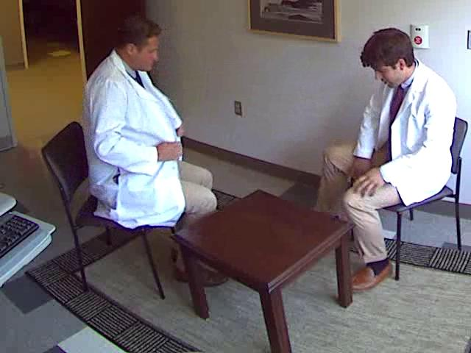
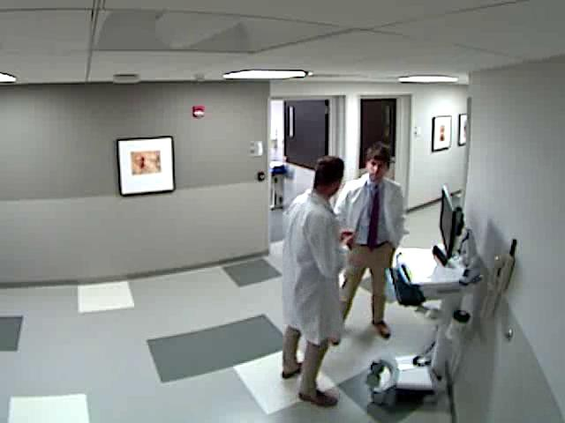
Feedback-seeking techniques
Handout
How to teach

Slide 12
Encourage a Growth Mindset
Reward the process (efforts & strategies), not the outcome
Avoid trait statements
Failing is learning
Focus on learning
Disavow your trait
Show how hard it is (and how hard you worked)
Share your failures

Slide 13
DIVIDER

Slide 14
PRIMING
Let preceptor know ahead of time
Follow-up/next steps
Ask permission
Understanding your purpose
Feedback and your response

Slide 15
ENCOURAGE EFFECTIVE FEEDBACK
Be specific
Unpacking the label
Paraphrase
Stop/Keep/Start

Slide 16
ARTIFICE
Self-deprecation
Coaching
Flattery
Make it about them
Indirect feedback
Notes:
Discuss with audience personal experiences with feedback-seeking.
Explore application of the provided background and techniques to an educational setting or curriculum.

Slide 17
EVALUATE
Please evaluate this presentation using the conference mobile app!

Slide 18
THANK YOU

