Slide 1
From Good Intentions to Action: Tools and Systems Approaches to Address
Social Determinants and Injustice in Health

Slide 2
Starting a Grassroots SDOH Screening Initiative in the Backyard of an Ivory Tower
Heather Bleacher, MD MPH
University of Colorado Family Medicine Residency

Slide 3
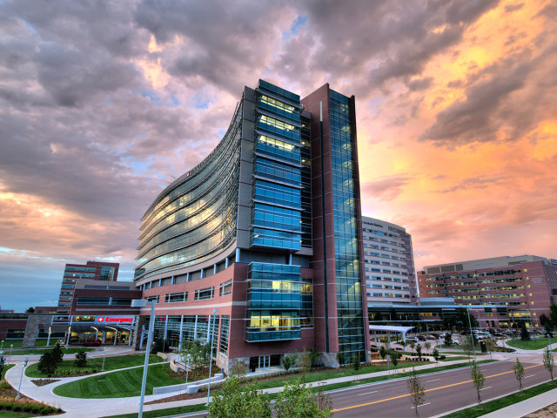
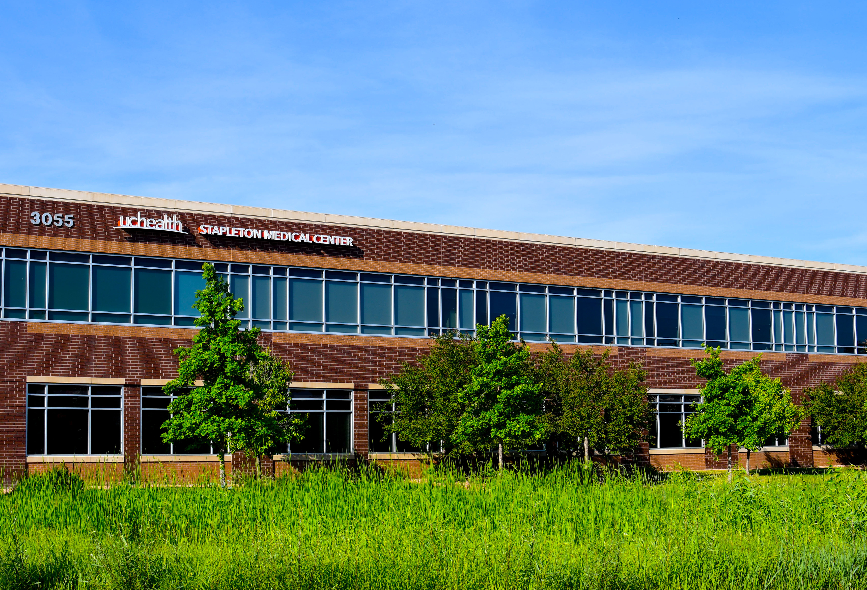
AF Williams
Family Medicine Center
Notes:
The UCHealth system includes:
10 hospitals
Over 60 locations

Slide 4
SDOH Screening By the Numbers
29 months of planning
5 versions of the screening tool
9 months of screening
2018 patients screened
541 patients reporting needs
2 social workers

Slide 5
The Greatest Struggles
Being at the mercy of the health system’s priorities
Patient engagement
Staff engagement
Closing the loop on community referrals

Slide 6
The Key Ingredients
Pay attention to what is happening in your system
Understand the local SDOH landscape
Build an SDOH dream team
Get data and make it work for you

Slide 7
From Good Intentions to Action: Tools and Systems Approaches to Address
Social Determinants and Injustice in Health

Slide 8
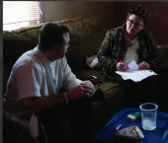
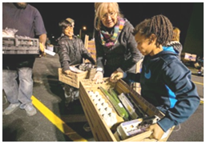
The State of the US Health Care
The Need for Change - 2005
Very high cost
Very poor access
Poor population-based health outcomes
Very poor outcomes for children and women of childbearing age
Waning primary care career choice
SDOH
System Approaches
Care Coordination
Hotspotting
Community Care Collaborations
Jerry Kruse, MD, MSPH
December 2018

Slide 9
Characteristics of Effective Systems of Care - 2005
The PCMH
The Essential Functions
Care Coordination at SIU Medicine
Regional planning and resource allocation
Universal health insurance
Highly regulated health insurance function
No out-of-pocket expenses for primary care
Narrow range of physician incomes
High supply of primary care physicians
Relationship with a usual source of comprehensive, longitudinal medical care
1. First Contact Access
2. Patient-focused Care Over Time
3. Comprehensive Care
4. Coordinated Care (Integrated Care)
5. Family Orientation
6. Community Orientation
7. Cultural Competence
1. Identification of High Risk,
Highly Vulnerable,
High Utilizers
Top 1% - Hotspot
Top 10% - Targeted
2. Registries
3. Transitions of Care
4. Specific Disease
Management Programs
5. Navigators
Hotspotting and Community Care Collaborations
Coordinated and Integrated Care
Family Orientation
Community Orientation
Cultural Competence
The Patient-Centered Medical Home
Community Health Workers

Slide 10
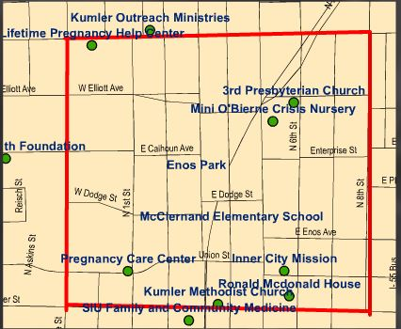
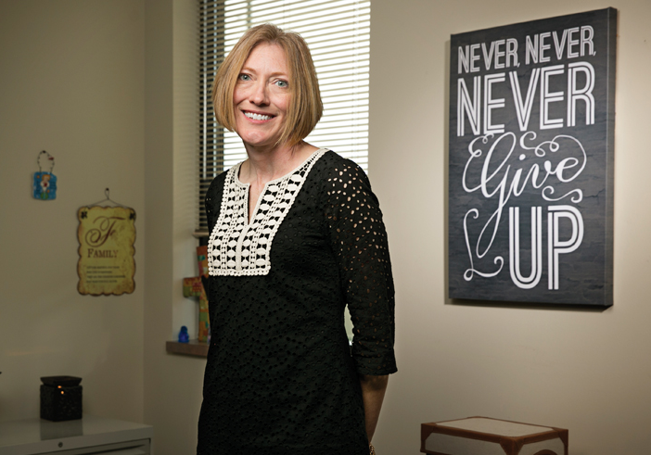
Enos Park
Access to Care
Collaborative
2 year results
100% established a medical home
93% had a primary care visit
83% appointment keep rate
54% more have health insurance
34% decrease in ER use
36% decrease in hospital charges
25% increase in Quality of Life index
Tracey Smith, DNP

Slide 11
Enos Park
Access to Care
Collaborative
2 year results
87% of the homeless housed
69% increase in employment
53% increase in income
74% increase in housing safety
31% increase in food access
22% decrease in police calls
0% parolee recidivism
Tracey Smith, DNP

Slide 12
From Good Intentions to Action: Tools and Systems Approaches to Address
Social Determinants and Injustice in Health

Slide 13
The EveryONE Project
Danielle D. Jones, MPH
Manager, Center for Diversity and Health Equity
American Academy of Family Physicians

Slide 14
2017 Social Determinants of Health (SDOH) Survey
About the Survey
Purpose is to inform the AAFP of the prevalence of this issue among our members and the patients they serve
Identifies
family physicians’ perceptions of SDOH
activities of primary care clinics (screening, referral, advocacy)
barriers and needs
Results (Available at www.aafp.org/everyone)
Four in ten indicated this is either an ‘essential’ or ‘high’ priority issue
Nearly 60 percent are screening patients for SDOH and making referrals to social service resources
Family physicians are establishing high impact partnerships to address the issue with the help of:
Community based organizations (35 percent)
health insurers (13 percent)
philanthropic organizations (15 percent)
Notes:
An initial first step for the AAFP was to assess its members attitudes and actions involving the social determinants of health. We conducted a survey in late summer 2017 asking about the importance of SDOH in their practice, activities around screening and referral, community engagement and advocacy, as well as any barriers or needs. Results showed that nearly 60% were screening and making referrals to community based social services to address issues identified in the screening. In addition, members were developing local collaborations with other organizations to address the needs of the community.

Slide 15
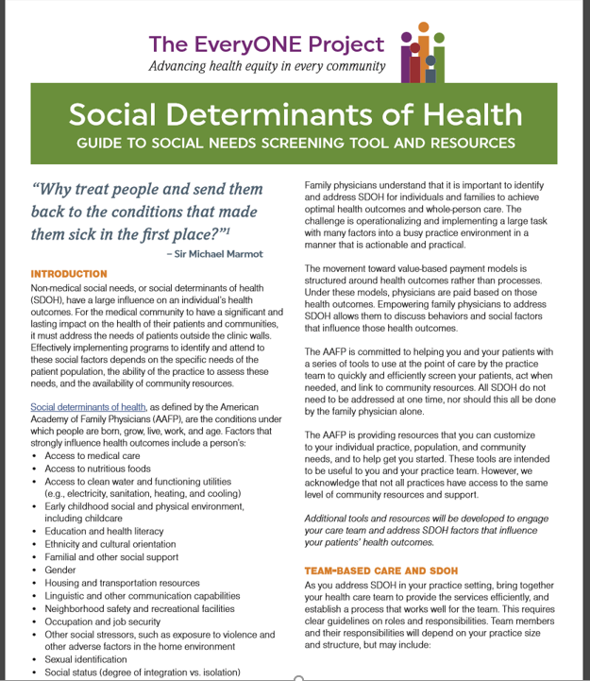
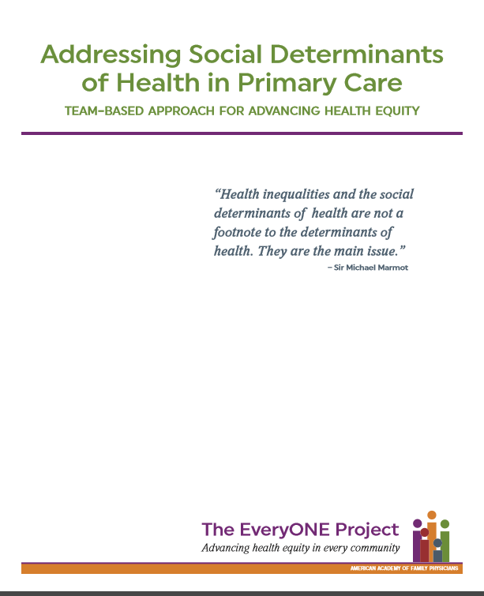

Slide 16
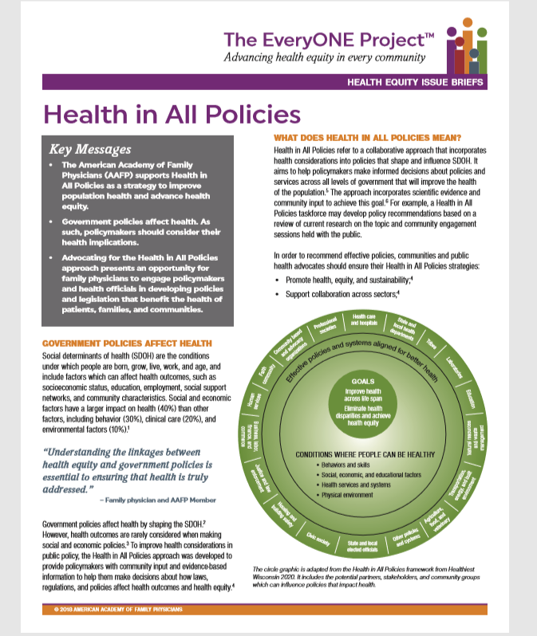
AAFP Health Equity Issue Briefs

Slide 17
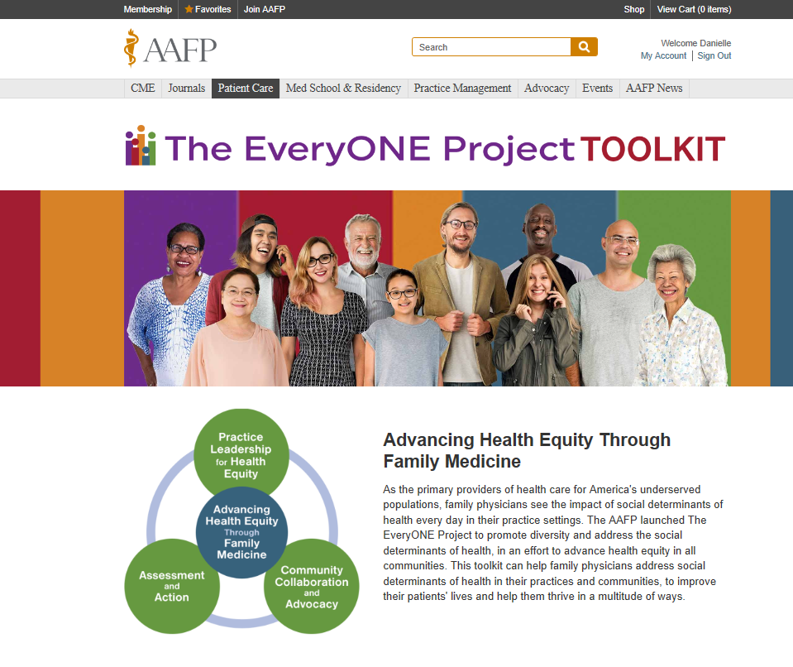

Slide 18
From Good Intentions to Action: Tools and Systems Approaches to Address
Social Determinants and Injustice in Health

