Slide 1
Integration and evolution of the role of pharmacy students in an interprofessional student run clinic
Kristen Cook, PharmD, BCPS
Jessica Downes, PharmD, BCACP
William Hay, MD

Slide 2
Objectives
Assess the current role of pharmacy in your student run clinic
Develop ideas to expand the role of pharmacy in your student run clinic

Slide 3
We have no financial disclosures or conflicts of interest with the topic in this presentation.

Slide 4
What’s going on at your clinic?
www.socrative.com
Room: COOKUNMC
Notes:
Put questions in Socrative about makeup of audience plus what they think the roles of pharmacy are.

Slide 5
Think, Pair, Share
What is the current role of pharmacy students in your student run clinic?
Describe the way that pharmacy students collaborate with other members of the care team in your student run clinic.
Notes:
Spend 5 minutes in small groups
Spend 5 – 10 minutes sharing as a larger group
Could also add “padlet” as a way for groups to document what they come up with? May be better to just keep it “verbal”…
Maybe verbally would be good. Should we create a worksheet for them to think through? I can do this.

Slide 6
SHARING Clinics
Four student-run clinics throughout Omaha
1999 Founded- Pharmacy member Sam Augustine
Sharing, Goodlife, Respect, Vision
Interdisciplinary approach to providing comprehensive care
Students including: medical, nursing, pharmacy, physical therapy, physician assistants, medical lab sciences, medical nutrition, social work
Preceptors
Student Advisory Committee leads clinical operations
Fundraising & University support
Approximately 400 patient visits in 2019
Notes:
Use existing Nebraska Medicine clinic buildings for evening clinics that are completely student-run.
The SHARING Clinics are made up of four entirely student-run clinics in the Omaha area. The clinics are staffed by student providers from each of the academic disciplines at UNMC. This truly multidisciplinary approach provides comprehensive care for patients and a wonderful learning environment for student providers. Faculty providers are present at all clinics to ensure that each patient is properly cared for.
Clinic operations are overseen by a Student Advisory Committee, which is composed of students from all of UNMC's academic programs. A Faculty Advisory Committee works to support the Student Advisory Committee. Students and faculty also serve on several sub-committees: Quality/Clinic Operations, Education, Fundraising, Research, and Youth Outreach.

Slide 7
History of Pharmacy Students in Sharing Clinic
Dispensing medications
Access to medications
Advanced clinical team member
1999
2020

Slide 8
Challenges = Opportunities
Out of control medication costs
Increasing complexity of patients
Interprofessional education standards
Change in clinic location
Lack of pharmacy preceptors
Formulary management & ownership of medication costs
Utilization of pharmacy more for therapeutic decision making and disease state management
Recruitment of preceptors with advanced clinical knowledge and cutting edge practices
Expand on attitudes outside of clinic and develop interprofessional staffing
New pharmacy education standards
Leadership in adherence and business aspects of the clinic
Focus on development of clinical skills outside of traditional role of pharmacy

Slide 9
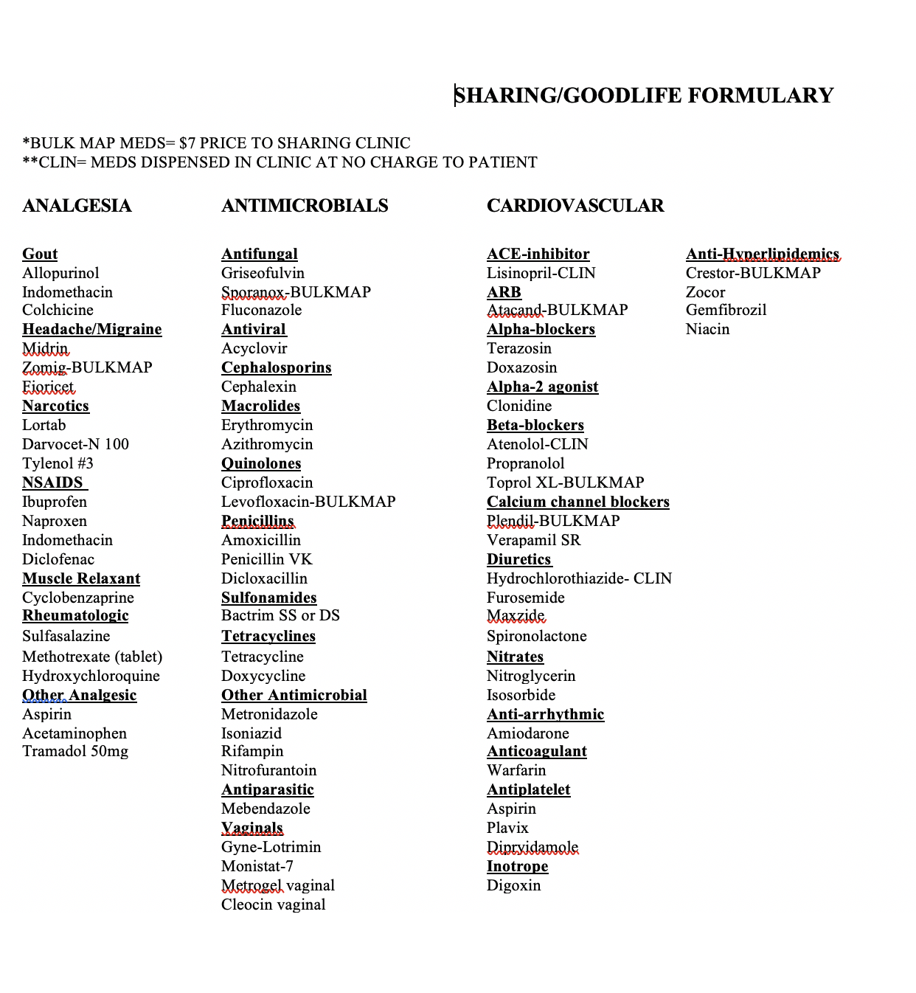
Medication Costs
Report generated from partner pharmacy
Led by pharmacy student and faculty administrators
Helps to identify potential alternatives for expensive medications
> $50 is flagged
Quality committee discussion/ review
High cost patients

Slide 10
Current Clinical Role
dd
Joint Commission of Pharmacy Practitioners. Pharmacists’ Patient Care Process. May 29, 2014. Available at: https://jcpp.net/wp-content/uploads/2016/03/PatientCareProcess-with-supporting-organizations.pdf.
Notes:
Every patient is assigned a medical OR physician’s assistant (PA) student PLUS a pharmacy student
Prep for visit by reviewing patient’s medication list and pertinent labs
Responsible for taking a thorough medication history from the patient
Collaborate as a team to assess and develop a plan and education
I thought we could talk through the pharmacy student role list above in terms of the PPCP and educate the other providers about it.

Slide 11
Pharmacy Student Notes
SOAP note documentation by all pharmacy students
Continuity
Shared responsibility and decision making

Slide 12
Interdisciplinary Team Presentations
Ensuring guideline-based recommendations
Collaborative discussion between medical and pharmacy students and preceptors
Encourage pharmacy administrators to serve in a leadership role

Slide 13
Strengths for this “new” role for pharmacists
Advancement of pharmacy practice
Advocacy from medical providers within the clinic
Strengthening of relationships within the professions
Shift towards interprofessional education in the didactic curriculum
Notes:
Advancement of pharm practice: allow students to actually experience this side that is a mainstream of pharmacy education: being at the center of decision making along with the medical providers.
Advocacy from medical providers: this role absolutely wouldn’t be successful if we didn’t have buy-in from the medical providers.
Strengthening of relationships and interprofessional education: This exposes students to this model early on so that when they get to clinical practice, they are familiar with the other disciplines and their individual roles, talents, and education

Slide 14
Impact of pharmacy students in this role
Share data from interprofessional survey?
I’m checking with Timi and Sam who did the study to see if we can use it. Hopefully will hear back soon!

Slide 15
How is the role of pharmacy students in your clinic different and similar to our model?

Slide 16
How would you like to see the role of pharmacy students expand in your clinic?

Slide 17
What concerns do you have for pharmacy students in this “new” role?

