Slide 1
Innovative Implementation of Family Medicine Electives in a New Curriculum
Sean Robinson, MD Rebecca Cantone, MD Ryan Palmer, EdD Frances Biagioli, MD

Slide 2
Disclosures
Dr. Palmer, Dr. Biagioli, Dr. Robinson and Dr. Cantone have nothing to disclose

Slide 3
Who We Are
Sean Robinson, MD – Director of Family Medicine Electives and Sub-Internships
Rebecca Cantone, MD – Director of Family Medicine Core (Clerkship), Director of Family Medicine Advising, FMIG Advisor
Fran Biagioli, MD – Vice Chair of Education
Ryan Palmer, EdD – Director of Curriculum Development and Evaluation, FMIG Advisor

Slide 4
Objectives
Cater the development of medical school electives to student interest in order to develop an early interest in family medicine and increase the family medicine workforce
Develop electives that have specific skill sets to improve entrustable professional activity (EPA) evaluation and track throughout their education
Collaborate with FMIG to continue involvement

Slide 5
Audience Survey
Clerkship / Elective Directors
FMIG Leads
Students
Others?

Slide 6
Who is offering electives?
How do you decide what/when to offer?
Do you include your students?
Notes:
Do you include your students in helping with elective development and innovation

Slide 7
Who here is moving towards a competency based curriculum?
Notes:
Without too much discussion – this could side track widely

Slide 8
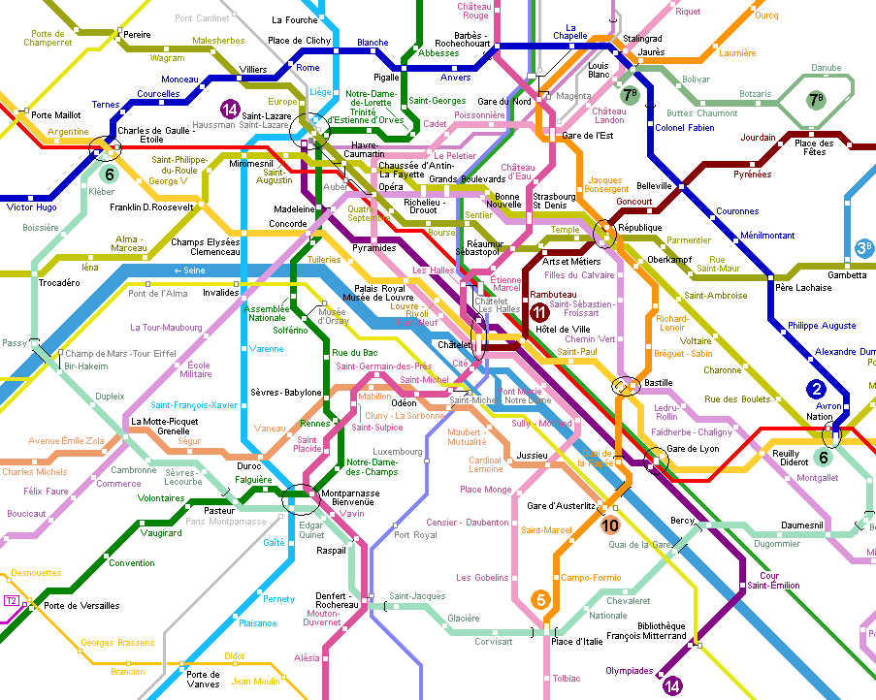
Roadmap
Introduce the new curriculum
yourMD
EPA and Competencies
Discuss Electives
Development
Data tracking
Grading innovations
FMIG involvement
Using pre-clinical electives and event attendance to plan clinical electives
Notes:
The general outline of the discussion , very brief here

Slide 9
Your MD is for:
Students – customized path to M.D.
Faculty – developed by faculty
Society – produce physicians with knowledge, skills and attitudes that society needs most in 21st century
Notes:
VERY brief – this is what the med school planned/why

Slide 10
Principles of Our New Curriculum
Learner-centered
Active learning methods
Core knowledge, skills and attitudes with opportunities for individualization
Competency-based
Fully integrated basic, clinical, & health systems sciences
Critical thinking, inquiry, and lifelong learning
Notes:
Central tenets, we will focus on these two, utilized for our elective development

Slide 11
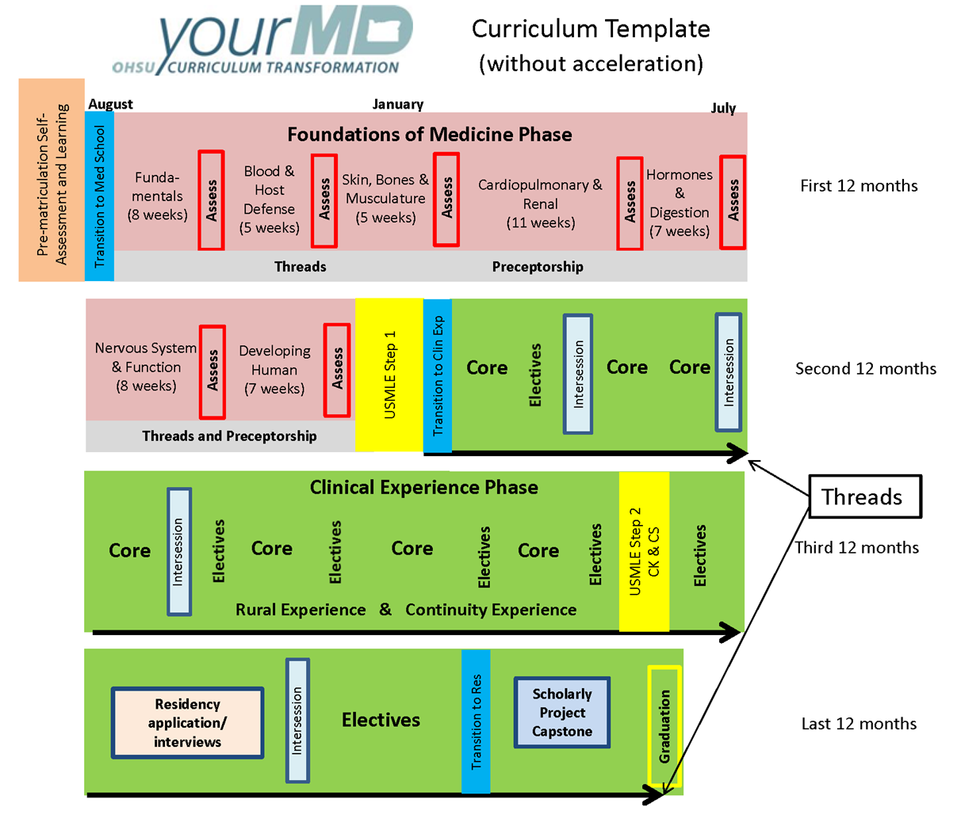
Lectures / Learning – first 18 months – Less Family Medicine Involvement in Curriculum
Clinical Experiences – 2.5 years!
More elective time – Draw in students earlier
Notes:
Explain new shortened pre clinical years –
pros from our standpoint are more clinical time, earlier electives, can cater electives to needed competencies for graduation and attract students to fm
students get to cater their education to their future careers, our standpoint this gives us the opp to capture students through exposure within our electives
Cons – less exposure in the pre-clinical years, don’t know what family medicine is unless already planning to do it until they do their core, which could be VERY late
only 4 weeks of a clerkship (this is the “mandatory” rotation that all students will take, electives may or may not be filled (can’t have exposure if students don’t take our electives)
Our goal is to develop a broad scope of FM electives that will attract a broad variety of students with the goal of exposing them to the breadth of our field

Slide 12
Required Clinical Experiences
Core – 4 weeks each
Family Medicine
Internal Medicine
Neurology
OB/Gyn
Pediatrics
Psychiatry
Surgery
Continuity experience
New!
Rural experience(s)
Elective experiences
2-4 weeks
Notes:
Goal of the slide – point out the now new focus and importance placed with the electives and offerings.

Slide 13
43 OHSU Competencies for MD degree
Students will need to be “entrusted” for all 43 in order to graduate
Plus AAMC 13 Core EPAs
Notes:
Competencies devised by OHSU SOM, used the AAMC core EPAs to develop the competencies. EPA still is the language to evaluate the competencies, which were approved by curriculum committees of the med school.
Association of American Medical Colleges. Core Entrustable Professional Activities for Entering Residency. Curriculum Developers’ Guide. 2014, available at https://members.aamc.org/eweb/upload/core%20EPA%20Curriculum%20Dev%20Guide.pdf accessed February 6, 2017

Slide 14
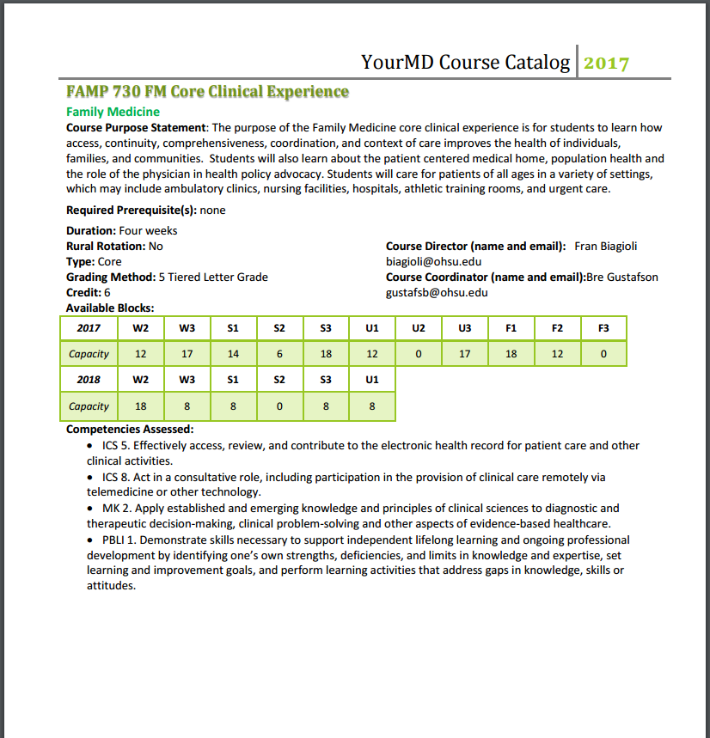
Notes:
Example

Slide 15
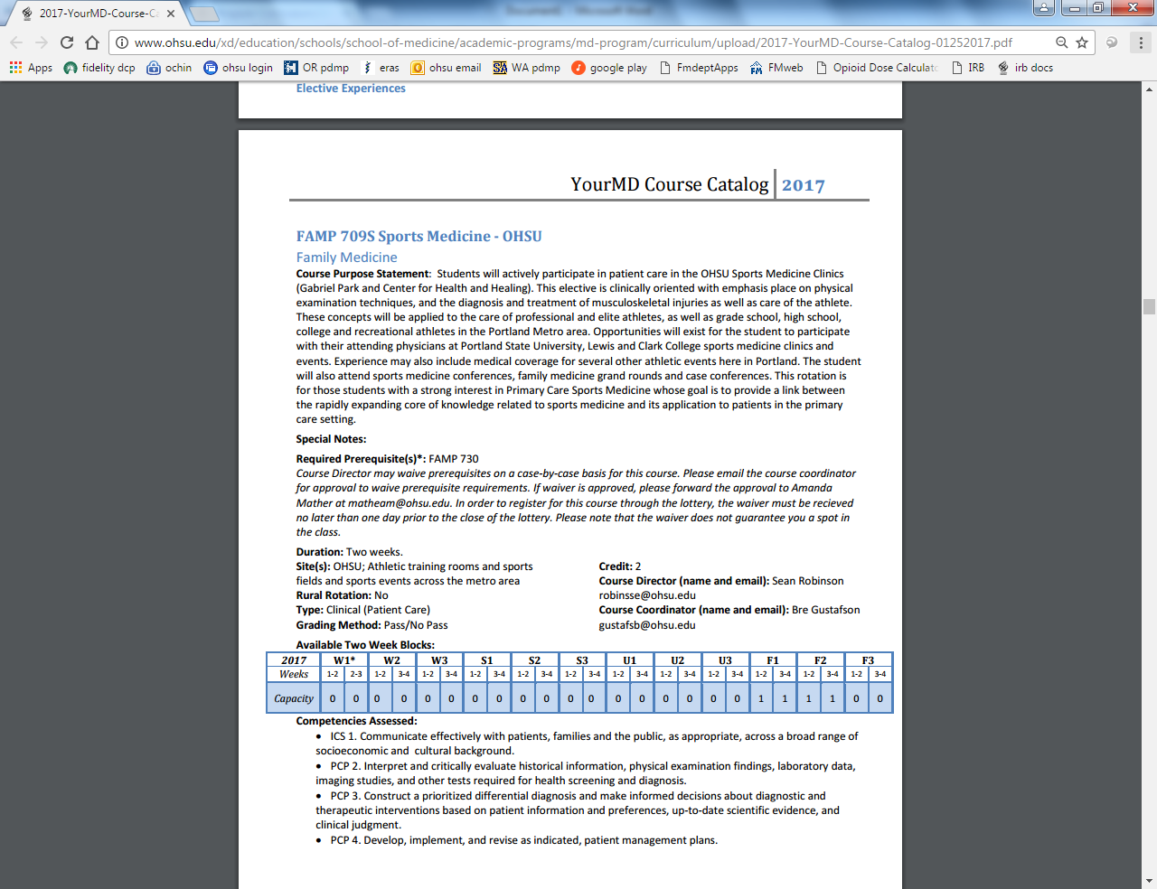
Notes:
Example

Slide 16
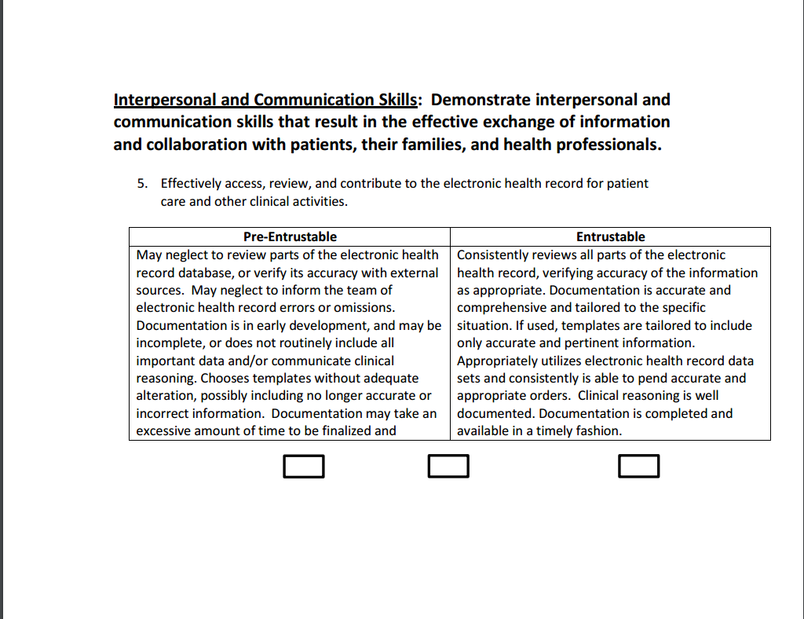
Notes:
Discuss this is the expectation of the student and for the assessor to fill out upon completion of the rotation – entrusable is the evaluation of the competency

Slide 17
Development of Electives
Faculty interests
Known Family Medicine areas of concentration
Student-Faculty exposures
Pre-clinical elective interest
Competencies/EPA progression
FMIG driven interest and direction
Notes:
Now the idea is to use some of these tools or requirements to our advantage. Students need to competency in all 43 at multiple times. If we are cognizant of which competencies are not offered regularly and can fill the void, we may reach students in a new way that we otherwise would not have.
The other barriers with development of electives is the variability of experiences and competencies offered and how to assess them.
So in development a new elective, there has been a new wrinkle in the process of ensuring we are able to capture the competency adequately to give the statement on entrustment
The other more usual aspects of development are at play as well – (see slide)
Underlying goal is to capture student interests early and expose to our excellent diverse faculty (in spectrum) to drive up student FM interest and hope to increase graduating student numbers in FM
2 potential important cohorts two think about and how to capture them (the other obvious cohort is the already self ID student that plans on FM as a career – these electives will help bolster their application and provide meaningful experiences to prepare them for residency) :
1 – the student that is on the fence with FM and another specialty (peds, OB, IM)
2 – The other students that do not get actual exposure to our field and may not know the breadth of our field
With elective design we should be able to attract these cohorts
Tools for attraction:
FMIG
Actually using the mandated competency requirements to our advantage – the weak link competencies (i.e. track and offer competencies that other departments are not offering). The beauty of our field is that we can provide meaningful clinical exposures to our students that will fulfill every 43 competency
Allowing plasticity with the elective (offer more popular electives more often, seeing patterns of popular electives and expanding upon those ideas (Women’s heath > translates to an inpt OB elective AND outpt procedural women’s health elective and prenatal elective --- again if the demand is there). Hence the importance of tracking this data

Slide 18
Electives examples
Student completion of special elective
Integrative Medicine
Women’s health
Sports Medicine
FMIG requests for events/talks
Student evaluation of pre-clinical experiences
Behavioral Health
Student feedback on core rotations
Rural Medicine
Hospice Medicine
FMIG attendance of events
Inpatient Medicine
Notes:
Red boxes – intake from students; orange boxes – electives based on what we can offer and what the students want

Slide 19
Grading
Currently Pass-Fail
Addressing competencies, soon to be adding to entrustment of rest of experience
Students will pick electives with areas in which they need “entrustment.”
Notes:
Electives for the most part are pass/fail… but thinking more broadly to the future of this curriculum it will be competency based and an actual grade will likely go away thus the stress tracking and formulating a rubric to assess competencies will be important

Slide 20
Data Tracking
Formulated a robust tracking system
Students
Grades
Competencies
Elective offerings and consensus
This starts with participation in FMIG at beginning of medical school
Pending IRB approval to study
Notes:
If we start looking at who’s interested or on the fence early, we can attract them based on what other things they are considering or what they want out of their careers.

Slide 21
Discussion
How are you currently tracking FM interest in students?
What experiences do you offer students?
Have you noticed matches in FM going up or down?
Do you have FMIG and if so, how do you use it?

Slide 22
Thank you to:
Tracy Bumsted, MD, MPH, Associate Dean of UME
OHSU Department of Family Medicine

Slide 23
Contacts
Sean: robinsse@ohsu.edu
Becca: cantone@ohsu.edu

Slide 24
Please evaluate this presentation using the conference mobile app! Simply click on the "clipboard" icon on the presentation page.

Slide 25
Thank You

Slide 26
Notes:
Below these slides are extra slides – used for examples of our grading conversation if that comes up as an example.

Slide 27
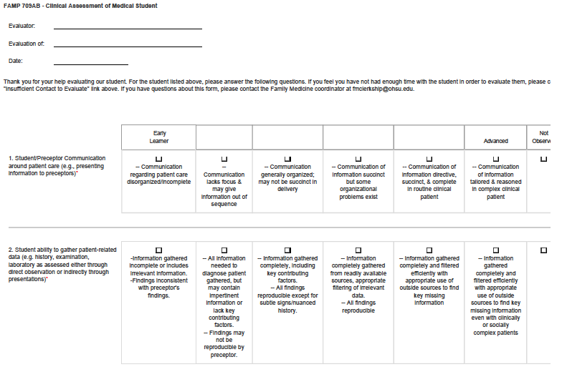
Notes:
This will serve as a backup slide in case the discussion goes toward this conversation
Add picture of the evaluation to discuss assessing competency (if topic arises)

Slide 28
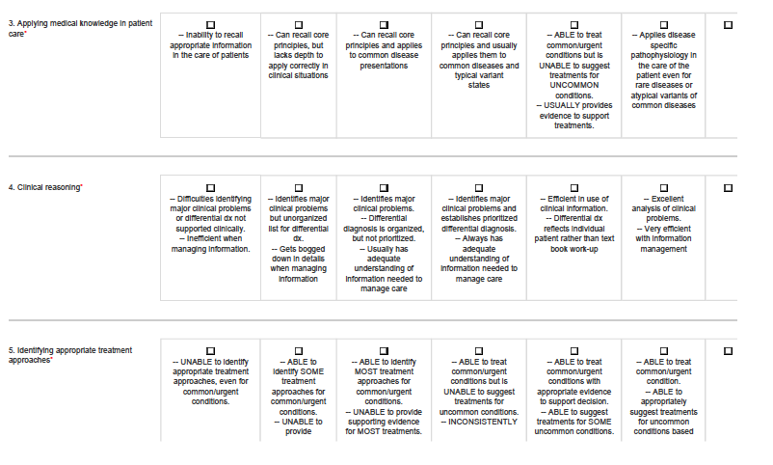

Slide 29
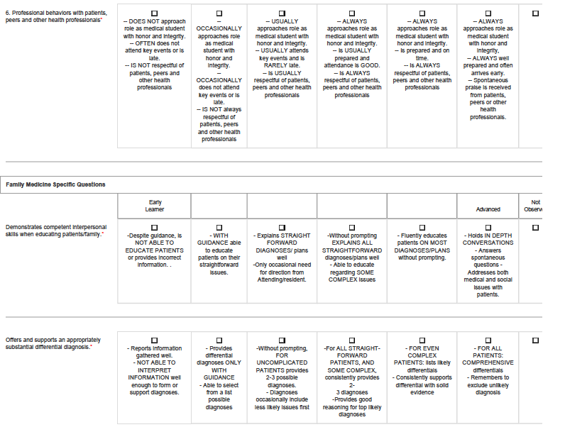

Slide 30
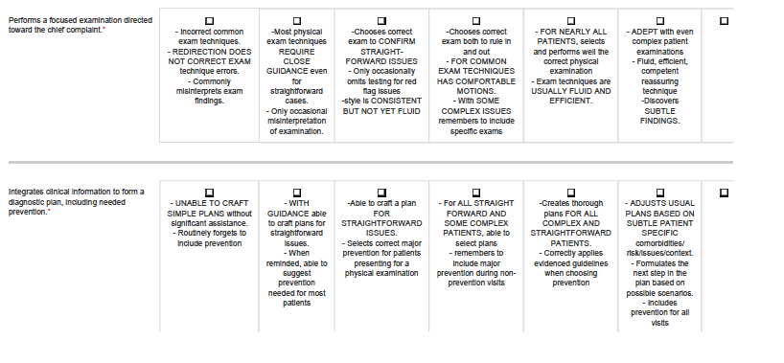

Slide 31
